Slide 1
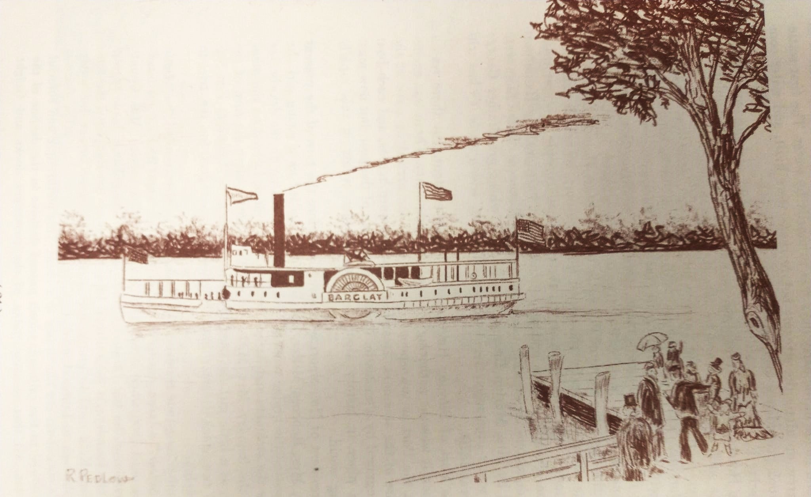
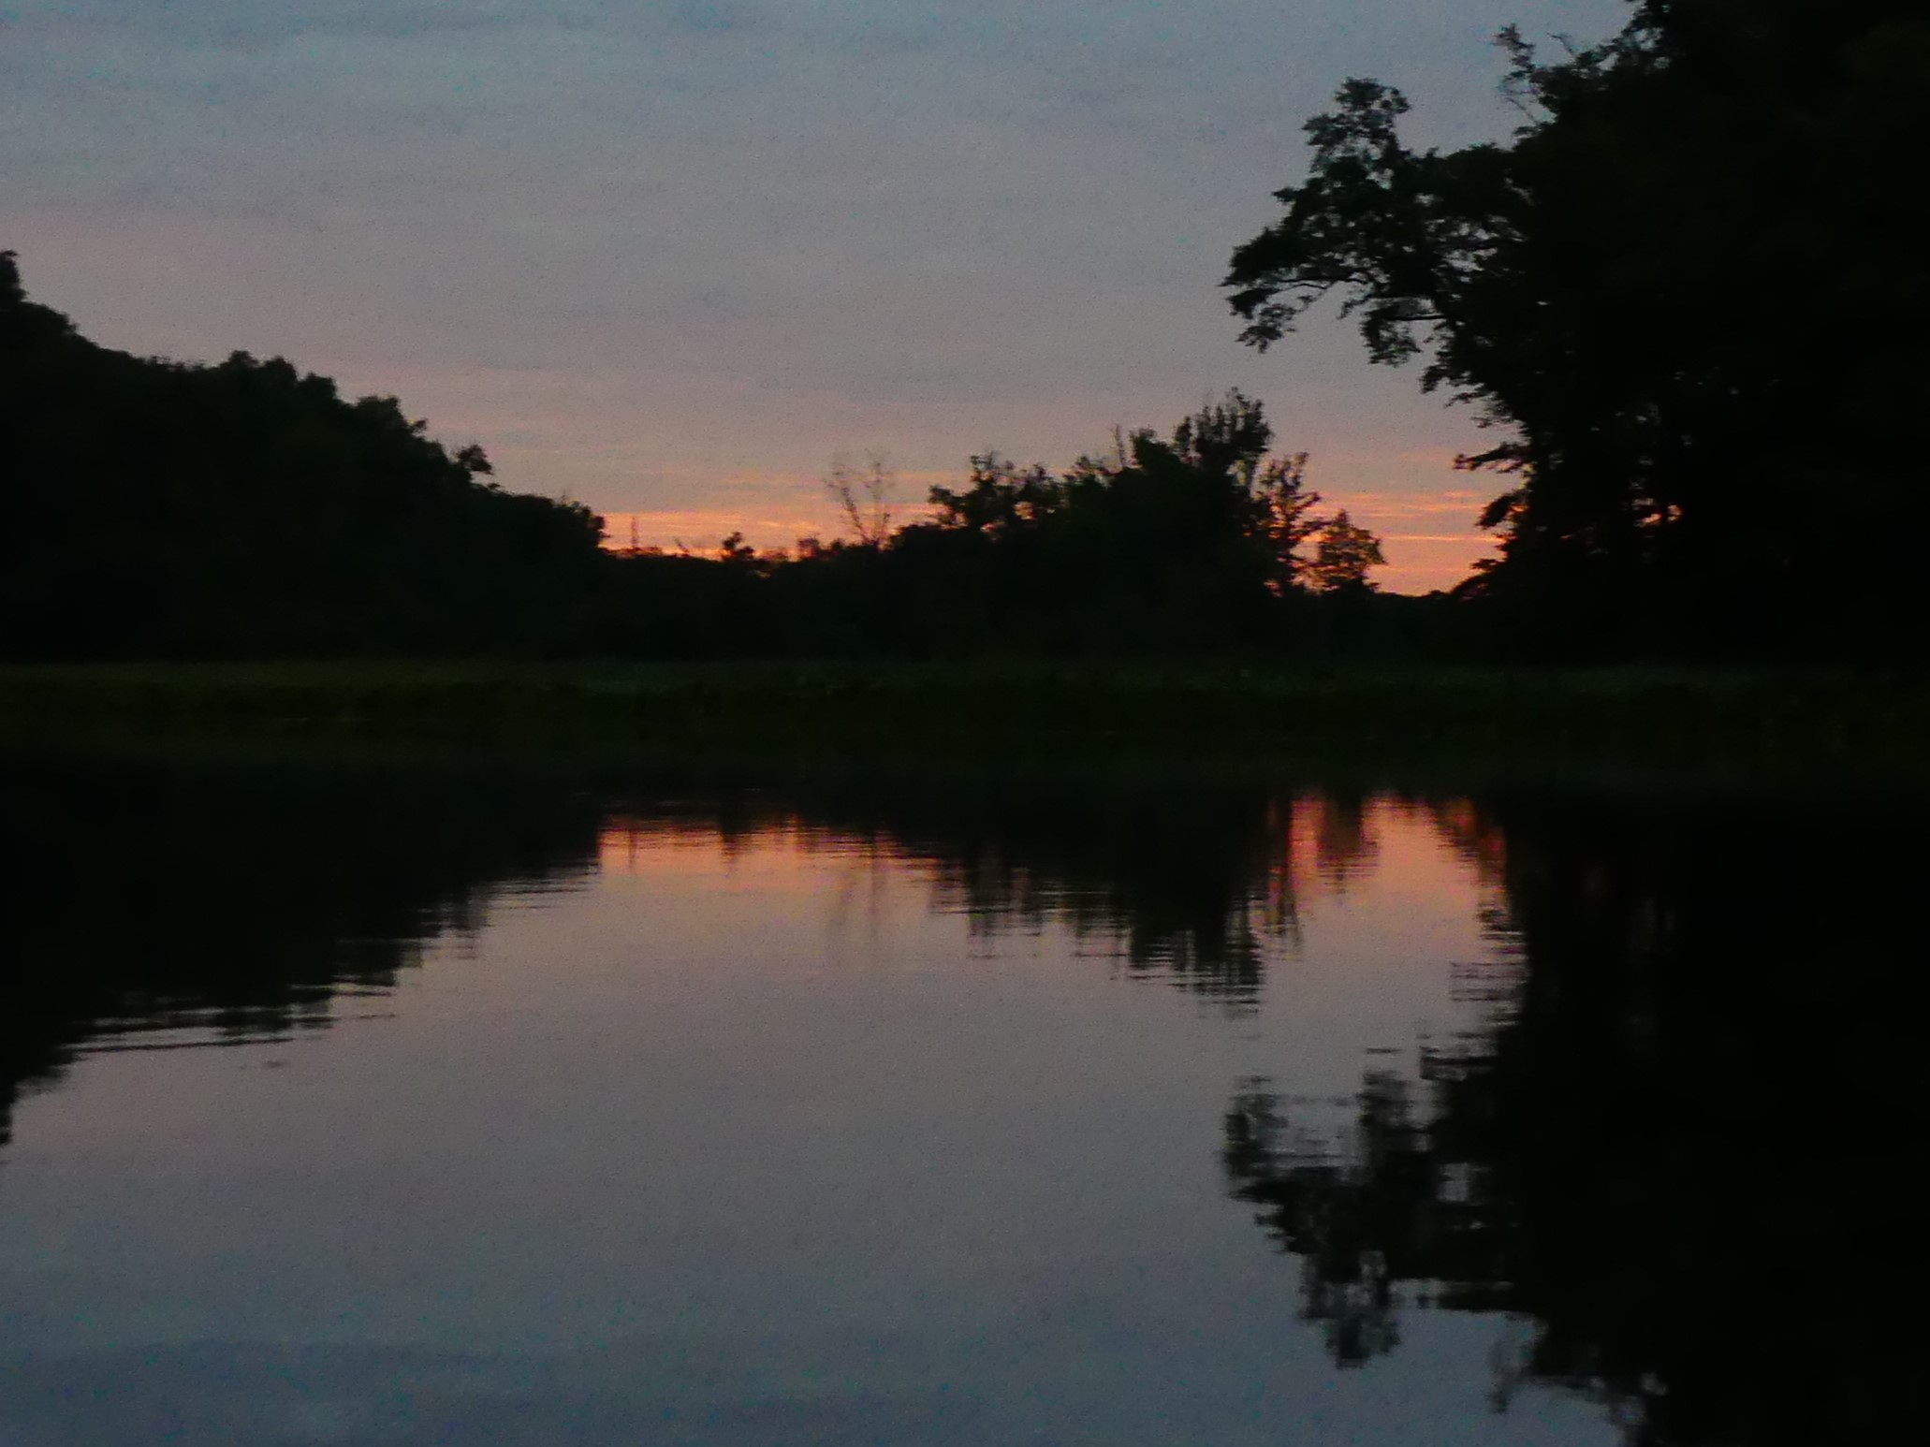
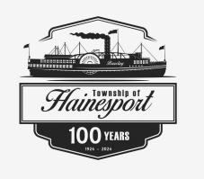
Herring Hall

Slide 2
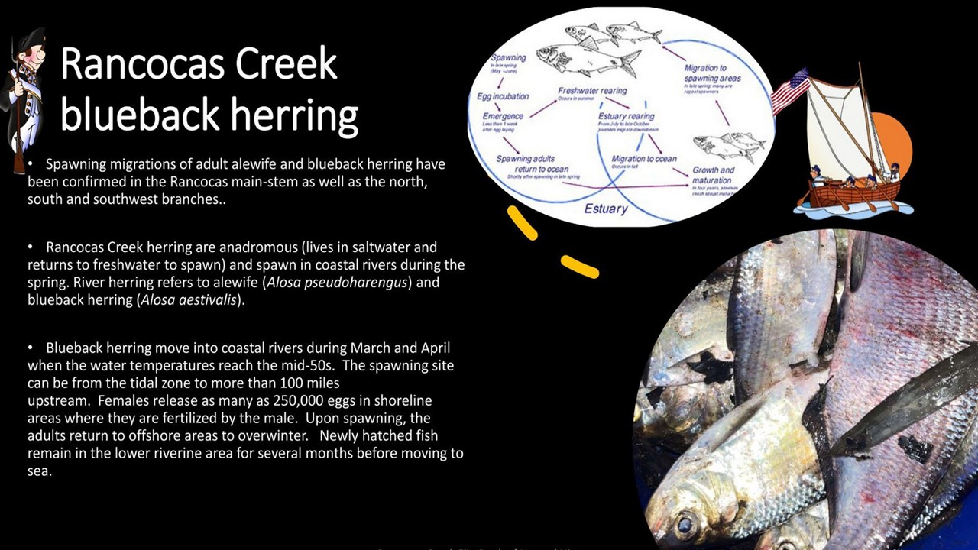
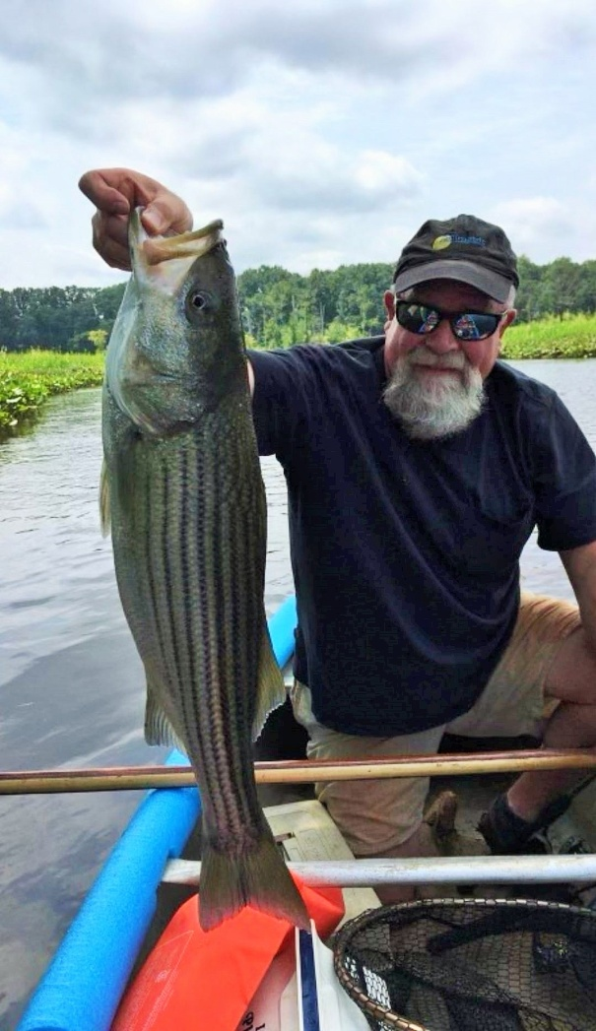
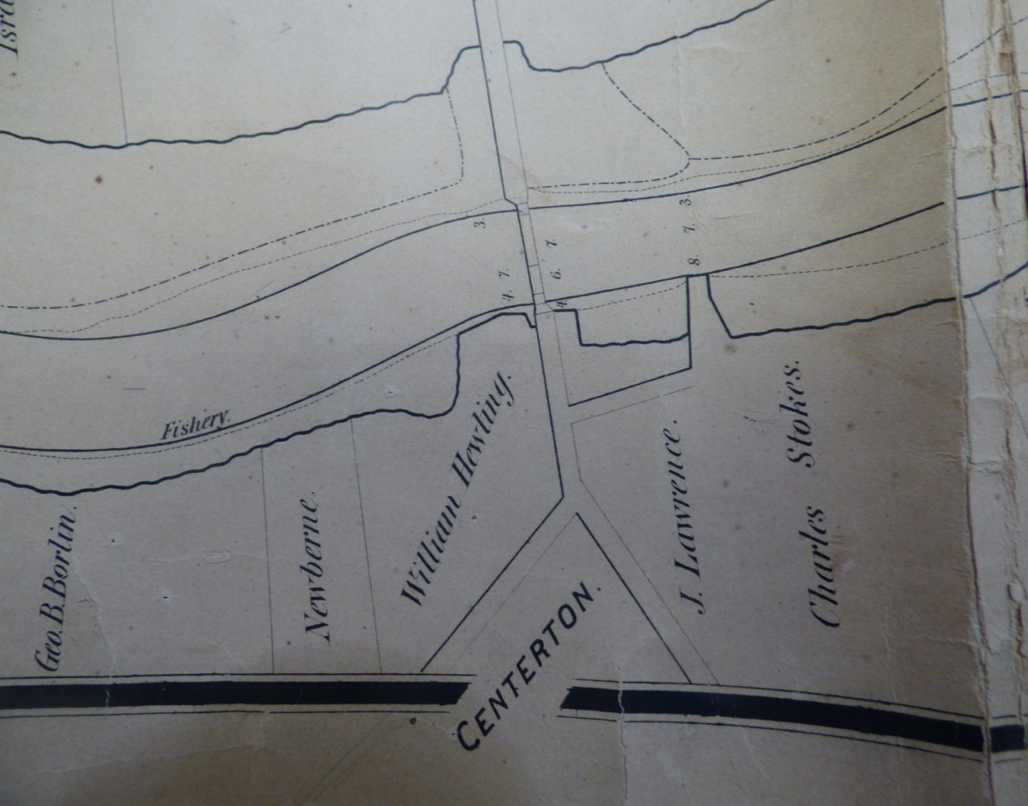
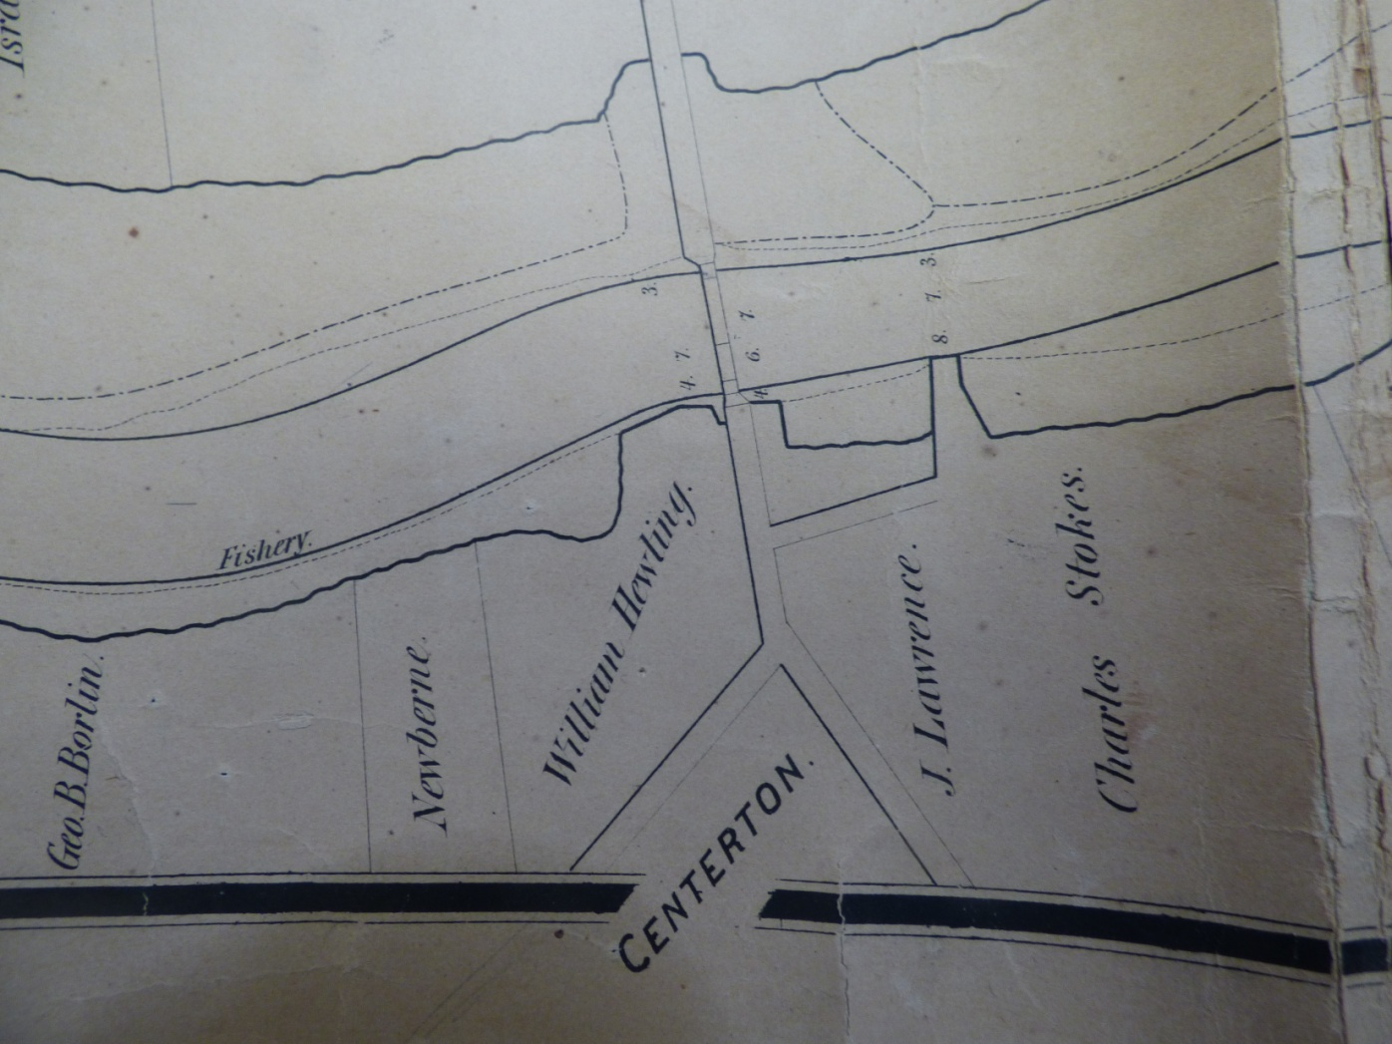
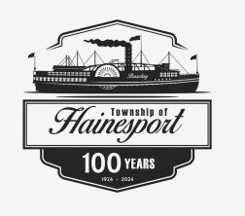
Atlantic Ocean, Delaware Bay, Delaware River Estuary, Rancocas Creek
April 2023

Slide 3
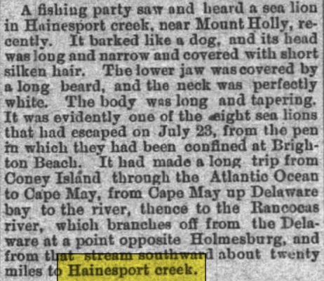
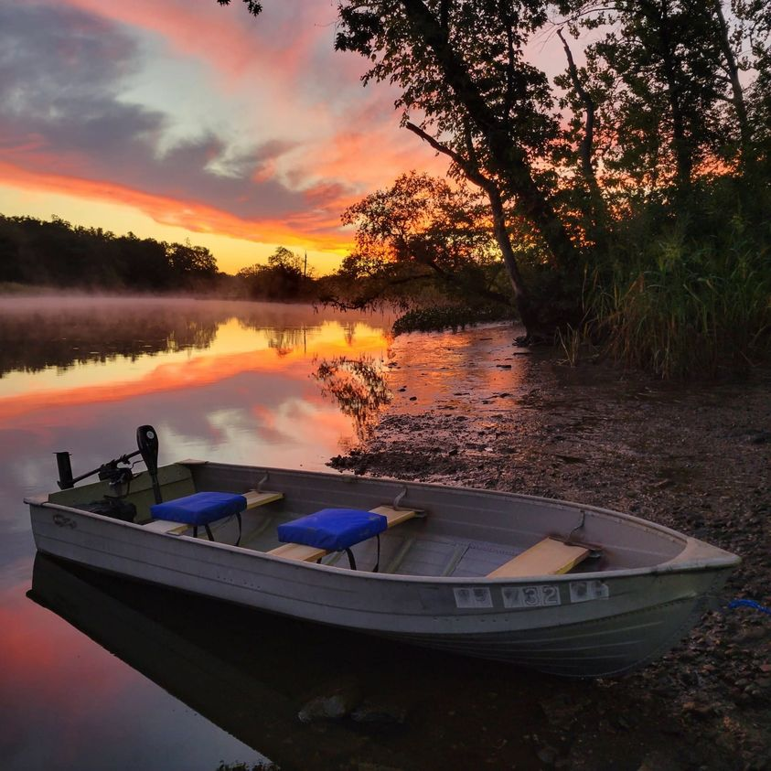

Hainesport
Low Tide
1886 A Red Lions Excursion
2009
Low Tide
2015

Slide 4
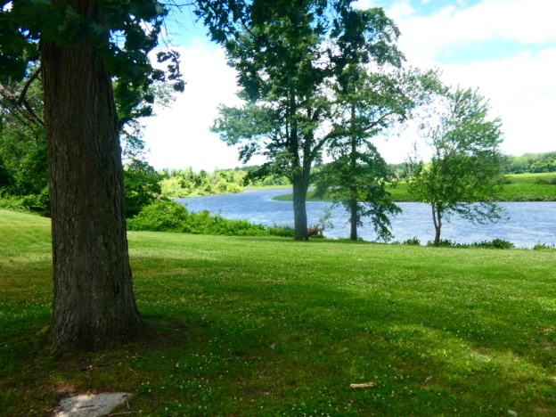
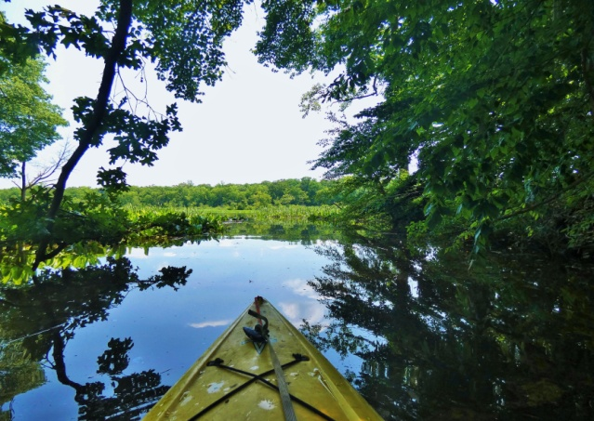
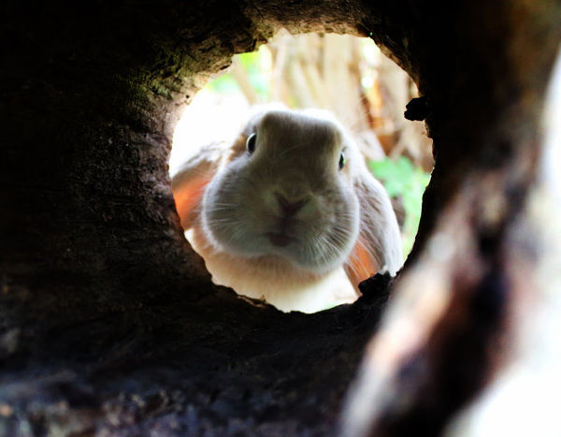
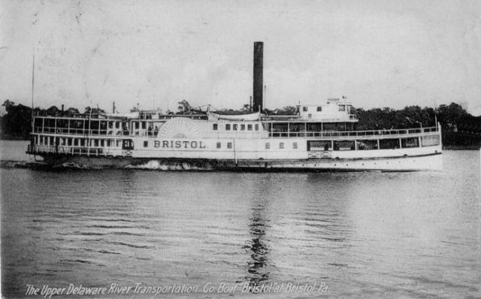

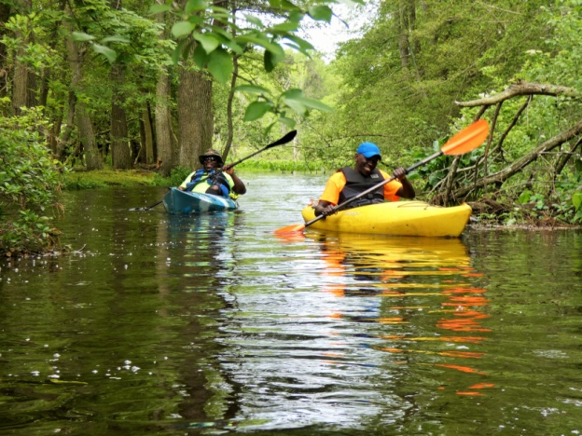
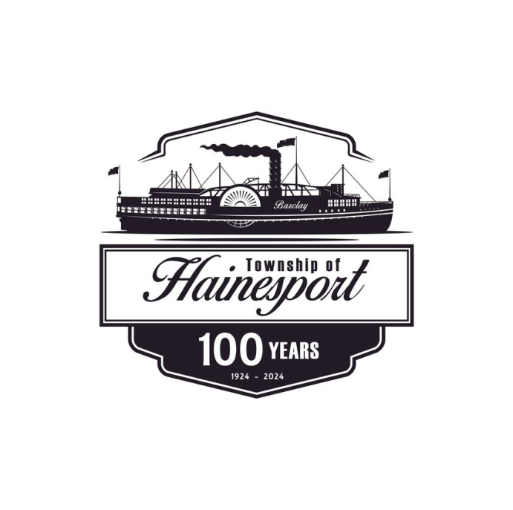
Down the Rabbit Hole
Phossy Jaw
Cuban Filibusters
Tugboats
<<< Artwork by Hainesport resident Frank Vellucci

Slide 5
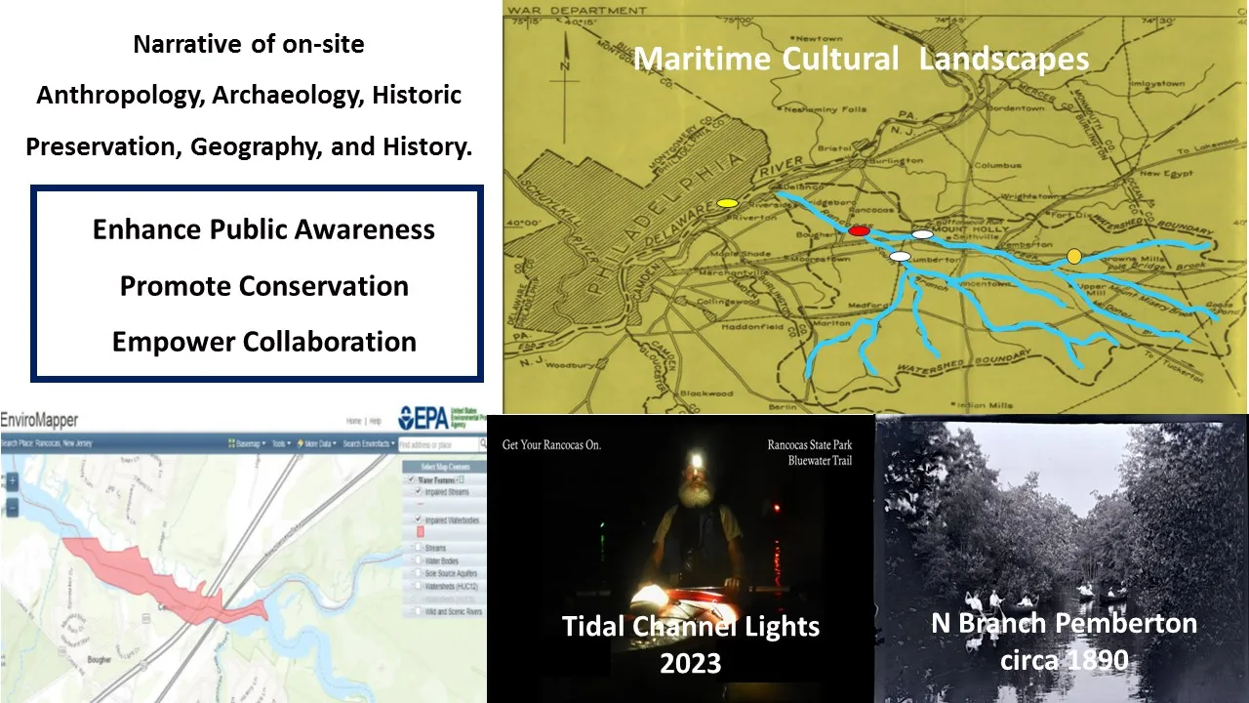

Hainespot Narrative
Maritime Cultural Landscape
1955

Slide 6
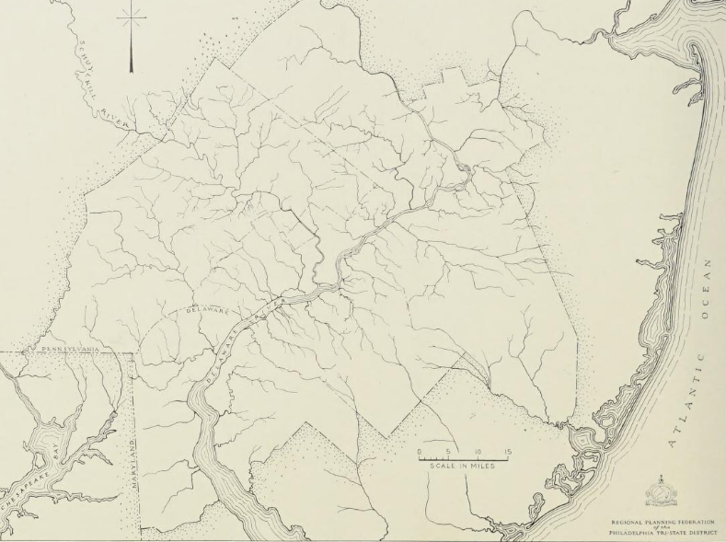
The greatest navigation possibilities are on the Rancocas where boats plied as far upstream as Hainesport, a distance of 20 miles: ref DVRPC 1931

Slide 7
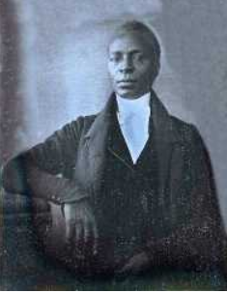
Rancocas Creek Maritime Occupations 1664-1703
Underground Railroad
Farmers
Bargemen
Boatmen
Ship Chandlers
Coopers
Ferrymen
Lightermen
Mariners and Seamen
Ropers
Shipbuilders
Shipwrights
Ship Carpenters
Watermen
Whalemen and Whalers
James Forten - Notable Delaware River, Philadelphia Sail Loft Owner. By Nature of the Delaware River maritime trade he knew of the Pine Barrens Western Outflow – Rancocas and Other West Jersey Delaware River tidewaters
1798 - James Forten purchased a sail making business in Philadelphia. Became one of the wealthiest businessmen in Philadelphia. Abolitionist.
Reference: 1664-1703 West Jersey Documents NJ State Archives as Published

Slide 8
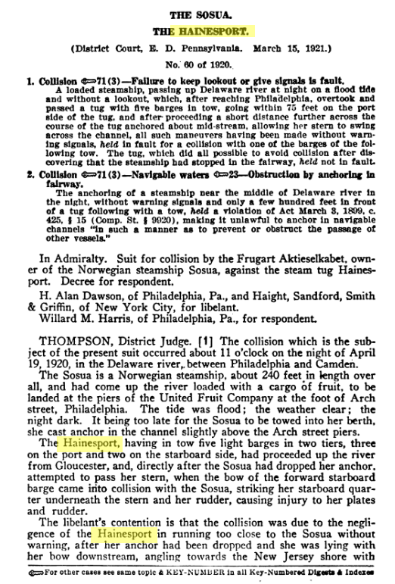
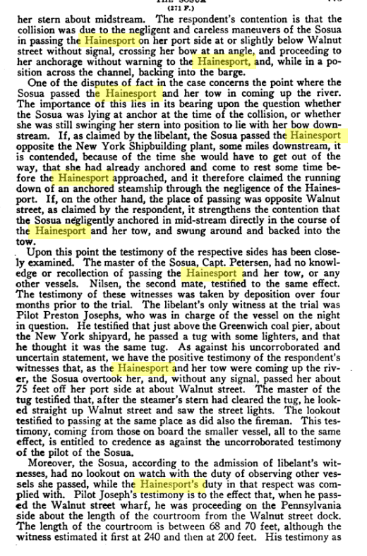
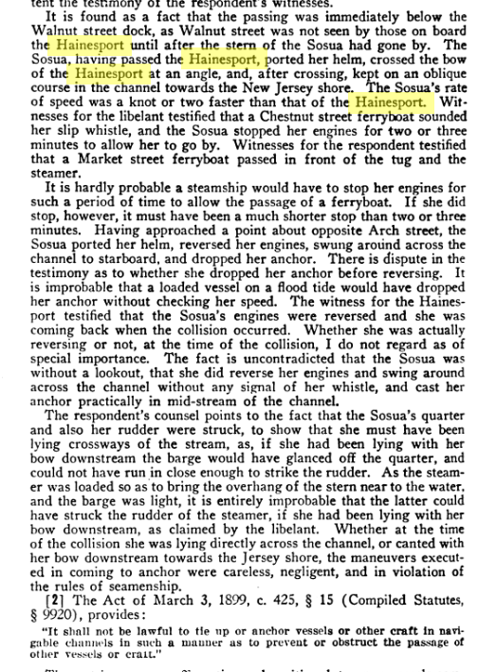
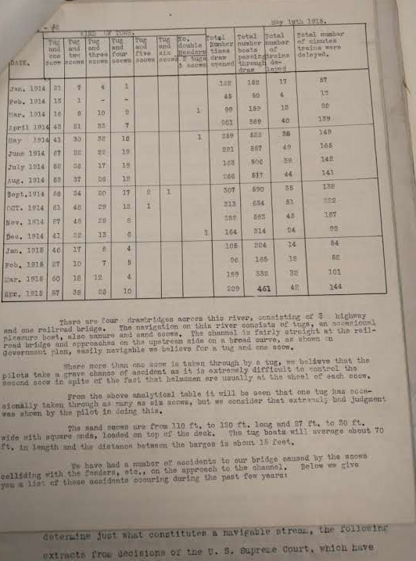
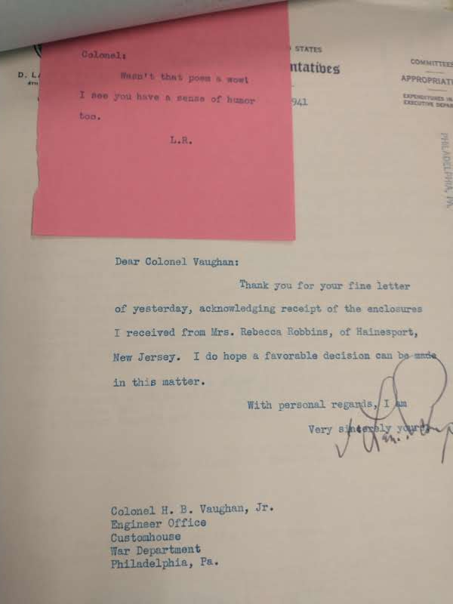
Rancocas Creek Sand Scows
100-120 feet 27-30 wide, square ends, deck top load, 70-80 feet long. Distance between barges 15 – 20 feet

Slide 9
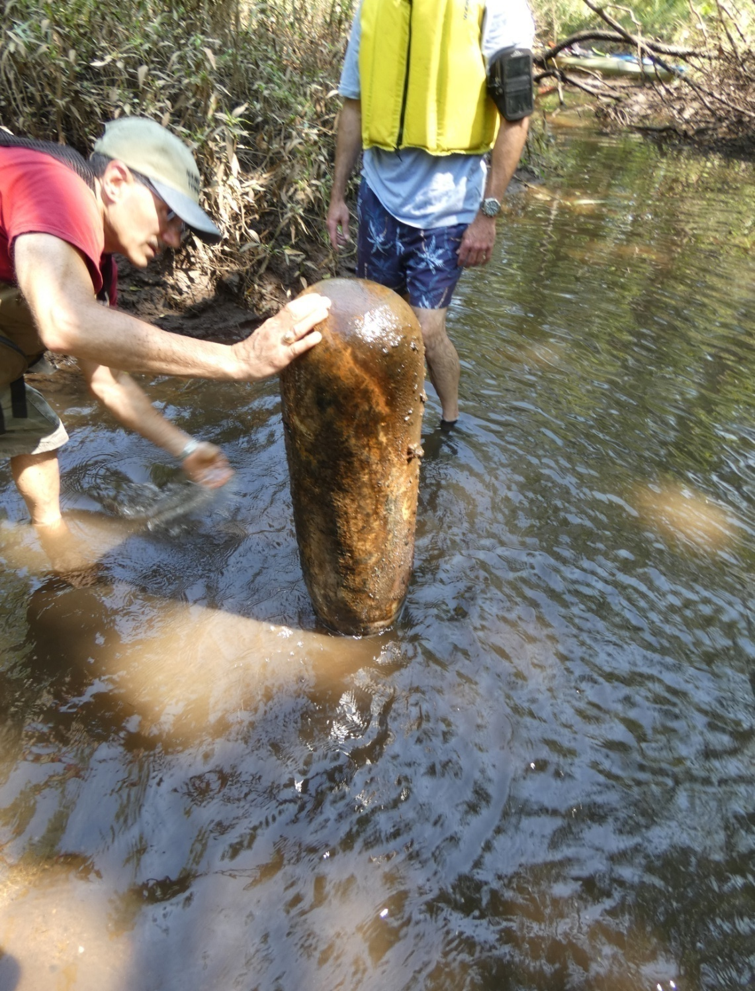
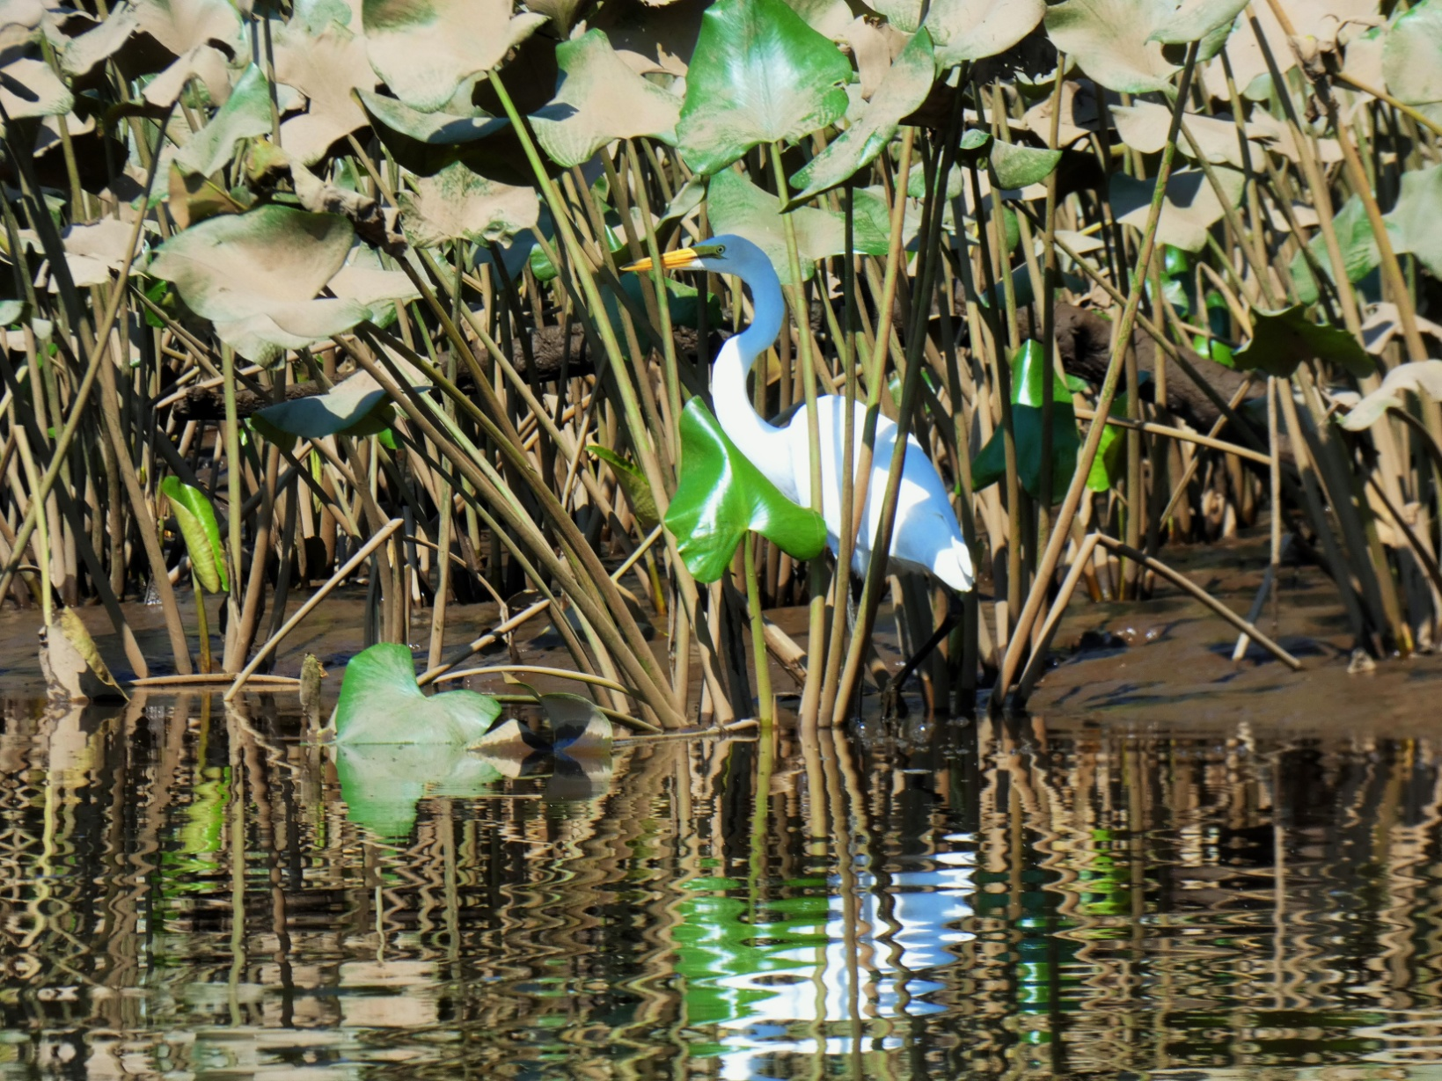
Phosphorus Retort
American Egret, Confluence

Slide 10
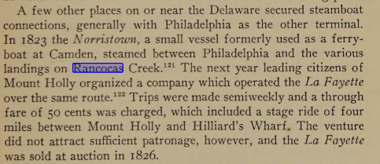
Steamer Barclay Leaves Arch Street Wharf, daily at 2 ½ p.m.. Progress, Delanco, Bridgeboro, Centretown, Hainesport. Leaves Hainesport Daily at 7 a.m.. Stages meet boat for Mt. Holly and Lumberton

Slide 11
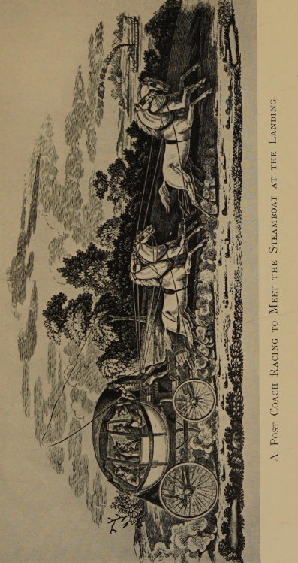


1818
Local Steamboat and Coach Lines 1823

Slide 12
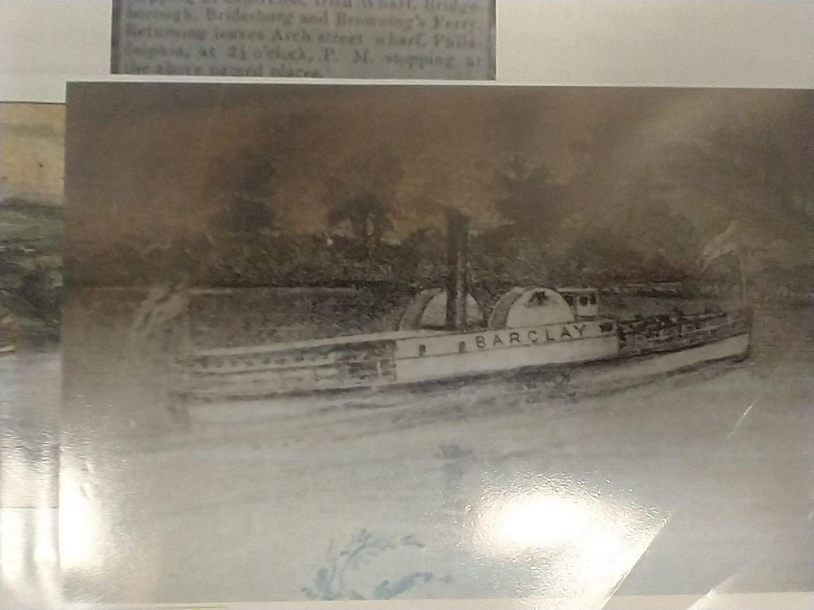
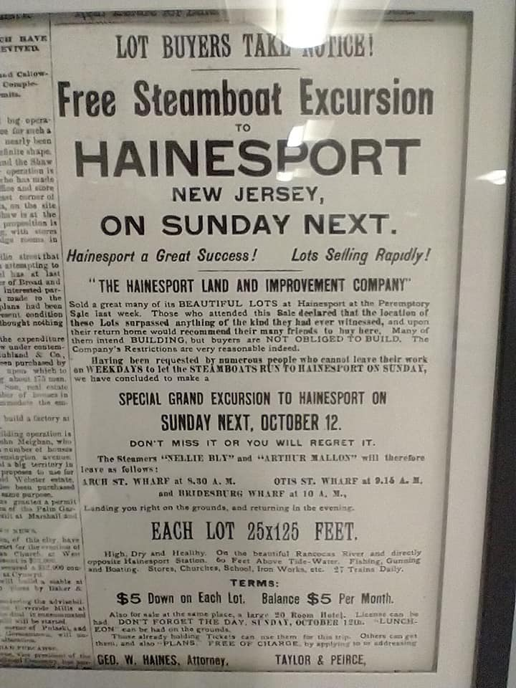
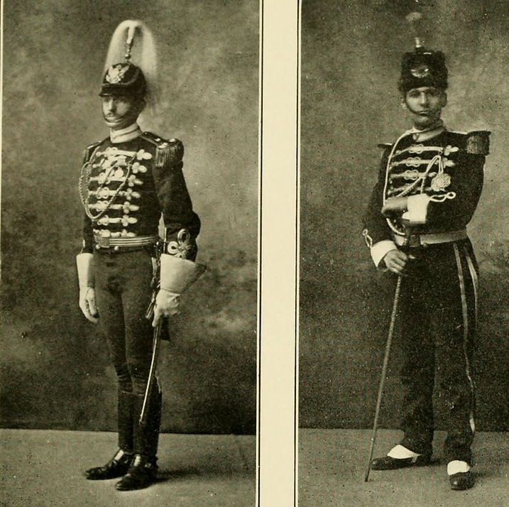

Slide 13
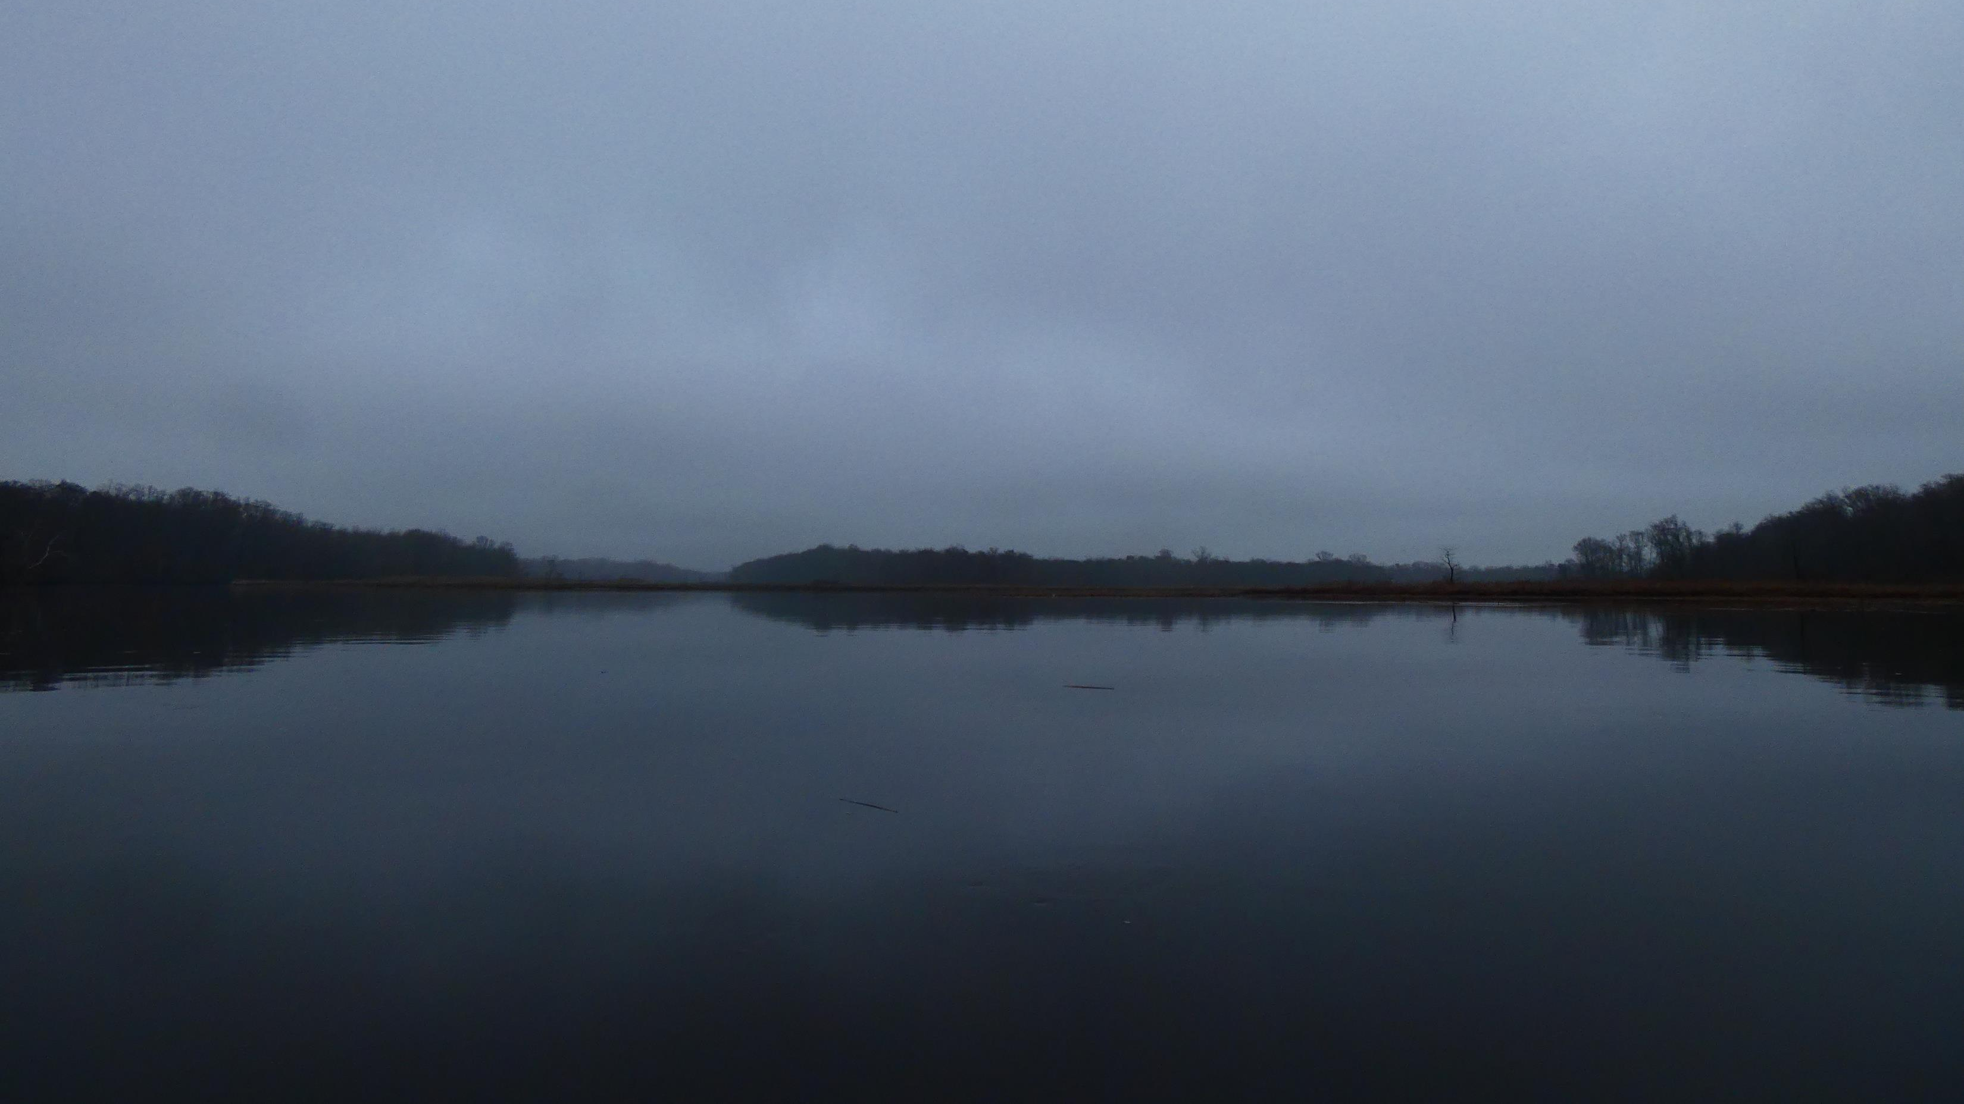


Slide 14
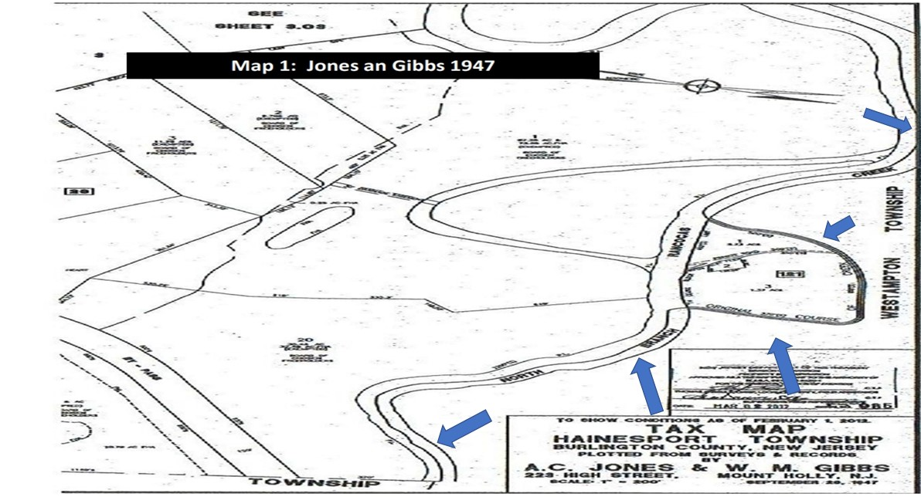

Slide 15
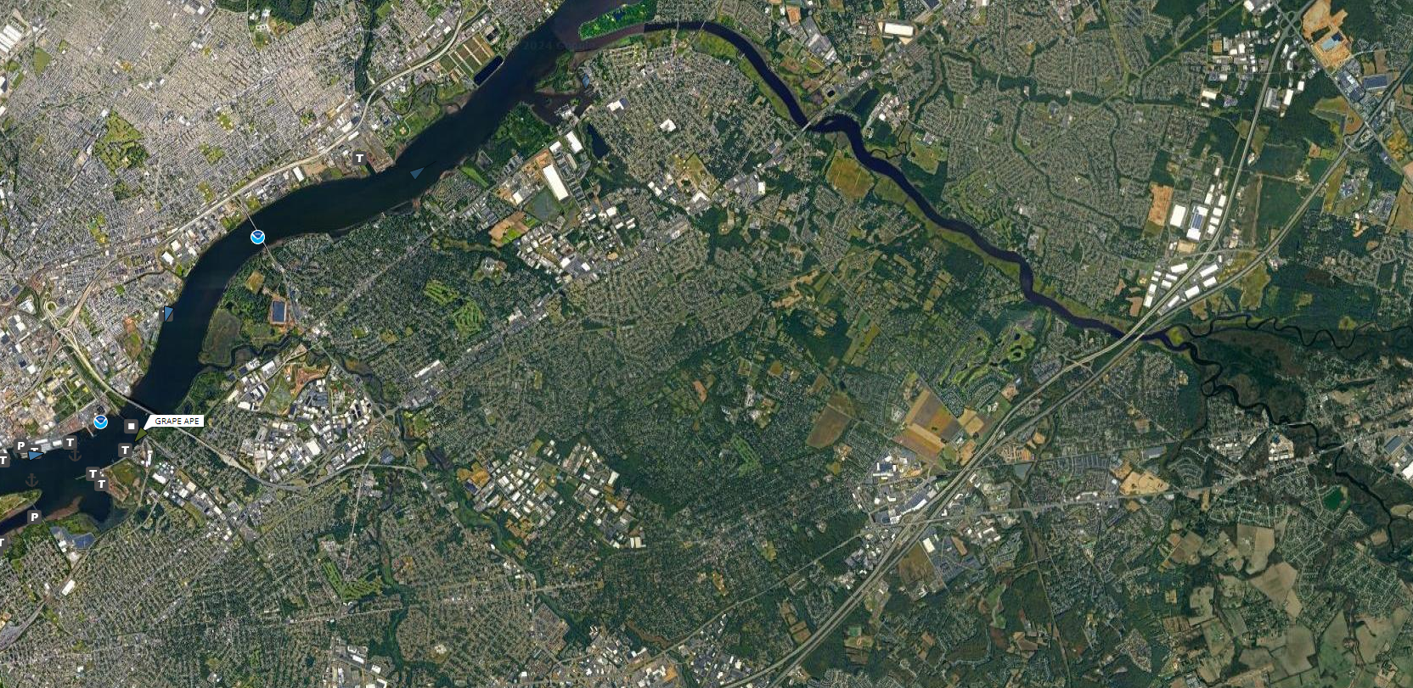
Texas
Hainesport

Slide 16
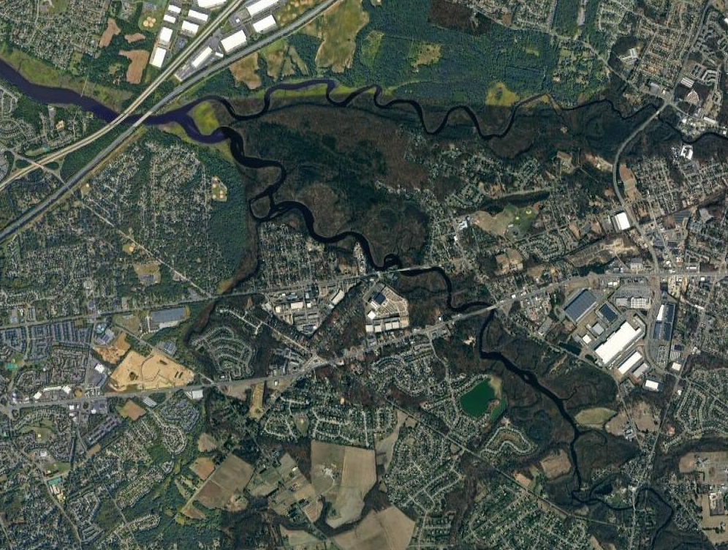
Melpine
Leeds
Timbuctoo
Texas
Stone Quarry
Foundry
Flo’s
Haines
Creek Turn
Atsion

Slide 17
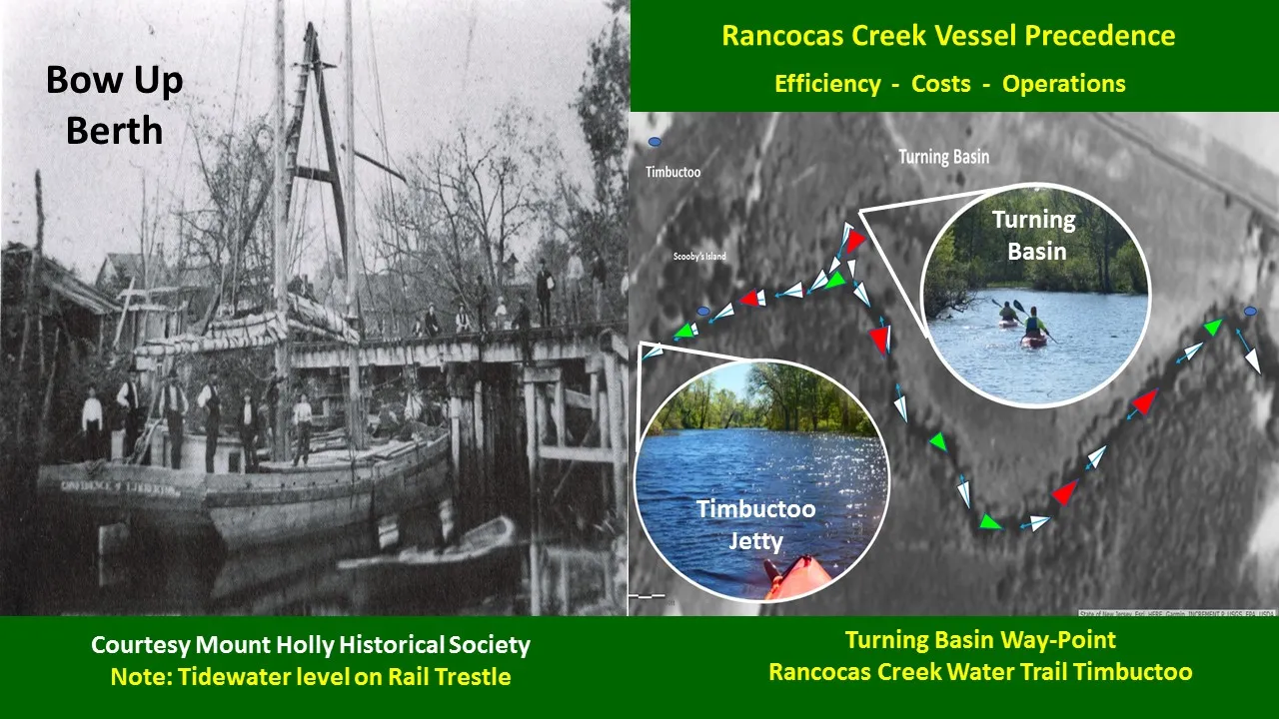

Slide 18
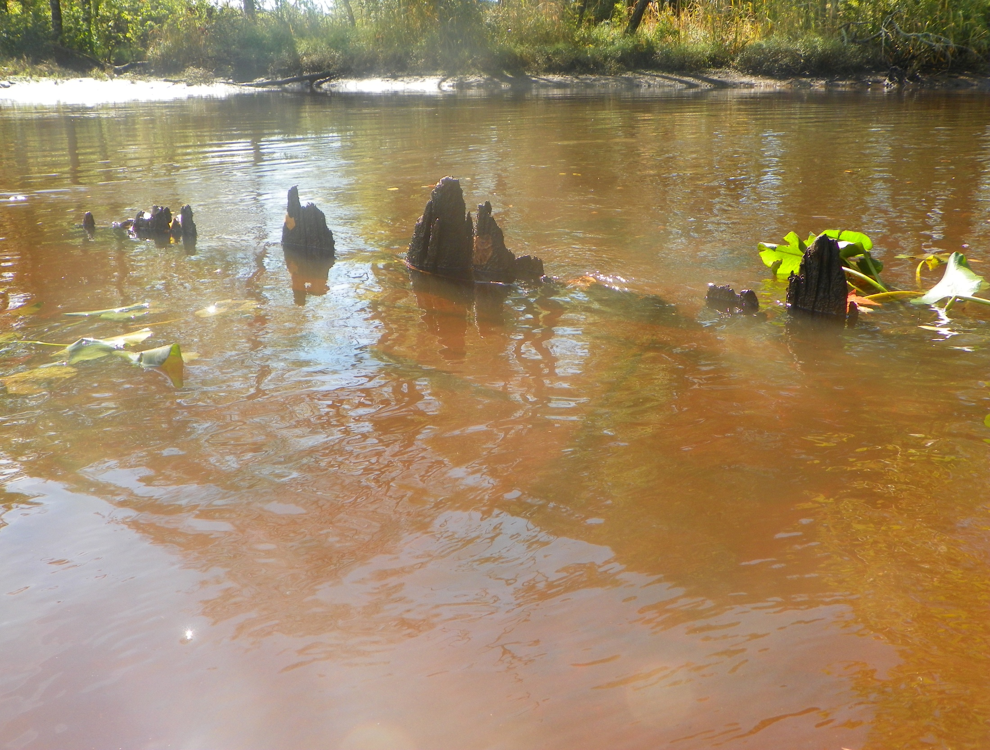


Timbuctoo
.

Slide 19


Slide 20
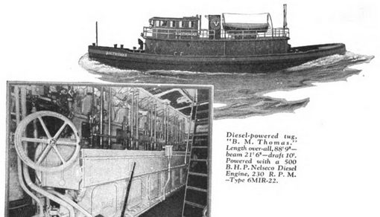
Hainesport Transport and Mining Company 1927

Slide 21
600

Slide 22
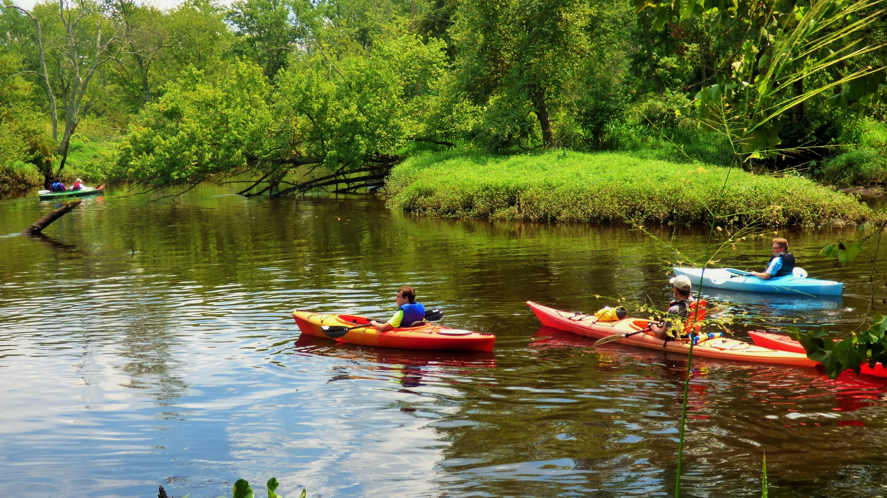


Slide 23
$600,000 in 1898 is $22,249,807 dollars in 2023

Slide 24
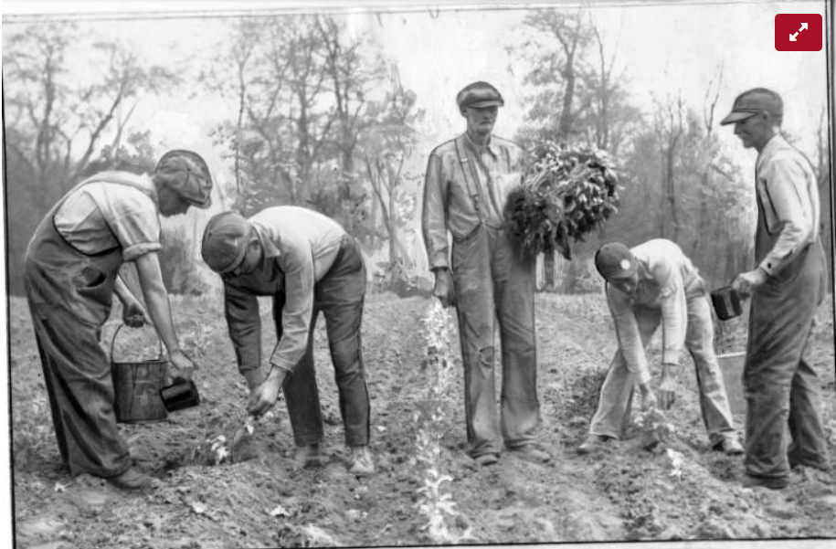
(left to right); Spencer Glenn, Arthur Siebke, N.D. Symonds, Mayberry Perry, and William Perry.
REF: Bulletin reporter Paul F. Cranston 5-5-1933

Slide 25
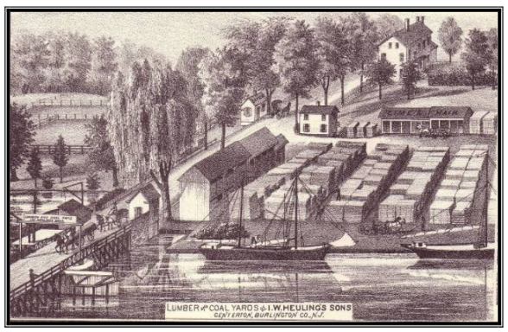
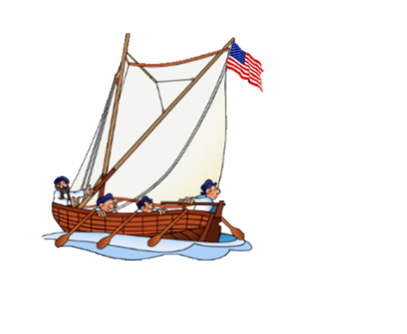
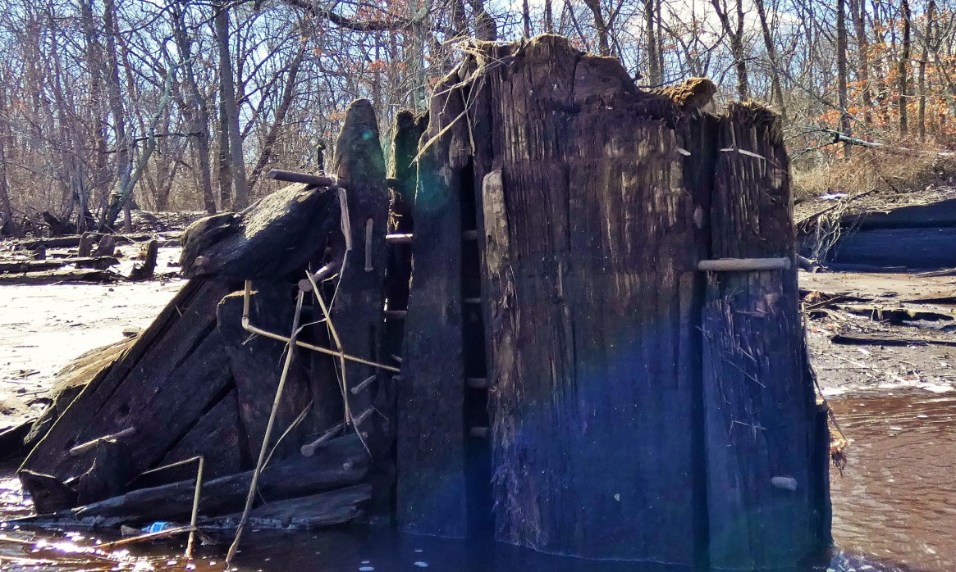

Exploring Historic Pathways,
Discovering New Understandings
Schooner Rudder Dated to mid 1840’s

Slide 26
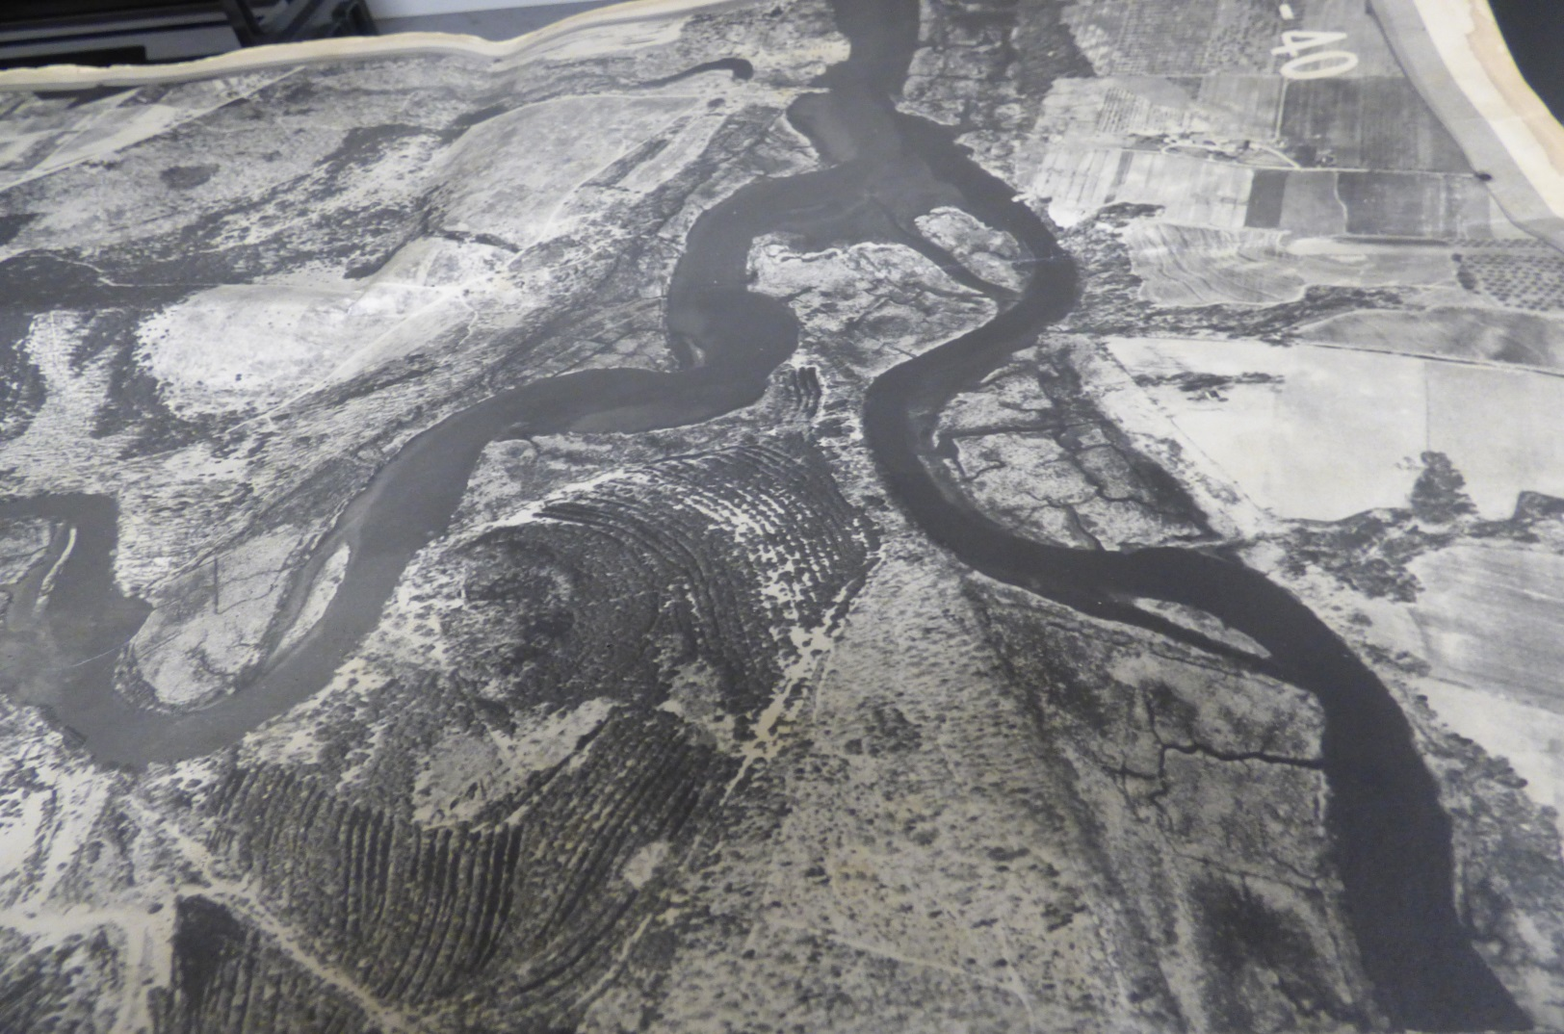

Hainesport

Slide 27
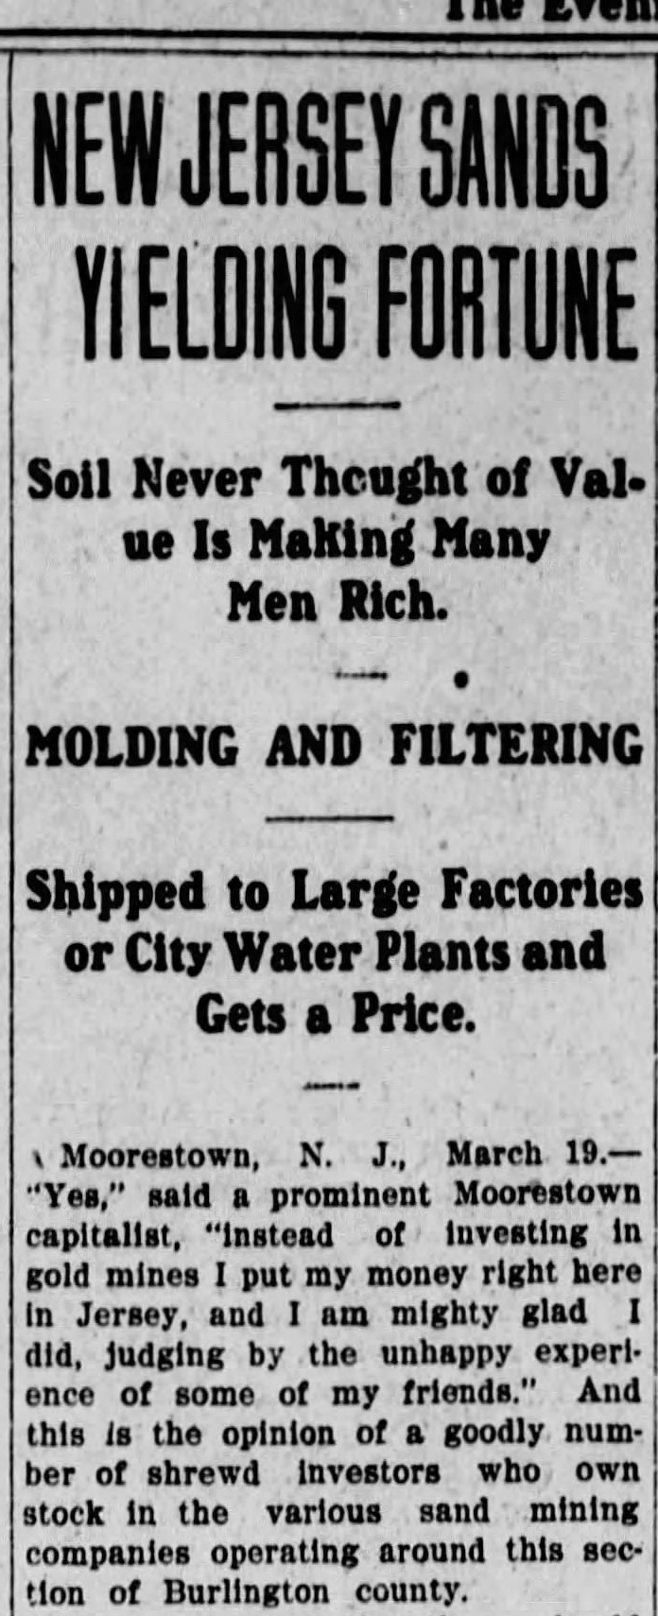
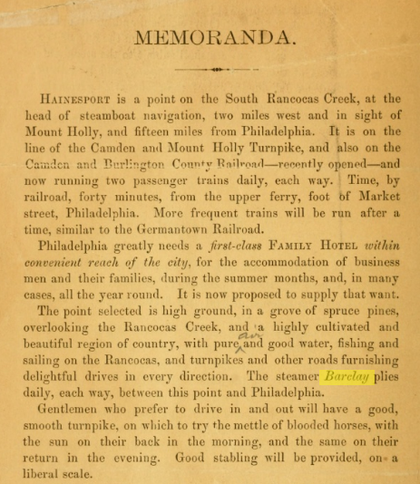

March
1909

Slide 28
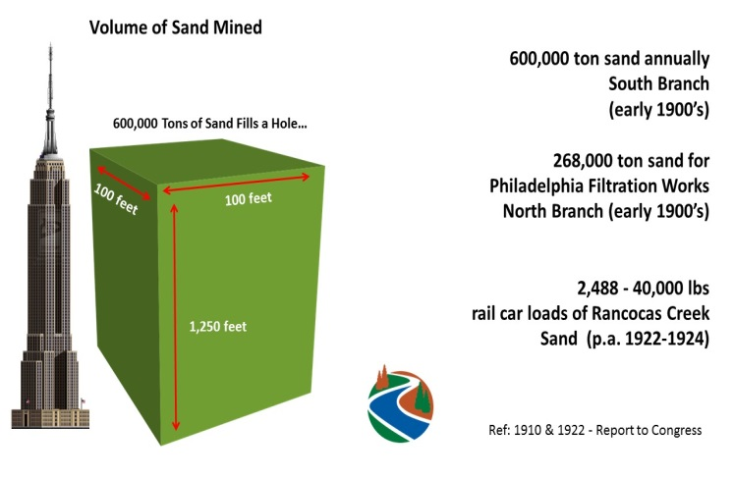
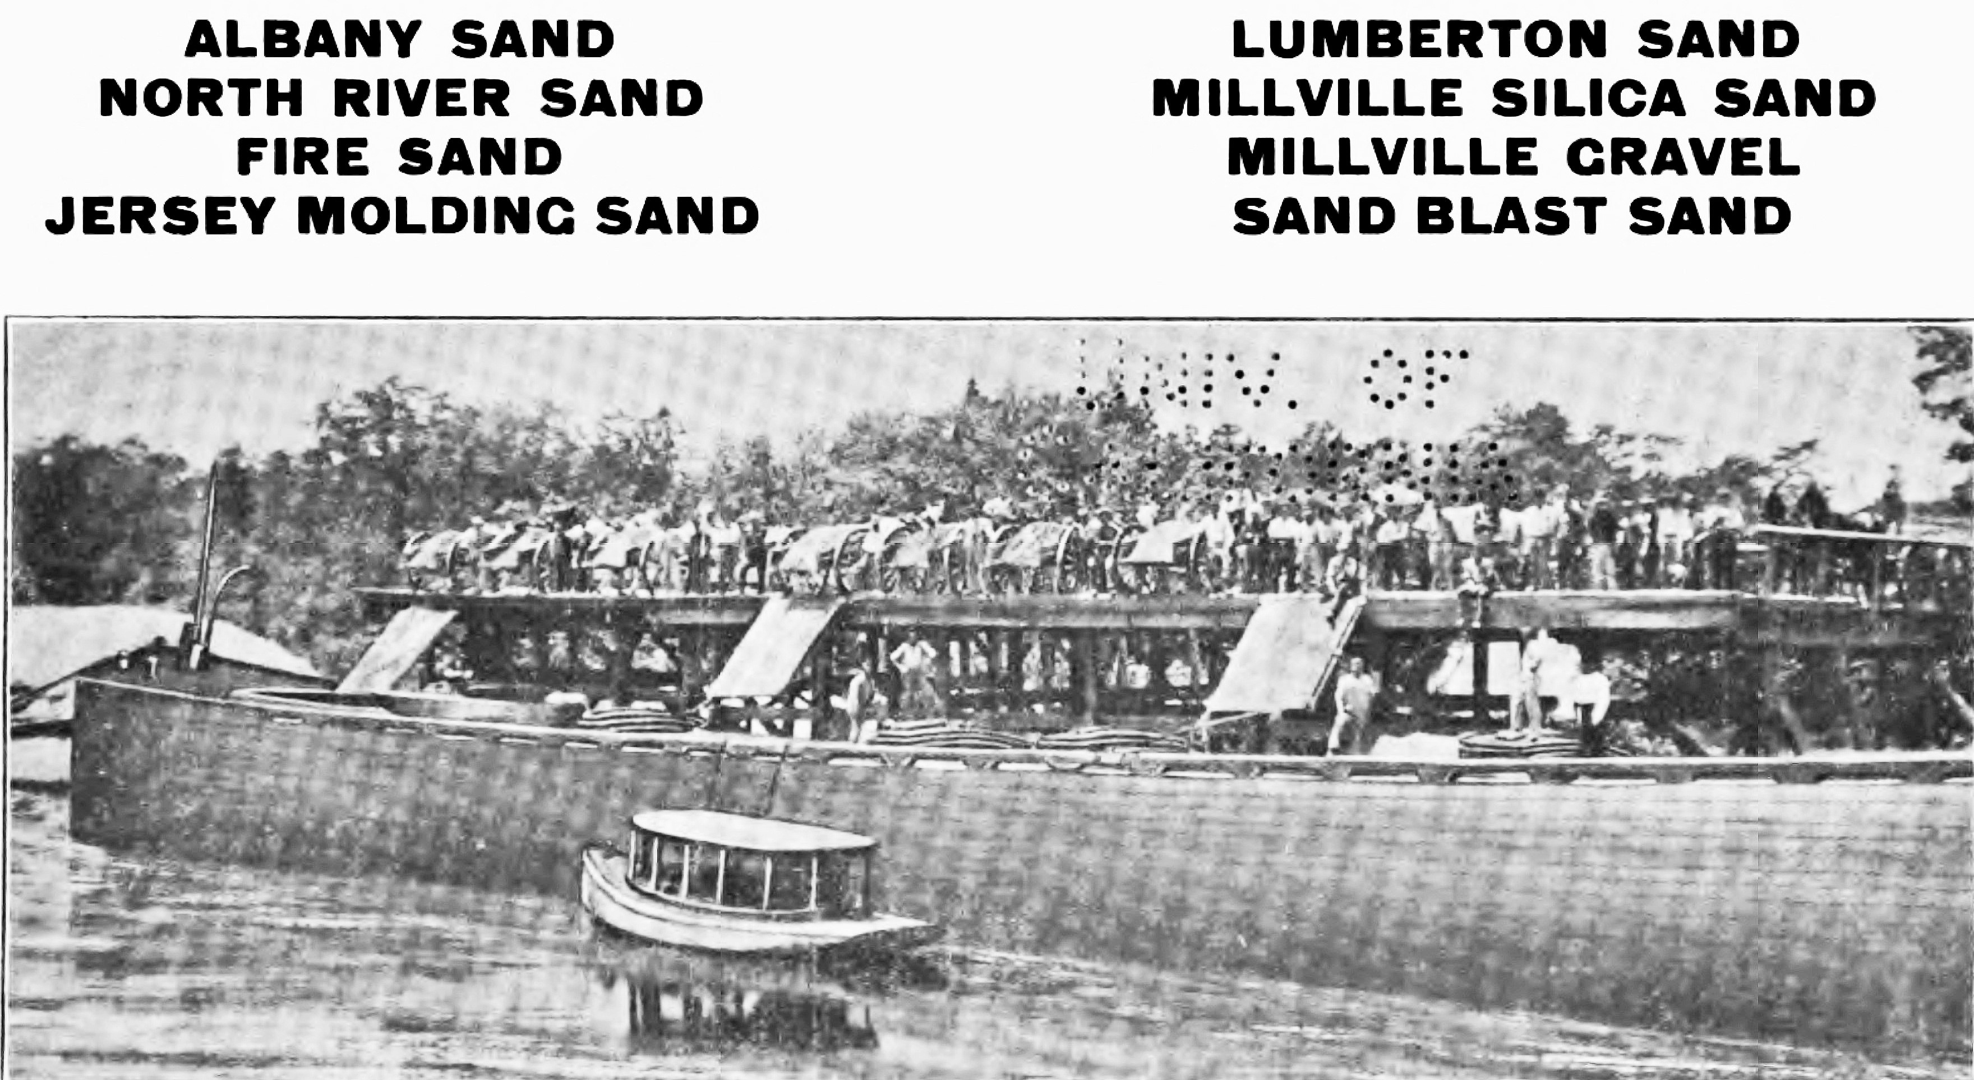

Commerce & Sand Markets
Barges 300-350 Tons
Pettinos Brothers
Exploring Historic Pathways, Discovering New Understandings

Slide 29
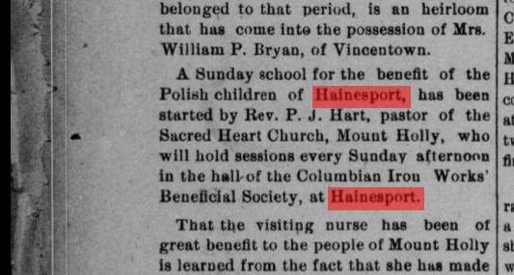
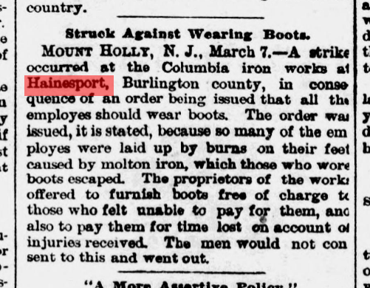




1906
1889
1897
1898
1927
Aleksander Gierymski - 1887

Slide 30

Hainesport Resident WW 1 Veteran

Slide 31




Reference: P. Uhland Collection....Thanks and Obliged
Exploring Historic Pathways, Discovering New Understandings

Slide 32




Slide 33



South Branch High Tide

Slide 34



Riparian Chart Rancocas Creek
Timbuctoo >>>
Melpine
Stone
Quarry
Hainesport
Foundry

Slide 35



Dorothy
Cross
Courtesy RF Collection
Argillite Knife 6,000-8,000 years old
Rancocas State Park
photo rbennet

Slide 36



Tugboat Rancocas
Philadelphia Maritime Exchange 1887

Slide 37



Rancocas Creek Wharves 1887
Feb. 27th, 1838
Rancocas Steamship Company Inc.
Wharf at Riverside belonging to Geo Van Sciver Sand
Two wharves at Bridgeboro. Belong to Geo VanSciver, Upper and lower side of drawbridge.
Sand wharf , 2 miles below Centerton
Three wharves at Centerton. Two on lower side of bridge belong to J W Paxton Sand.
One wharf above the bridge for Phosphorus
Wharf 3-4 miles above Centerton on Lumberton Branch belong to DeFrain Sand
Two wharves above Defrain belong to JW Paxton
Reynolds and Johnson Foundry Wharf Hainesport
VanSciver Wharf at Hainesport, above bridge.
ref: Schulich-Woolf Rare Book Collection
Courtesy Mt. Laurel Historical Society

Slide 38


Slide 39


Rancocas Creek Centreton Area Wrecks - 2023

Slide 40






Rare and endangered plants of the intertidal zones of NJ’s Rancocas Creek: Hainesport, Timbuctoo, Westampton, Willingboro , Mount Laurel, Centerton and Confluence.

Slide 41



Slide 42




Mixers
“Mixers”
“Dippers”
“Mixers”
“Boxers”
Ref: British Parliament Report 1884
Harpers Weekly 1886

Slide 43


Slide 44





Slide 45


Snapping Turtle Old Sand Mine Site
South Branch

Slide 46



Reference: Shipman Mansion Red Dragon Canoe Club, Riverside, NJ

Slide 47





July 10, 1929

Slide 48

Stewardship
South Branch Hainesport

Slide 49


Slide 50

Rancocas Creek Sand Mine Industry
Rancocas Creek Tethered Barge
Reference: Tracy Muller Photo

Slide 51

Multi-Use - It Takes Many Drops to Make a Water Trail
Multi - Use
South Branch Passing Lumberton Sand Mine

Slide 52

VanSciver Sand Mine and Barge Ops
J. B. Van Sciver, Sr. born in Hainesport, May 14, 1861, with his brother George, developed the Hainesport Mining & Transportation Company, and the De Frain Sand Company.
During World War I, Van Sciver Corporation supplied sand, gravel and concrete to build the Emergency Fleet Corporation’s shipyard on Hog Island in the Delaware River.
Philadelphia - Pier 67
Reference: Hagley Library

Slide 53



Slide 54


Rancocas Creek Tidal Landings - 1898 US Army Engineers
Cooks Landing - Engles Landing - Stone Quarry Landing- Haines Bank - Foundry Landing - “The Sluice” - Turning Basin - Sand -Hickney Shoal
Other - see Paul Schopp’s Rancocas Creek Landing List

Slide 55



Stone Quarry Landing - Rancocas State Park
South Branch - Hainesport
Courtesy Lumberton Historical Society

Slide 56




Slide 57


Boat Hook Rancocas Creek Tug Minerva
Circa around 1910
Compliments of Burlington County Lyceum

Slide 58






Hainesport Landing
Ray Stork Collection

Slide 59


Creek Turn Park Sand Mine

Slide 60


Creek Turn Pottery
Water Trail Way Point

Slide 61


Creek Turn Park South Branch

Slide 62



Exploring Historic Pathways, Discovering New Understandings

Slide 63





Courtesy Lumberton Historical Society
Port of Philadelphia
Delaware River
Tidal
Lumberton
Atsion Wharfs
# 4 and # 5
Atsion - Lumberton - Rancocas Creek
NJ Pinelands National Reserve Naval Stores
Sailed to Delaware River Ports & Markets
Land
1766
NJ Pioneer Navigation Act
Atsion Furnace
Exploring Historic Pathways, Discovering New Understandings

Slide 64



1897
Rancocas Creek Tidewater Fishery
(Rancocas overfished then stocked w shad)
Fish Hawk's main deck was filled with hatching equipment to allow her to serve as a floating hatchery for American Shad, stripped bass, mackerel, and herring. A pump supplying 10,000 US gallons (38,000 L) of water per hour and two 500-US-gallon (1,900 L) distribution tanks fed the equipment. Fertilized fish eggs were placed in 36 hatching cones, each capable of hatching 200,000 American shad eggs, and feed valves regulated the current through the cones to keep the eggs gently in motion so they would not mat or settle to the bottom. Fish Hawk also had 18 hatching cylinders – each capable of holding 250,000 eggs – with wire gauze bottoms; the cylinders were suspended from beams hanging over the sides of the ship and Partially submerged, with nine on each side. Cam machinery caused the cylinders to rise gently and drop more rapidly for about eight inches (20 cm), which made the eggs circulate freely without settling on the bottom.
Reference: NOAA Historical Center
Pilot on Board
US Fish Hatchery Vessel “Fish Hawk” stocked Rancocas Creek w 800,000 Shad Fry 1897

Slide 65







  Maritime Crossroads
  Delaware River Water Trail
RCNWT Insert
N Branch Channel
Main Stem
Mt. Holly
N Branch
Main Stem-Rancocas
Hainesport Boat Launch
Burlington County Park
Mt. Holly Oxbow – Mill Race
S Branch
Lumberton

Slide 66

Thank You

