Slide 1
Delaware Breakwater/Dover AFB/Port of Salem/Deepwater/Commodore Barry Bridge/Piers 2/378/96/82/80/78/Fairless/Trenton/Migon Creek and Torresdale Tidal Gates/MITENS Snap Deck
Proposed Site Locations
Delaware River Federal Navigation Channel Tide Water Microgrid Network
Mid-Atlantic Marine Highways and Delaware River Federal Navigation Channel
Delaware River Basin
Specific Sites of Interest – See MITENS Snap-Deck (available upon request)
Distal Terminus – Delaware Bay Breakwater
Proximal Terminus – Trenton Falls
Possible Site Locations by Delaware River Miles
Other
For Select Release

Slide 2
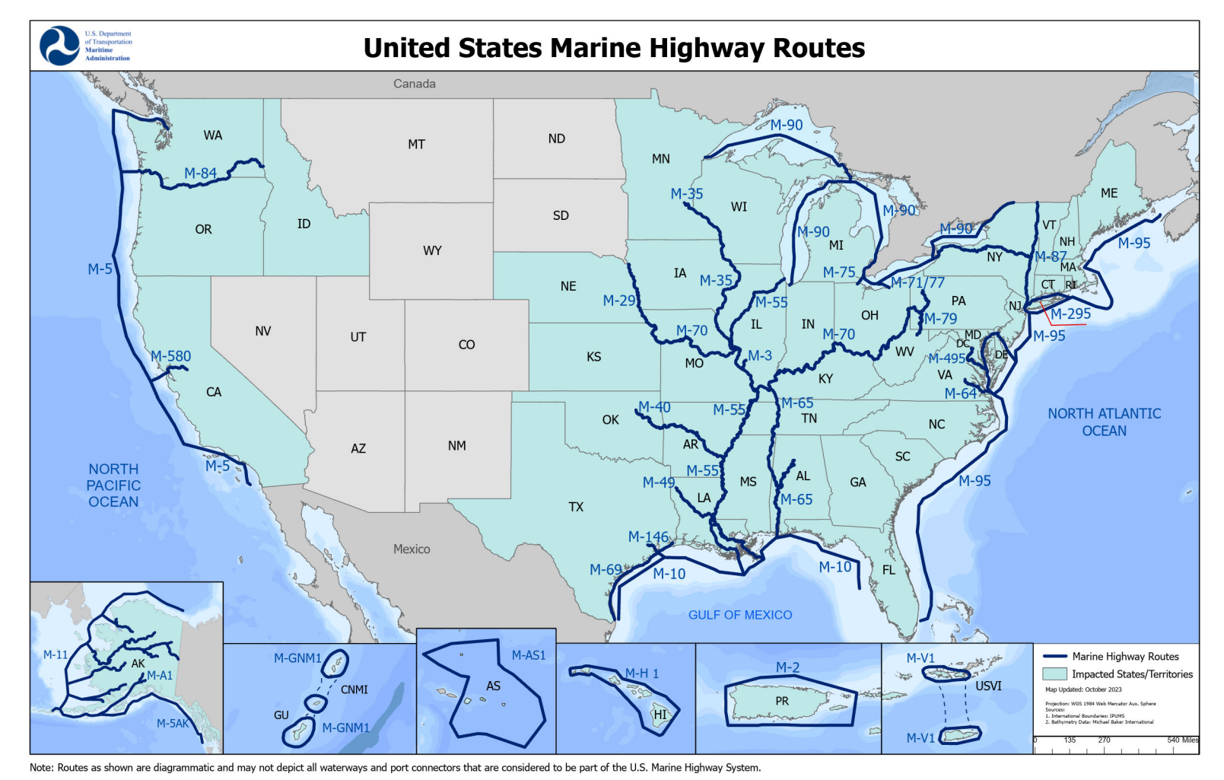
Mid-Atlantic Marine Highway
Delaware River Federal Navigation Channel

Slide 3
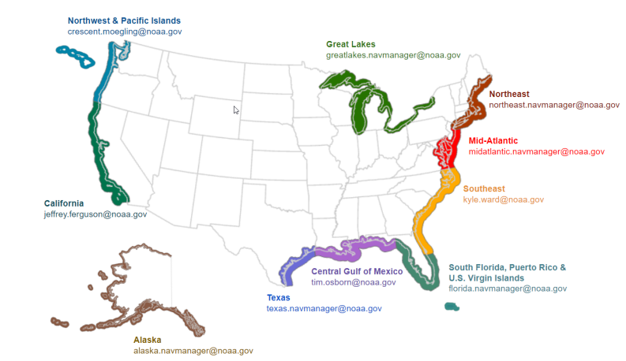

Mid-Atlantic Marine Highway
New Jersey-Pennsylvania-Delaware-Maryland-Virginia

Slide 4
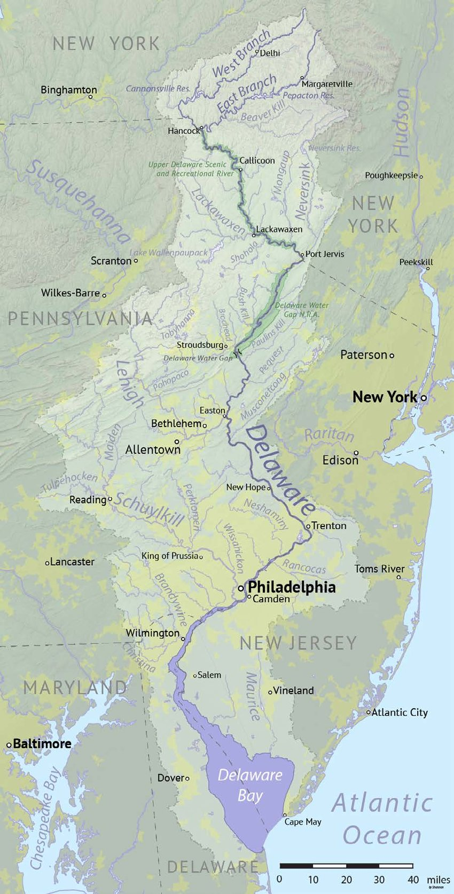
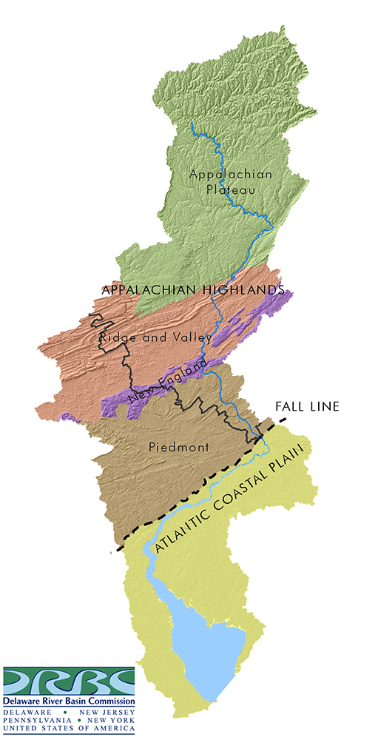
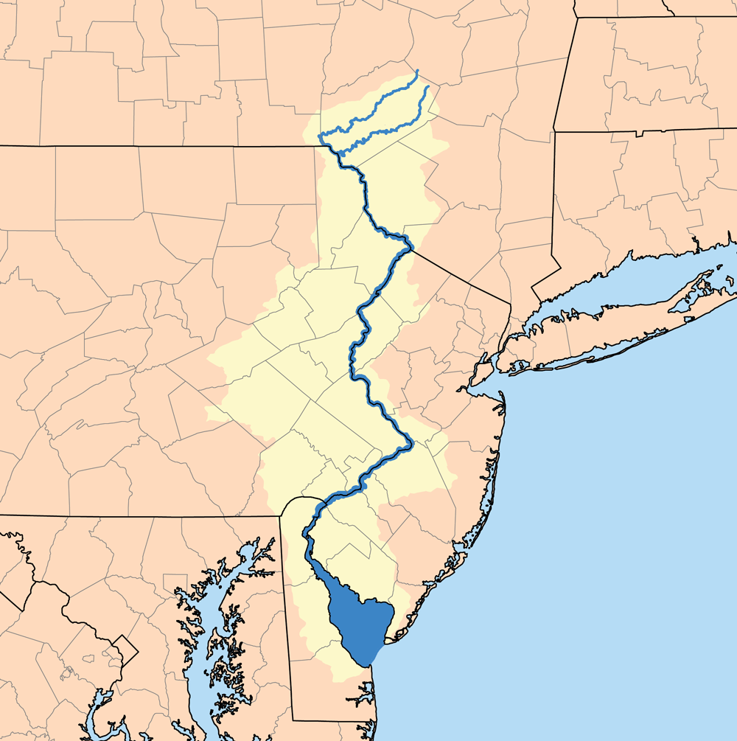
Delaware River Basin
Delaware River Basin
Physiologic Regions
Delaware River Basin States and Counties
New York
Pennsylvania
New Jersey
Delaware

Slide 5
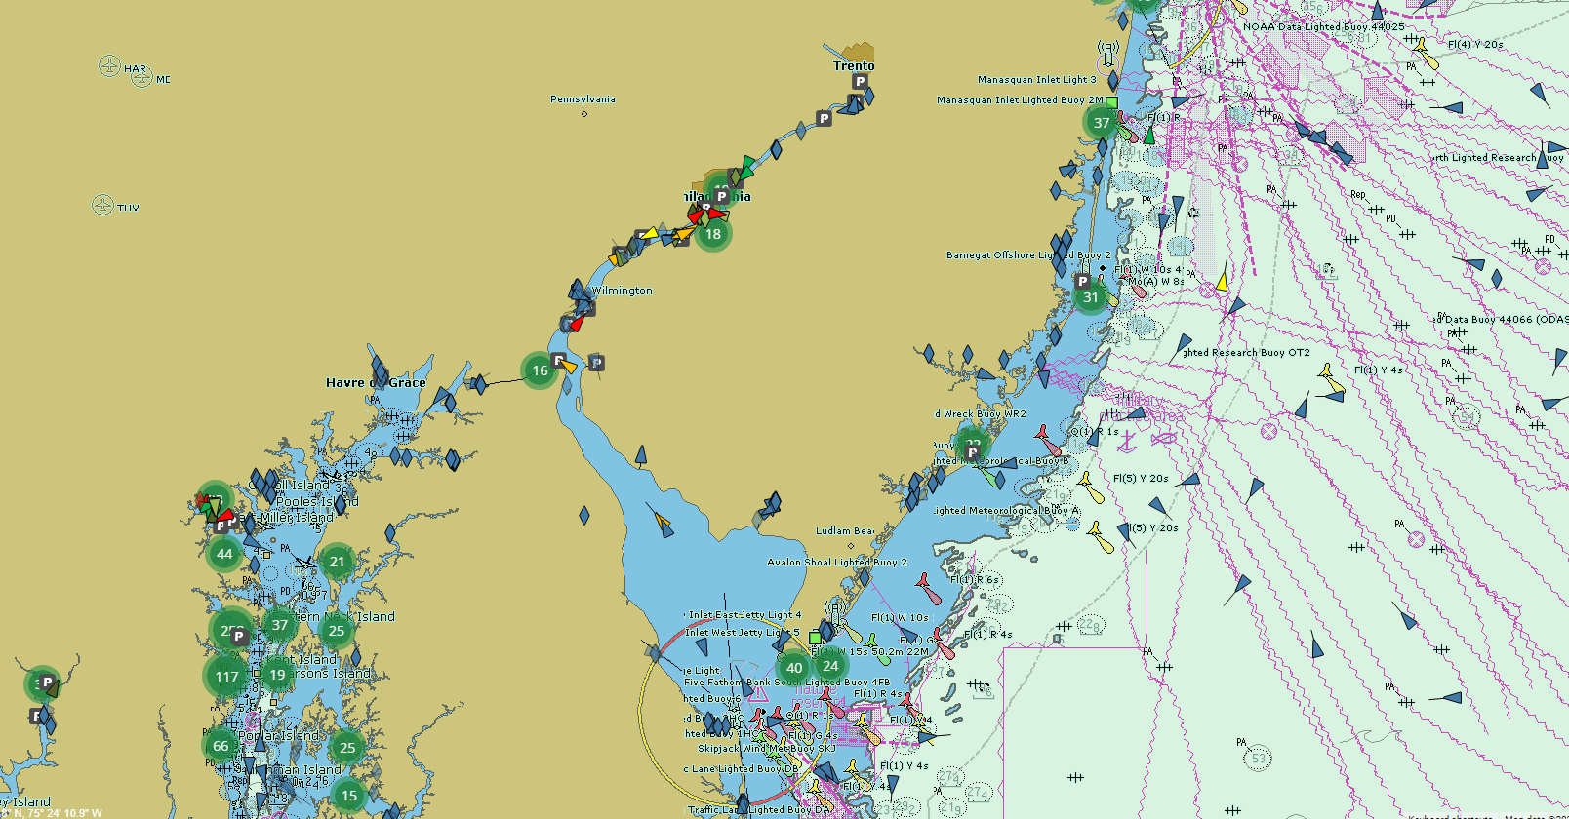
Proximal Terminus
Mid-Atlantic Marine Highway Ports
Delaware River Federal Navigation Channel
Trenton
New Jersey
Pennsylvania
Philadelphia
Camden
Wilmington
Delaware
New Jersey
Salem
C and D Canal
Maryland
Maryland
Delaware
Delaware
Bay
Delmarva
Maryland
Distal Terminus

Slide 6
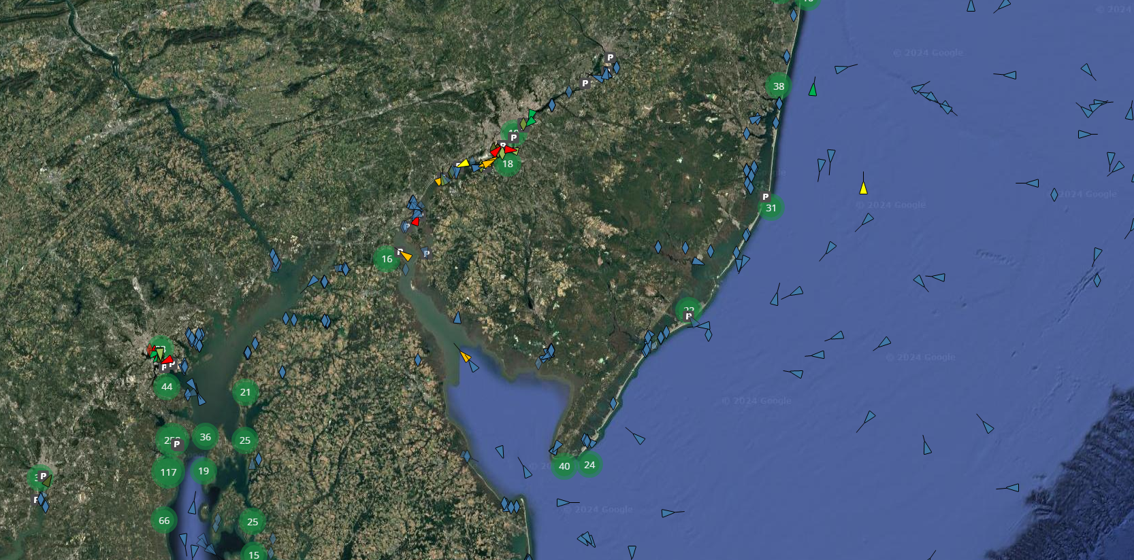
Fairless
Piers
Tioga
78
80
82
96
2/3
Trenton
Rancocas Creek
Commodore Barry Bridge
Port of Paulsboro
Port of Wilmington
Deepwater
Mid-Atlantic Marine Highway
Delaware River Federal Navigation Channel
Possible Ports, Piers and Terminal Locations for Mid-Atlantic Marine Highway Aggerated Maritime Microgrid Network
Port of Salem
Big Stone Beach
Dover
Air Force Base
Delaware Bay Breakwater

Slide 7
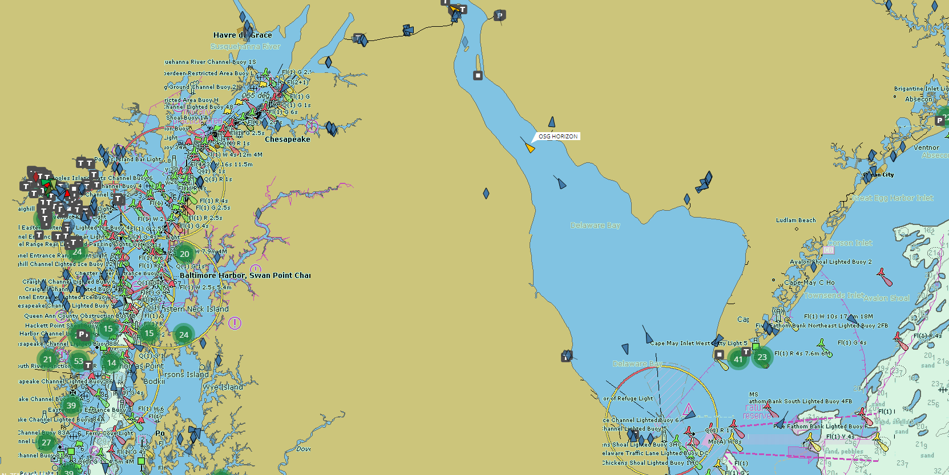
Port of Salem
Mid-Atlantic Marine Highway
Delaware River Federal Navigation Channel
Maritime Microgrid Network
Distal Terminus
Dover Air Force Base
Big Stone Beach
Delaware Bay Breakwater

Slide 8
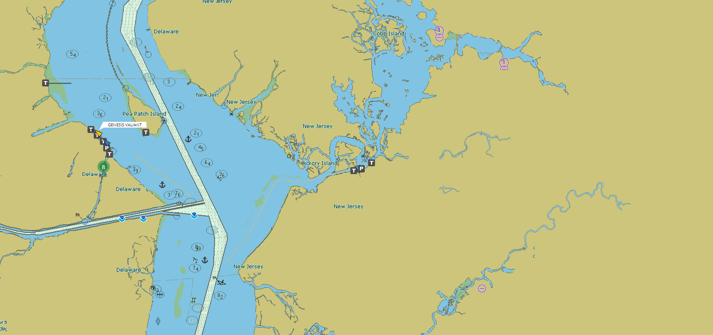
Port of Salem

Slide 9
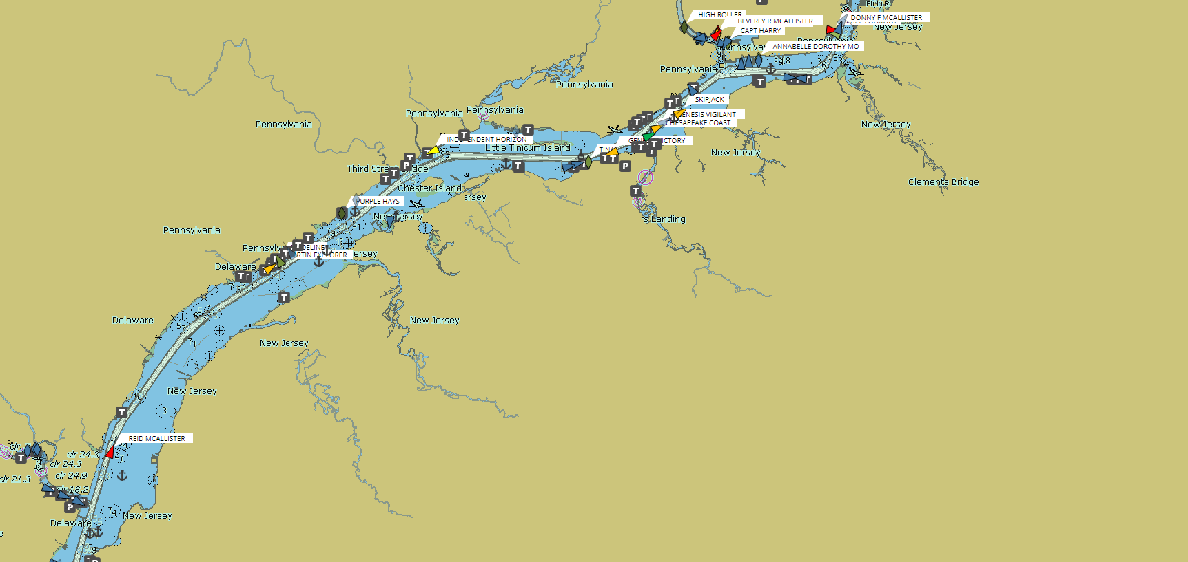
Pier 2/3
Not Marked
SE Pennsylvania Tidewater Rivers and Creeks
Port of Paulsboro
See State of New Jersey Tidal Energy Potential Report
Port of Wilmington
Deepwater
Commodore Barry Bridge

Slide 10
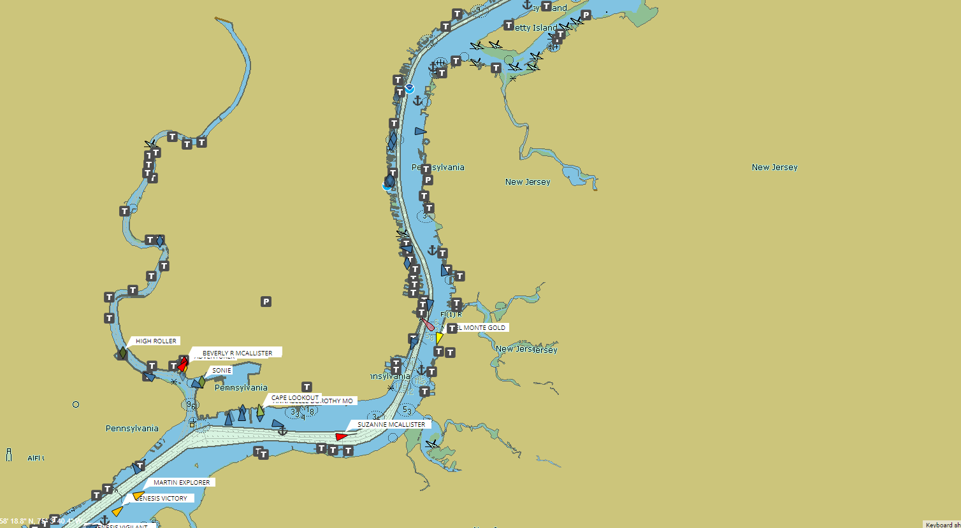
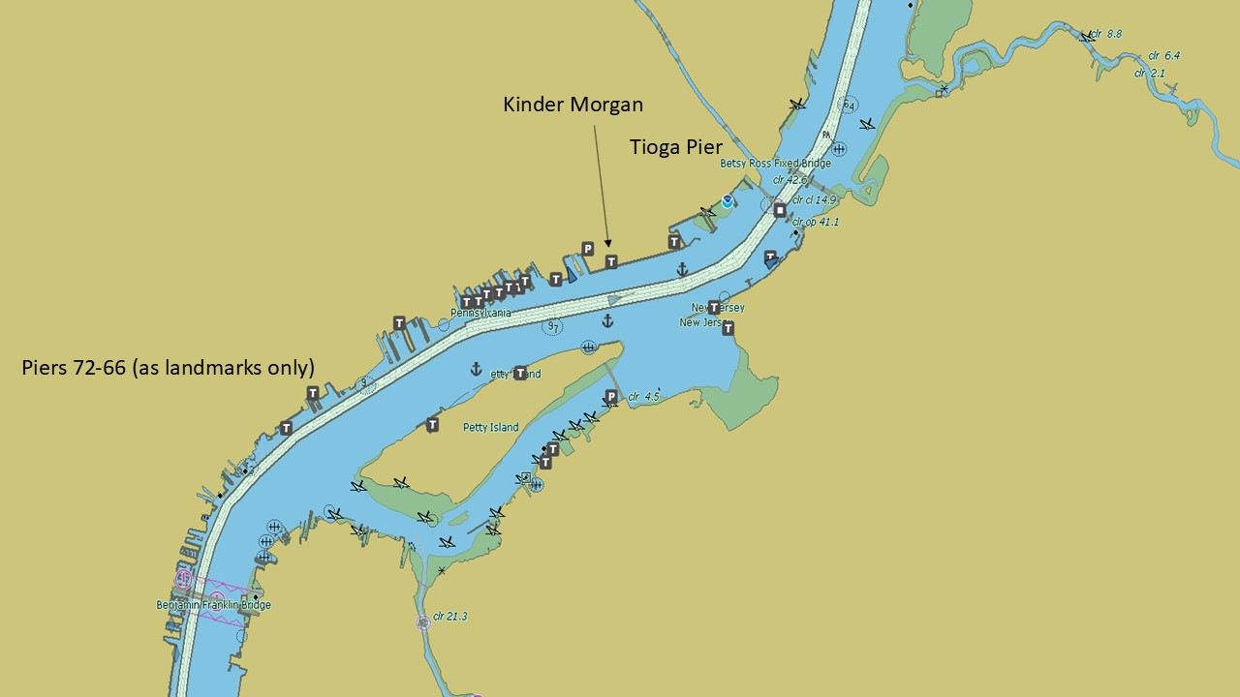
Tioga Pier
Piers 72-66
As Landmarks Only
New Jersey
Tioga Pier
Pier 78 Forest Service Products
Pier 80
Pier 82
Mingo
Creek
Tidal
Gate
Bellwether
Industrial
District
Pier 96
Pier 2/3
New Jersey

Slide 11
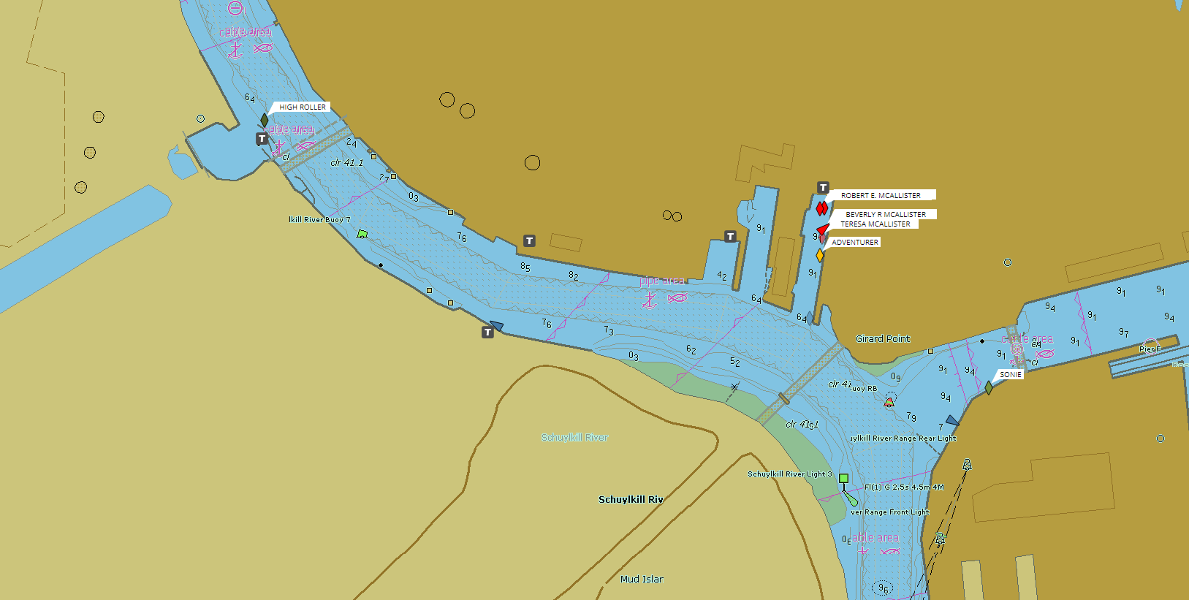
Bellwether Industrial
District
Pier 2/3
Mingo
Creek
Tidal Gate

Slide 12
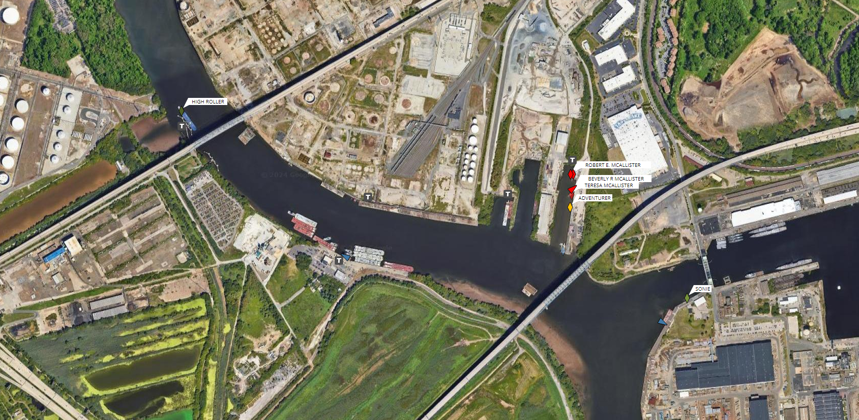
Bellwether District
?
Pier 2/3
Mingo
Creek
Tidal
Gate
?
?

Slide 13
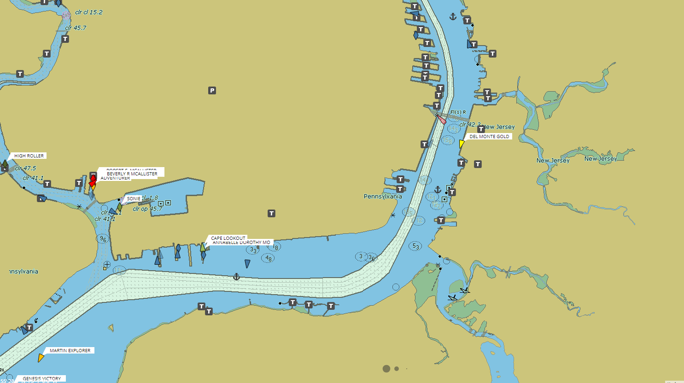
Piers
96/82/80/78
Bellwether District
Pier 2/3
Mingo
Creek
Tidal
Gate

Slide 14
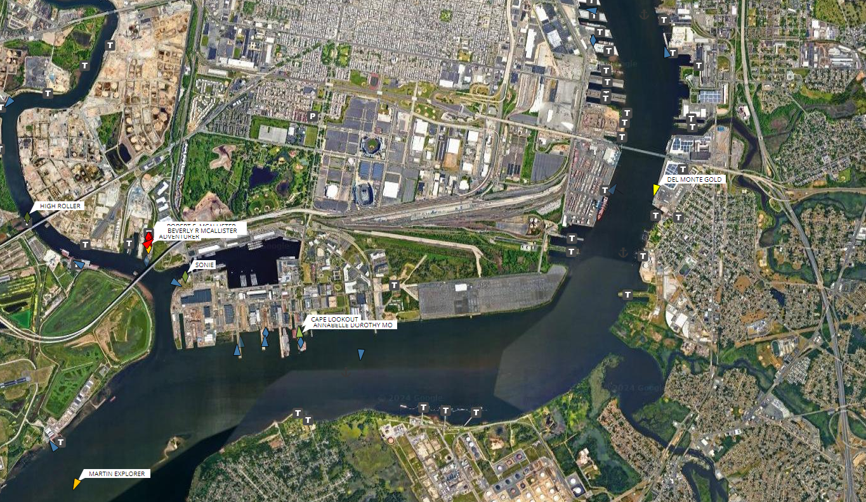
?
Piers
96/82/80/78
Bellwether District
?
Pier 2/3
Mingo
Creek
Tidal
Gate

Slide 15
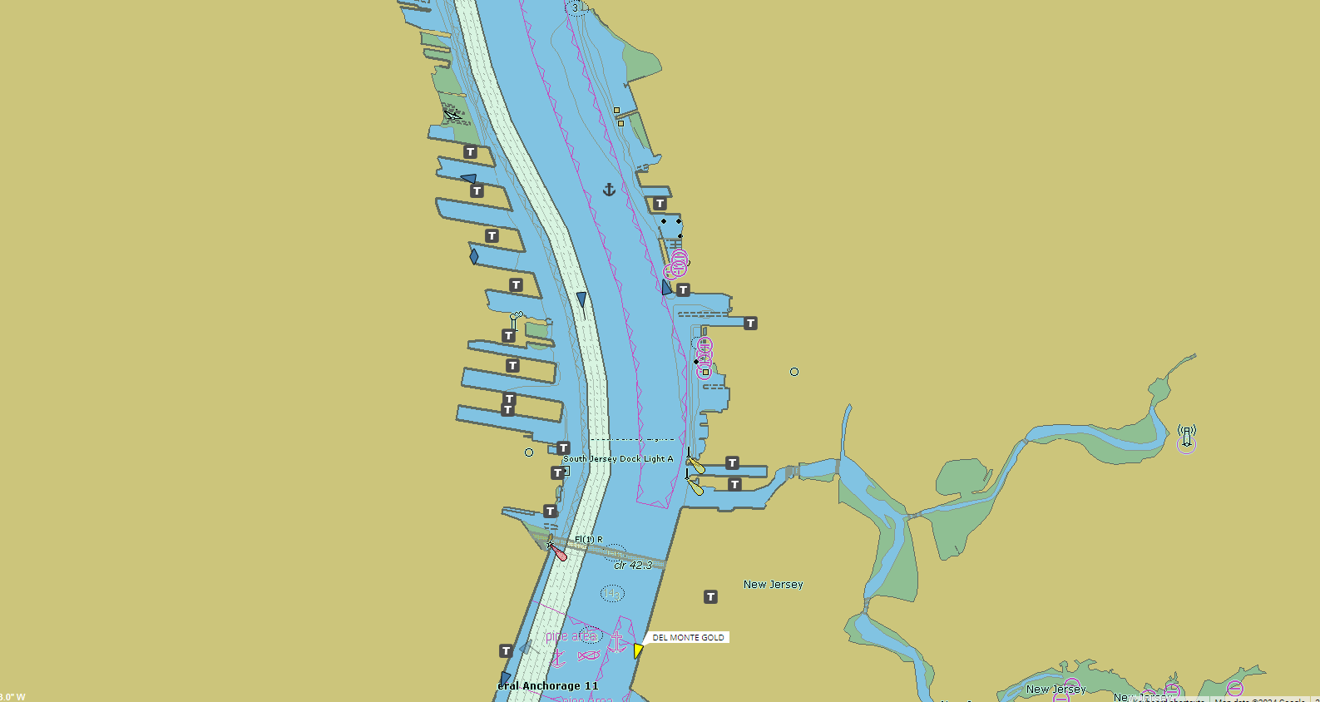
Pier 78 Forest Service Products
Pier 80
Pier 82
Pier 96

Slide 16
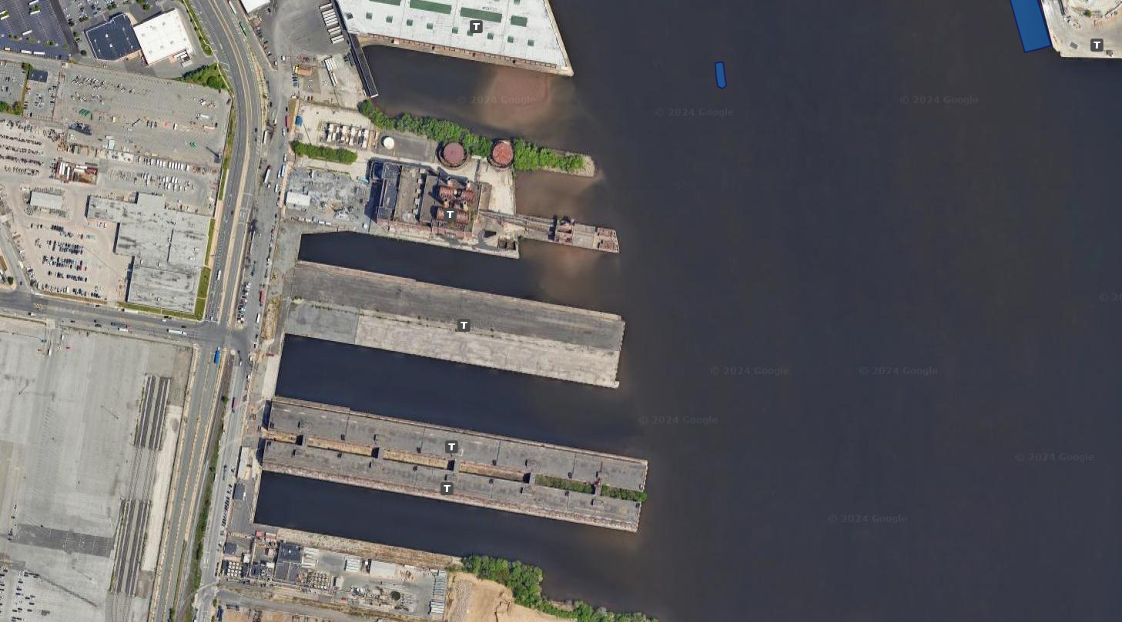
?
Pier 96
?
?
?

Slide 17
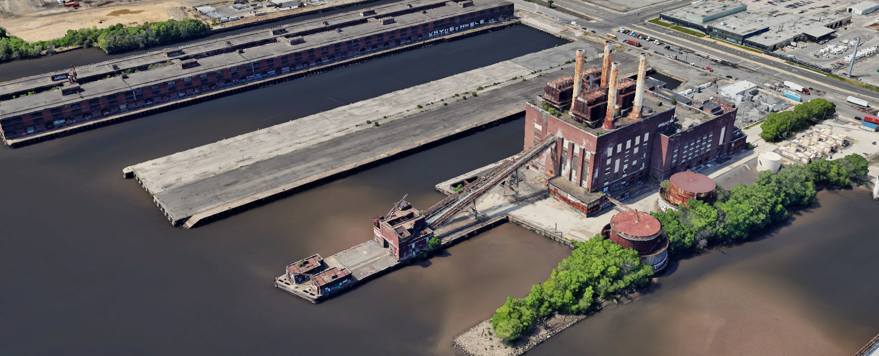
?
Pier 96
?
?

Slide 18
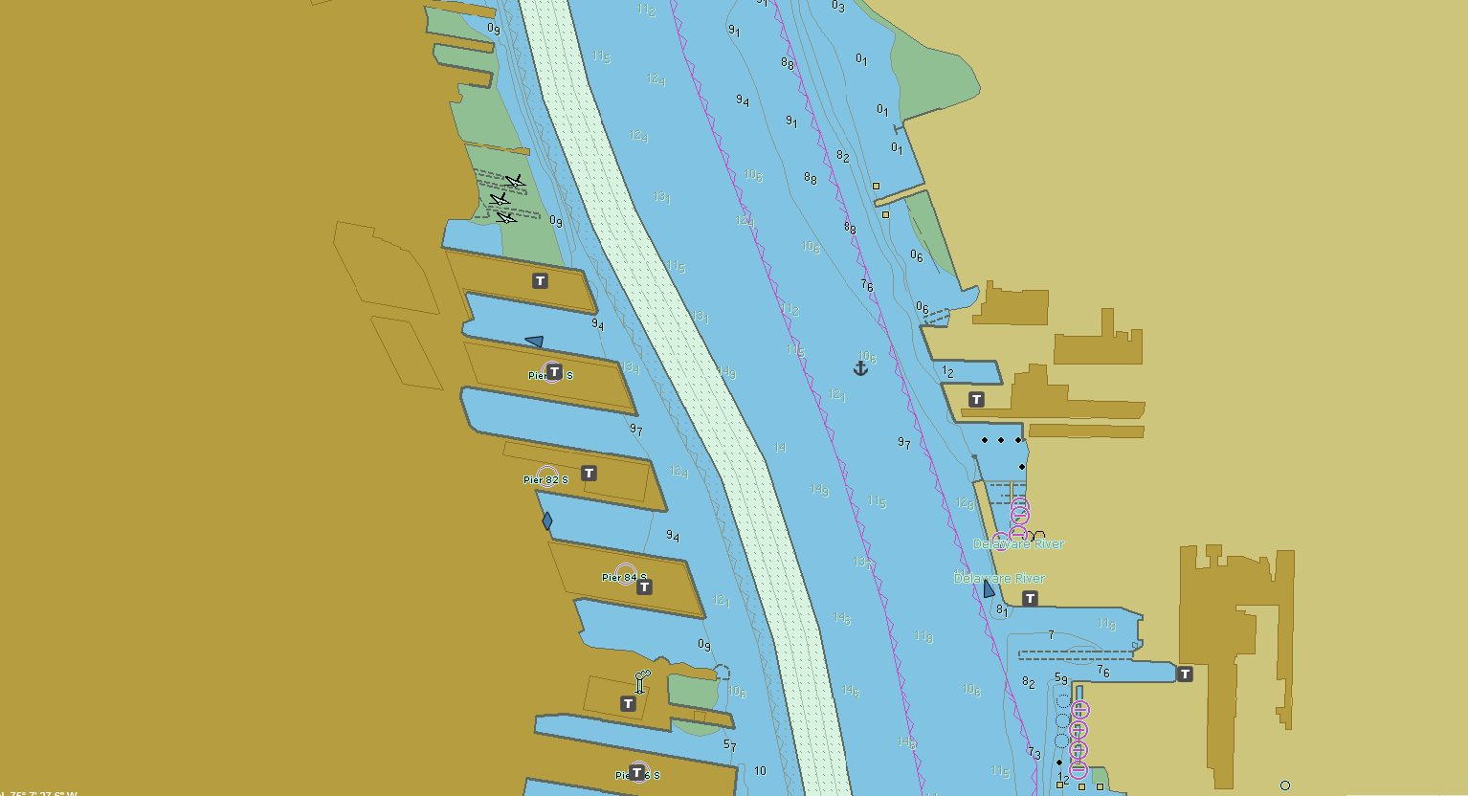
Pier 78 Forest Service Products
Pier 80
Pier 82
Pier 96

Slide 19
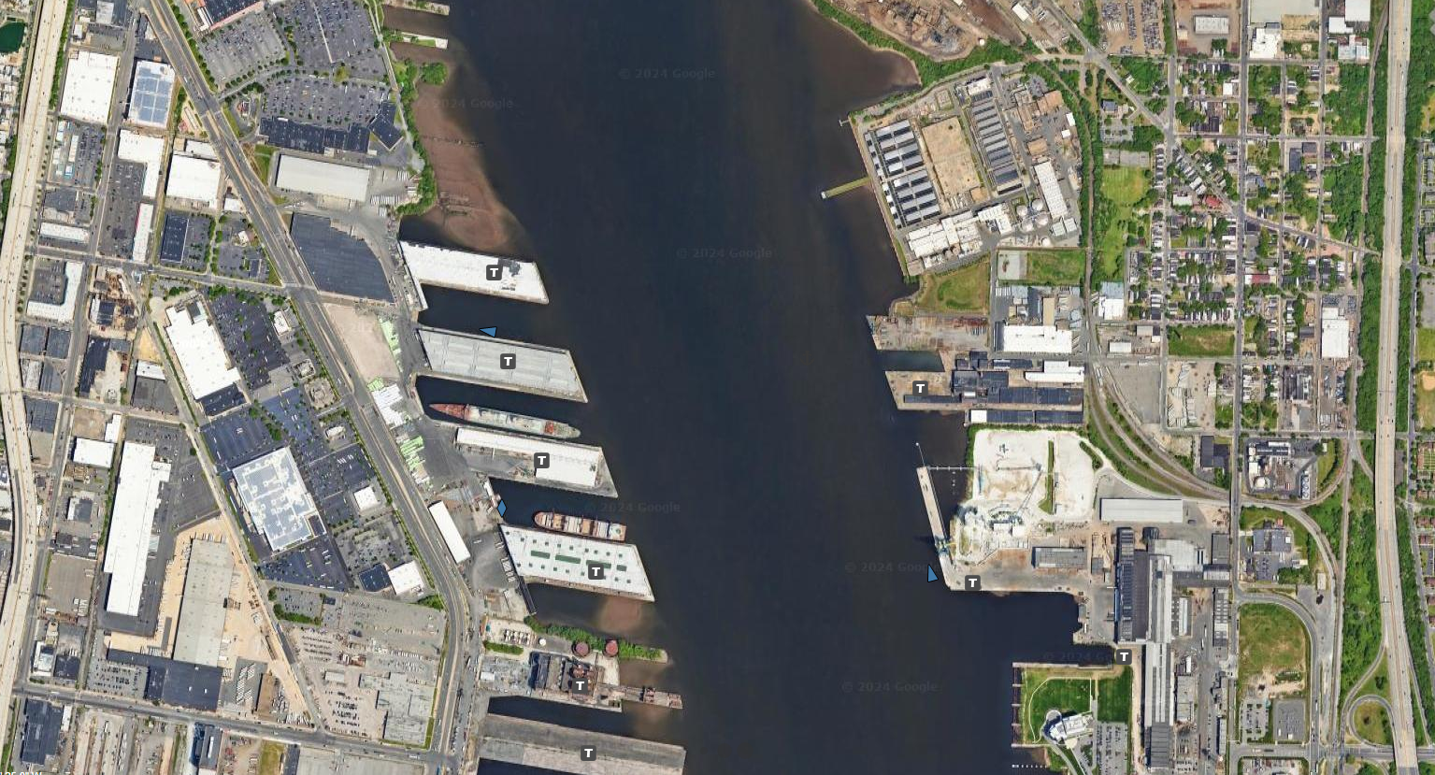
?
Pier 78 Forest Service Products
?
Pier 80
Pier 82
?
Pier 96

Slide 20
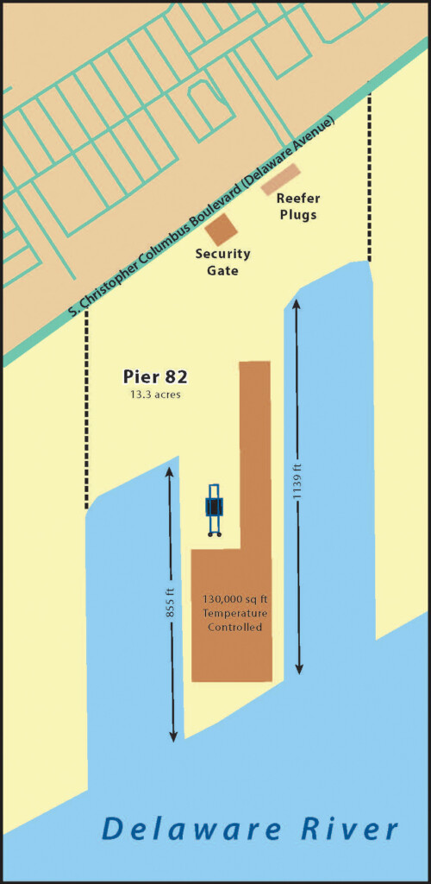
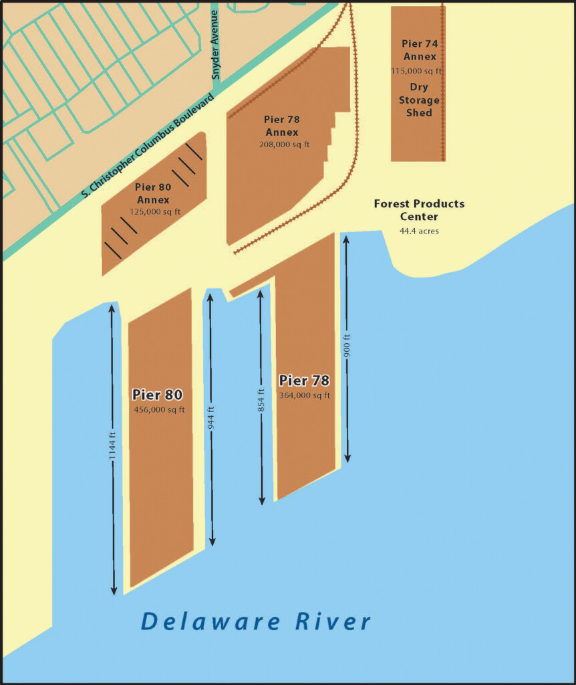
Pier 96 ?
Philadelphia Forest Product Center

Slide 21
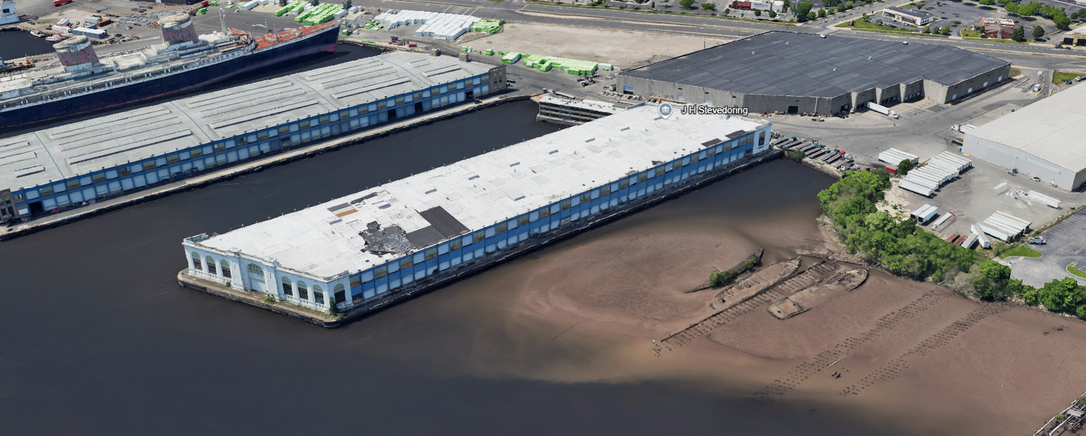
?
?
?
?

Slide 22
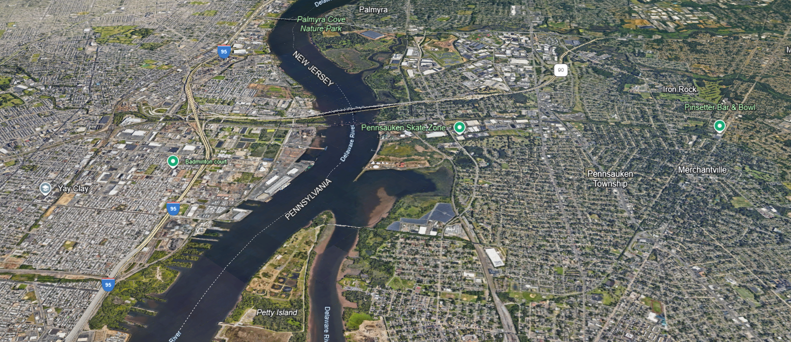
Tioga Pier
?
Kinder Morgan

Slide 23
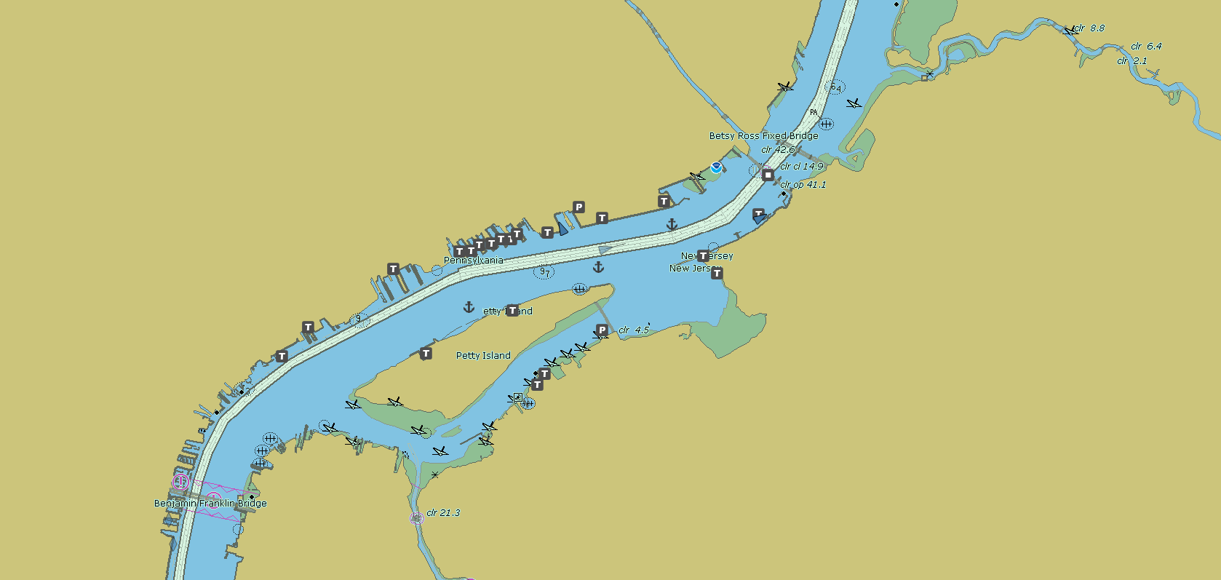
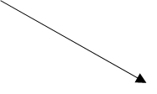
Kinder Morgan
Tioga Pier
Piers 72-66 (as landmarks only)

Slide 24
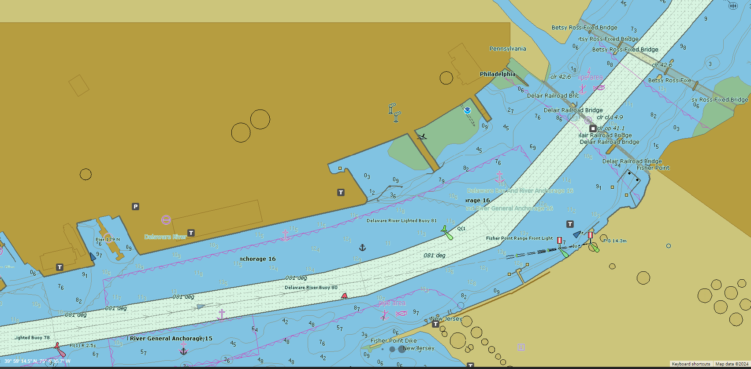
Tioga Pier
Kinder Morgan

Slide 25
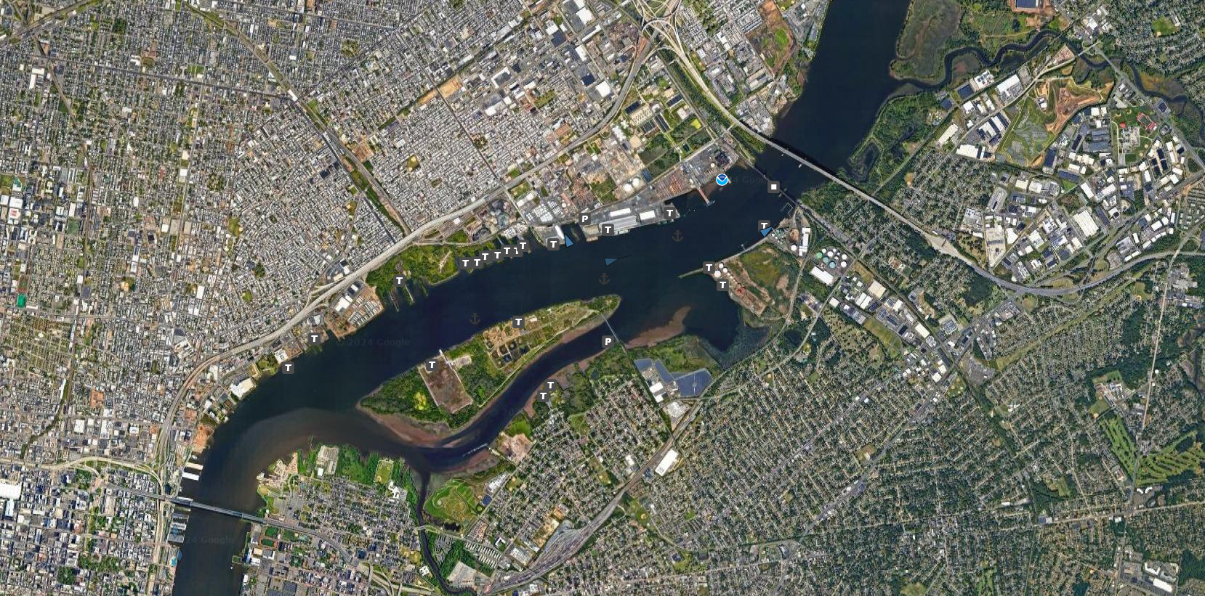
Tioga Pier
?
Kinder Morgan
?
?
?
Piers 72-66 (as landmarks only)

Slide 26
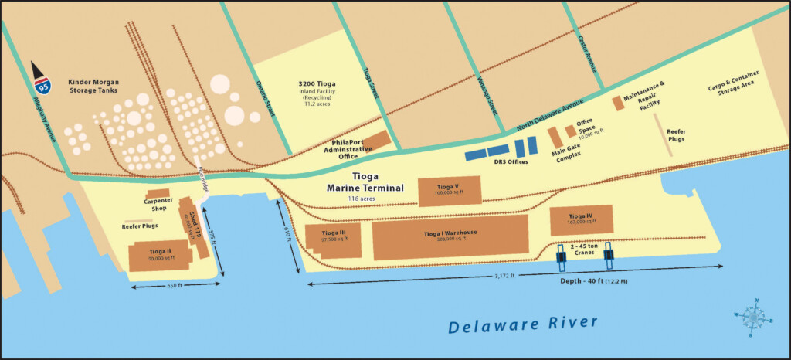

Slide 27
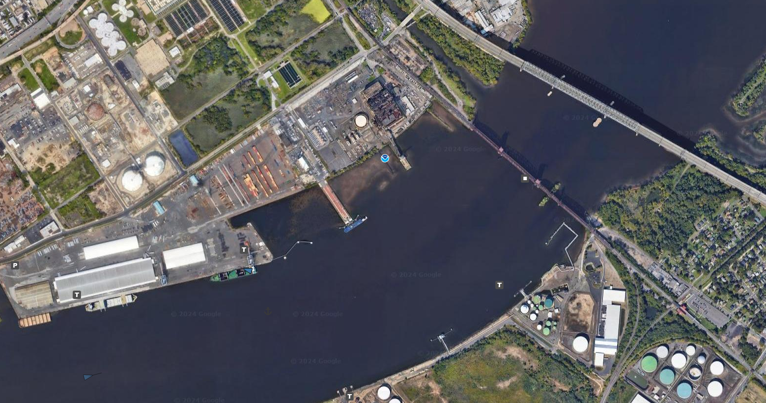
?
?

Slide 28
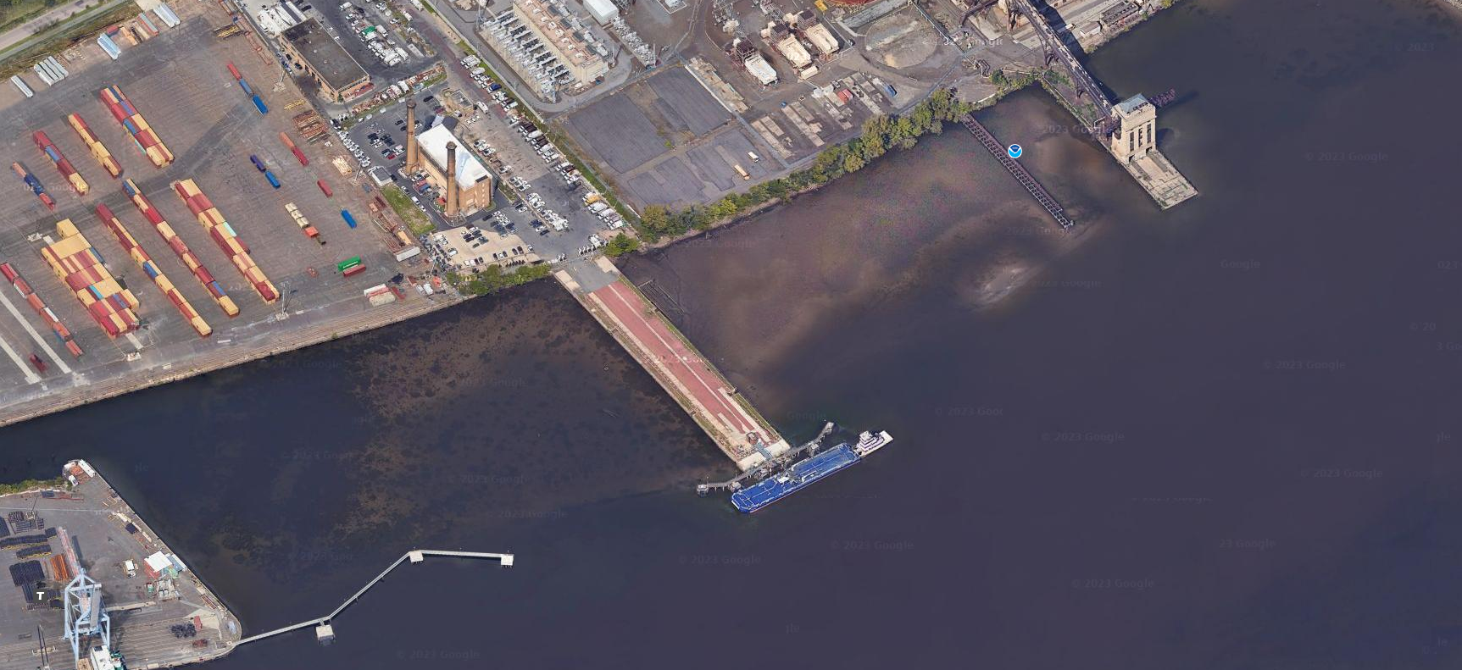
?
?
?
?
?

Slide 29
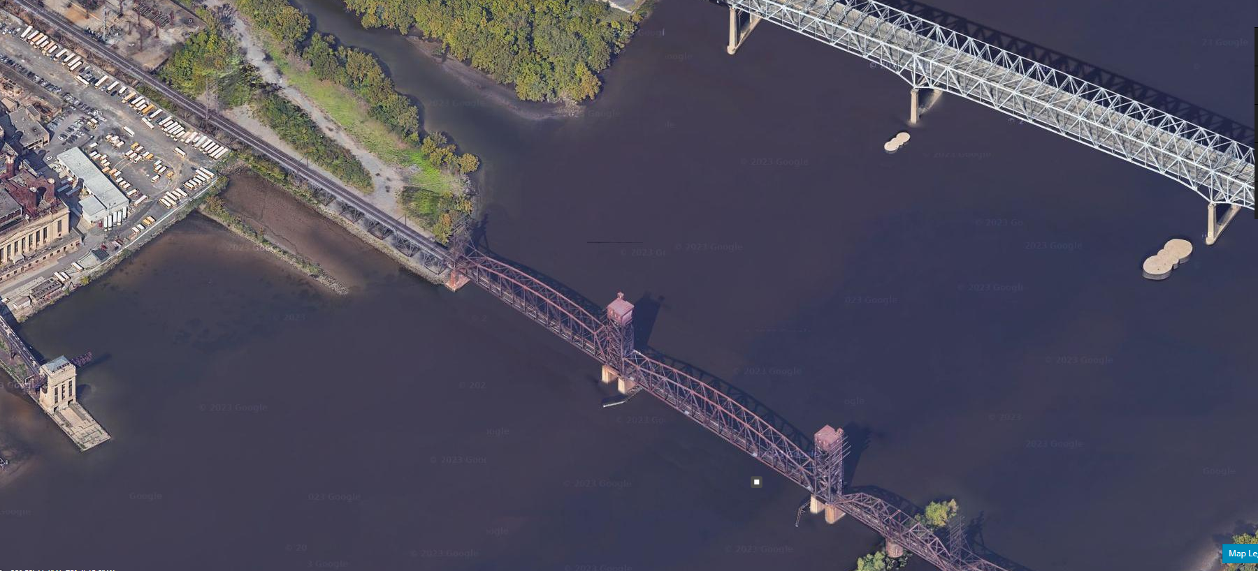
?
?
?
?
?
?
?

Slide 30
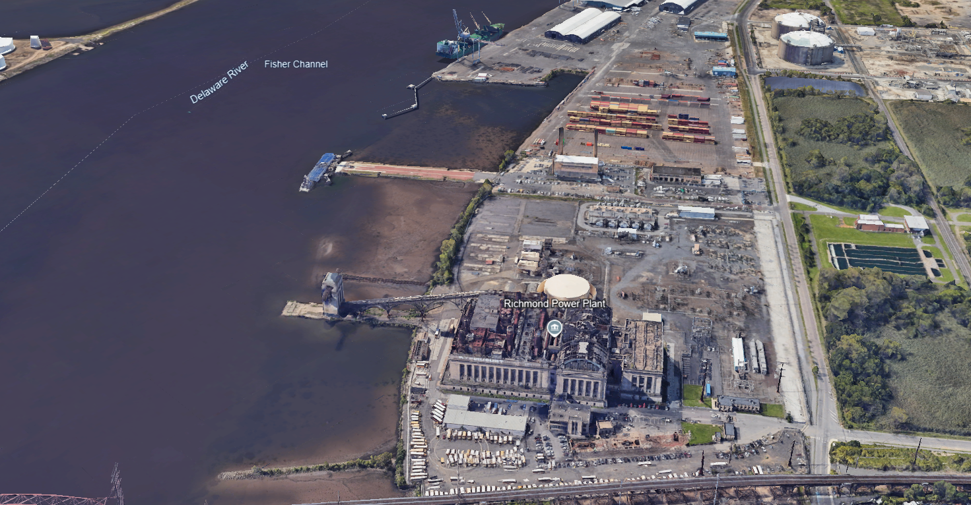
?
?

Slide 31
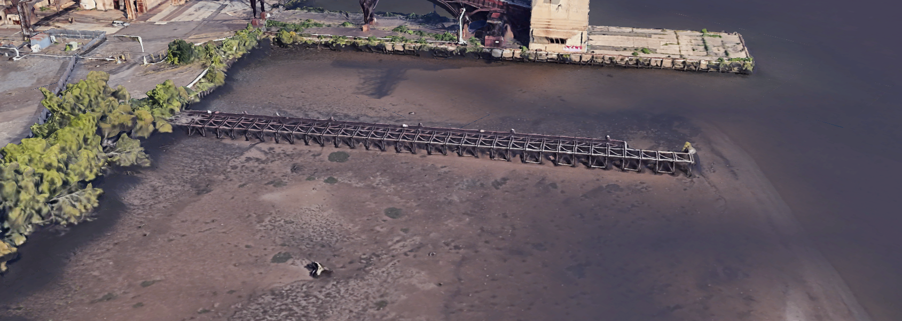
?
?

Slide 32
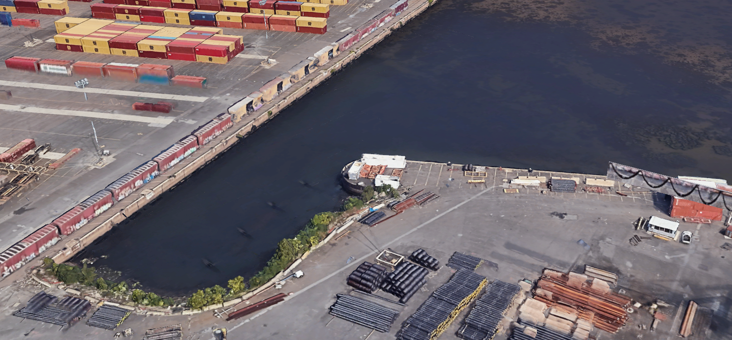
?
?

Slide 33
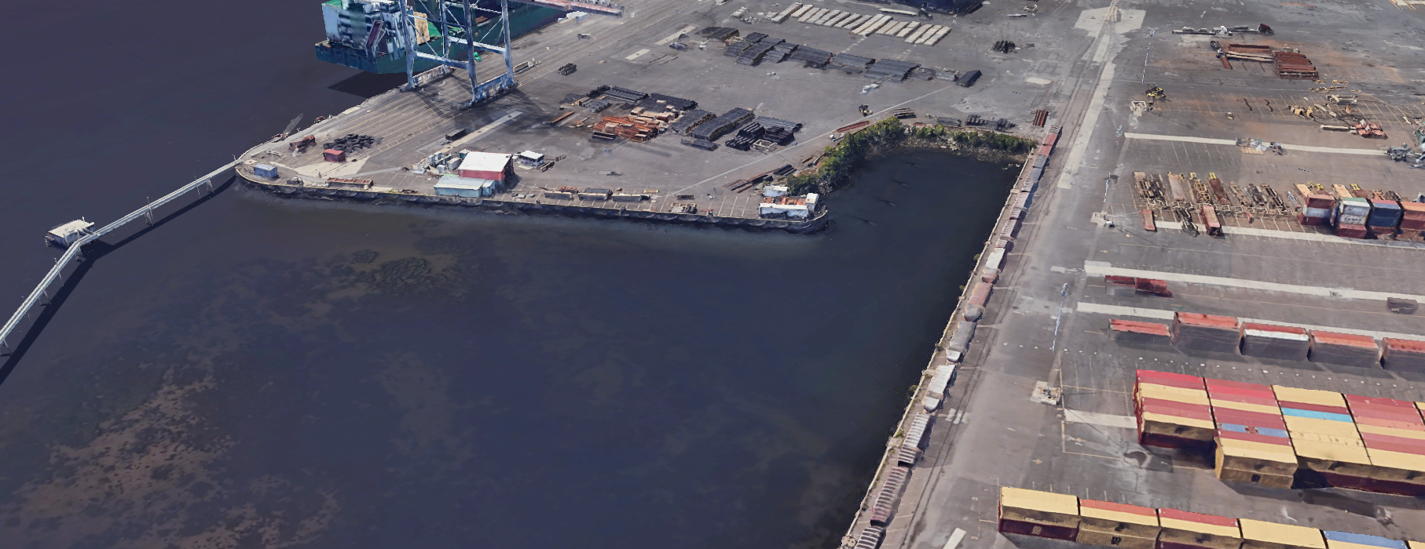
?
?

Slide 34
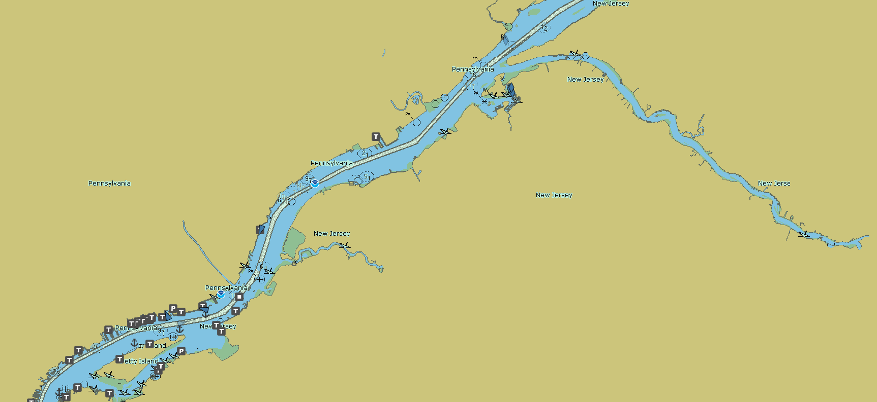
Torresdale Tidal Gates

Slide 35
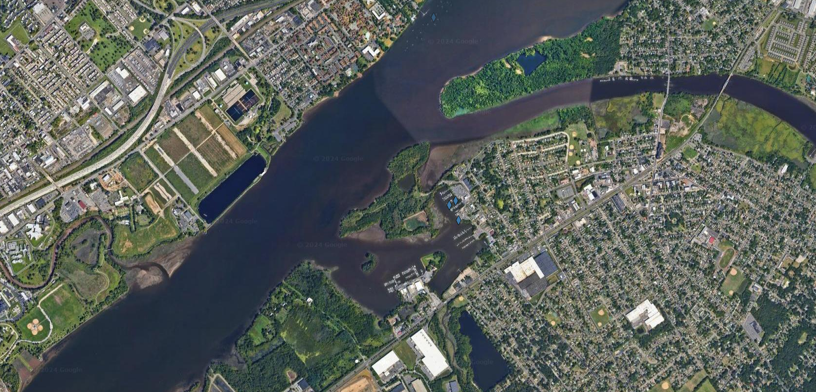
Torresdale Tidal Gates
?

Slide 36
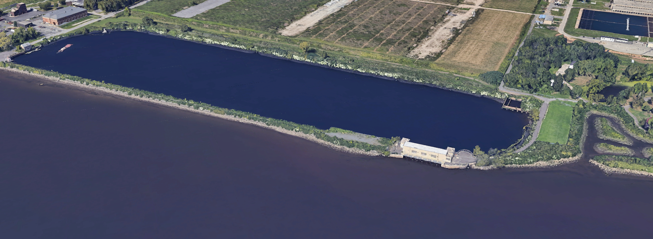
Torresdale Tidal Gates
?

Slide 37
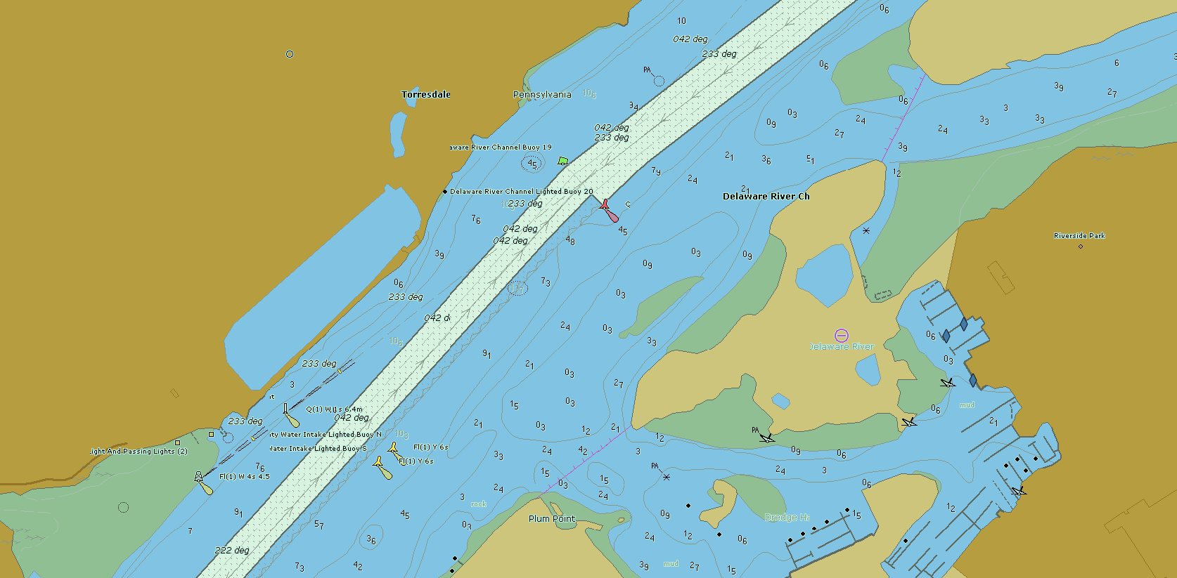
Torresdale Tidal Gates

Slide 38
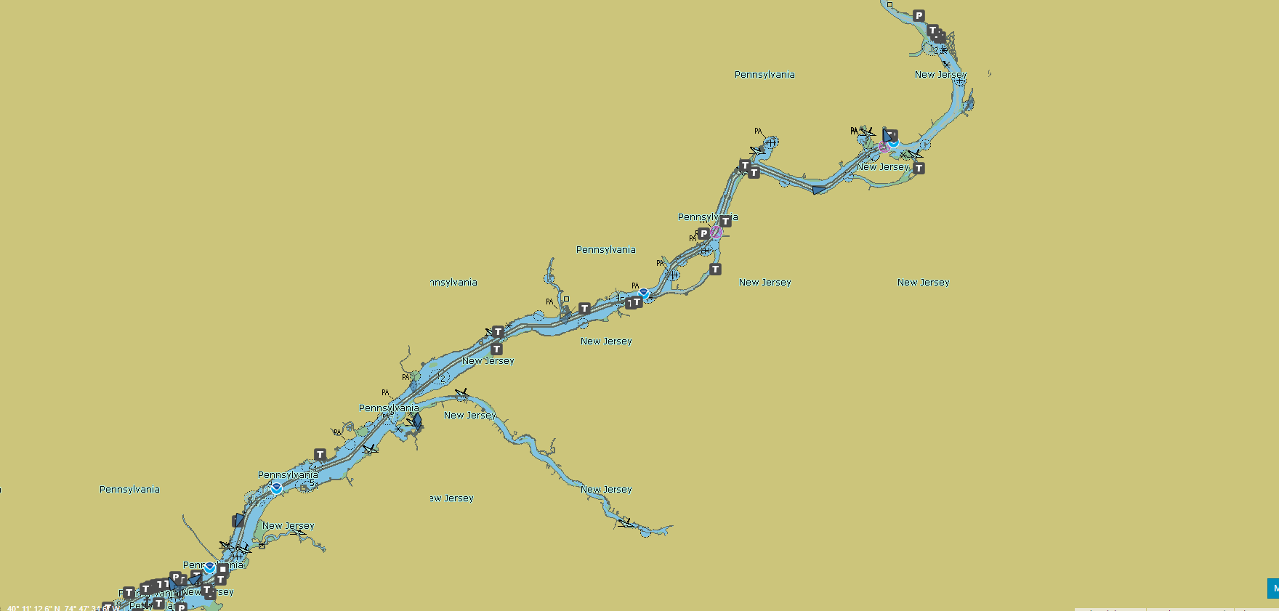
Bellweather
Kinder Morgan
Torresdale Tidal Gates
Tioga Pier
Kinder Morgan

Slide 39
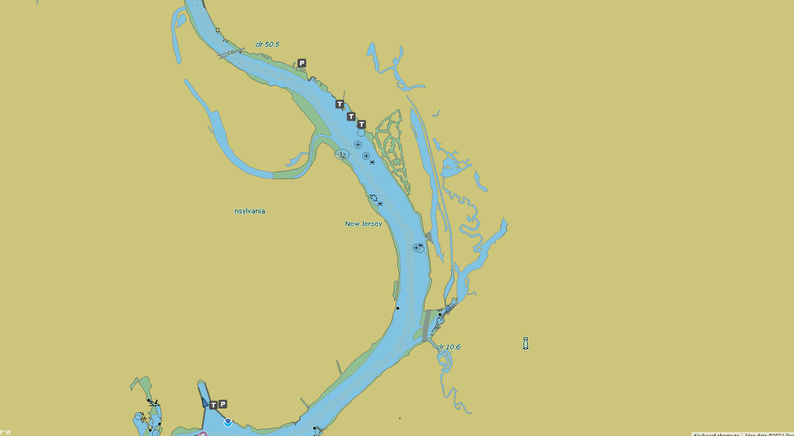
Old Shipyard
Bellweather District Mixed Used Warehousing
Kinder
Morgan

Slide 40
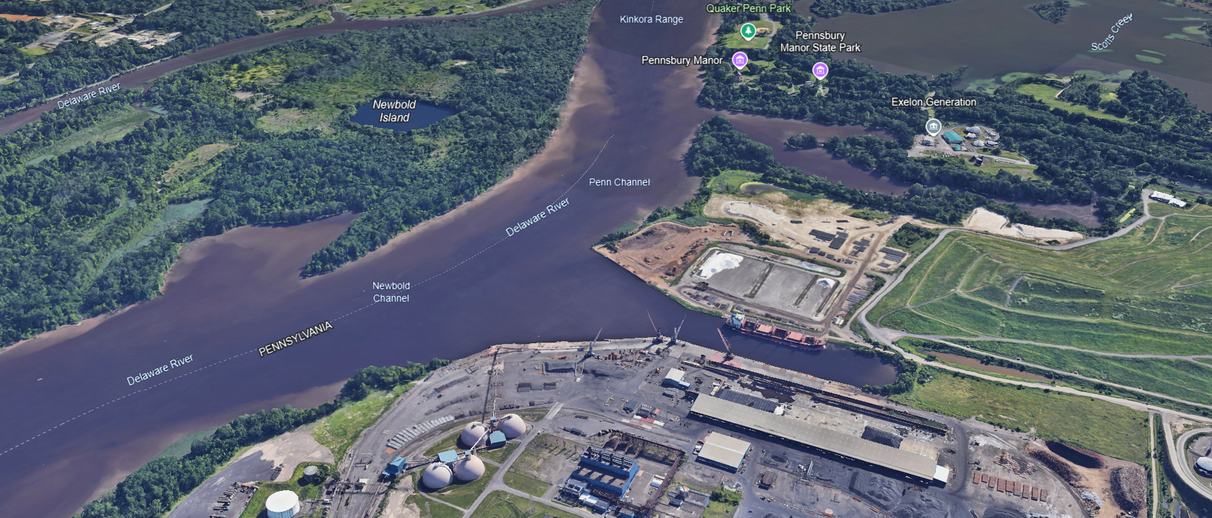
?
?
?

Slide 41
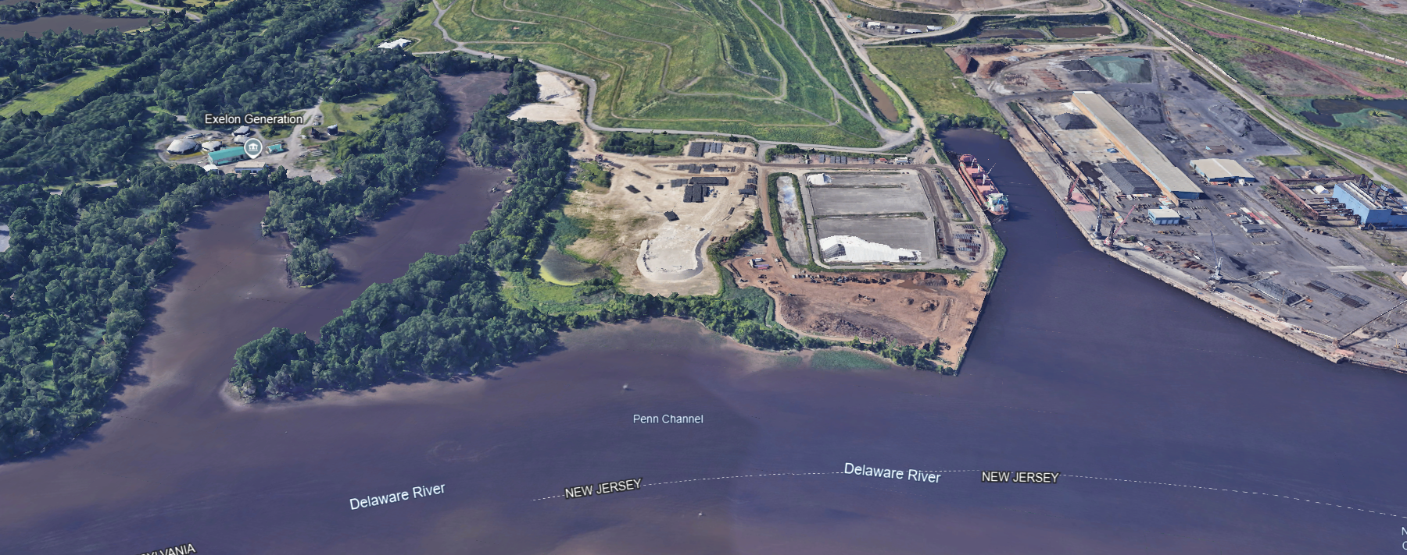
?
?
?

Slide 42
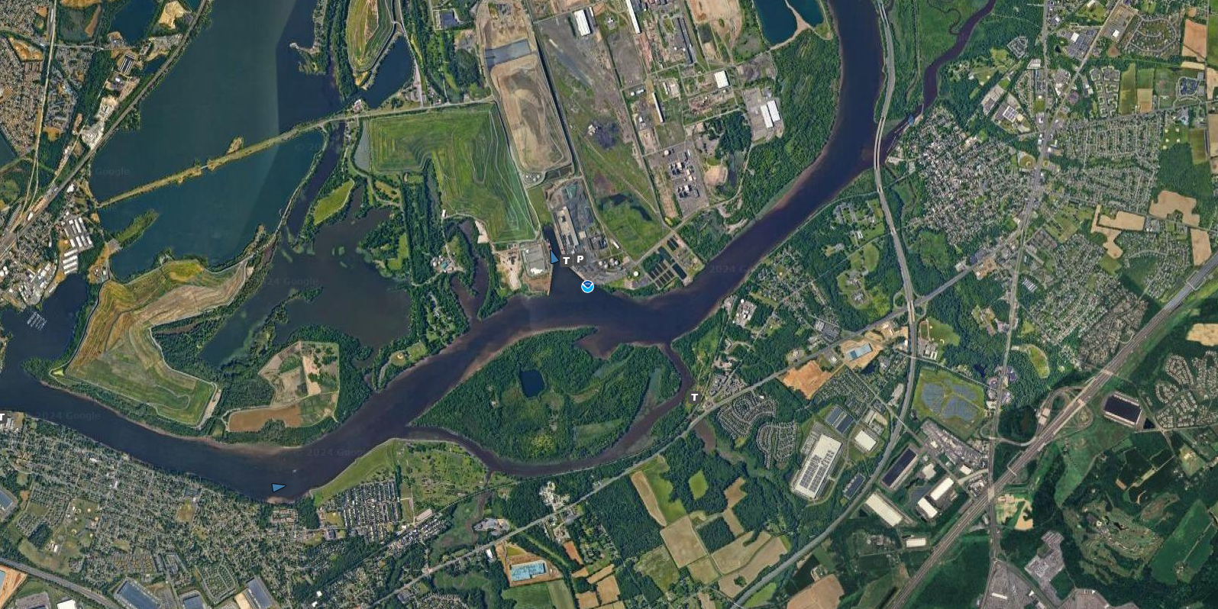
Kinder Morgan
?
?

Slide 43
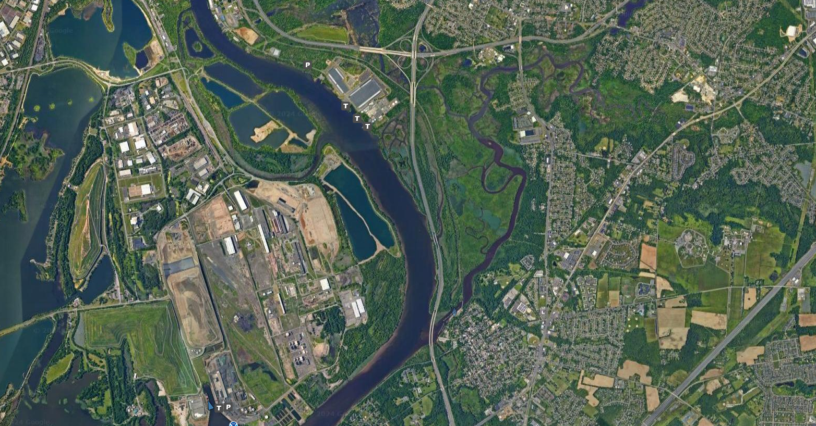
Old Shipyard
Bellweather District Mixed Used Warehousing
?
Kinder
Morgan

Slide 44
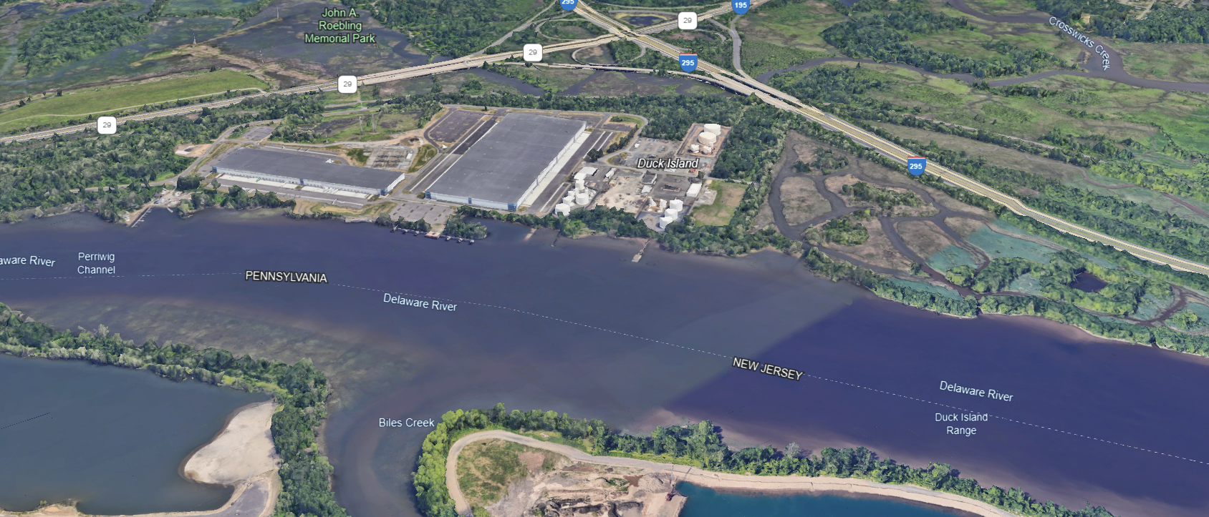
?
?
?

Slide 45
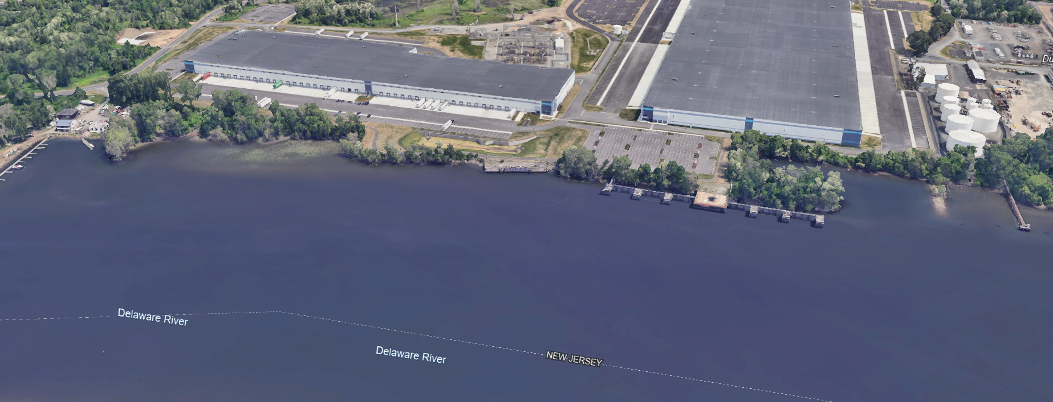
?
?
?
?

Slide 46
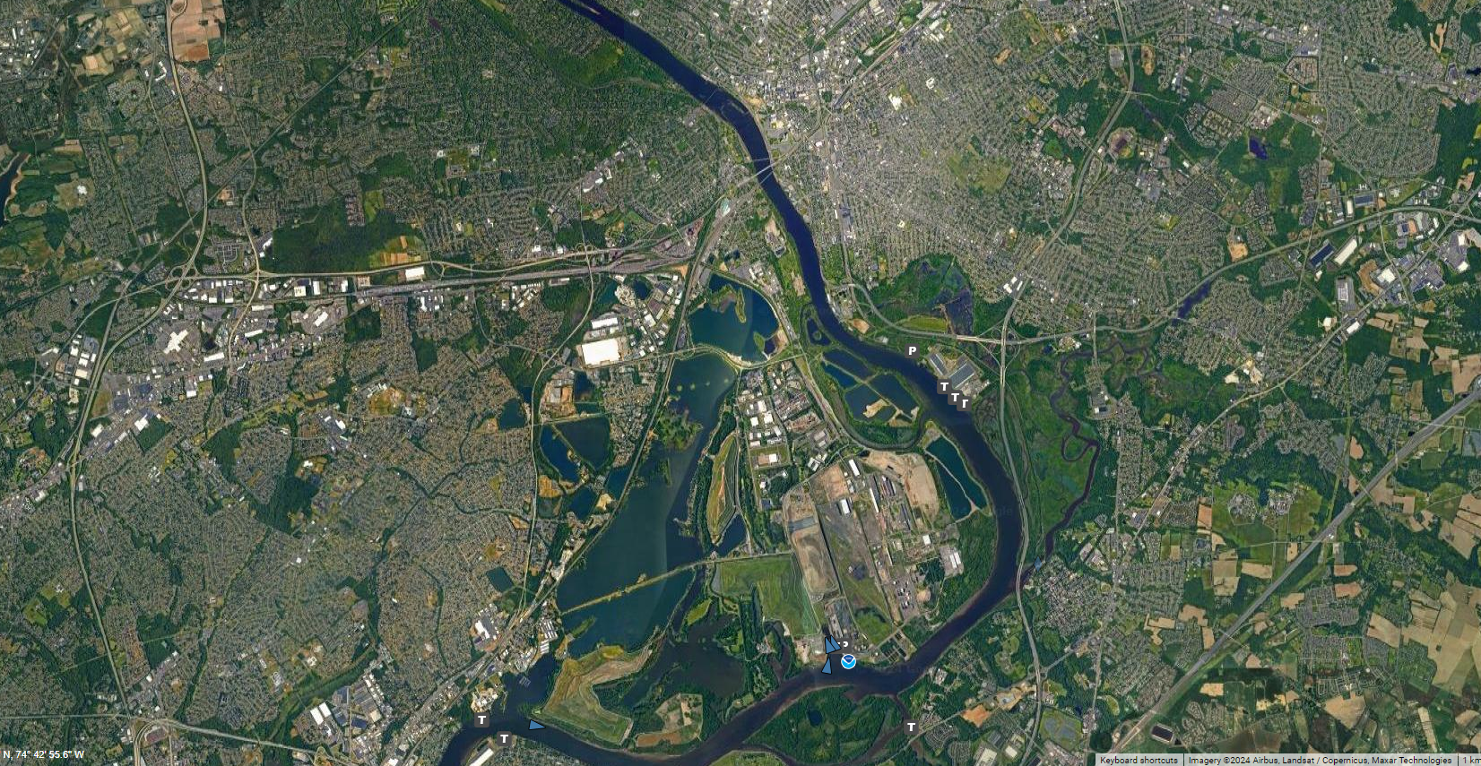
Trenton Falls
Proximal Terminus
Delaware River Microgrid Network
Trenton Bellwether
Kinder Morgan

Slide 47

Trenton Falls 001
Proximal Terminus Delaware River Microgrid Network

Slide 48

Trenton Falls 002
Proximal Terminus Delaware River Microgrid Network

Slide 49

Proximal Terminus Delaware River Microgrid Network
Trenton Falls 003
End Users
End Users

Slide 50


Trenton Falls 004
Proximal Terminus
Delaware River Microgrid Network
End Users
End Users
End Users

Slide 51





Slide 52
Possible Site Locations By Official Federal Navigation Channel Delaware River Miles

Slide 53


Mid-Atlantic Marine Highway
Delaware River Federal Navigation Channel
Mile 0.00 to Mile 28.00
Dover AFB Mile 24.00
Big Stone Mile 8.00
Distal Terminus
Delaware Bay Breakwater Mile 0.00

Slide 54

Port of Salem Mile 59.00
Mid-Atlantic Marine Highway
Delaware River Federal Navigation Channel
Mile 28.00 to Mile 60.00

Slide 55

Mid-Atlantic Marine Highway
Delaware River Federal Navigation Channel
Mile 60.00 to Mile 105.00
Port of Philadelphia
Miles 93 -105
Port of Paulsboro Mile 88.00
Port of Wilmington Mile 73.00
Deepwater Mile 73.00
Commodore Barry Bridge Mile 82.00

Slide 56

Torresdale Tide Gate Mile 109.00
Rancocas Creek Mile 110.00
Tioga Mile 103.00
Port of Philadelphia
Miles 93 -105
Mid-Atlantic Marine Highway
Delaware River Federal Navigation Channel
Port of Philadelphia Miles 93-105
Pier 2/3
Port of Paulsboro Mile 88.00

Slide 57


Proximal Terminus
Trenton Falls Mile 135.00
Trenton Yard Mile 131.00
Fairless Mile 122.00
Mid-Atlantic Marine Highway
Delaware River Federal Navigation Channel
Mile 100.00 Mile to 134.00
Torresdale Tidal Gate Mile 109.00
Tioga Mile 103.00
Rancocas Creek Mile 110.00

