Slide 1
Rancocas Pathways
“Tatras”
Blocks 85 Lots 37 Lot 38
31/35 Church Street
Mount Holly, New Jersey
Rancocas Pathways, a 501c3 organization

Slide 2
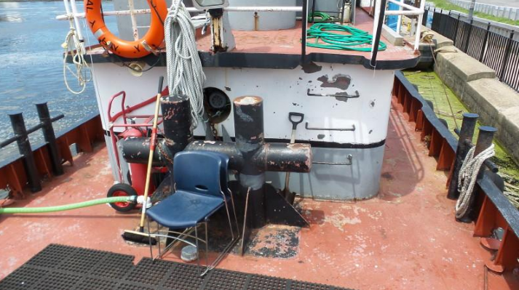
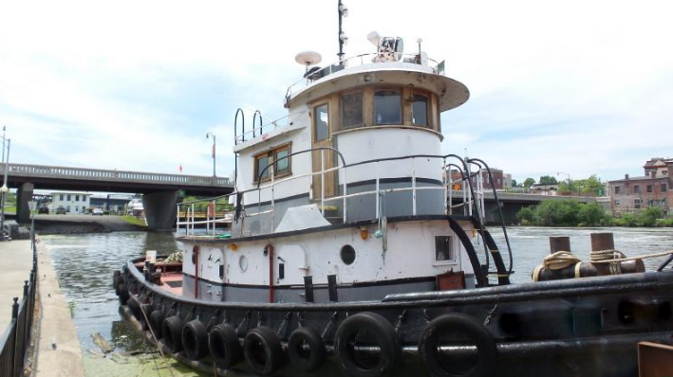
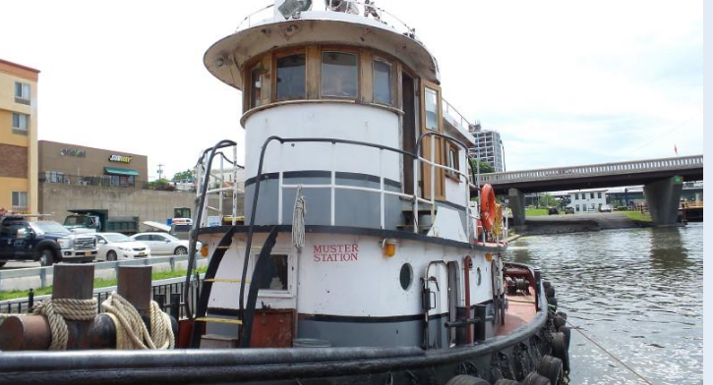
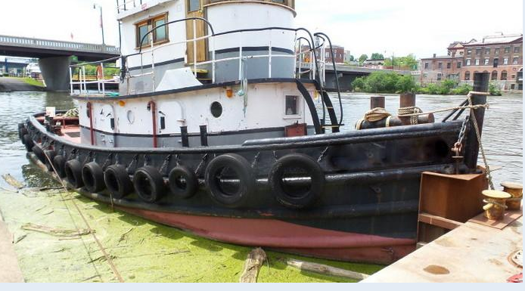
18 x 6 = 108 inches 72 high for 1st deck
108 inches 2nd deck (9 feet)
Units for design of “Tatras”

Slide 4
Mill Race
Key for Dimensions
Limit of Lot Use
Riparian Buffer 12 feet
Limit of Lot Use
Outdoor
Seating
Quite Helm Pod
Lot 37
Lot 38
40 feet
52 feet
Galley
Outside Deck
North
Unless otherwise noted
each grid square represents
8 feet by 8 feet
Sidewalk
30 feet
Sidewalk
Church Street

Slide 5
Mill Race
Key for Dimensions
Limit of Lot Use
12 feet
Mill Race Bank
Limit of Lot Use
Lot 37
Lot 38
Outdoor
Seating
Quite Helm Pod
8 x 10
40 feet
32 feet
Galley
Outside Deck
North
8 x 20
16 feet
Sidewalk
30 feet
Sidewalk
Church Street

Slide 6
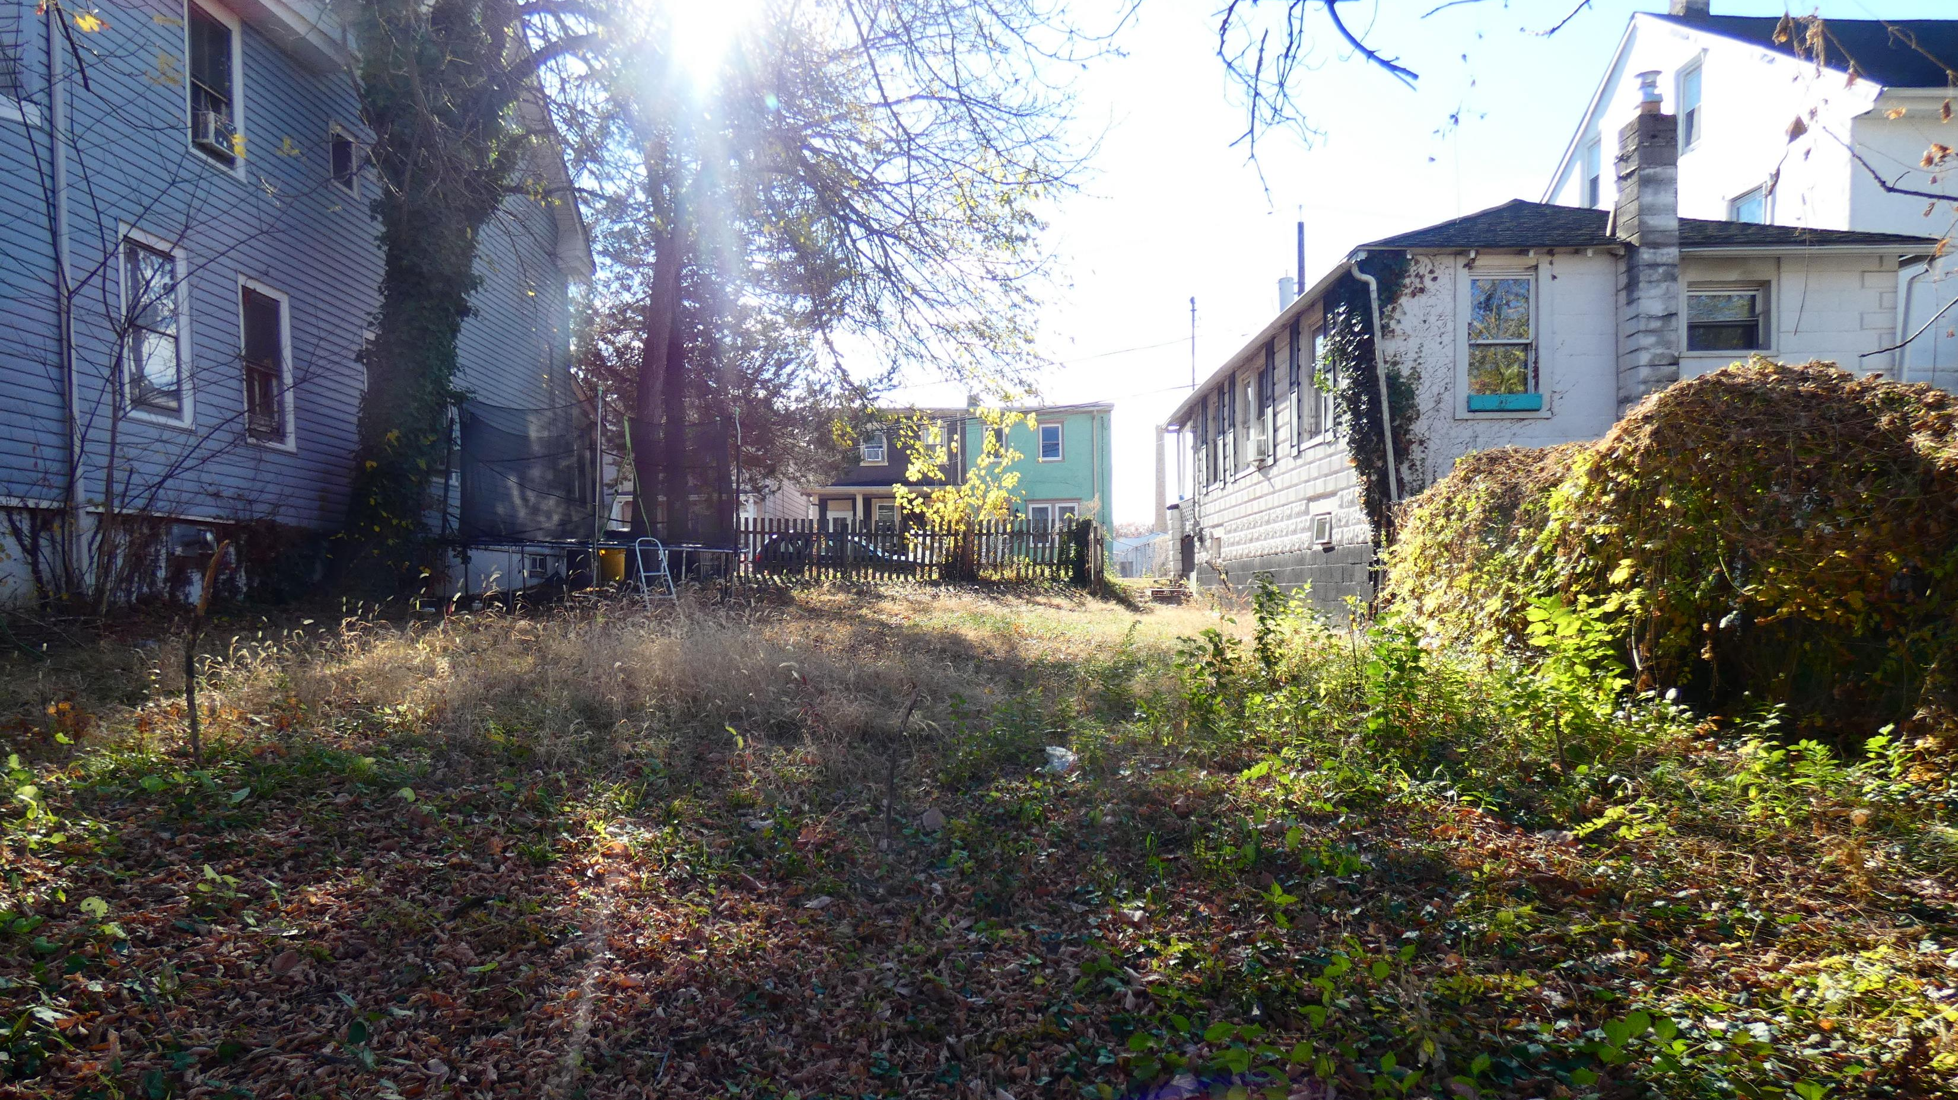
Looking South Towards Church Street
16 feet
28 feet

Slide 7
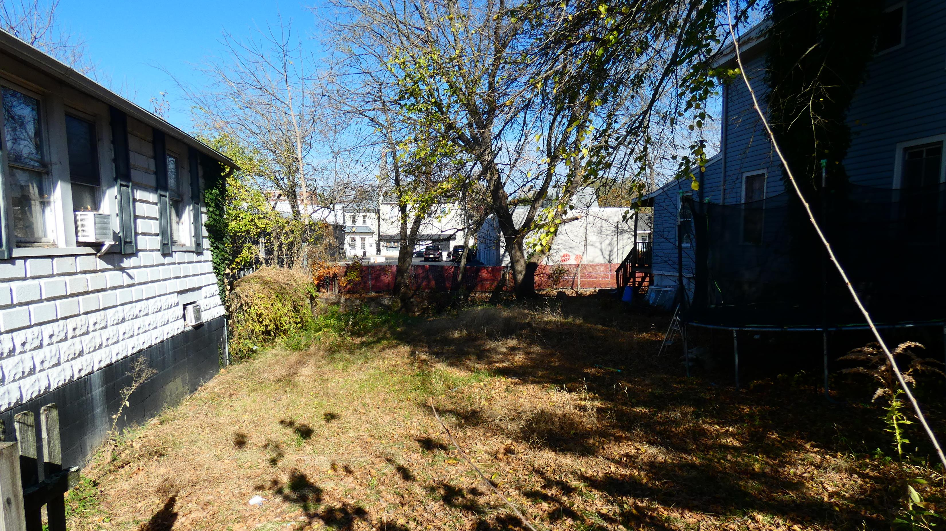
Looking North Towards the Mill Race
16 feet
28 feet

Slide 8
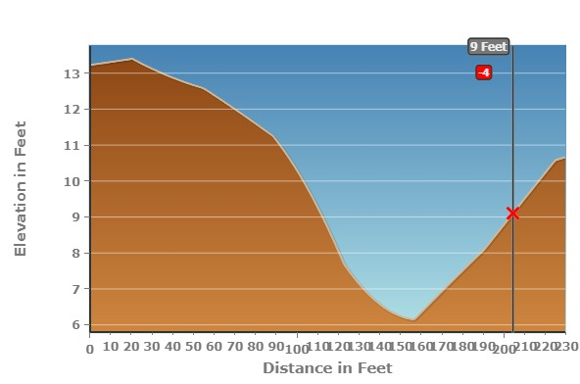
53 feet
40 feet
Limit of Lot use
10 feet above sea level
Church Street Sidewalk
14 feet above sea level
Riparian Buffer
9 feet above sea level
Mill Race

Slide 9
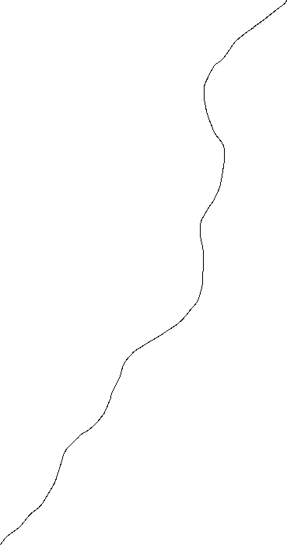
Mill Race
6 Feet Above Sea Level
Limit of Lot Use
12 feet
Limit of Lot Use
13 Feet
Above Sea Level
Lot 37
Lot 38
11 Feet
Above Sea Level
Site
Elevations
Outdoor
Seating
Slope
Quite Helm Pod
32 feet
14 feet
Galley
11 feet
13 Feet
Above Sea Level
12 Feet
Above Sea Level
Outside Deck
North
Church Street
Sidewalk
14 Feet Above Sea Level
Sidewalk

Slide 10
Mill Race
6
12 feet
Landscape
Plan
RURP Unit Pads
Natural and Grading
Limit of Lot Use
13
Limit of Lot Use
11
H
Lot 38
Lot 37
D.
Note:
Phase One
Trailer parking beds initally will be existing hard packed ground and gravel
Phase Two
poured and leveled
concrete pads
Outdoor
Seating
C.
11
Quite Helm Pod
G
G
Galley
12
13
A. Clean Fill (CF) where noted
B.
Outside Deck
North
B. Graded (G) where noted
CF
C. Graded (G) where noted
13
A.
D. Graded level (H) where noted
Trailer/Skid/Tow/Hitch Point
Sidewalk
14 Feet Above Sea Level
Sidewalk
Feet above sea level
Church Street
6

Slide 11
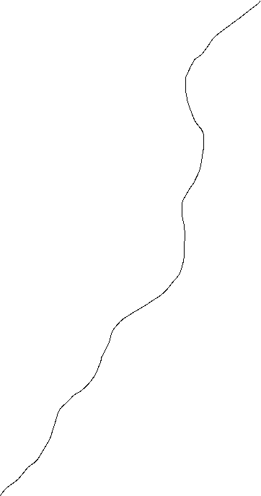
Mill Race
6
Tugboat Units Pads
Natural and Grading
Limit of Lot Use
12 feet
13
Limit of Lot Use
Note: Phase One
Unit Pads initially will be existing hard packed ground and gravel with standard industry best management practices
Phase Two
poured and leveled
concrete pads
Lot 37
Lot 38
Outdoor
Seating
A.
H.
North
A. Clean Fill (CF) where noted
Quite Helm Pod
B. Graded (G) where noted
Galley
C. Gravel level (H) where noted
D. Graded other
Outside Deck
H.
A.
Trailer/Skid/Tow/Hitch Point
Sidewalk
14 Feet Above Sea Level
Sidewalk
6
Feet above sea level
Church Street

Slide 12
Mill Race
Limit of Lot Use
Riparian Buffer 12 feet
Limit of Lot Use
Lot 37
D.
Lot 38
Outdoor
Seating
Tatra’s
RURP
Unit
Pads
North
C.
32 feet
Galley
40 feet
B.
Outside Deck
Galley
Note: Unit Pads:
Grass
Gravel beds
Standard Industry Practice
Concrete
A.
Gated Entry
28 feet
Church Street

Slide 13
Mill Race
RURP Unit Pads Dimensions
Limit of Lot Use
12 feet
Mill Race Bank
Limit of Lot Use
Lot 37
6 x 20
Lot 38
Outdoor
Seating
Note: Unit Pads:
Grass
Gravel beds
Standard Industry Practice
Concrete
8 x 20
Trailer/Skid/ Tow/Hitch
Quite Helm Pod
40 feet
Galley
8 x 20
Outside Deck
North
8 x 20
8 x 20
Sidewalk
28 feet
Sidewalk
Church Street

Slide 14
Unless otherwise noted each grid square
4 feet by 4 feet
Riparian
Buffer
12 feet
32 feet
Church St
Gated
Access
8 feet
8 feet
8 feet
6 feet
8 feet
Goat Locker
Helm
Church St
Roadway
Manning
Prop
11 feet
Unit
Pads
Unit
Pads
Unit
Pads
Unit
Pads
3 feet
Mill
Race
RURP Lot Gradient

Slide 15
Mill Race
Limit of Lot Use
Riparian Buffer 12 feet
Limit of Lot Use
Lot 37
Lot 38
Tatra’s
Tugboat
Units
Pads
Outdoor
Seating
c.
8 x10
B.
8 x 20
North
32 feet
Galley
40 feet
D.
8 x 20
A.
8 x 10
Outside Deck
Galley
Note: Unit Pads:
Grass
Gravel beds
Standard Industry Practice
Concrete
6 x 20
Gated Entry
28 feet
Church Street

Slide 16
Mill Race
6
Limit of Lot Use
12 feet
13
Limit of Lot Use
Note: Phase One
Unit Pads initially will be existing hard packed ground and gravel with standard industry best management practices
Phase Two
poured and leveled
concrete pads
Lot 37
Lot 38
C.
8x10
Outdoor
Seating
B.
8 x 20
North
Quite Helm Pod
Tugboat Units Pads
Dimensions
Galley
Outside Deck
D.
8 x 20
A.
8 x 10
Trailer/Skid/Tow/Hitch Point
Sidewalk
14 Feet Above Sea Level
Sidewalk
6
Feet above sea level
Church Street

Slide 17
Unless otherwise noted each grid square
4 feet by 4 feet
Riparian
Buffer
12 feet
36 feet
Church St
Gated
Access
6 feet
10 feet
20 feet
8 feet
Church St
Roadway
10 feet
Unit
Pads
Unit
Pads
Unit
Pads
3 feet
Mill
Race
Vertical Lot Gradient

Slide 18
D.
RURP Unit Pads
Alternative One: Details
C.
B.
A.

Slide 19
Mill Race
6
12 feet
Landscape
Plan
RURP Unit Pads
Natural and Grading
Limit of Lot Use
13
Limit of Lot Use
11
H
Lot 38
Lot 37
D.
Note:
Phase One
Trailer parking beds initally will be existing hard packed ground and gravel
Phase Two
poured and leveled
concrete pads
Outdoor
Seating
C.
11
Quite Helm Pod
G
G
Galley
12
13
A. Clean Fill (CF) where noted
B.
Outside Deck
North
B. Graded (G) where noted
CF
C. Graded (G) where noted
13
A.
D. Graded level (H) where noted
Trailer/Skid/Tow/Hitch Point
Sidewalk
14 Feet Above Sea Level
Sidewalk
Feet above sea level
Church Street
6

Slide 20
RURP Pad Details: Unit A
20 feet
8 feet
Sliding Door

Slide 21
RURP Pad Details: Unit B
20 feet
Cur
t
a
I
n
sink
2.5 x 3
2.5 x 3
Washer dryer ultlity
Cleavis
multrum
Tiled
shower
4 x 4
Door
8 feet
Sliding Door

Slide 22
RURP Pad Details: Unit C
20 feet
8 feet
Workbench
3 x 8
Sliding Door

Slide 23
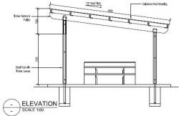
RURP Pad Details: Unit D
20 feet
Zen
6 feet
Wooden Shutters & Sliding Door
Mill Race

Slide 24
Tugboat Unit Pads
Alternative Two: Details
C.
8 x 10
B.
8 x 20
D.
8 x 20
A.
8 x 10

Slide 25
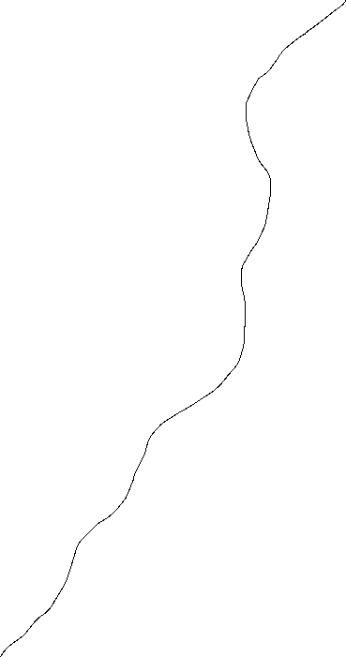
Mill Race
6
Tugboat Units
Limit of Lot Use
12 feet
13
Limit of Lot Use
Note: Phase One
Unoy beds initally will be existing hard packed ground and gravel with standard industry best management practices
Phase Two
poured and leveled
concrete pads
Lot 37
Lot 38
Outdoor
Seating
8 x 14
A.
H.
Quite Helm Pod
Galley
North
8 x 20
Outside Deck
H.
A.
Trailer/Skid/Tow/Hitch Point
Sidewalk
14 Feet Above Sea Level
Sidewalk
6
Feet above sea level
Church Street

Slide 26
Tugboat Units Pads. Section A.
8 feet
C.
8 x 10
B.
8 x 20
D.
8 x 20
10 feet
A.
8 x 10
Door

Slide 27
Tugboat Unit B. Forward with portholes and windows
2 x 4
closet
Quiet Area Bed
4 x 6
C.
8 x 10
4 foot high privacy shelving
B.
8 x 20
8 x 10
Glass Door
D.
8 x 20
Open
Hatch
A.
8 x 10
4 x 4
4 x 4
Counter
4 foot high
Solarium
Workshop
deck window

Slide 28
Tugboat Unit B. Starboard Side
20 feet
10 feet
10 feet
Solar Deck
Solar Deck
Unit A.
Port Holes
Port Holes
8 feet
9 feet
2 Feet
Unit Pad
Unit Pad
2 Feet
1 feet

Slide 29
Tugboat Unit B. Port Side
20 feet
10 feet
10 feet
Solar Deck
Solar Deck
deck window
Unit A.
Port Holes
8 feet
10 feet
Pad
Deck
2 Feet
Unit Pad
Unit Pad
2 Feet
2 feet

Slide 30
Tugboat Unit B. Aft with portholes and windows
2.5 x 3
2.5 x 3
Washer dryer ultlity
sink
Tiled
shower
Helm
4 x 4
Cleavis
multrum
Hatch Door
Locked
Hatch
8 x 10
shelving
5 x 4
Open
Hatch
Counter
4 foot high
Library
5 x 4
deck window

Slide 31

Tugboat Units Pads. Section C.
8 feet
Window
Window
C.
8 x 10
B.
8 x 20
Propane
2 burner and grill stove
D.
8 x 20
10 feet
A.
8 x 10
Door

Slide 32
Tugboat Unit D. Starboard Side
20 feet
10 feet
10 feet
Solar Deck
Solar Deck
deck window
Port Holes
8 feet
10 feet
Pad
Deck
2 Feet
Unit Pad
Unit Pad
2 Feet
2 feet

Slide 33
Tugboat Unit D. Aft with portholes and windows
3 X 5
4 x 4
C.
8 x 10
B.
8 x 20
Locked
Hatch
8 x 10
shelving
D.
8 x 20
A.
8 x 10
5 x 4
Open
Hatch
Counter
4 foot high
5 x 4
deck window

Slide 34
Tugboat Unit A. Forward
Meditation Unit
4 x 6
4 foot high privacy shelving
8 x 10
Window
Open
Hatch
4 x 4
4 x 4
Counter
4 foot high
Solarium
Workshop
deck window

Slide 35
Solar Deck
RURP & Tugboat Units Pads
Stern View
Facing Church Street
Pads A and D.
10 feet
9 feet
8 feet
Port Hole
Window
Port Hole
Window
1 feet

Slide 36
Solar Deck
Helm
8 feet
Bow View
12 feet
Sliding Door
Sliding Door
1 foot
4 feet
Trailer Deck Height
8 feet
12 feet

