Slide 1
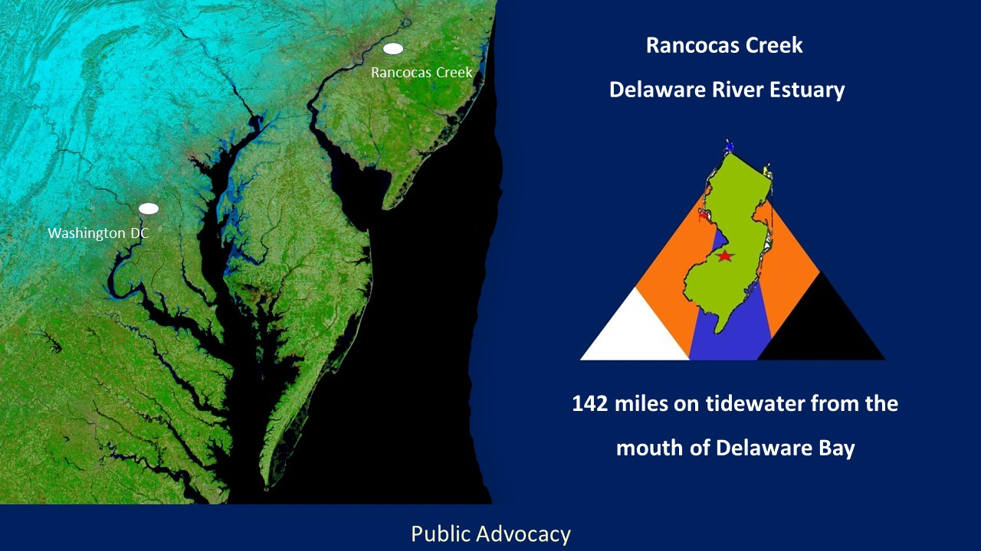
Delaware River
Ports
Rancocas Creek
Pinelands National Reserve
Port of Baltimore
148 Nautical miles on tidewater from Delaware Bay Twin Capes

Slide 2
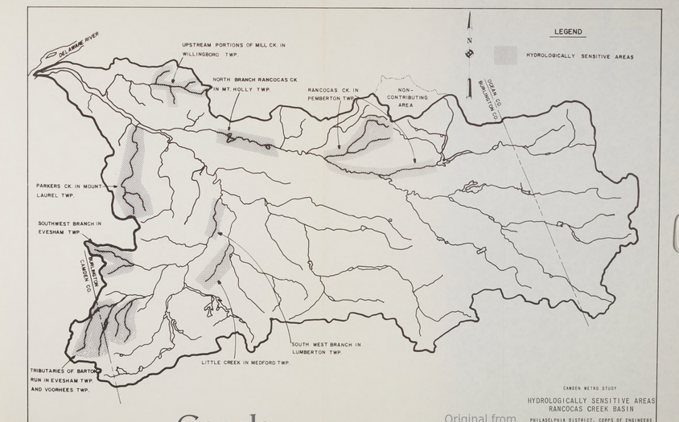

Slide 3
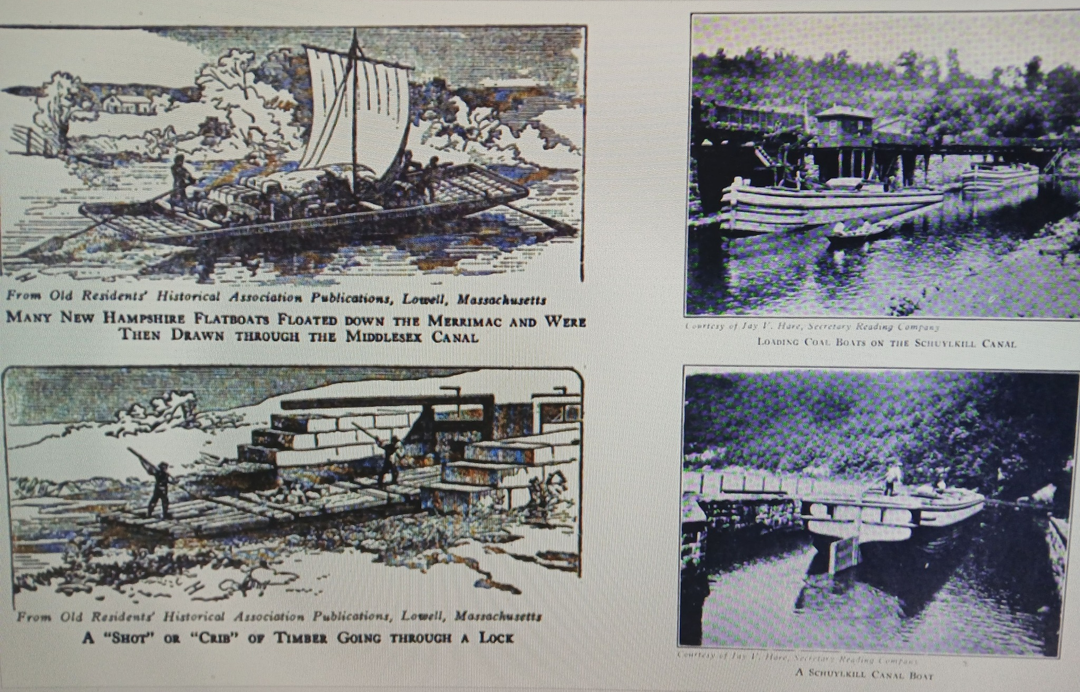
Water
Transportation

Slide 4
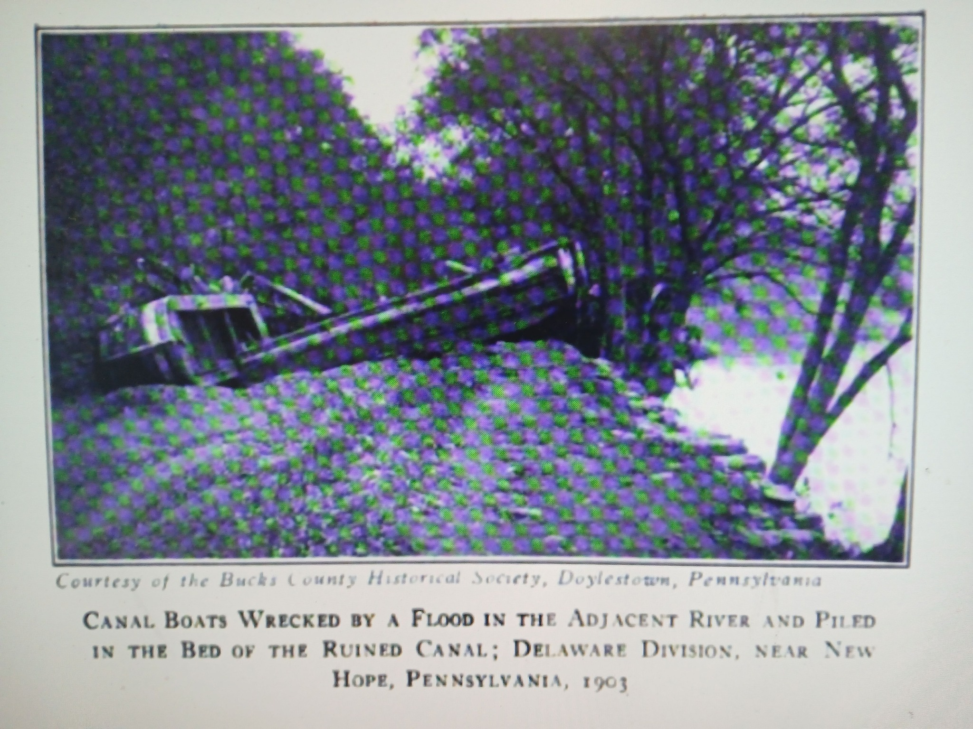
Damaged Canal Boat

Slide 5
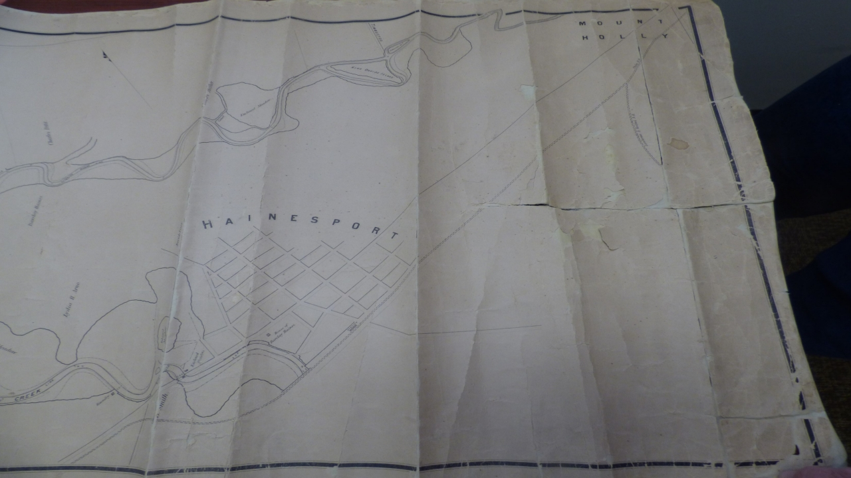
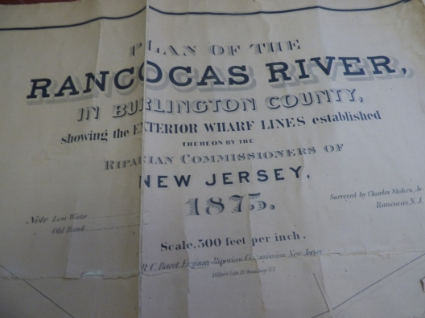
Sand Mines
Sand Mines
Sand Mines
Sand Mines
Sand Mines

Slide 6
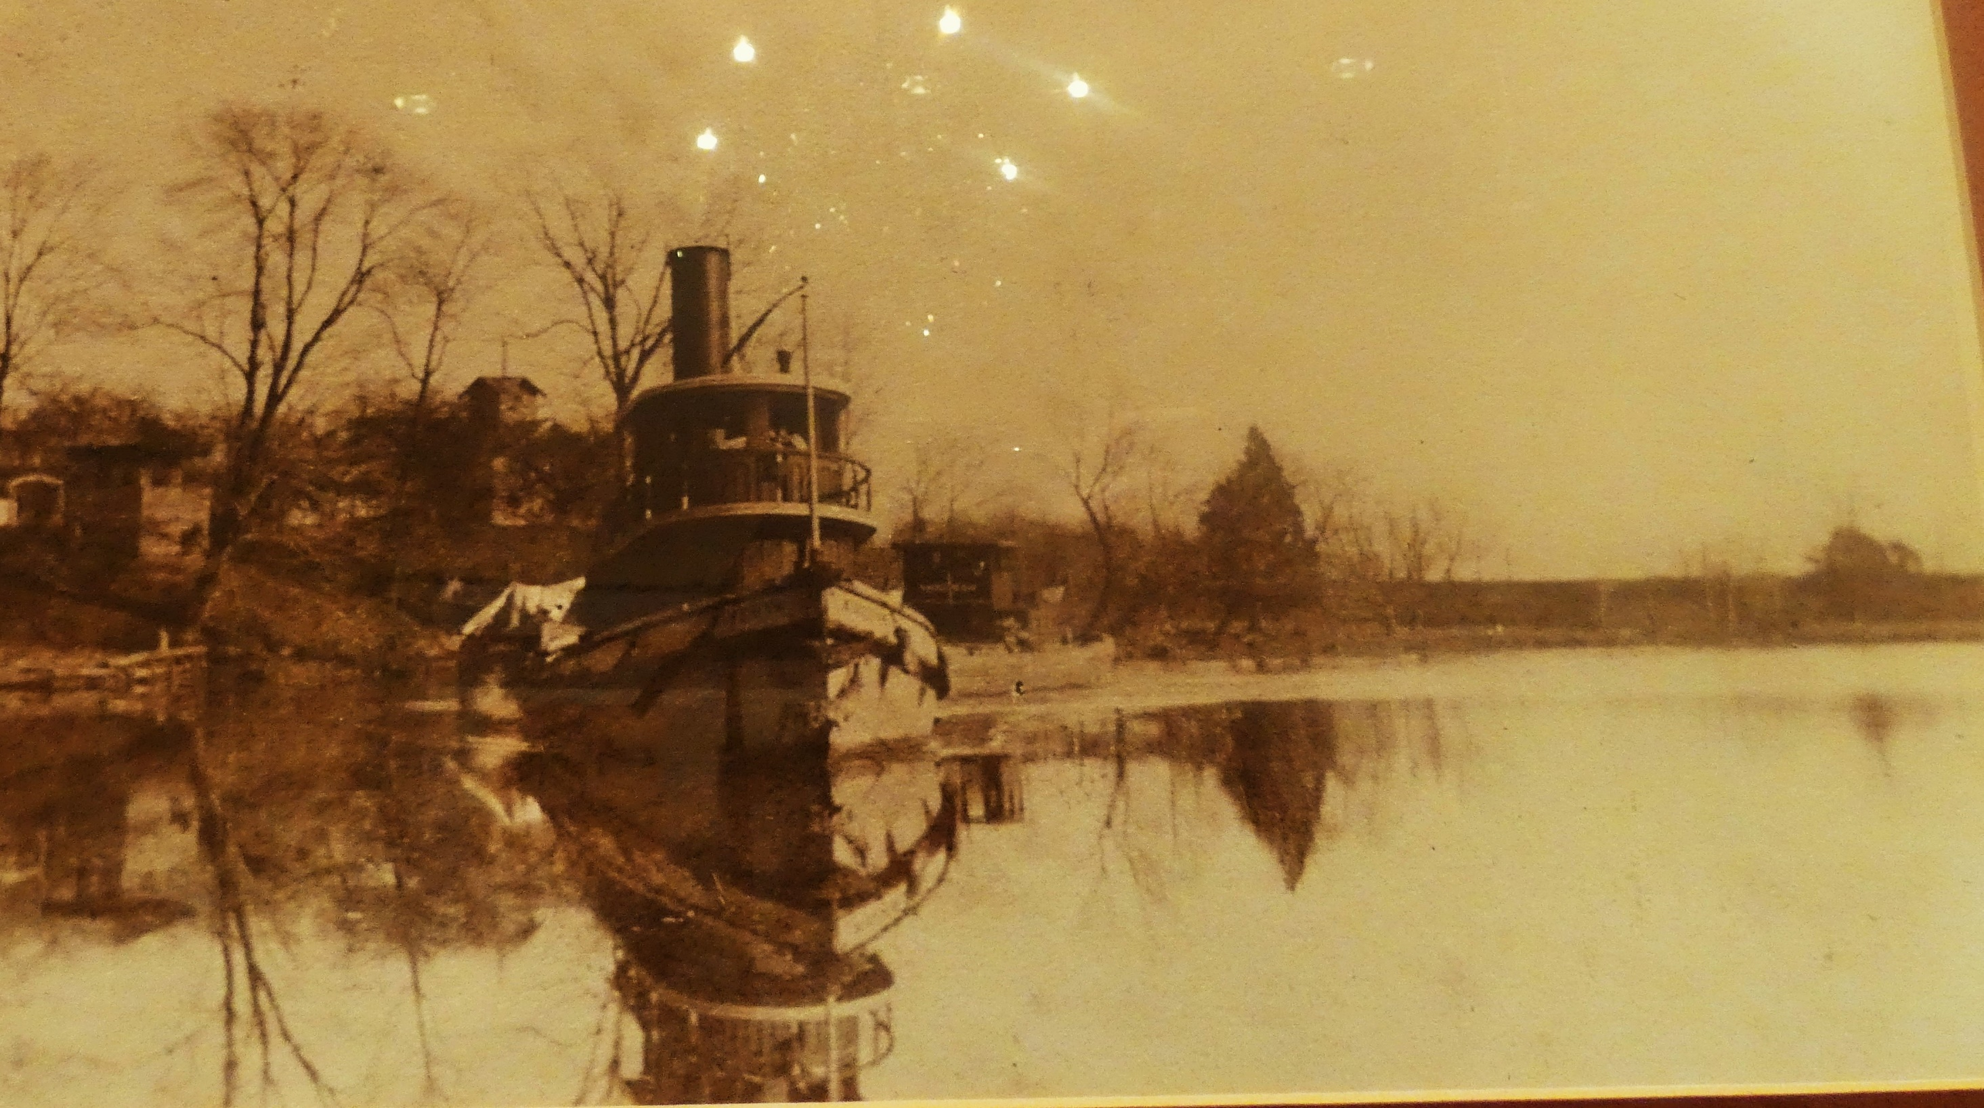


Hainesport South Branch Rancocas
House of Barclay Haines
Burlington County Lyceum of Science and Natural History

Slide 7
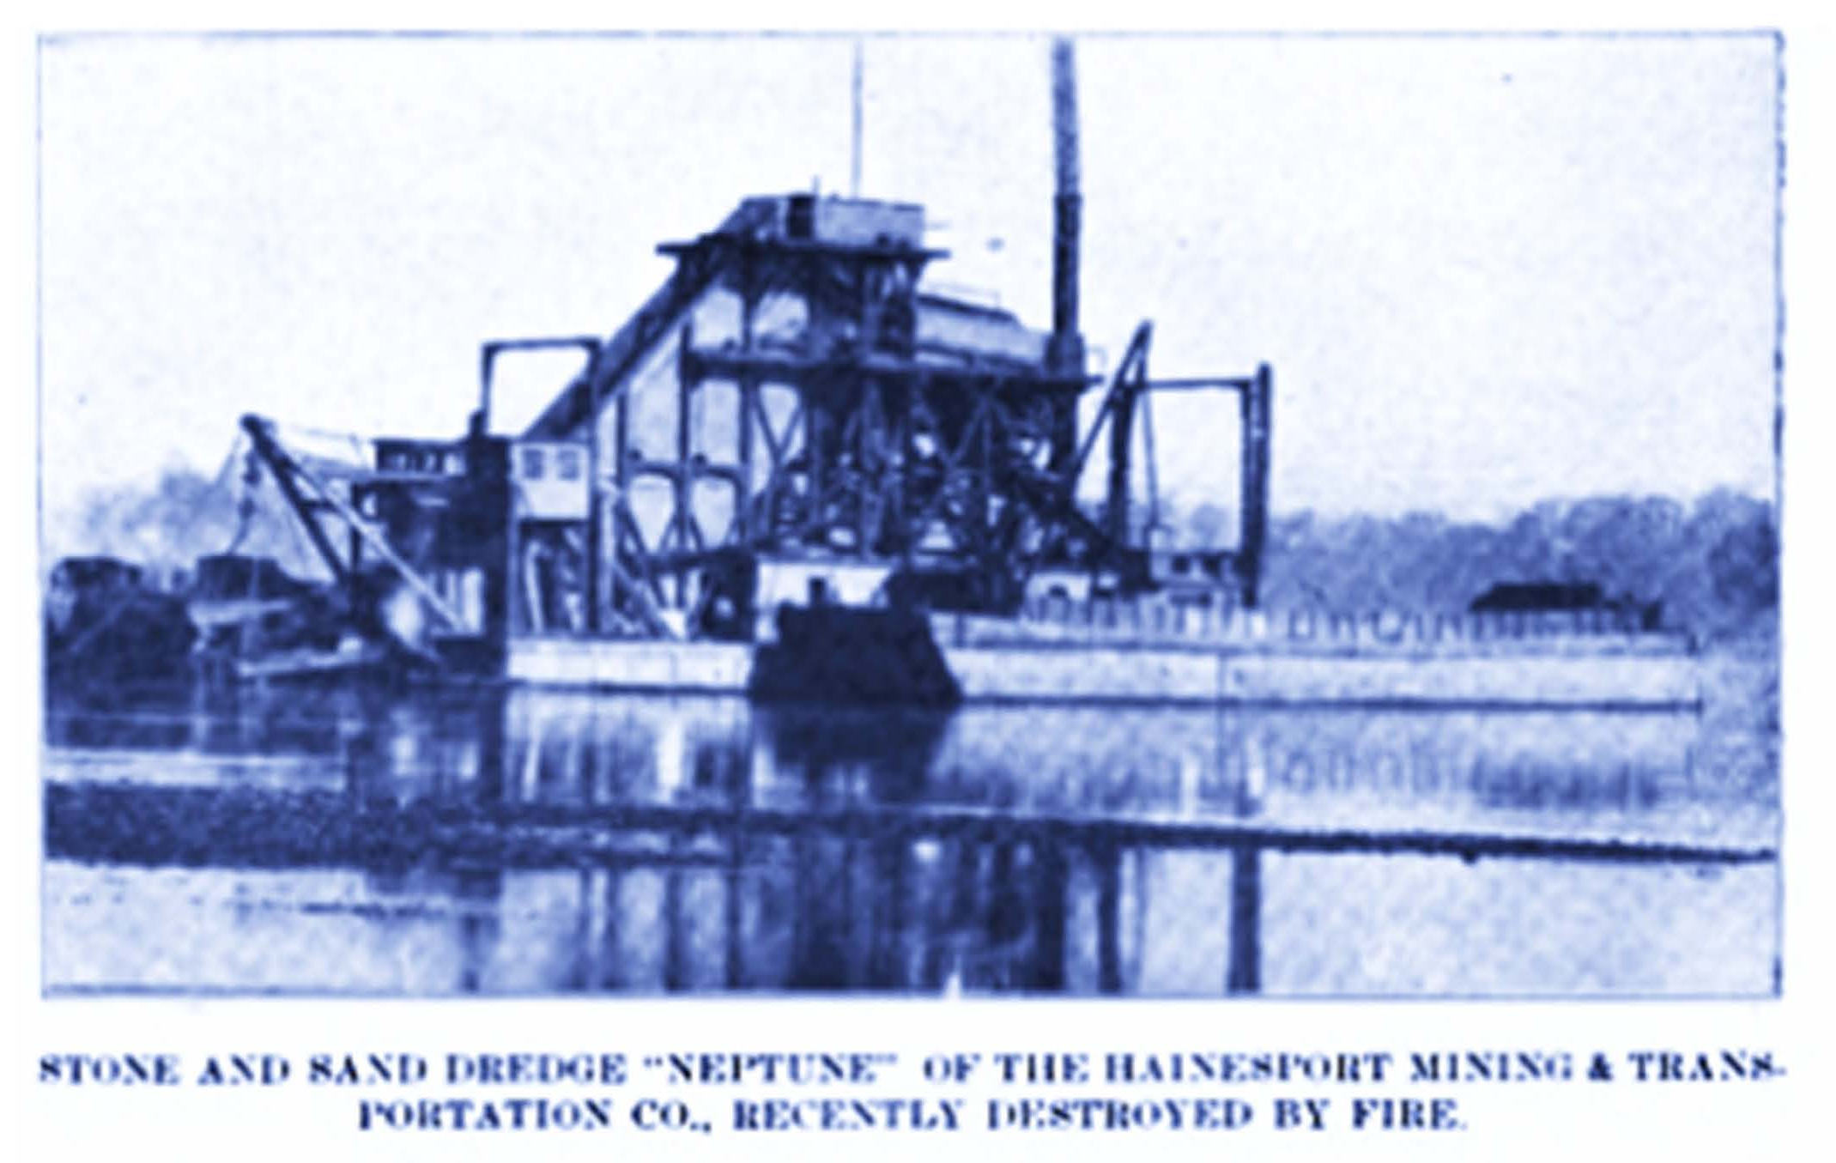
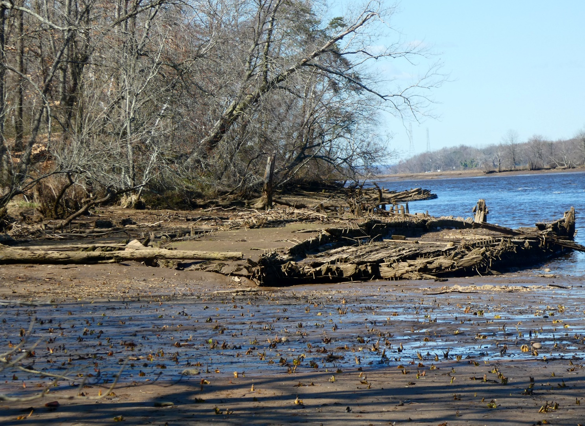
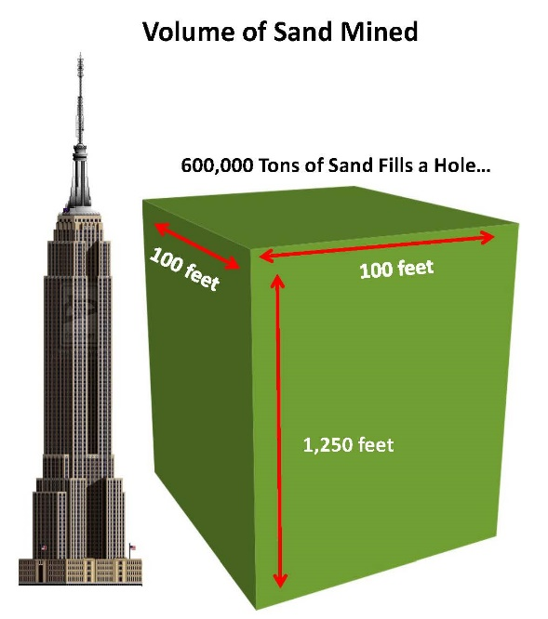

Slide 8
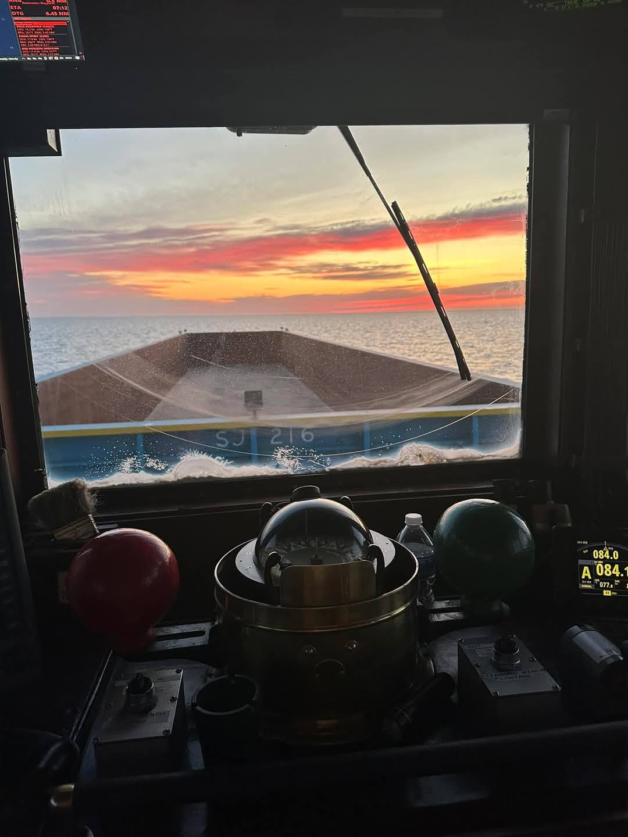
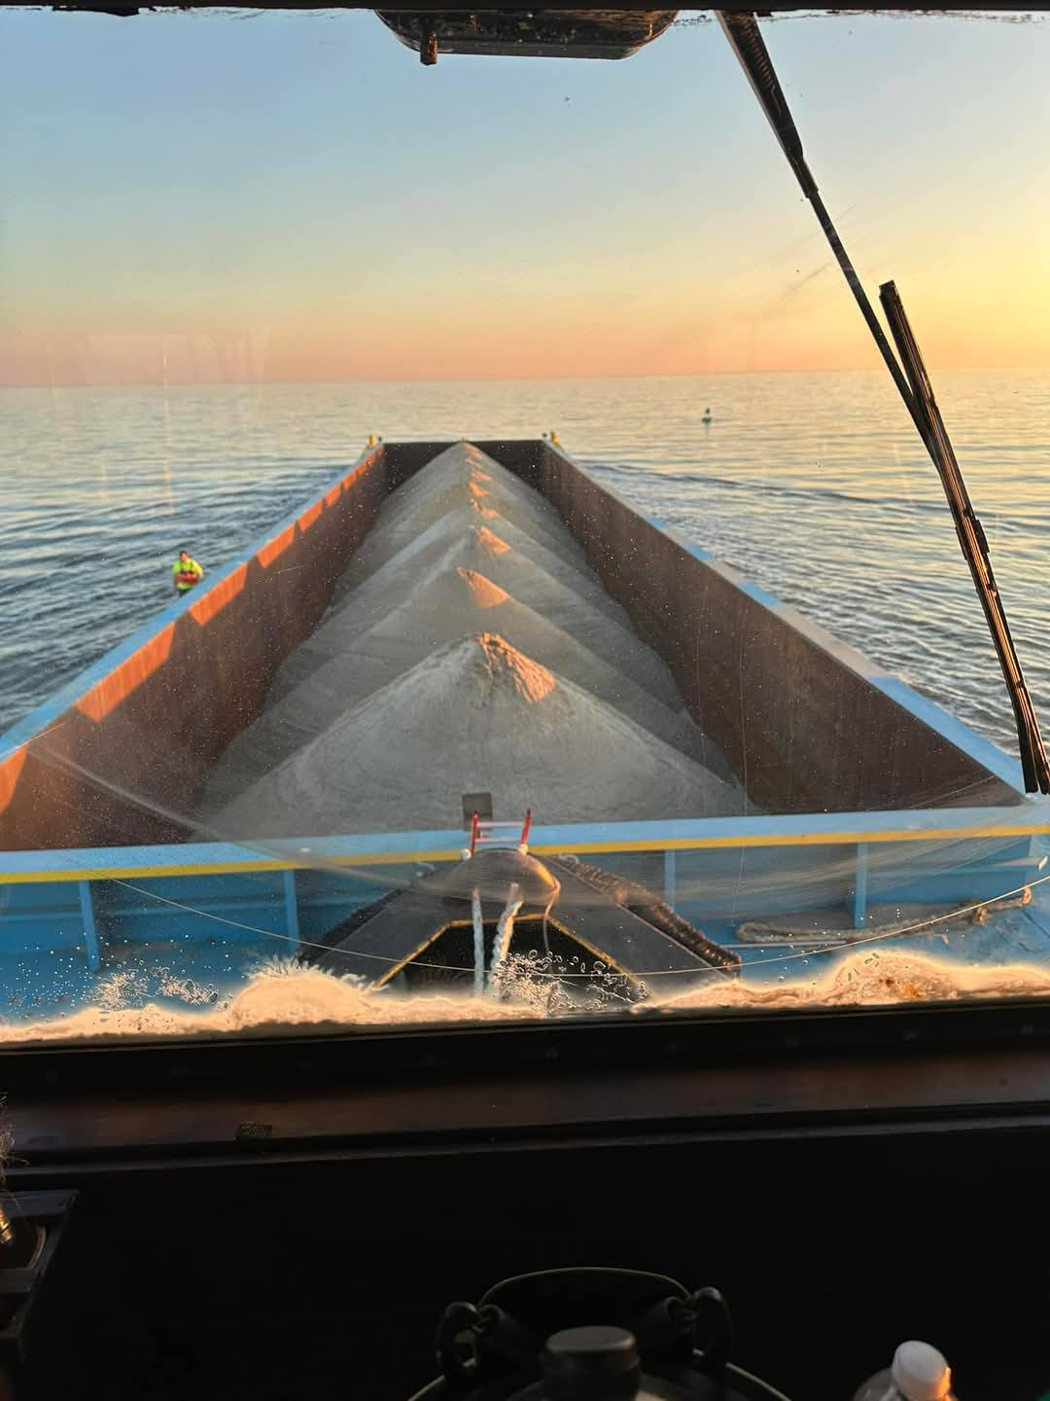
Sand Barge
Port
Elizabeth
Maurice River
New Jersey
Inbound
Out-bound

Slide 9
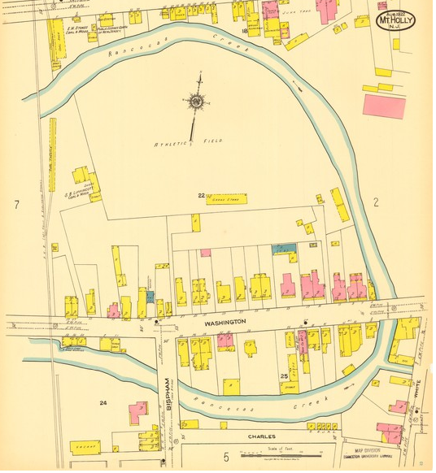
Ref: WS Rendell-Chairman of Mt. Holly Committee on Rancocas Creek Improvements
Sec of War Rancocas Creek Report , New Jersey

Slide 10
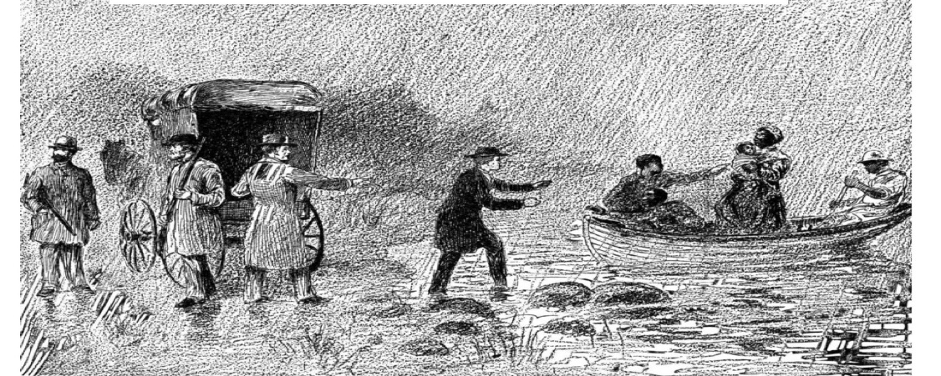
Fabric of the Rancocas Creek
Shark’s Meadow
Here You Are Safe
Lancaster County - Harpers Weekly
1849

Slide 11
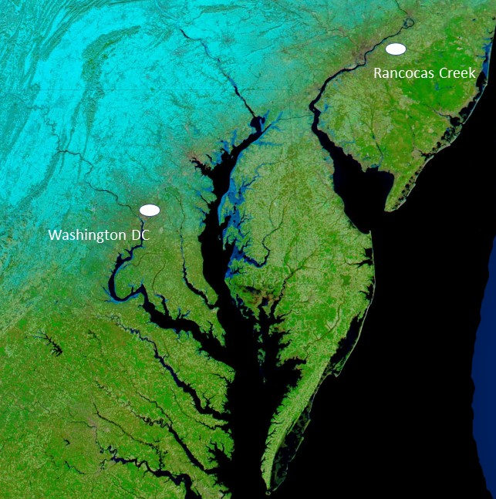
Black Jacks (sailors/watermen) when passing Baltimore, a city known for its spice factories, might say, "When you smell strong spices fill the air, then you will get off the ship after two sunsets.
Leesa Jones, Director of the Washington Waterfront Underground Railroad Museeum. Her contact information is a (609)---x----
Secret Codes of the Underground Railroad
Port of Philadelphia
Port of Baltimore

Slide 12

There are too many 'eyes' watching today. Stay in hiding
"A code could be something as benign as a woman standing on the dock holding sunflowers,"
"If she aimed the big brown 'eye' in the center of the flower towards the swamp, it might mean, 'There are too many 'eyes' watching today. Stay in hiding.’”
Leesa Jones, Director of the Washington Waterfront Underground Railroad Museum.
One could have a very unique bit of history peeled back to discuss

Slide 13
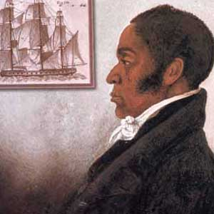
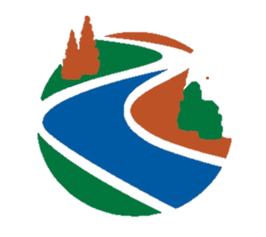
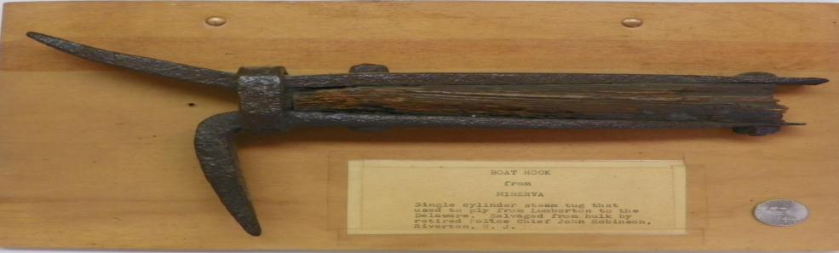
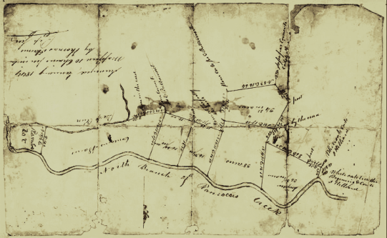
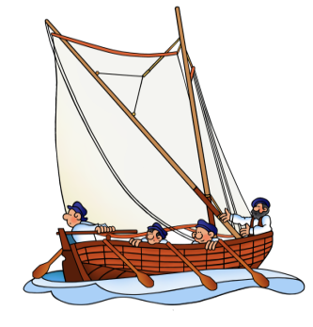
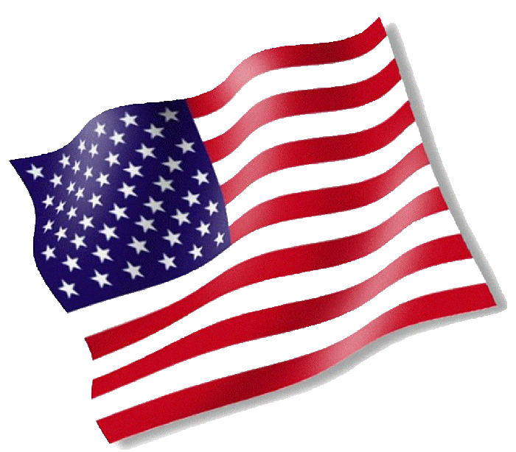
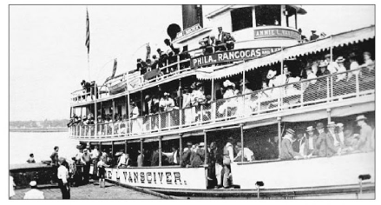
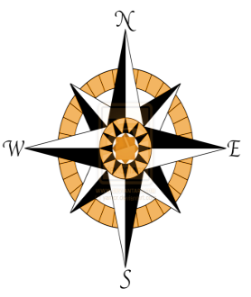
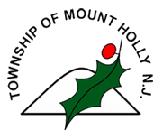
James Forten, Philadelphia Ship Owner, Abolitionist
Technology Bridges Narrative
Exploring Historic Pathways, Discovering New Understandings

Slide 14
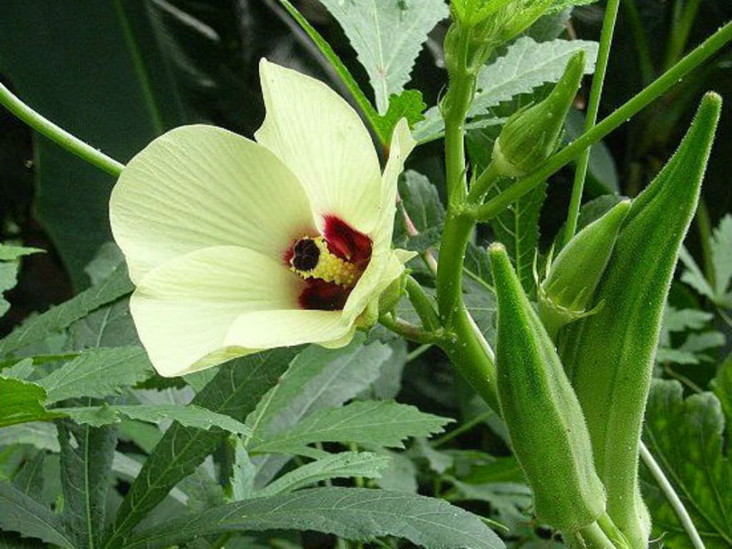
Okra/Okuru “Sticky Plant”
One code in particular was very important: It was a secret message let family members know they had escaped safely. "When they got on the ship, they'd have the abolitionist bring a piece of dried Okra back to a loved one.”
In the African language it was called Okuru, and it translated to 'sticky plant.' It was a symbol meaning once they reached their freedom, they would send for their loved one, and they'd be 'stuck together' again soon.
Leesa Jones, Director of the Washington Waterfront Underground Railroad Museum.
also
One would think a school program could grow okra for raising funds for activity.....

Slide 15
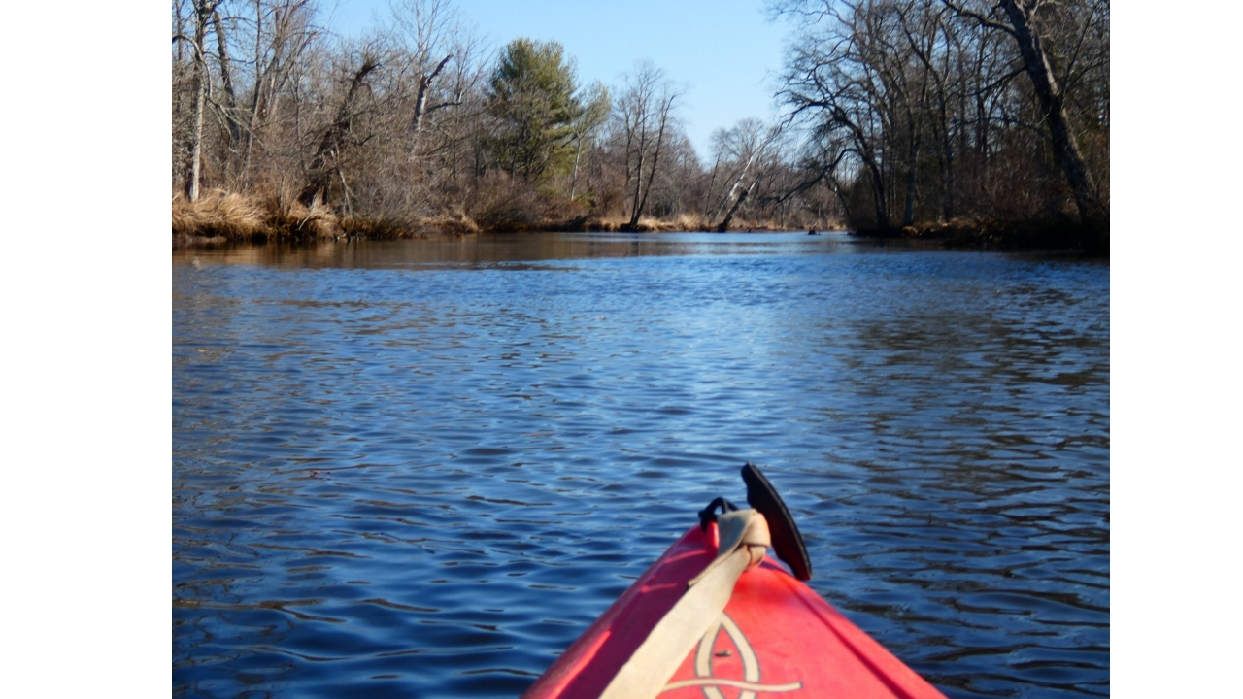
North Branch
Timbuctoo
North
Bank
Hainesport
Long Bridge Burlington County
Park
South
Bank
Rancocas Creek Water Trail

Slide 16
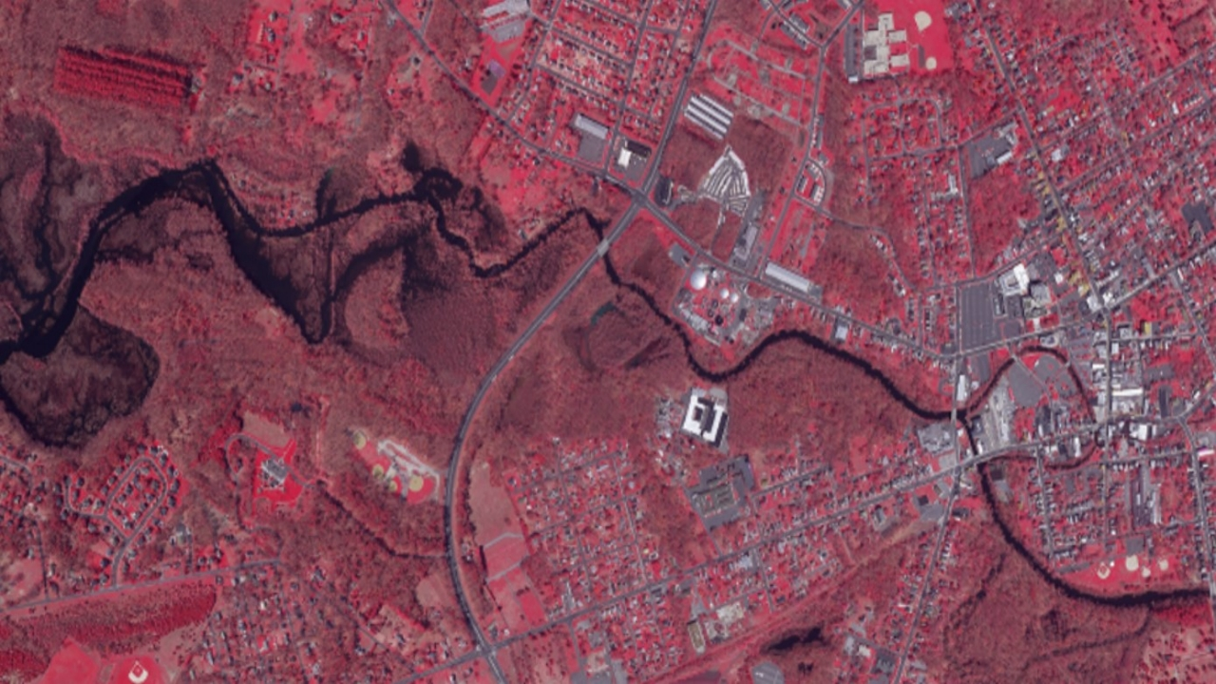

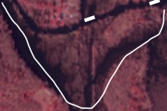


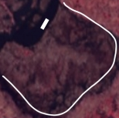

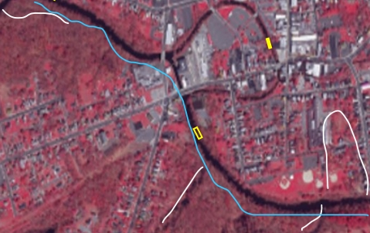
Lines Represent Original Creek Channel, Noting “Creek Walking”
Nature
Center
Timbuctoo
Mount Holly
Mount Holly
Hainesport

Slide 17
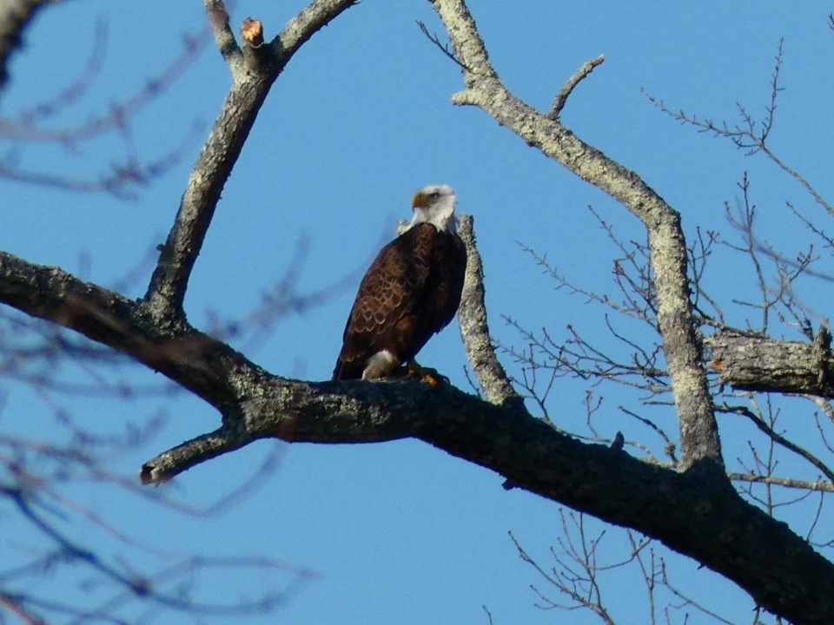
Timbuctoo
Natural
Area

Slide 18
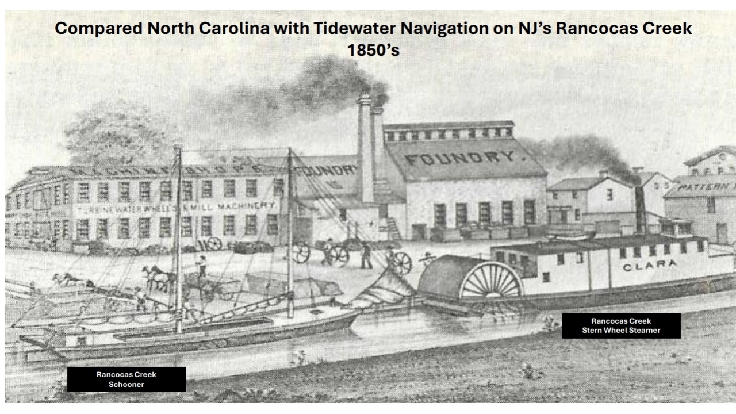

Slide 19
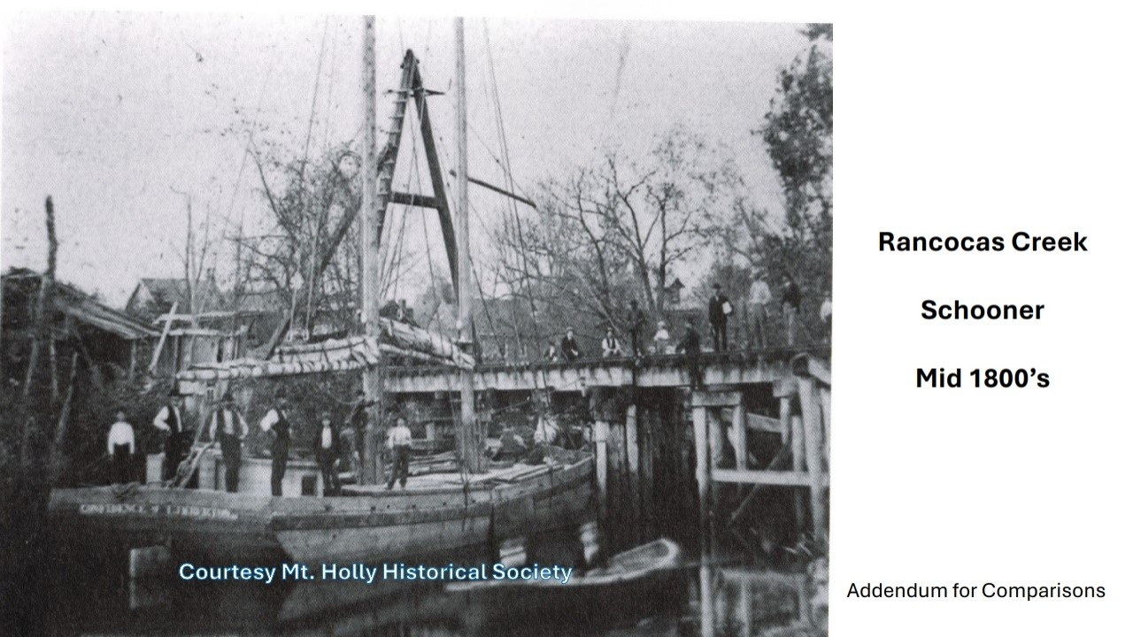
?

Slide 20
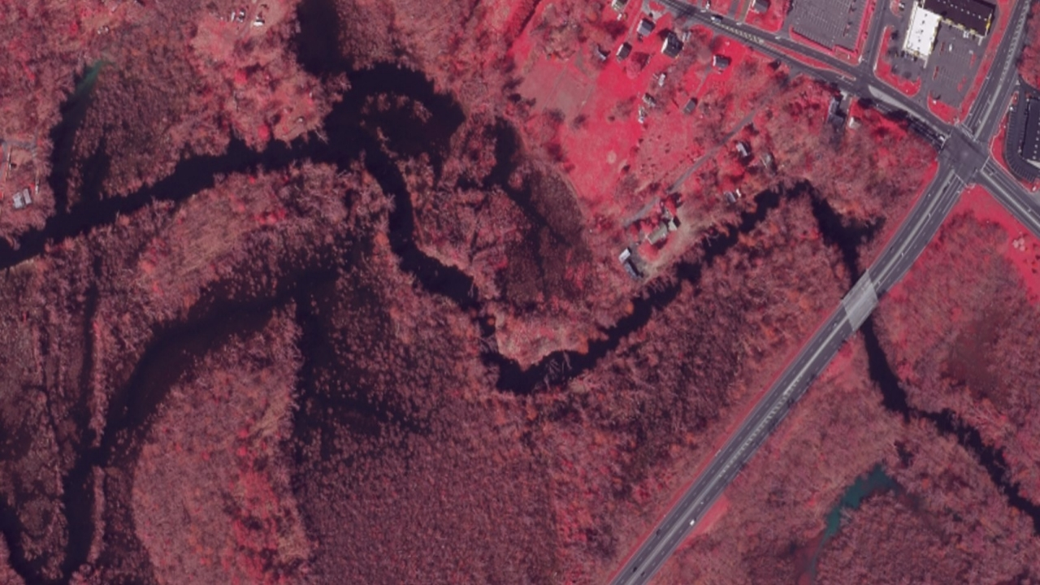

Rancocas Creek Water Trail
Ref: US Army a Report to Congress 1888
Grubb’s Run
Outflow
<<< Turning Basin
Scaled to size of 1774 Rancocas Creek Sailing Shallop
10 x 80
Arrow direction of travel & Tide Job

Slide 21
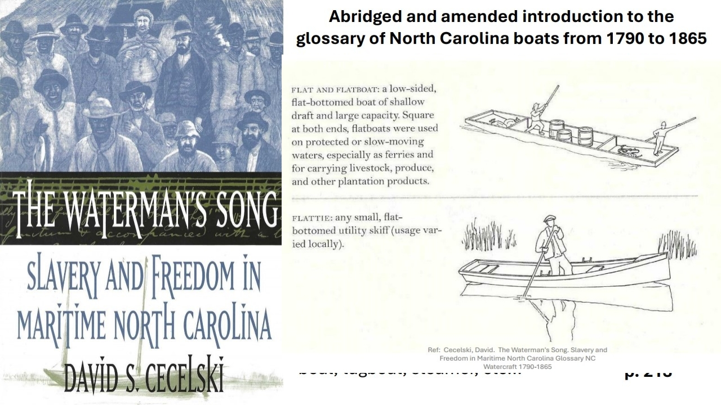

Slide 22
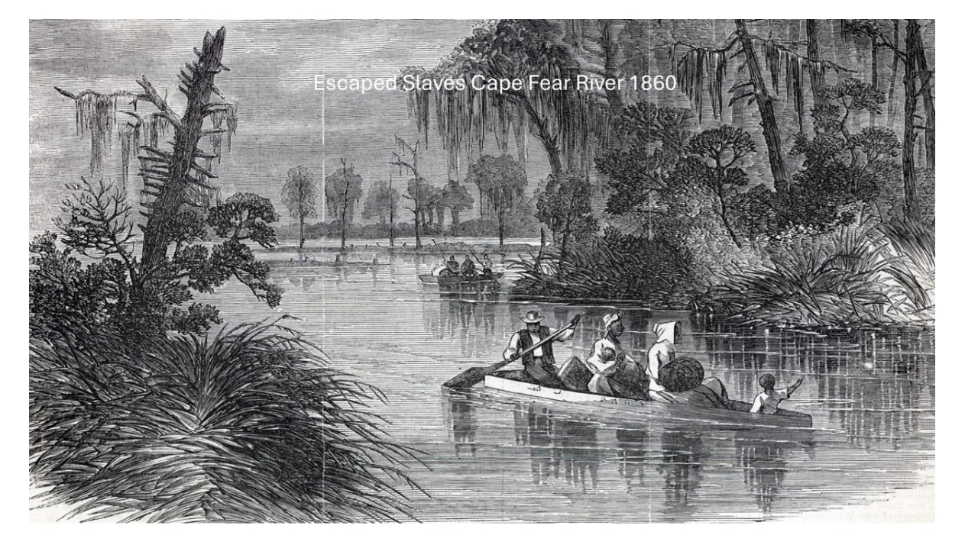

Slide 23
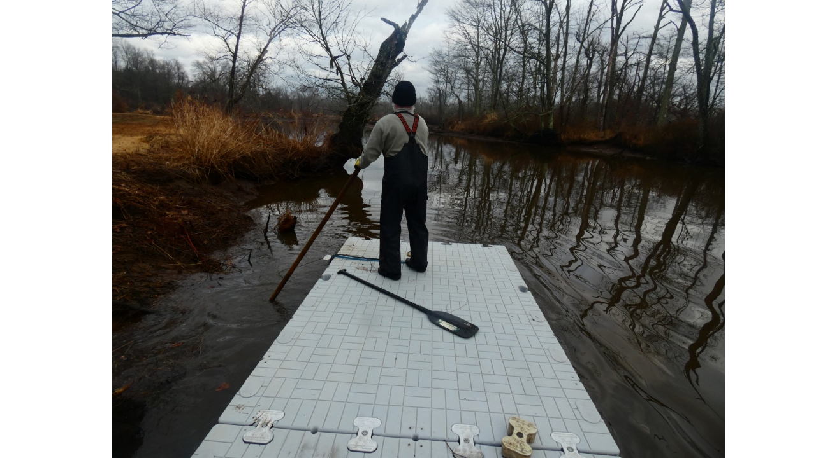
Rising Tide - Timbuctoo
500 feet in 6 minutes 34 seconds

Slide 24
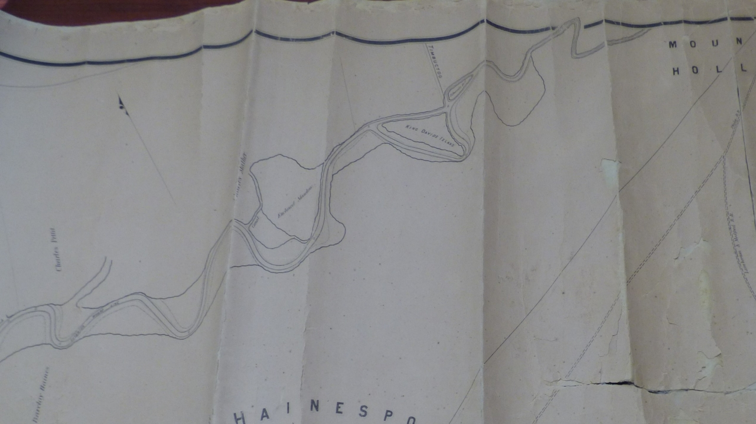


Slide 25
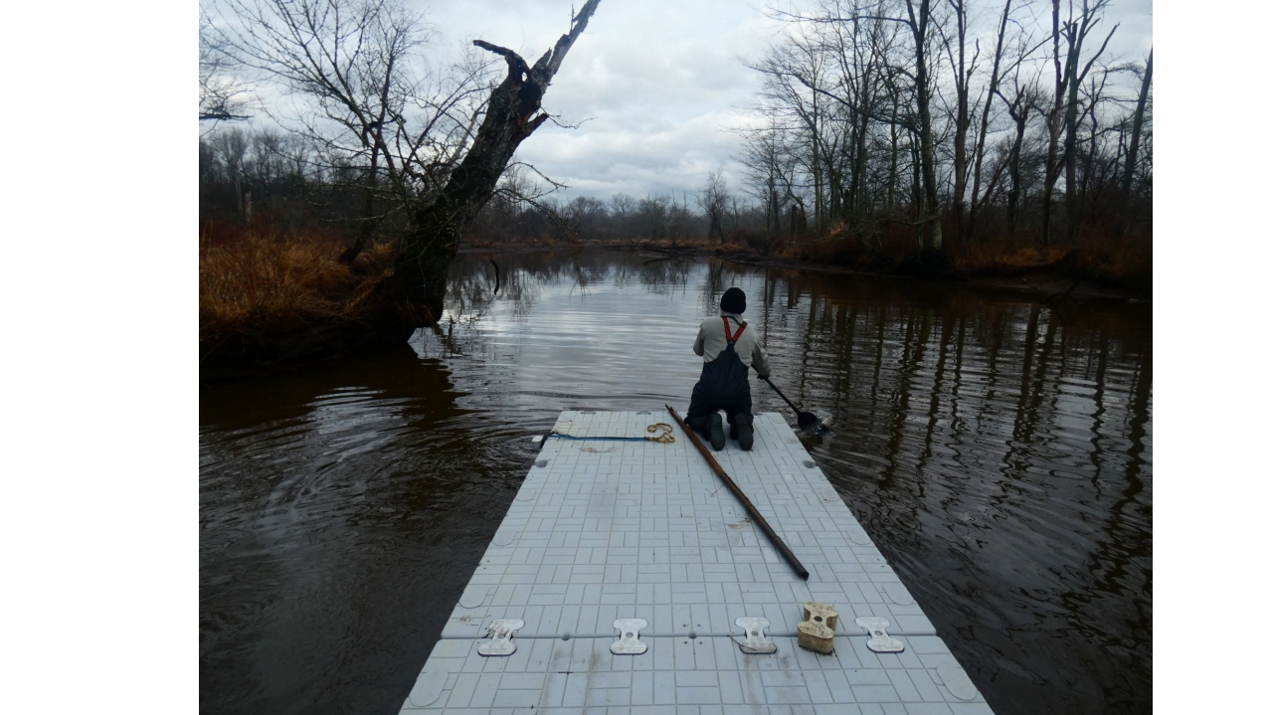
Advancing with Tide
North Branch Timbuctoo

Slide 26
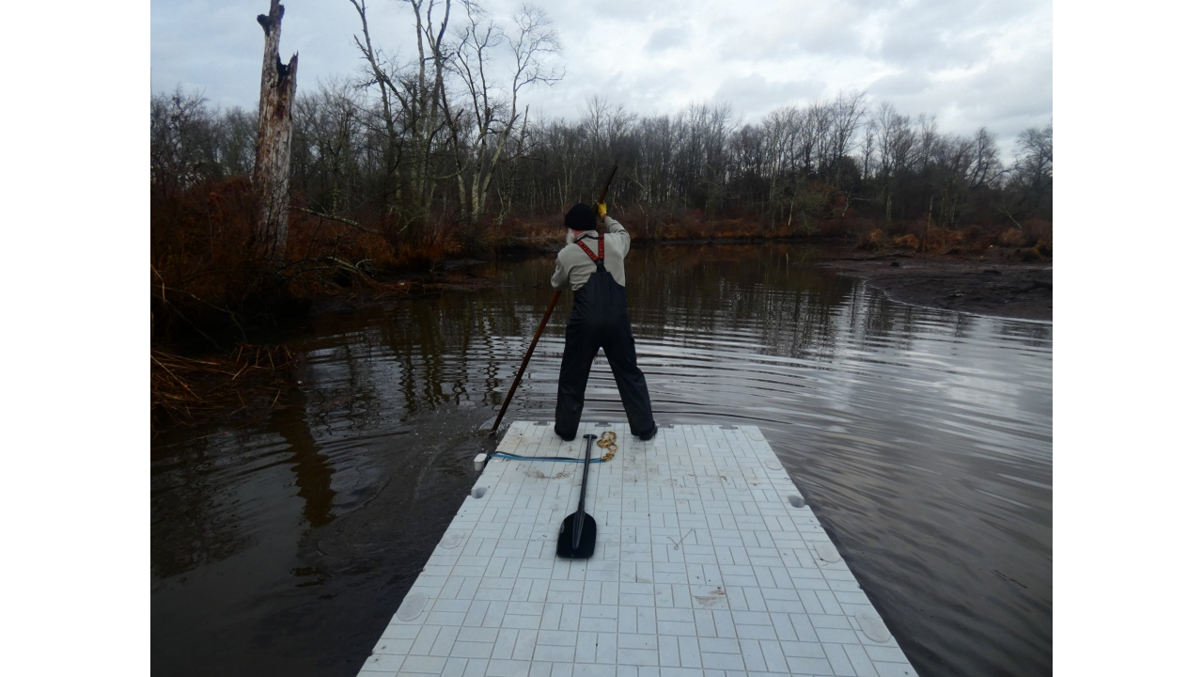
Advancing with Tide
Tide Mill / Turning Basin

Slide 27
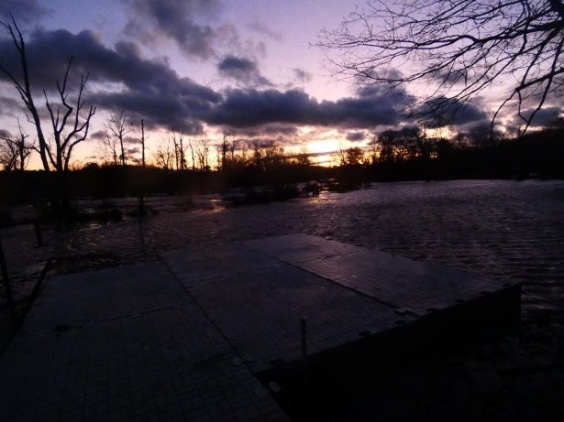

Here You Are Safe
“Here You Are Safe”

Slide 28
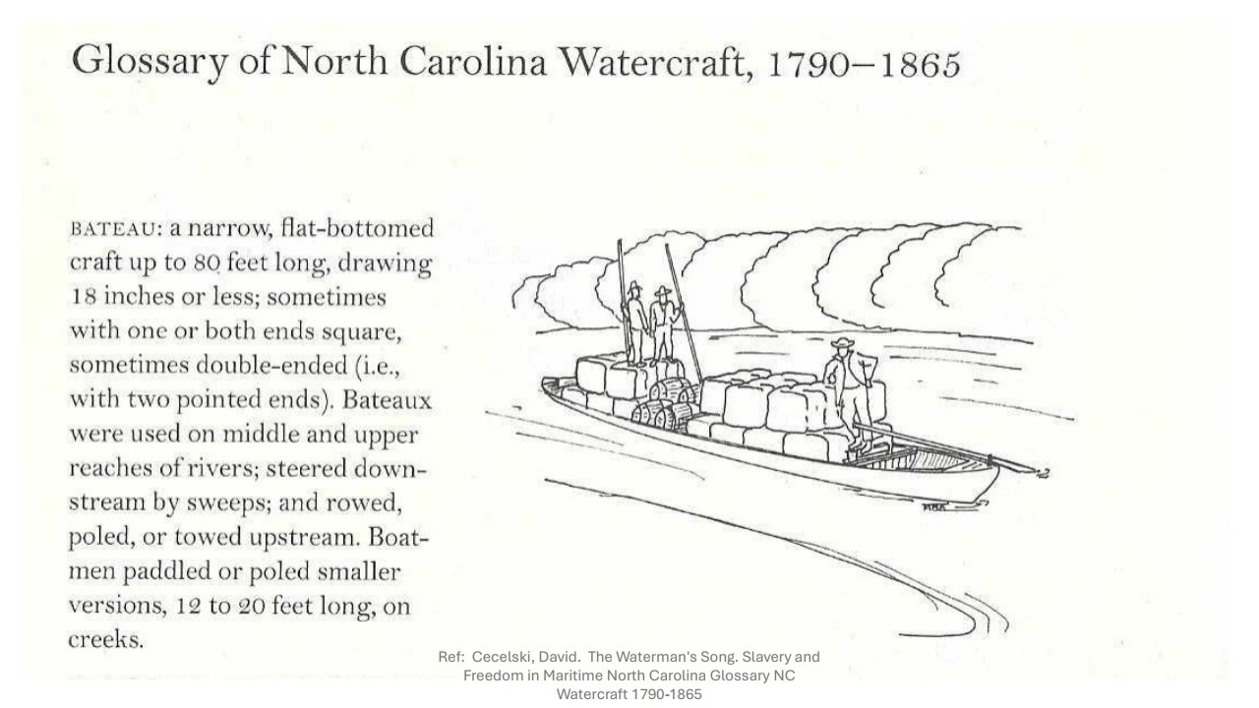

Slide 29
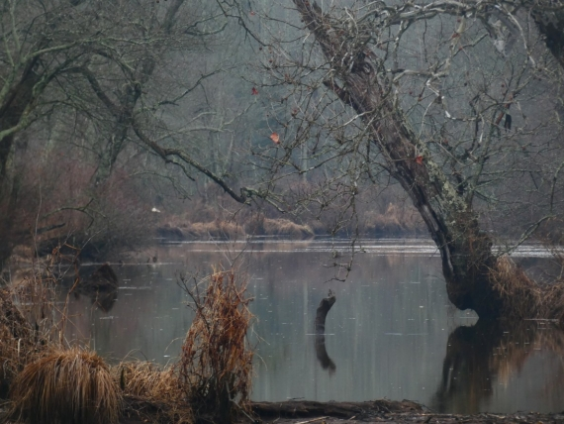
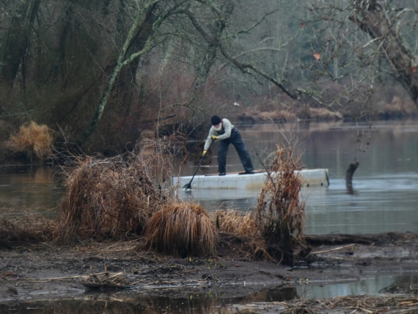
Flood Tide
Timbuctoo, North Branch

Slide 30
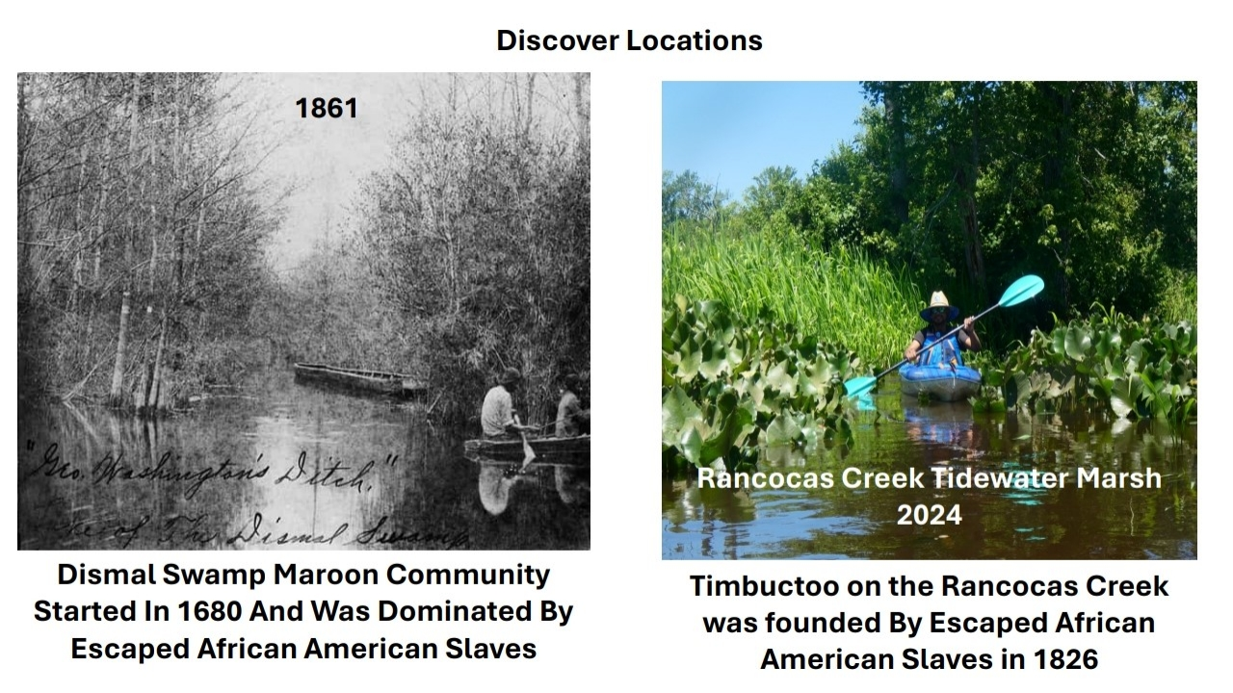

Slide 31
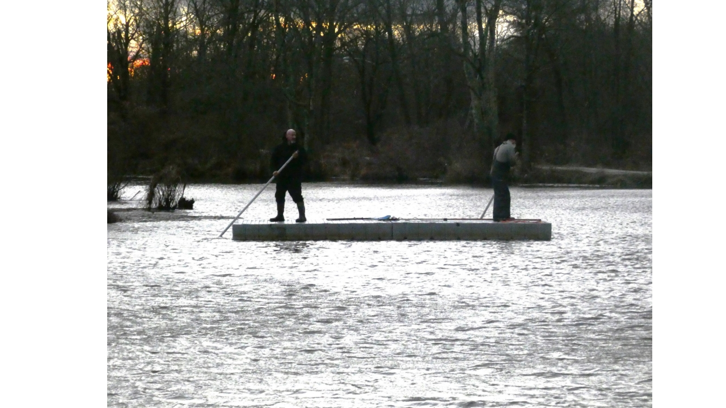
Obliged

