Slide 1
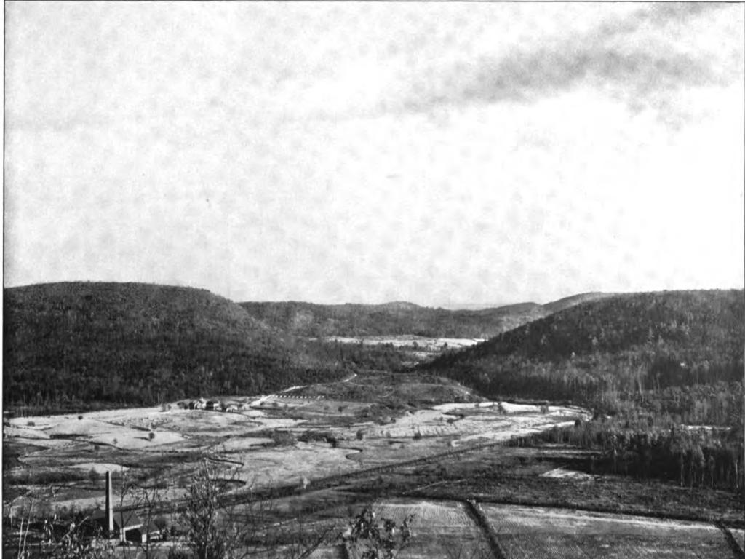

It’s Not Just Malls !
Newfoundland Gap

Slide 2
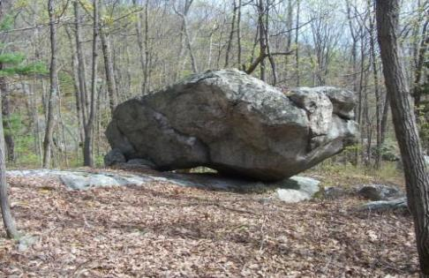
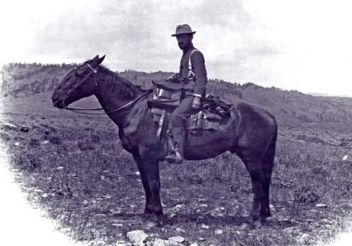
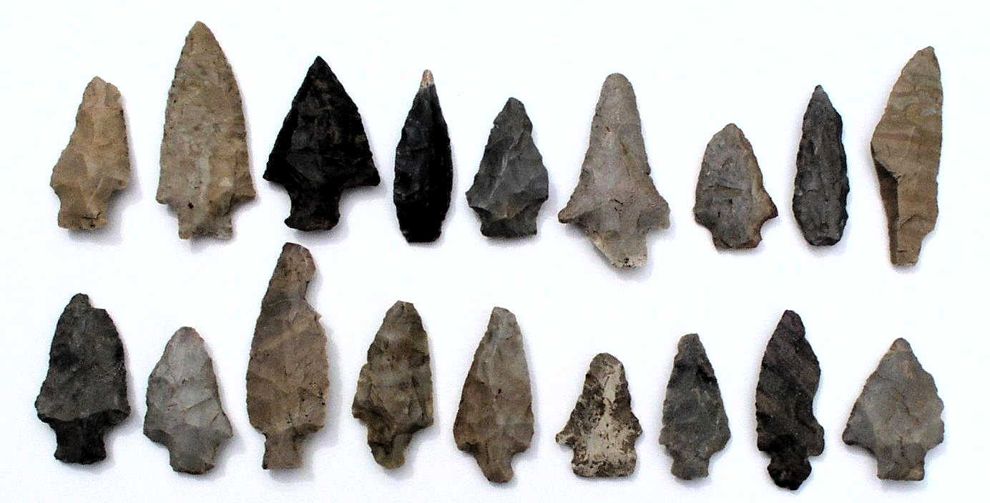
Ice Age
Land Use
Industrial Age

Slide 3
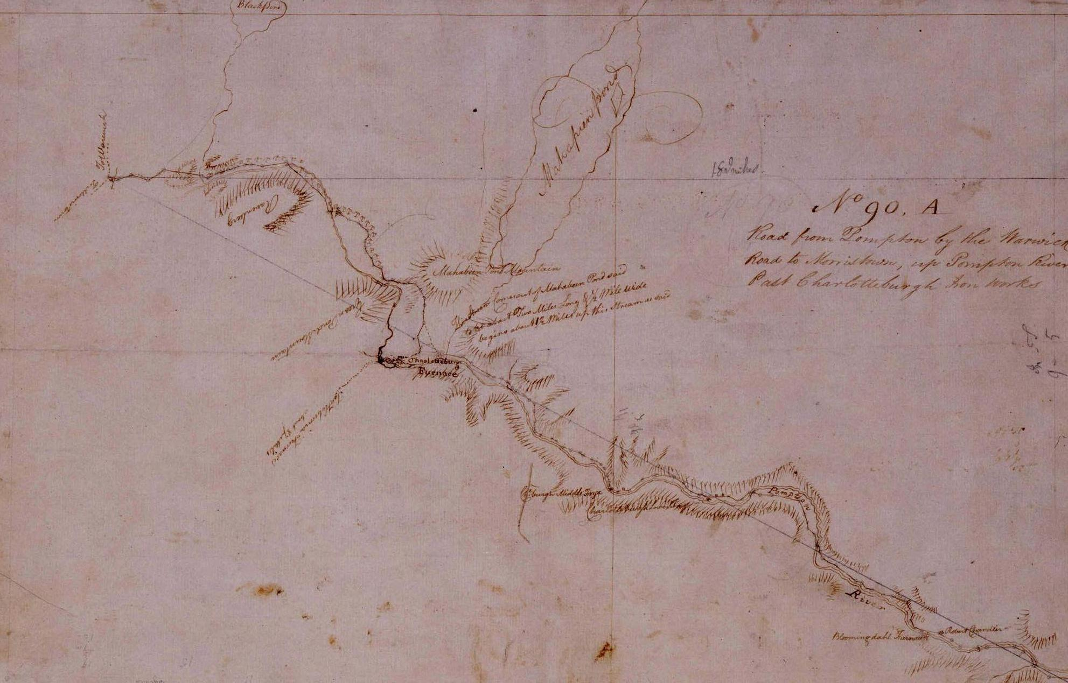
Robert Erskine
He pressed forward to Smith’s Clove, whence there were mountain passes
to the forts in the Highlands, and there he encamped…
June 1st, 1779

Slide 4
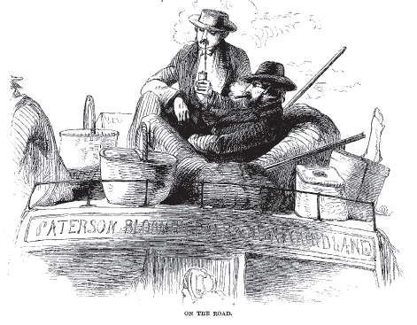
Paterson-Deckertown Stage Line May, 1860

Slide 5
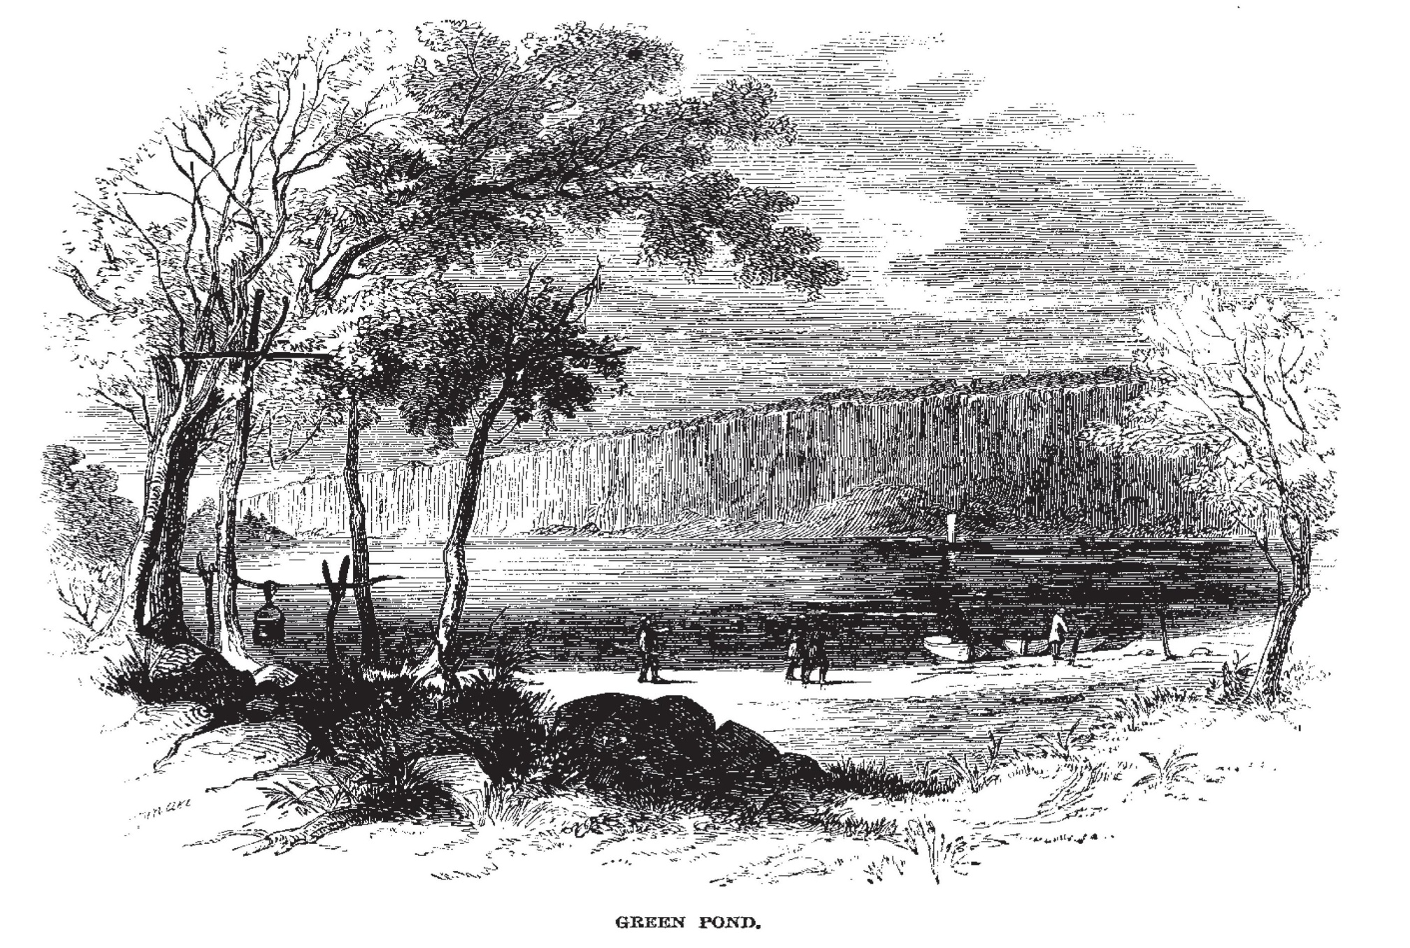

Slide 6
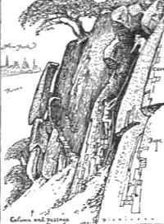
Bastion of
Multi-Use Outdoor Recreation
1926 NY Walk Book

Slide 7
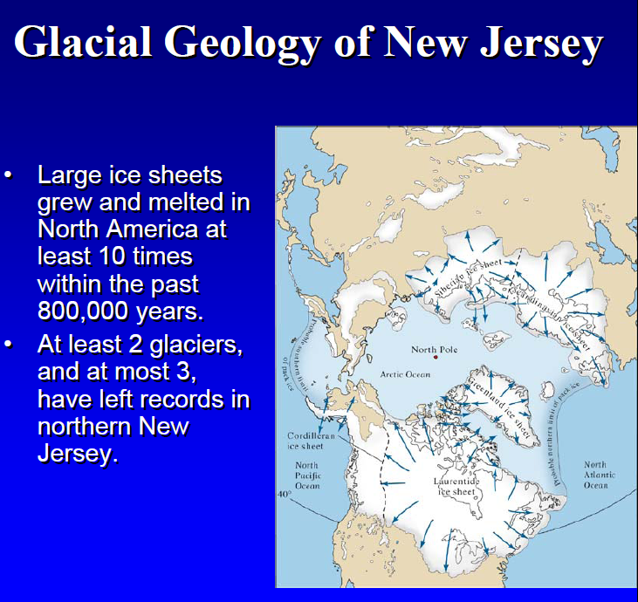

Slide 8
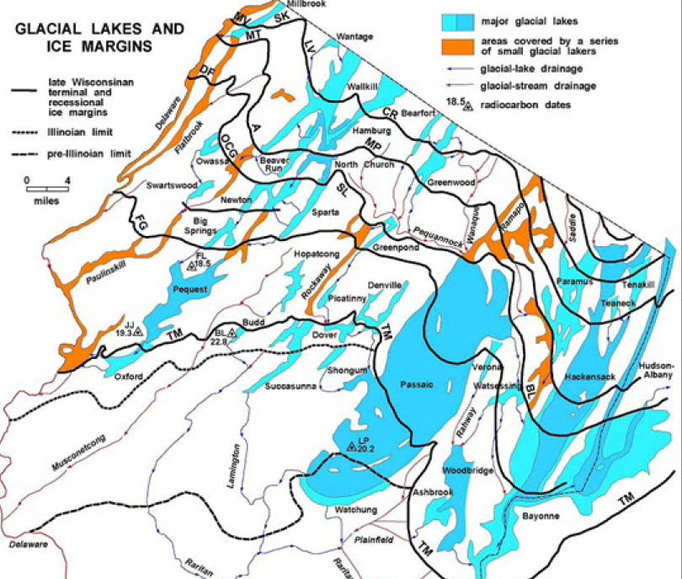

Slide 9
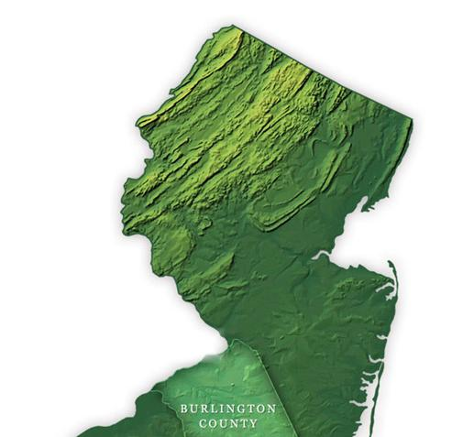
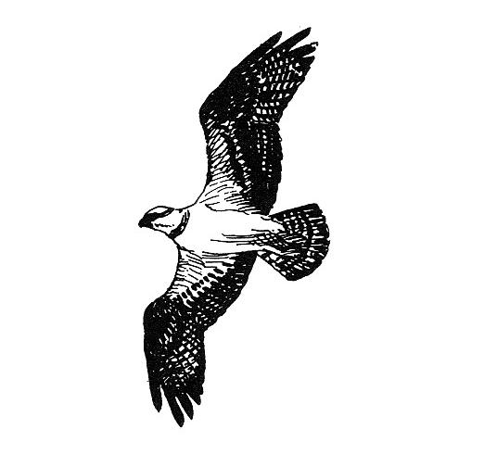
Continuous Ranges
and
Discontinuous
Valleys
Green Pond
Eastern Highlands
(More or Less Isolated Hills)
Ramapo's
Passaic
Western Highlands
Kittatinities
Waywayanda
Hamburg
Sparta
Allamuchy
Pohatcong
Central Highlands
Bearfort
Kanouse
Copperas
Green Pond
Bowling Green
Schooleys
M’conetcong

Slide 10
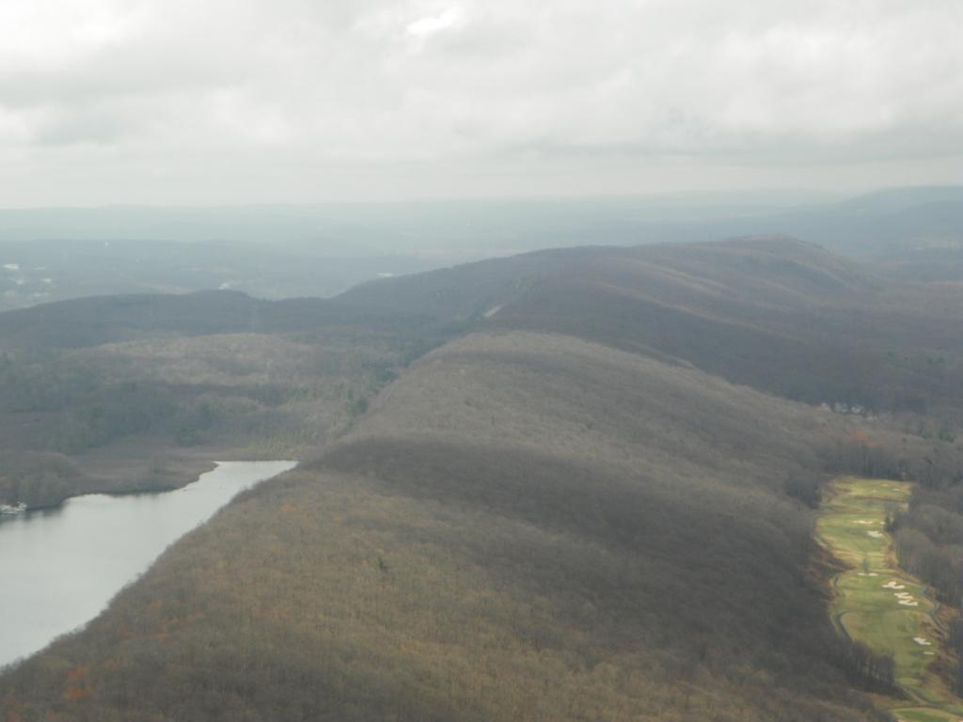
Green Pond Mountain
Macrosite

Slide 11
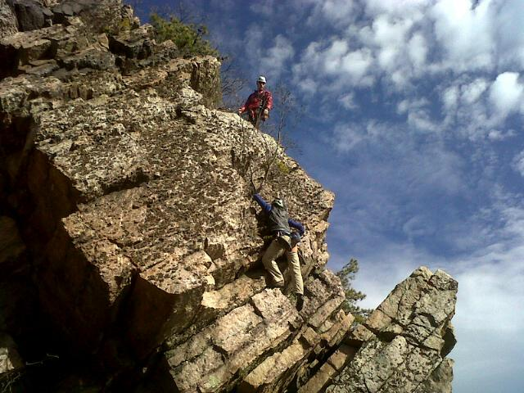
Green Pond
Mountain

Slide 12
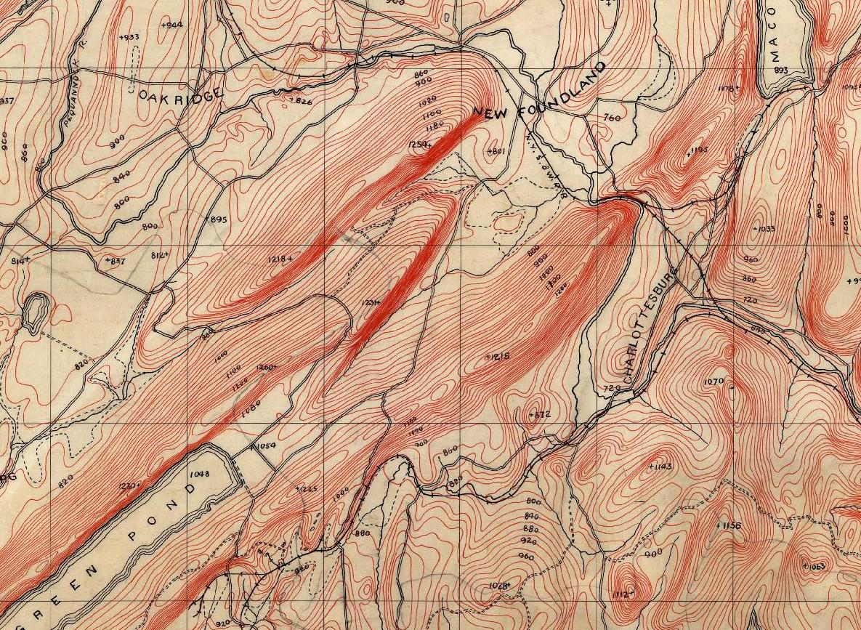
N

Slide 13
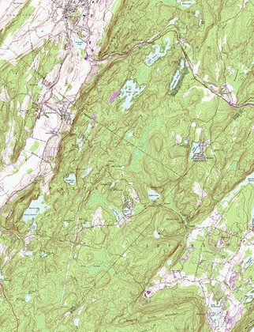
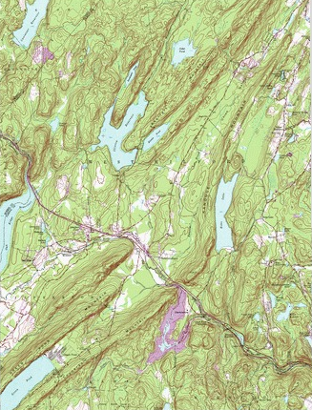
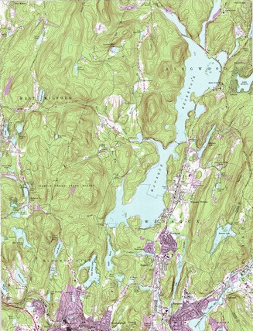
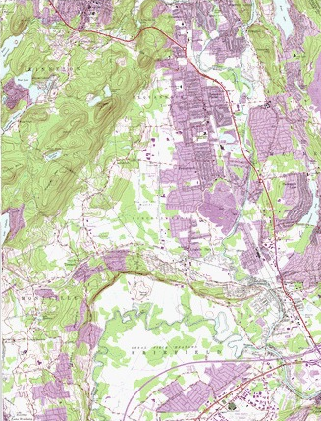
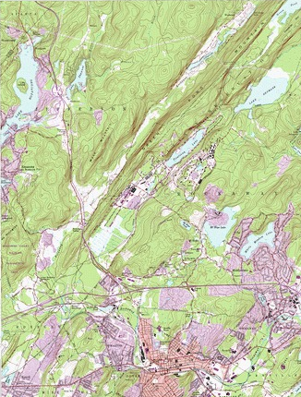
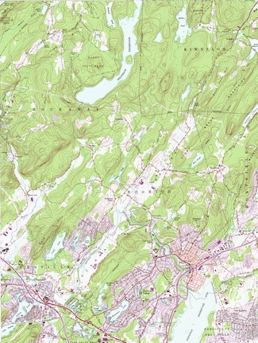
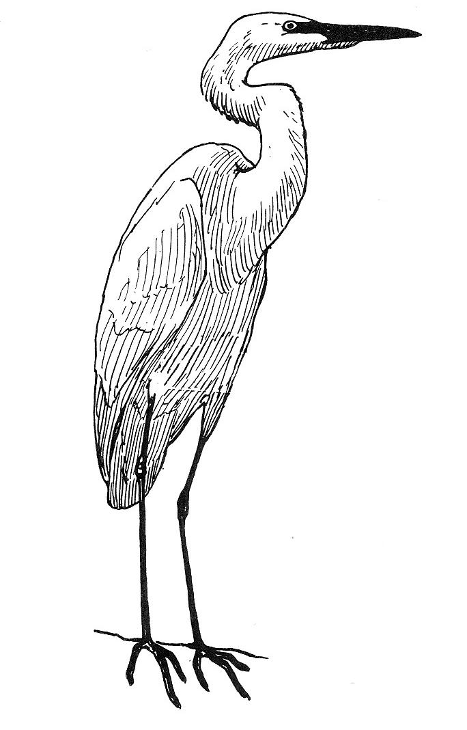
Continuous Ranges
and
Discontinuous
Valleys
West
Milford
Franklin
Wanaque
Reservoir
`
Eastern Highlands
(More or Less Isolated Hills)
Ramapo's
Passaic
Western Highlands
Kittatinities
Waywayanda
Hamburg
Sparta
Allamuchy
Pohatcong
Pequannock
Split-Rock
Reservoir
Central Highlands
Bearfort
Kanouse
Copperas
Green Pond
Bowling Green
Schooleys
M’conetcong
Wayne
Key
7 miles
Dover
Denville
Parsippany Troy Hills

Slide 14
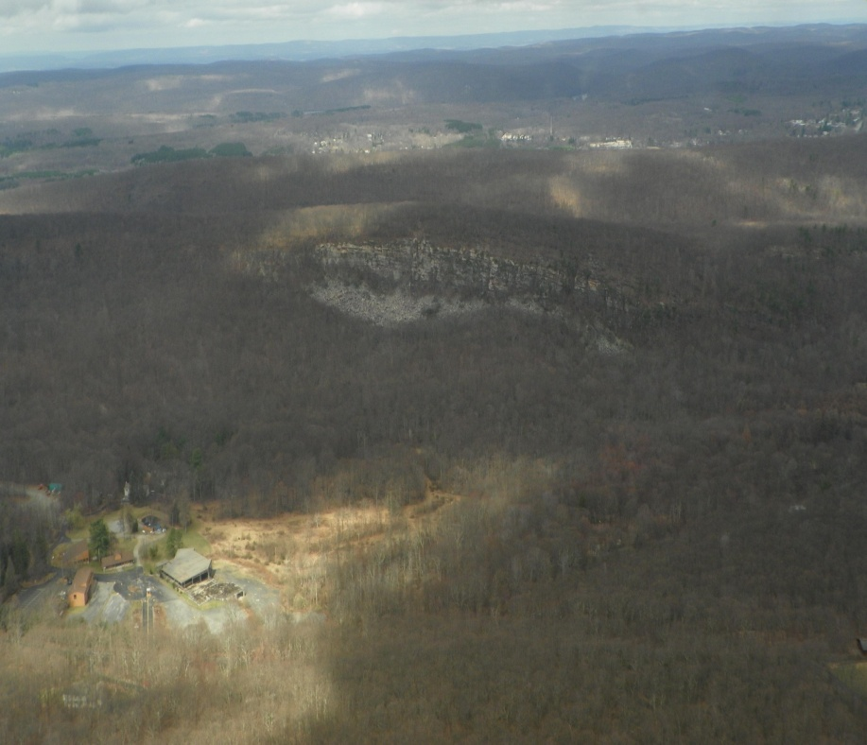
Hawks Cliff
Craigmeiur

Slide 15
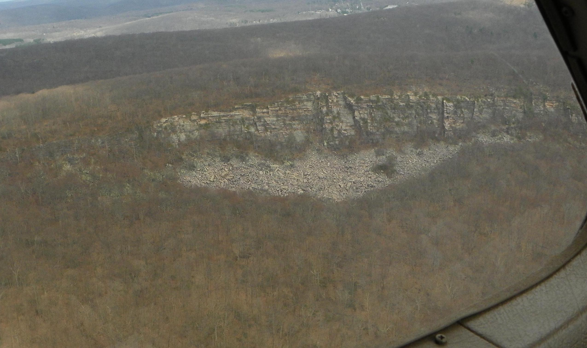

Slide 16
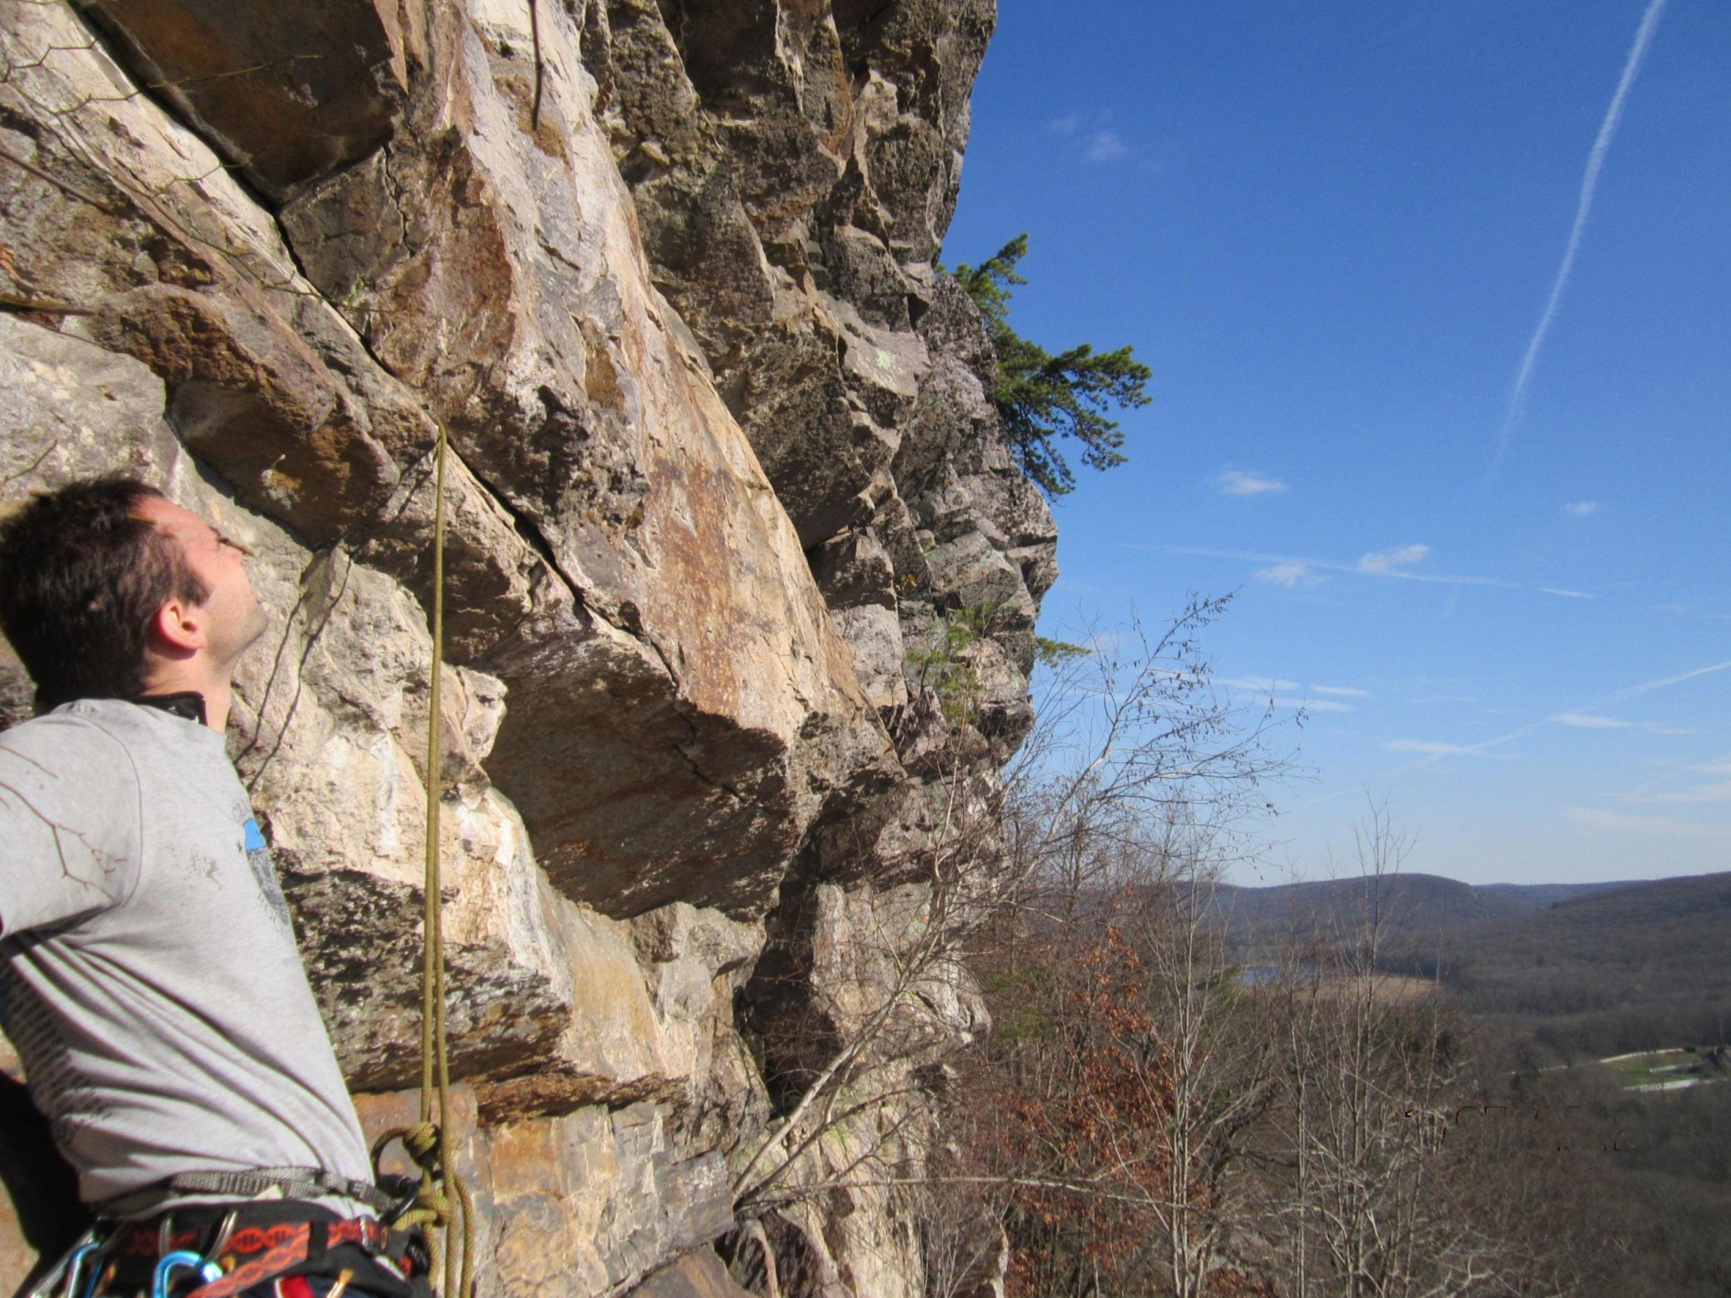
Glaciered Valley

Slide 17
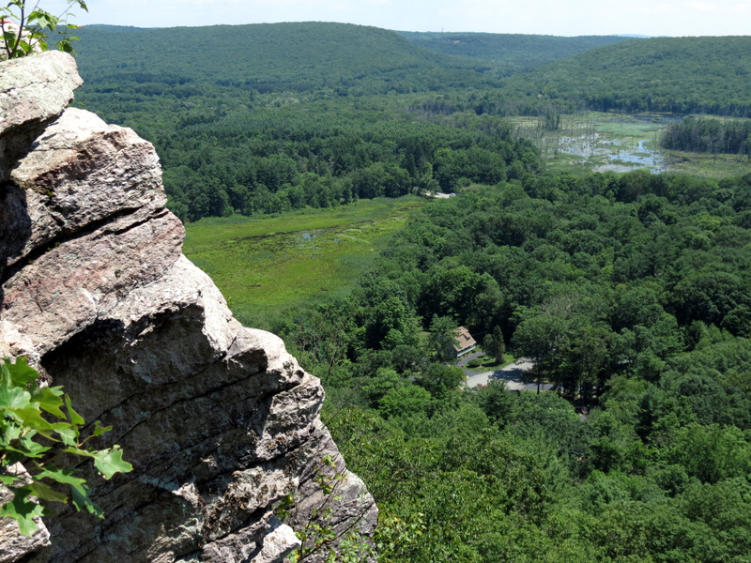
Deerhaven Pond

Slide 18
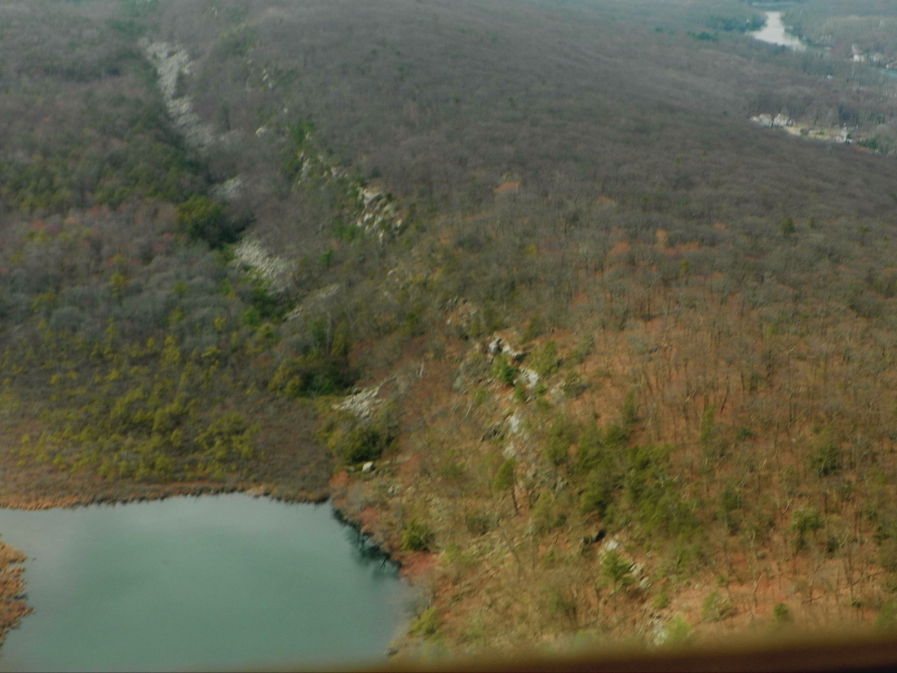
Green Pond

Slide 19
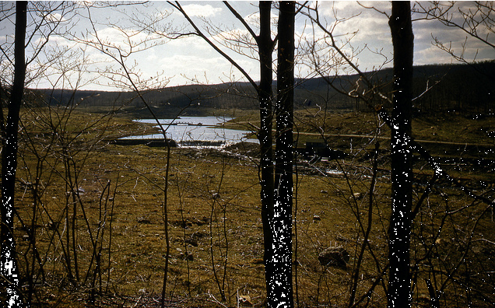
Pequannock River
Dam Site
Pre-1958

Slide 20
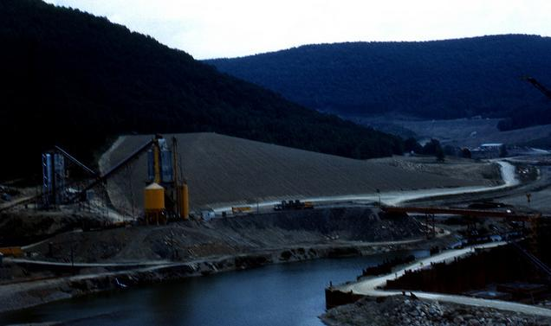
Pequannock River
Dam Site
1959

Slide 21
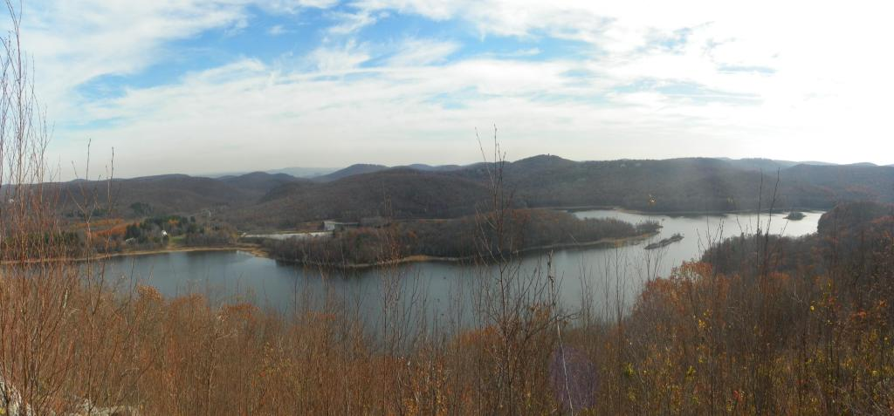
Charloetteburg Reservoir

Slide 22
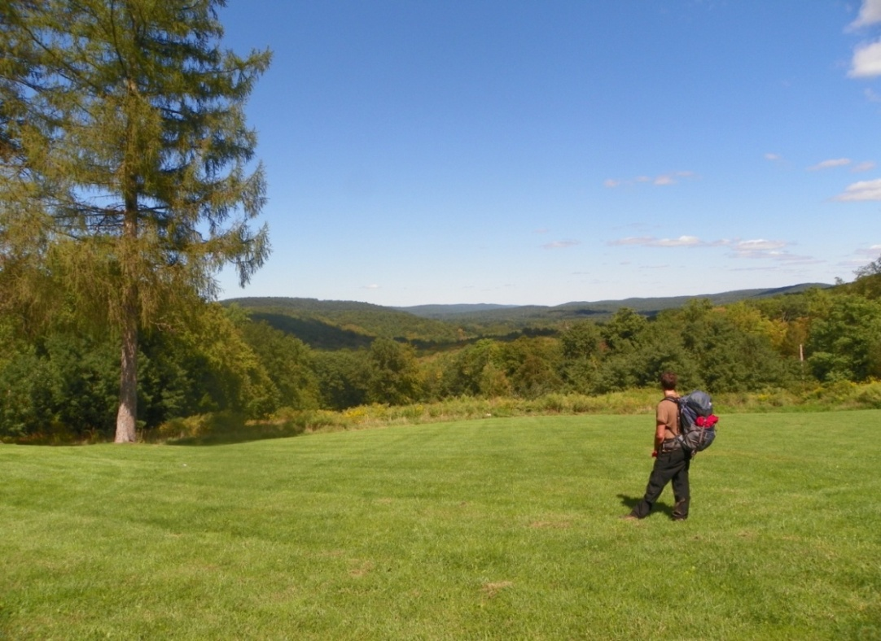
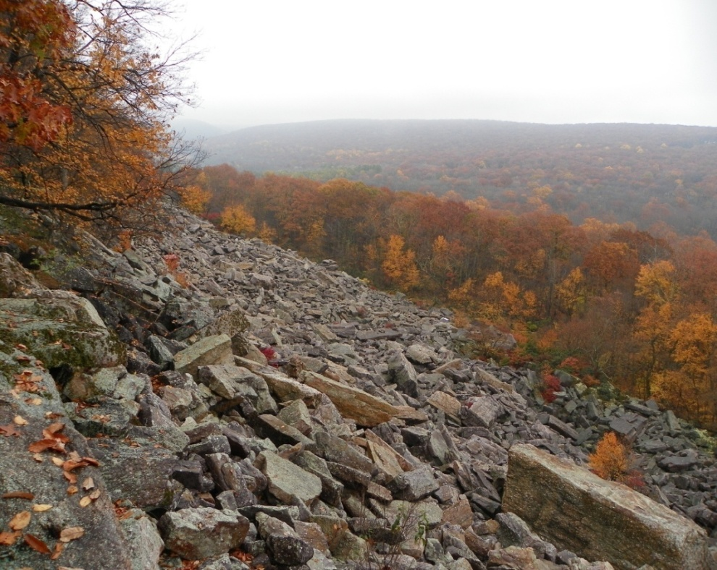
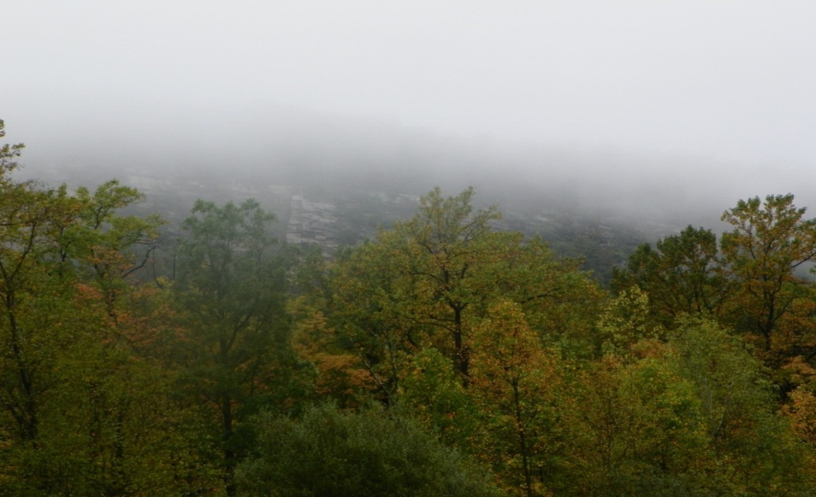
Uniqueness

Slide 23
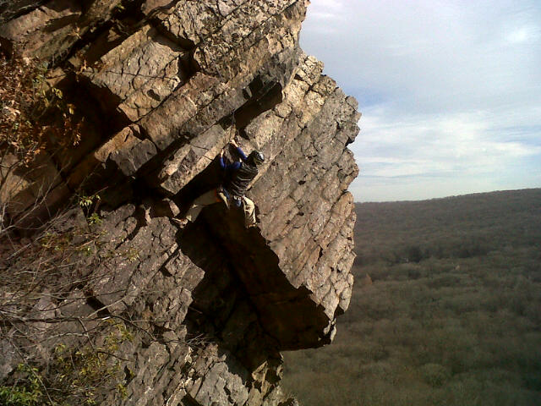
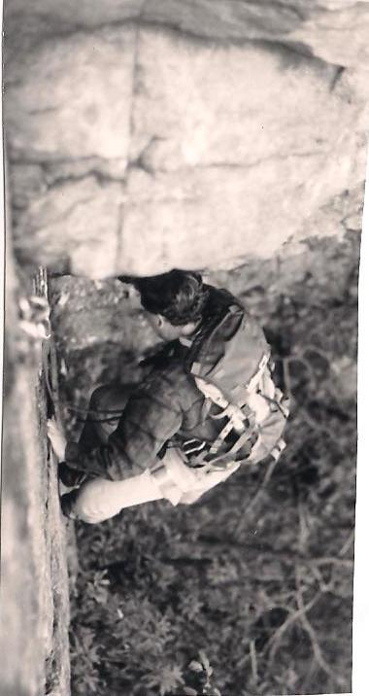
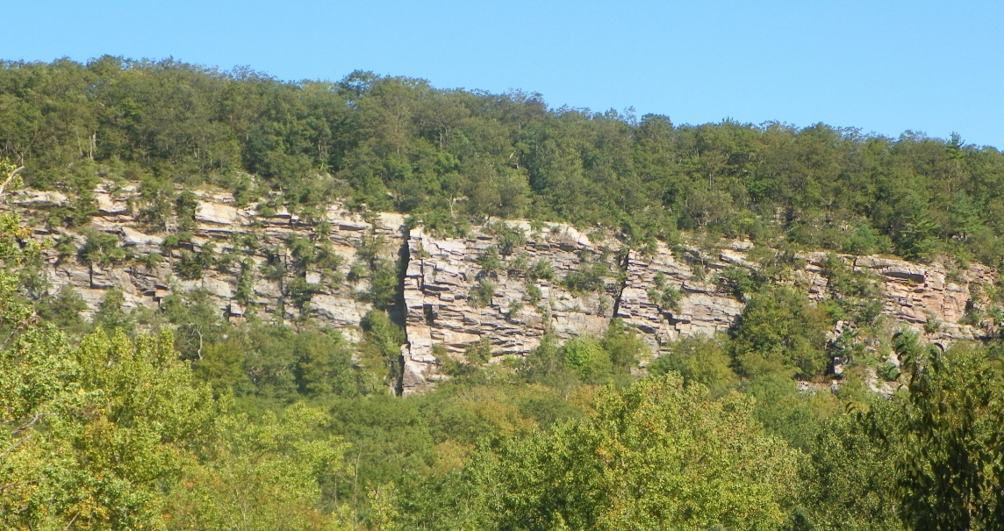
Erskine Slab
5.9

Slide 24
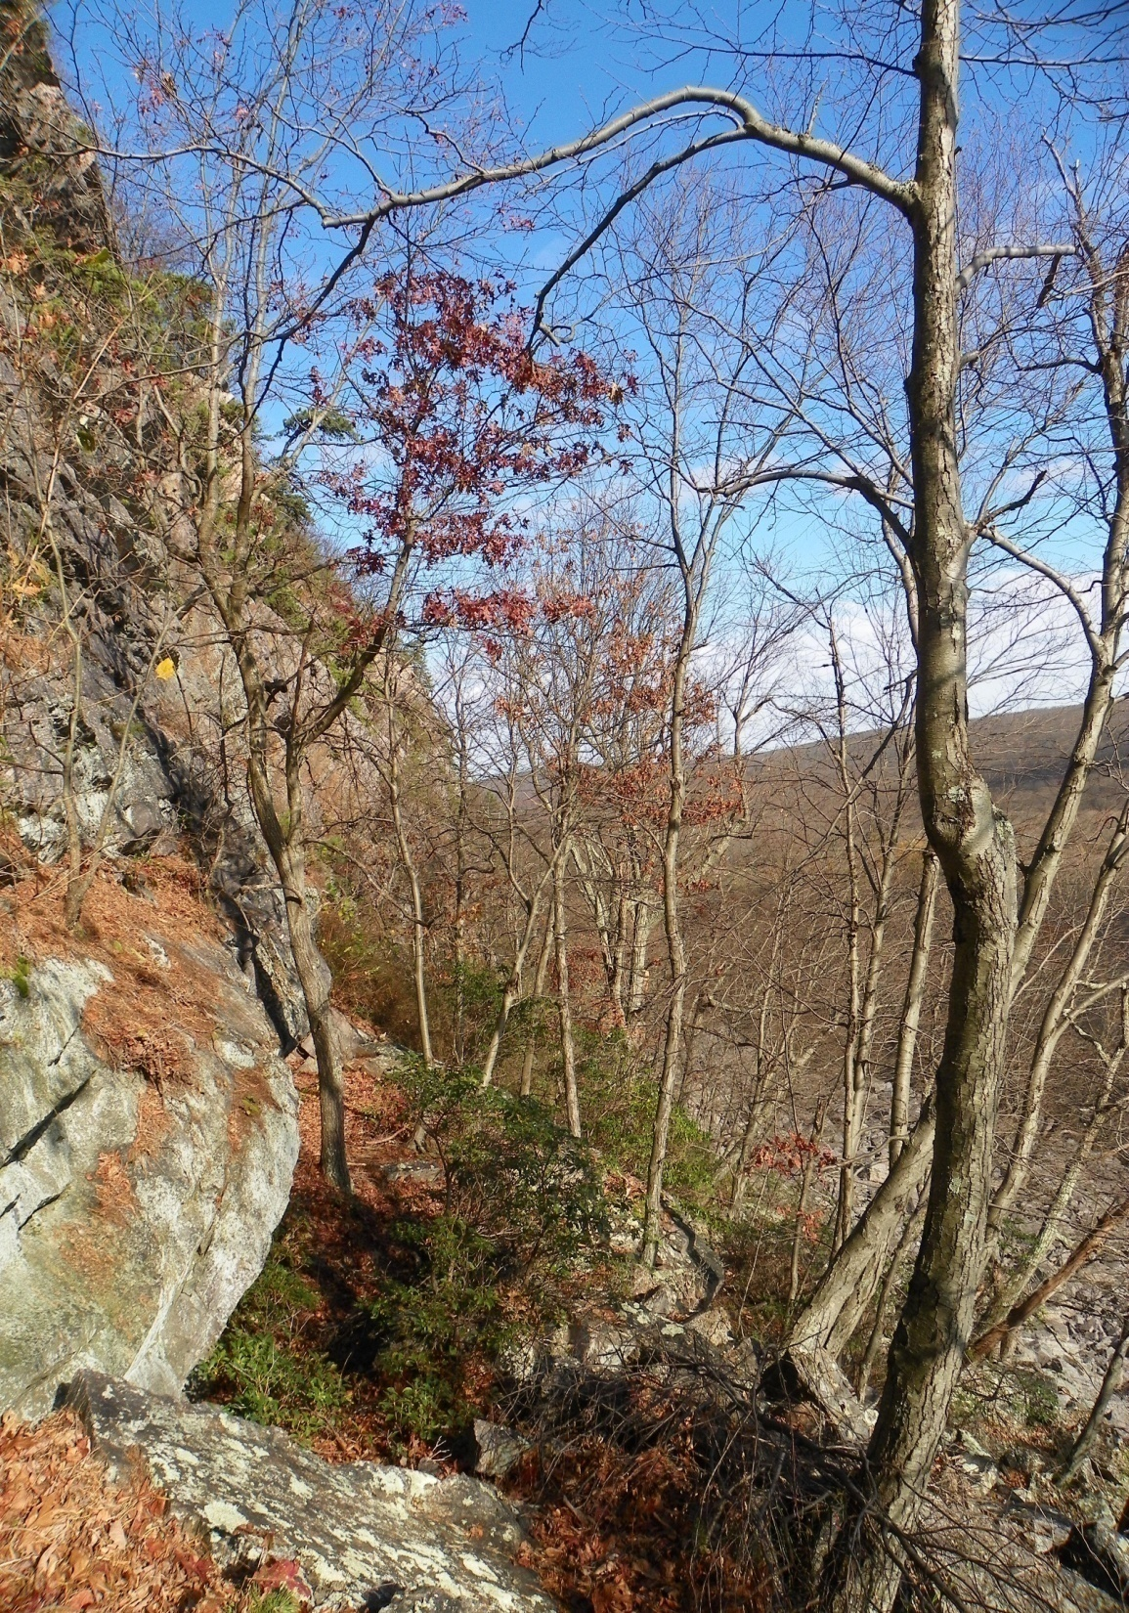
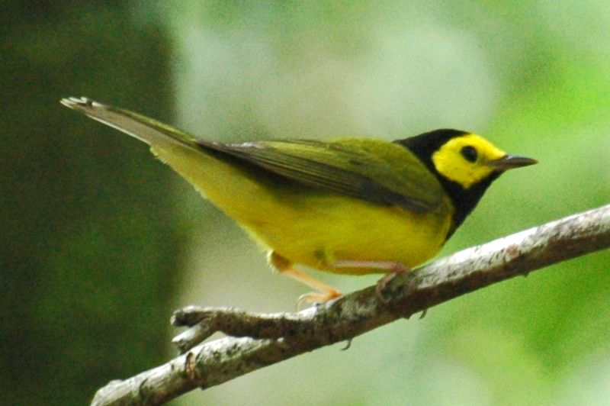
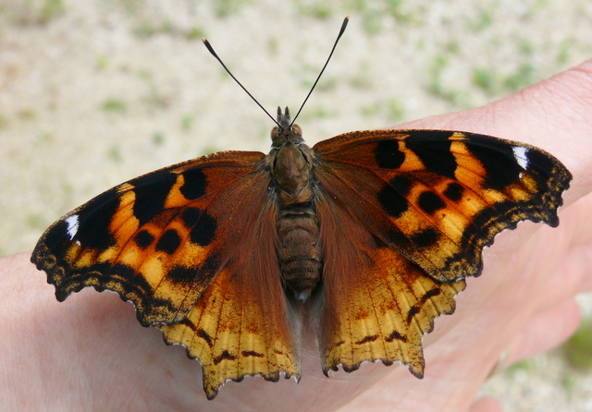
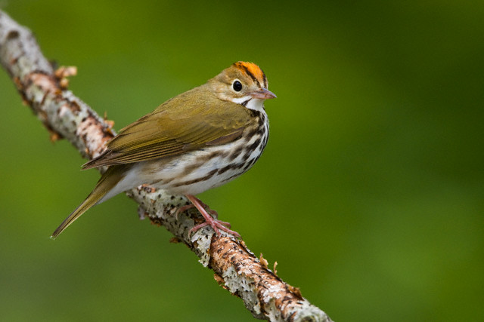
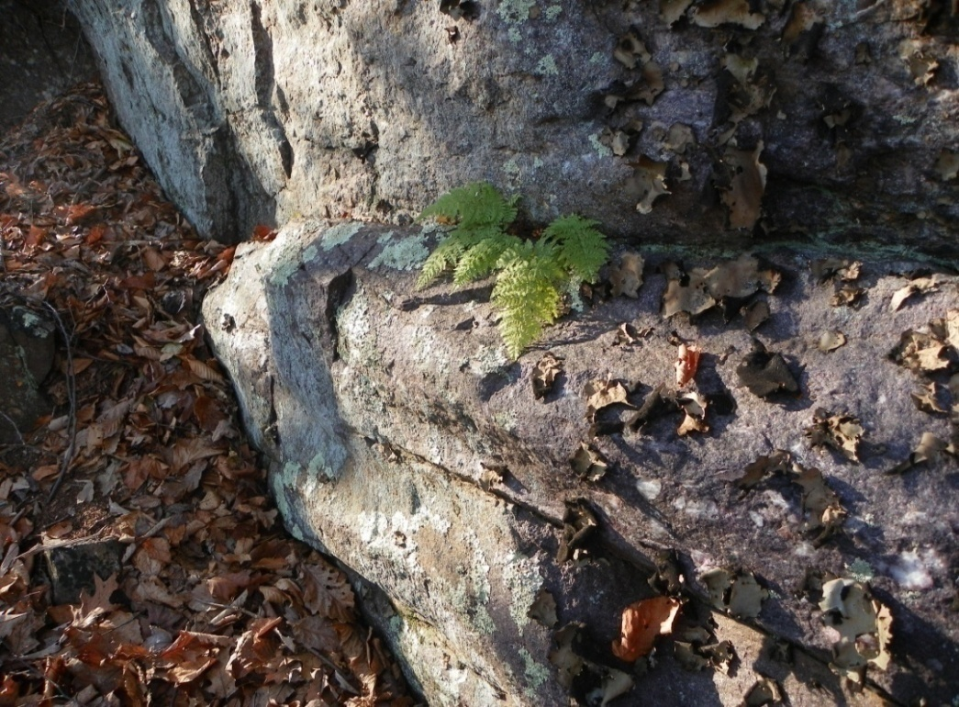
Photo: FWS: Hooded Warbler
Compton Tortoiseshell
Photo: FWS: Oven Bird

Slide 25
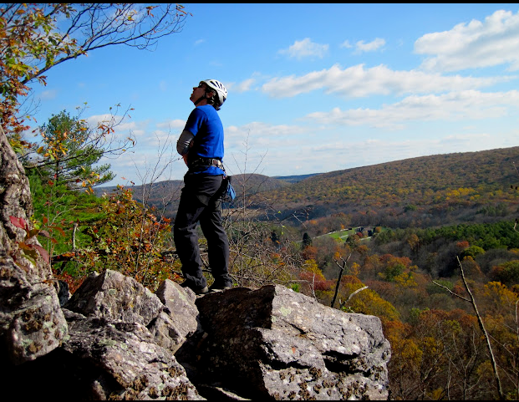


Slide 26
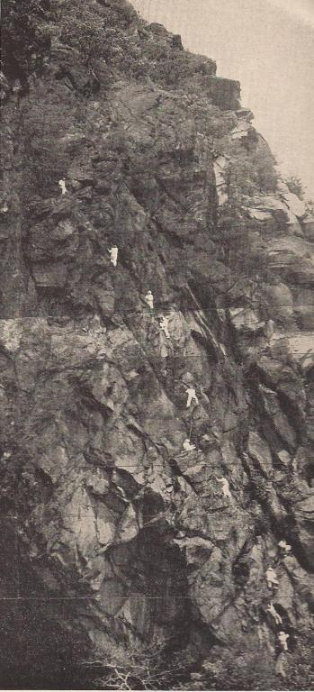
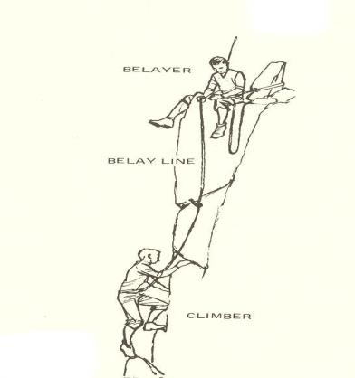
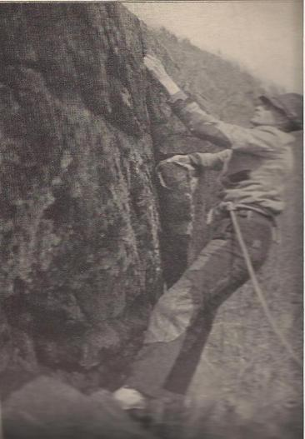
F. Weisner & L. Coveney
“Prize Route”
Storm King
1936
New England Rock
Used w/ permission
Laura Watermen
Appalachia, June 1938
Fluke on Breakneck Ridge
“The Cat Walk”
Hudson Highlands
1931

Slide 27
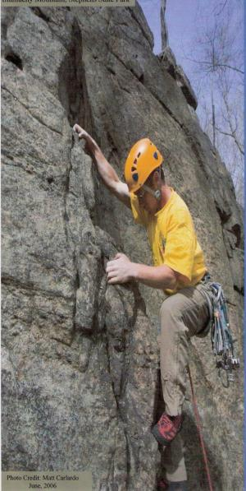
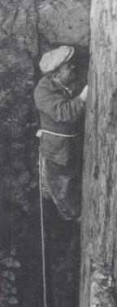
Fritz Weisner
“Tower Crack,” 5.8
Ragged Mountain
1933

Slide 28
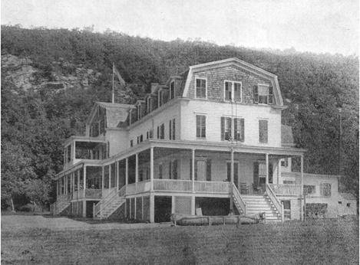
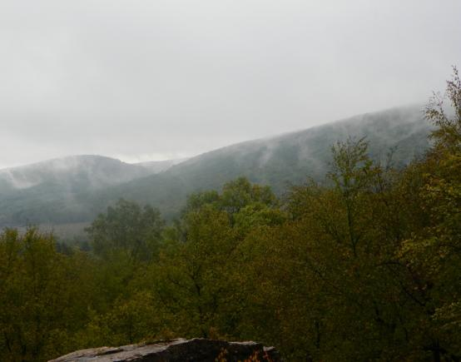
Heritage
Conservation
Access

Slide 29
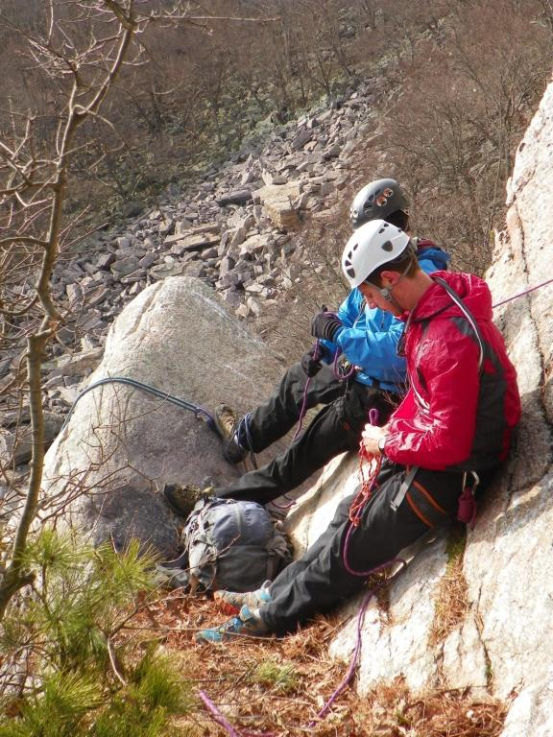
A
X
C
S

Slide 30


Slide 31

AXCS is a PRIVILEGE
User Groups
Management
Access Issues

Slide 32


State
Park
Wavier
Photo Credit: Matt Calardo
All Rights Reserved

Slide 33



HARMLESS, WHEN NO-ONES THERE !
Windbeam
w/ permission dr. r. norris

Slide 34



Wildlife
NJ’s climbing sites are in craggy, remote areas of NJ. Endangered and threatened species, timber rattlesnakes, copperheads, bobcats , raptors, owls and others inhabit such areas
Climbing Sites Endangered Critters
GENERAL ROCK-CLIMBING
INFORMATION
Restrictions on climbs in NJ Stay alert for nesting raptors. If you come across a raptor nest on a climb, BACK OFF IMMEDIATELY. Federal, State , local laws and SMART Climbing protects these animals
Contact the NJ DEP Endangered and Non-Game Species Program on any sightings of rare, threatened or endangered wildlife.
The phone number to call: 609.292.9400
Timber Rattlesnakes
Prickly Pear Cactus
The Access Fund is a national non-profit protecting climbing access
303-545-6772
Photo: Matt Calordo, April, 2006
RESPECT
FOR
NEW JERSEY’S NORTHERN
HIGHLANDS
Great Horn Owl.

Slide 35

P
E
R
C
E
P
T
I
O
N

Slide 36

P
E
R
C
E
P
T
I
O
N
P
E
R
C
E
P
T
I
O
N

Slide 37



Talus Slope Woodland
Photo: FWS

Slide 38




Characteristics

Slide 39

Cliff Ecology
Physical Environment
Biotic Environment
Human dimension of Ecosystem

Slide 40

Talus Slope Woodlands
Geology, Hydrology, Microclimates, and Geomorphology

Slide 41

Biotic Environment
Contiguous forest habitat;
Raptors and Owls;
Forest interior-nesting raptors;
Northern Goshawk
Red-Shouldered Hawk
Barred Owl
Saxicolous Plant Communities;
Bradley's spleenwort
(Asplenium bradleyi)
Narrow-leaved bur-reed
(Spargonium angustifolium)
Asplenium bradlevi

Slide 42


Slide 43



Human Dimension
Sgt.Torger Tokle
Green Pond, Hawks Cliff
1940’s US Army Carabiner
Green Pond Hawks Cliffs

Slide 44

Cinca de Maya
Hanging Block
Tall Order
Union Brothers
Good Times
Slot Machine
Bumper

Slide 45

Cinca de Maya
Hanging Block
Tall Order
Union Brothers
Good Times
Slot Machine
Bumper

Slide 46


PROTECT
Owl

Slide 47





Slide 48


Slide 49


Slide 50


Slide 51

Hanging Block
Tall Order
Jenga
Blue Vulture
Cinca de Maya
Jenga Wall

Slide 52




Highland
Critters
Black Racer
Allegheny Wood Rat
Photo Credit: John Parke, NJAS
NJ Bobcat
Five Lined Skink
Bobcat
Photo Credit: NJ Fish and Game

Slide 53



Slide 54


2nd Pitch,
Bowling Alley
5.4
Member’s Only Slab
5.3 – 5.7

Slide 55

Beyond the Climb…
…Protect The Resource
“Spleenwort”

Slide 56

Members Only
Frisbee
April Fool’s
Automated Enforcement
Brain Fart
Bowling Alley
Bumper
Slot Machine
Good Times
Union Brothers
Hanging Block
Tall Order
Jenga

Slide 57


Automatic Enforcement
5.9
Deerhaven lake

Slide 58

From the Patio, Right of Jenga

Slide 59

Buzzard’s Glory
M
E
R
L
I
N
Photo Credit: JIA

Slide 60



Ridge-Top
Pink Lady Slipper-
Pine Weed or Orange Grass
Photo Credit: John Parke, NJAS
.
Flora and Fauna
Cliff Top

Slide 61


Slide 62


It’s a good a place as any to learn…..
Joe Tasker
Not more
complications….
Peter Boardman

Slide 63





Bear Den Cracks
NJ Hardest
Digit’s
BDC’s

Slide 64


Bear Den Cracks

Slide 65


Slide 66

Hans
Wittich
NJ Highlands
Weiss Ecology Center
Back from Grand Teton
1st Ascent
Owen-Spalding
(var. Owen Chimney)

Slide 67
Grand Teton. Routes such as the entire northeast ridge, the black dike, and the east ridge were worked out by such pioneers as A. R. Ellingwood and Carl Blaurock, Hans Wittich and Otto Stegemaier, and R. L. M. Underhill and Paul Petzoldt. The status of the mighty Moran had fallen to "an easy day for a lady” as early as 1925 when Eleanor Davis (Ehrman) and Ellingwood reached the summit via the northeast ridge; she had also been the first woman to climb the Grand Teton, and had been on the first ascent of the South Teton.

Slide 68

Topping out onto the belay ledge, near the top of the Wittich Crack

Slide 69


Slide 70





Kittatinny Ridge
Delaware Water Gap
Mt. Tammany
“ SHORT-COMINGS SHOW UP IN THE REALITY OF THE CLIMB ”

Slide 71



… Protect The Resource.

Slide 72



Slide 73

Questions about Rock Climbing in NJ….
Climbing Advocacy
ingvarja@verizon.net

