Slide 1
retention
mentorship
stewardship
perseverance
interest
Trade Links Maritime Stewardship

Slide 2
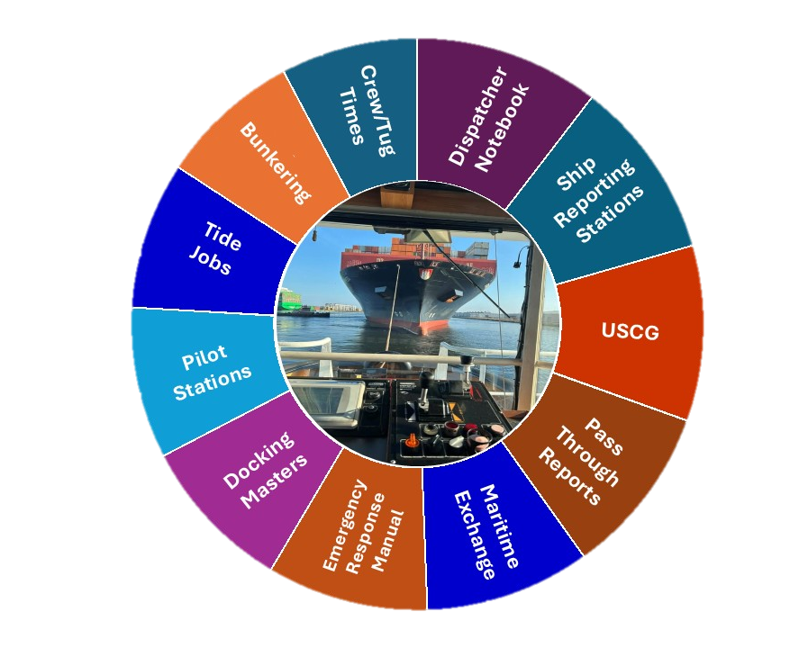

Stewardship
80%

Slide 3
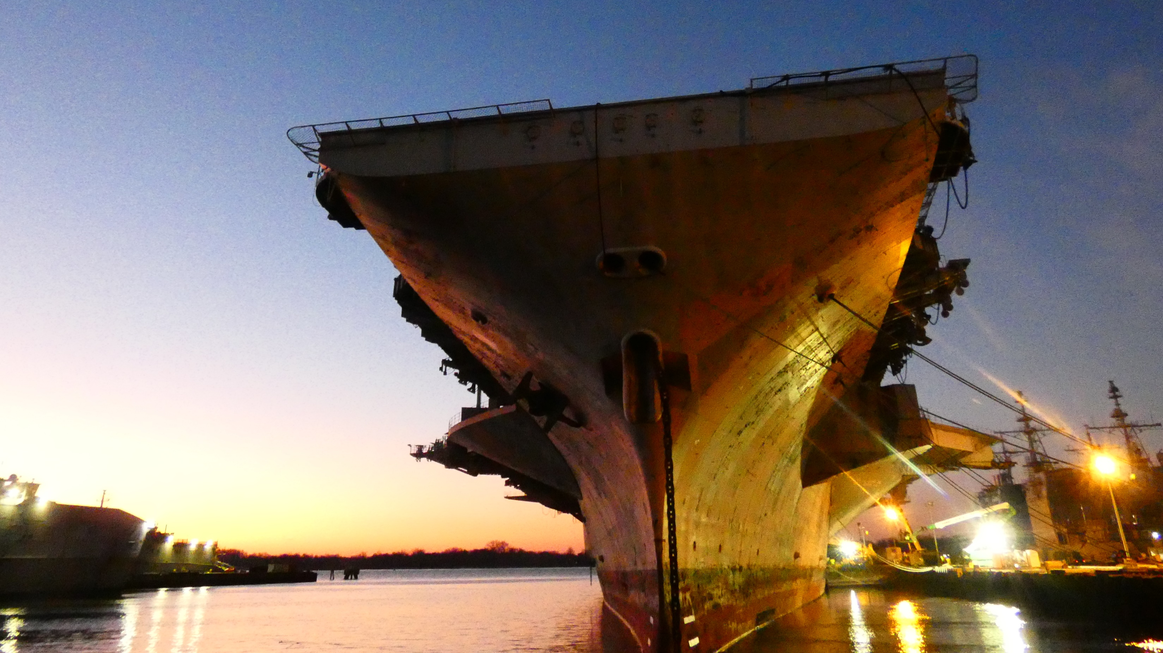
PNSY
CVN 67

Slide 4
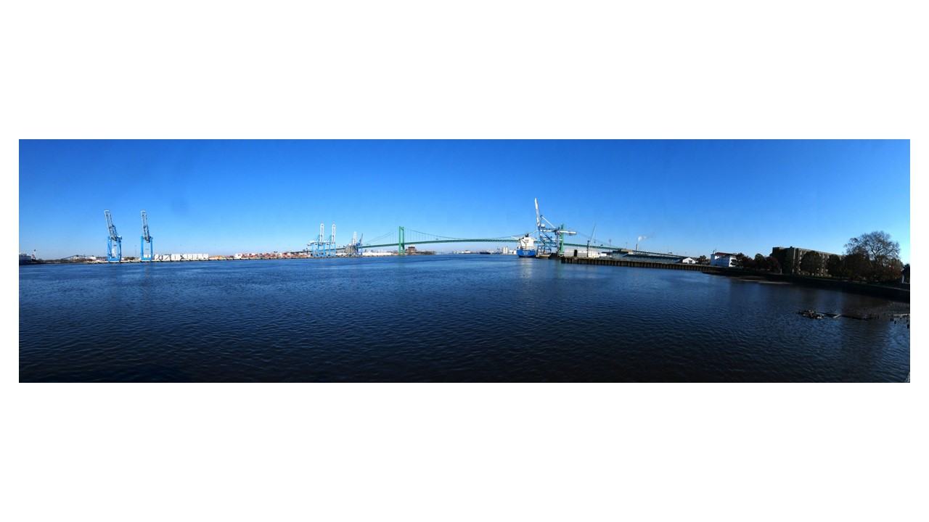
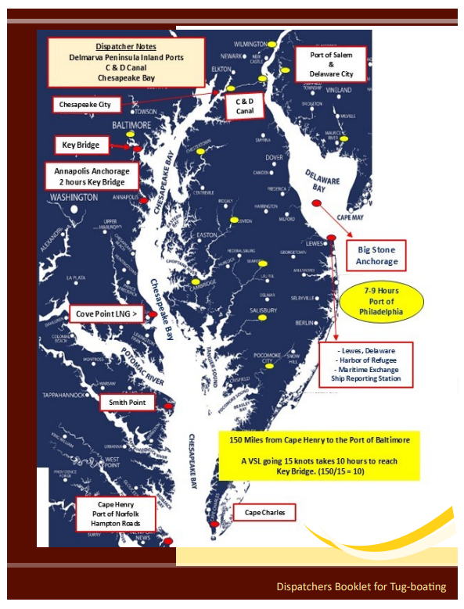
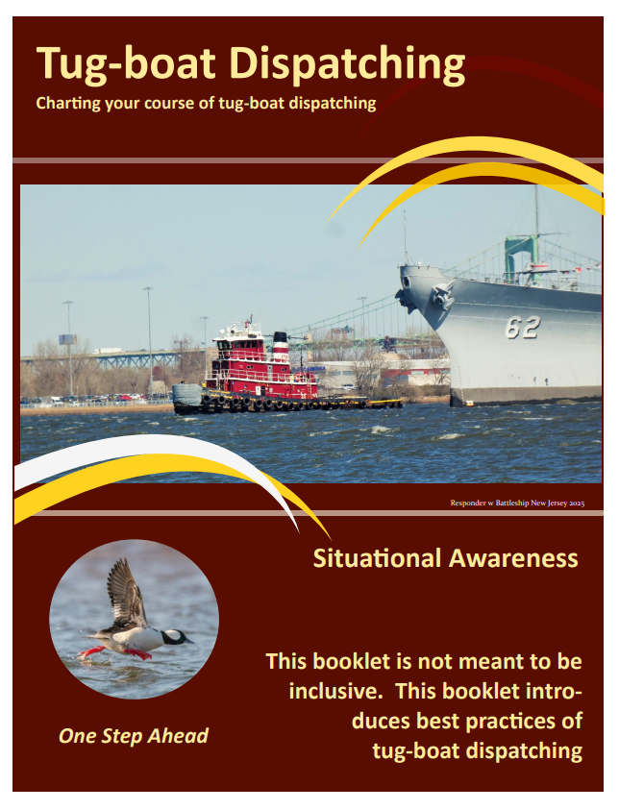
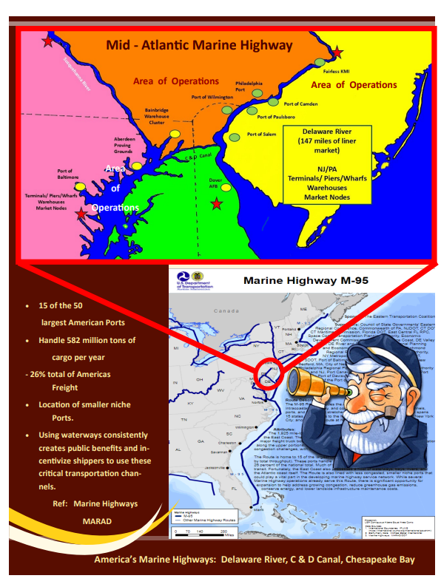
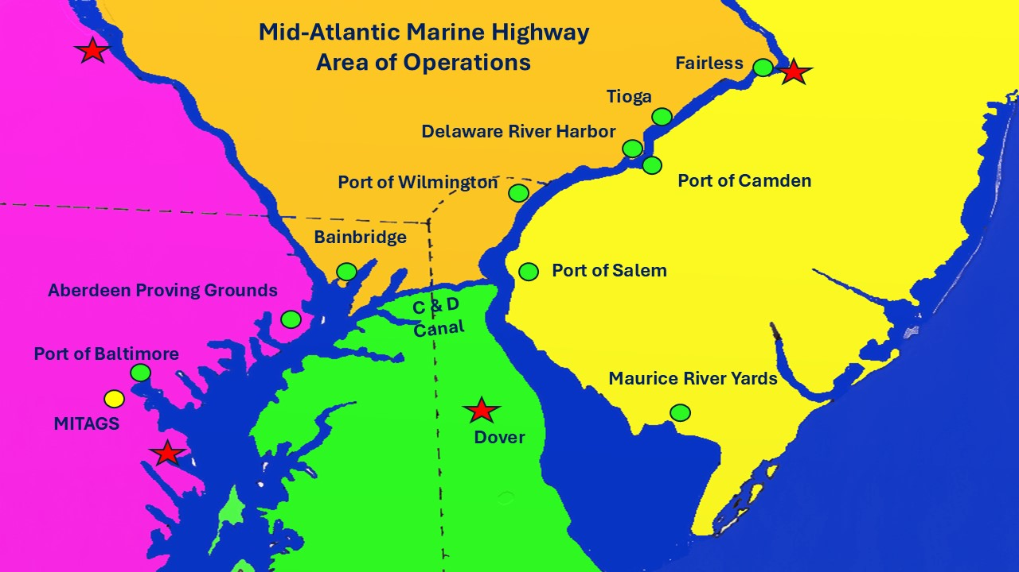
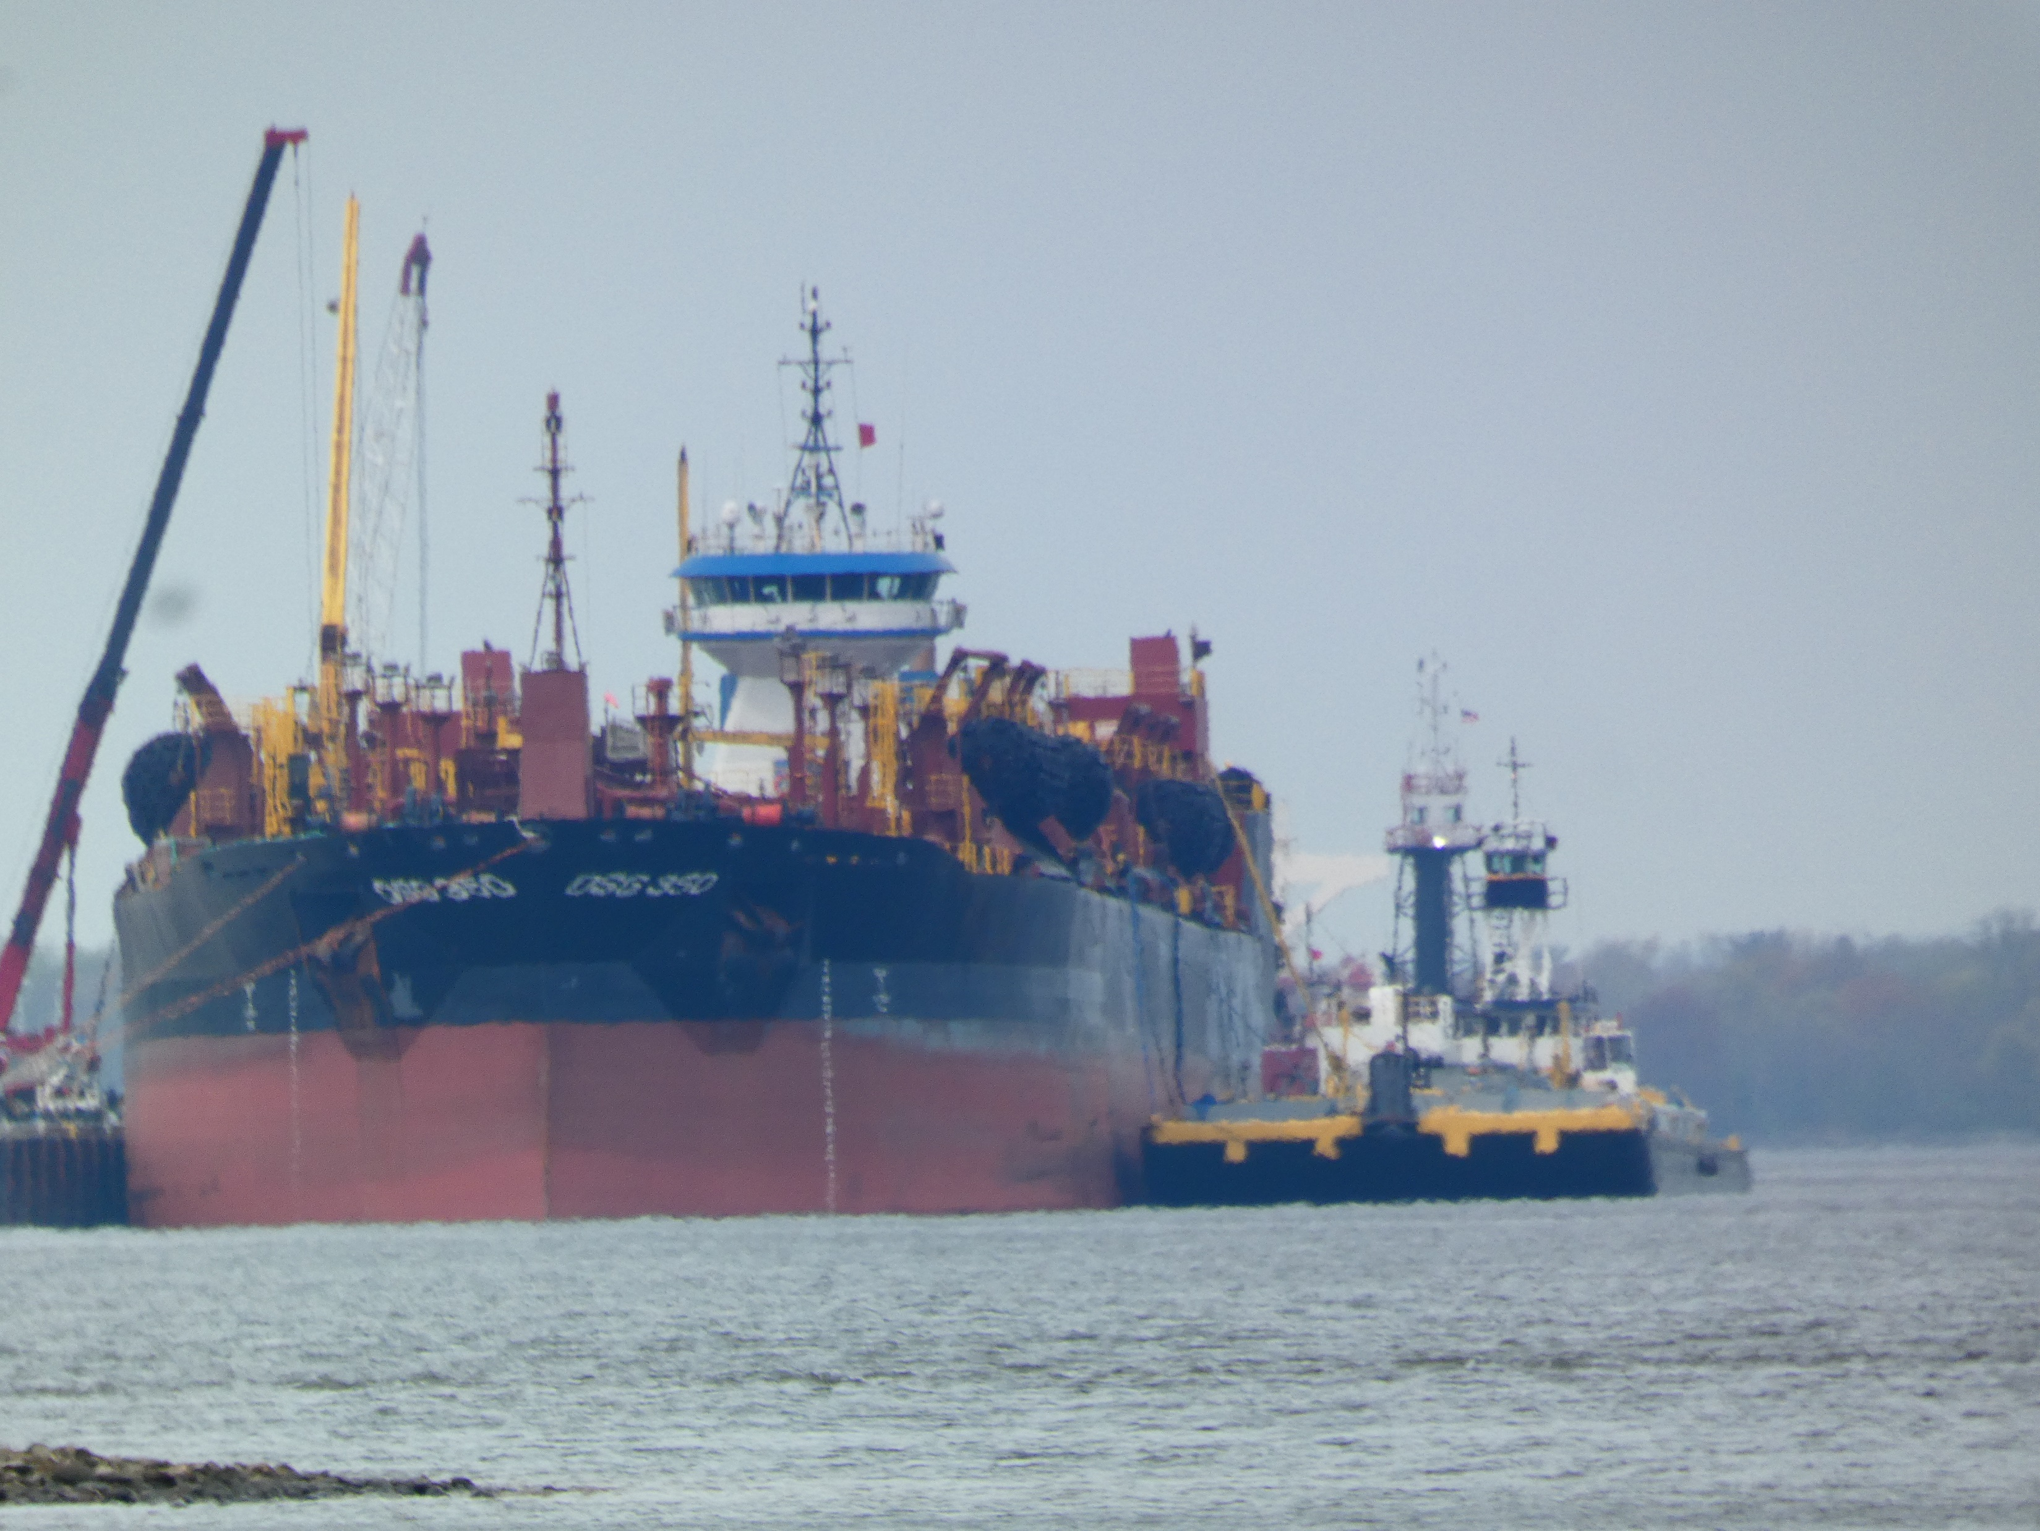
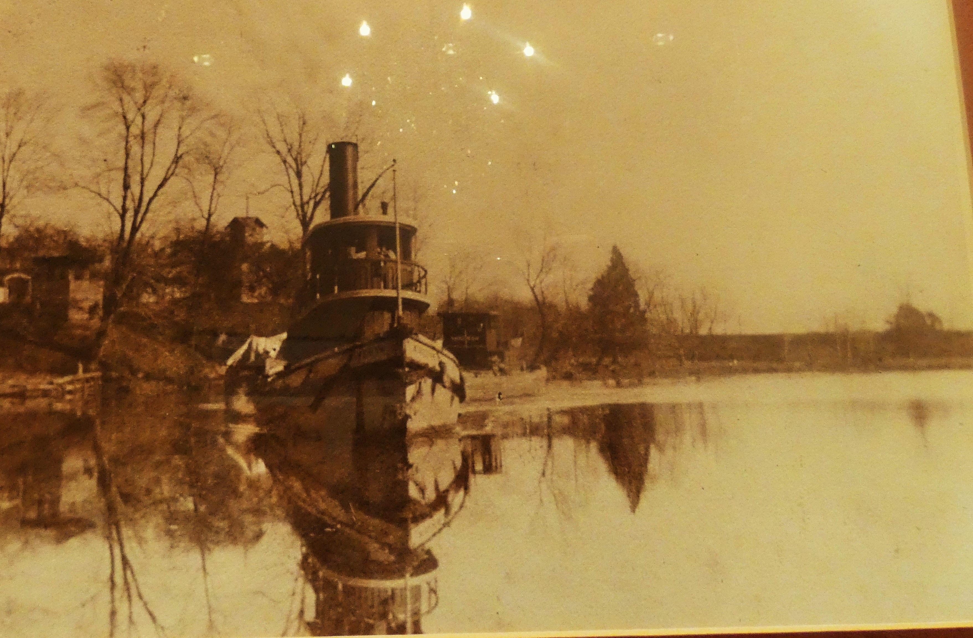
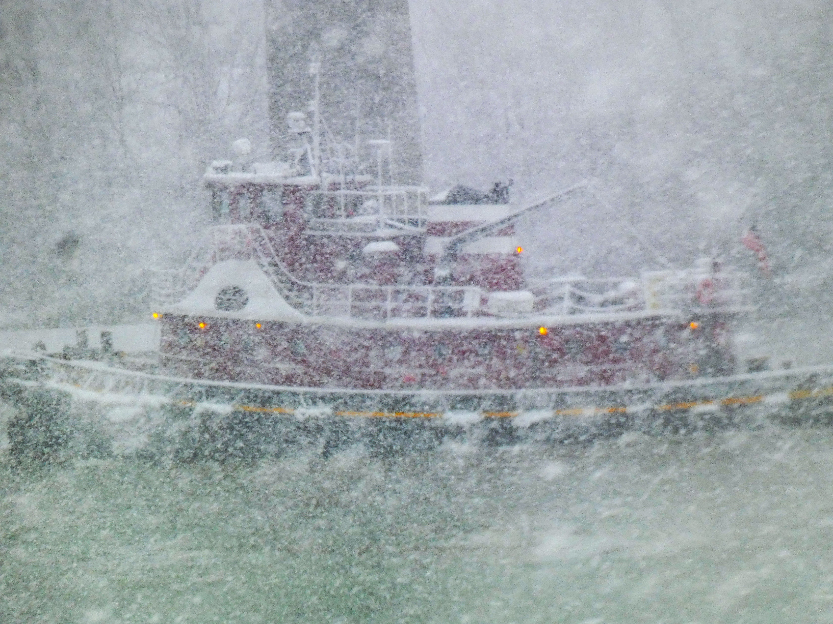
Tug Boats
“ Horseshoe ”
United States Marine Highway
M-95 Mid-Atlantic
Charting your course
Mt. Holly
Port of Camden
Hainesport
Rancocas Creek
Head of Tide
Port of Camden
Gloucester
Port of Bridgton
1687
Delmarva
Inland
Ports
Delaware
Capes
South Branch Rancocas Creek
Hainesport, NJ
146 NM above Delaware Capes
General Anchorage 11
Different Situations Communicate Acceptable Solutions Ref: Abridged 1932 USNA Midshipman Manual
2026 Mariners Conference / Stewardship

Slide 5
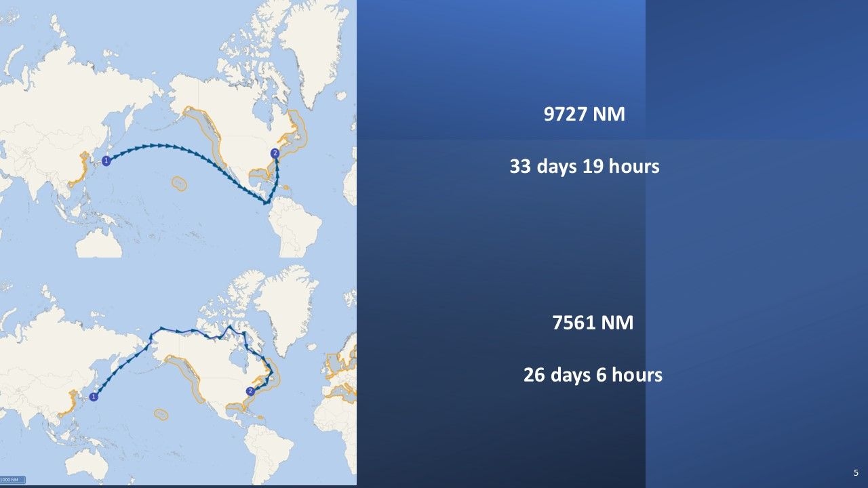
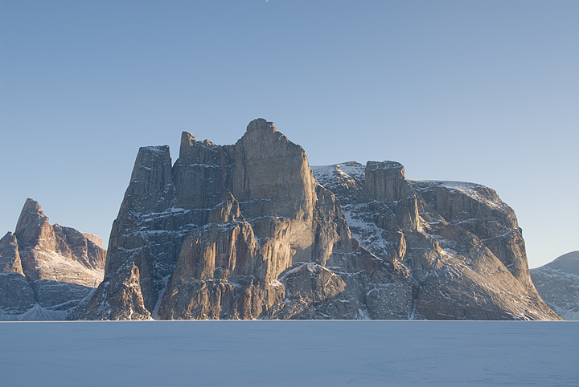
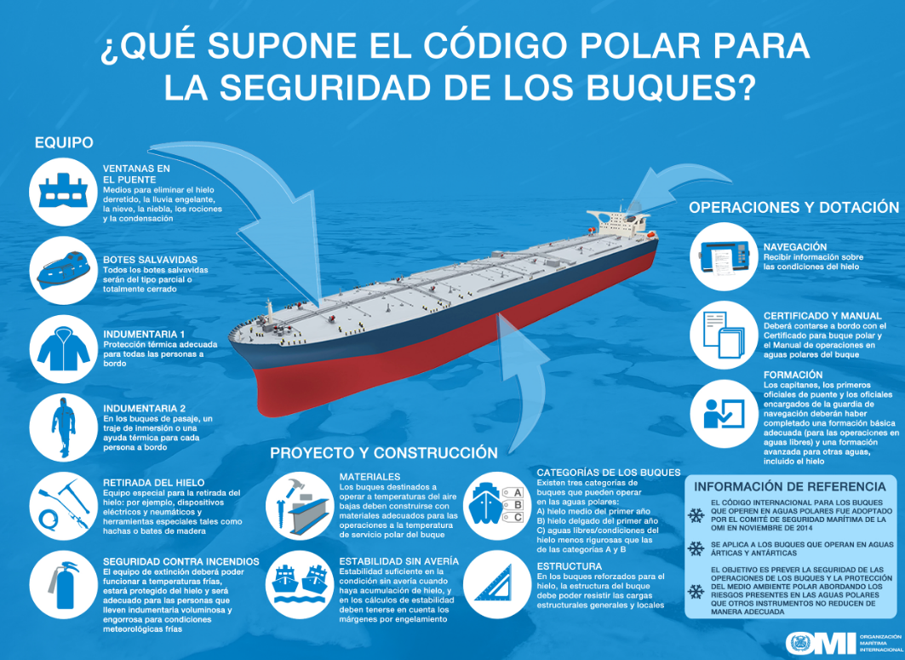
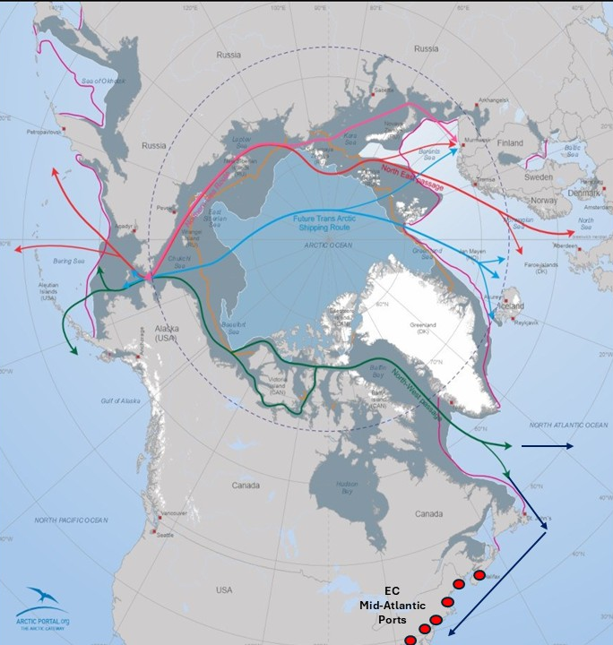

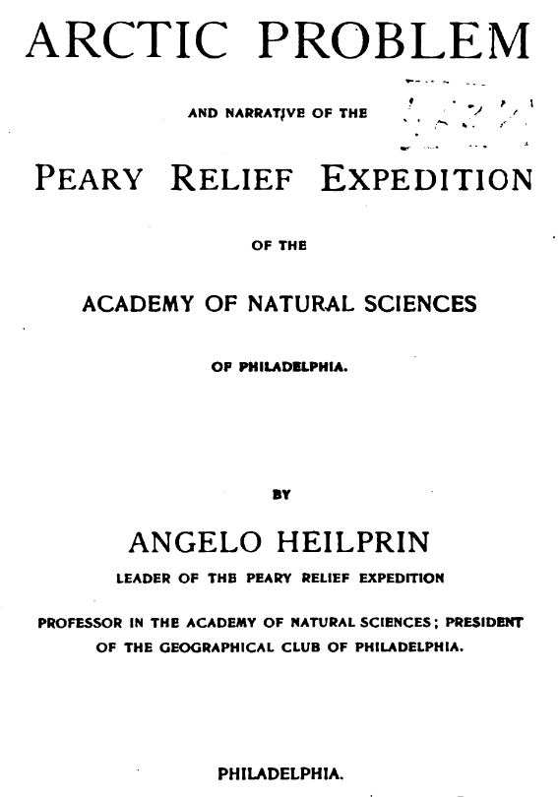
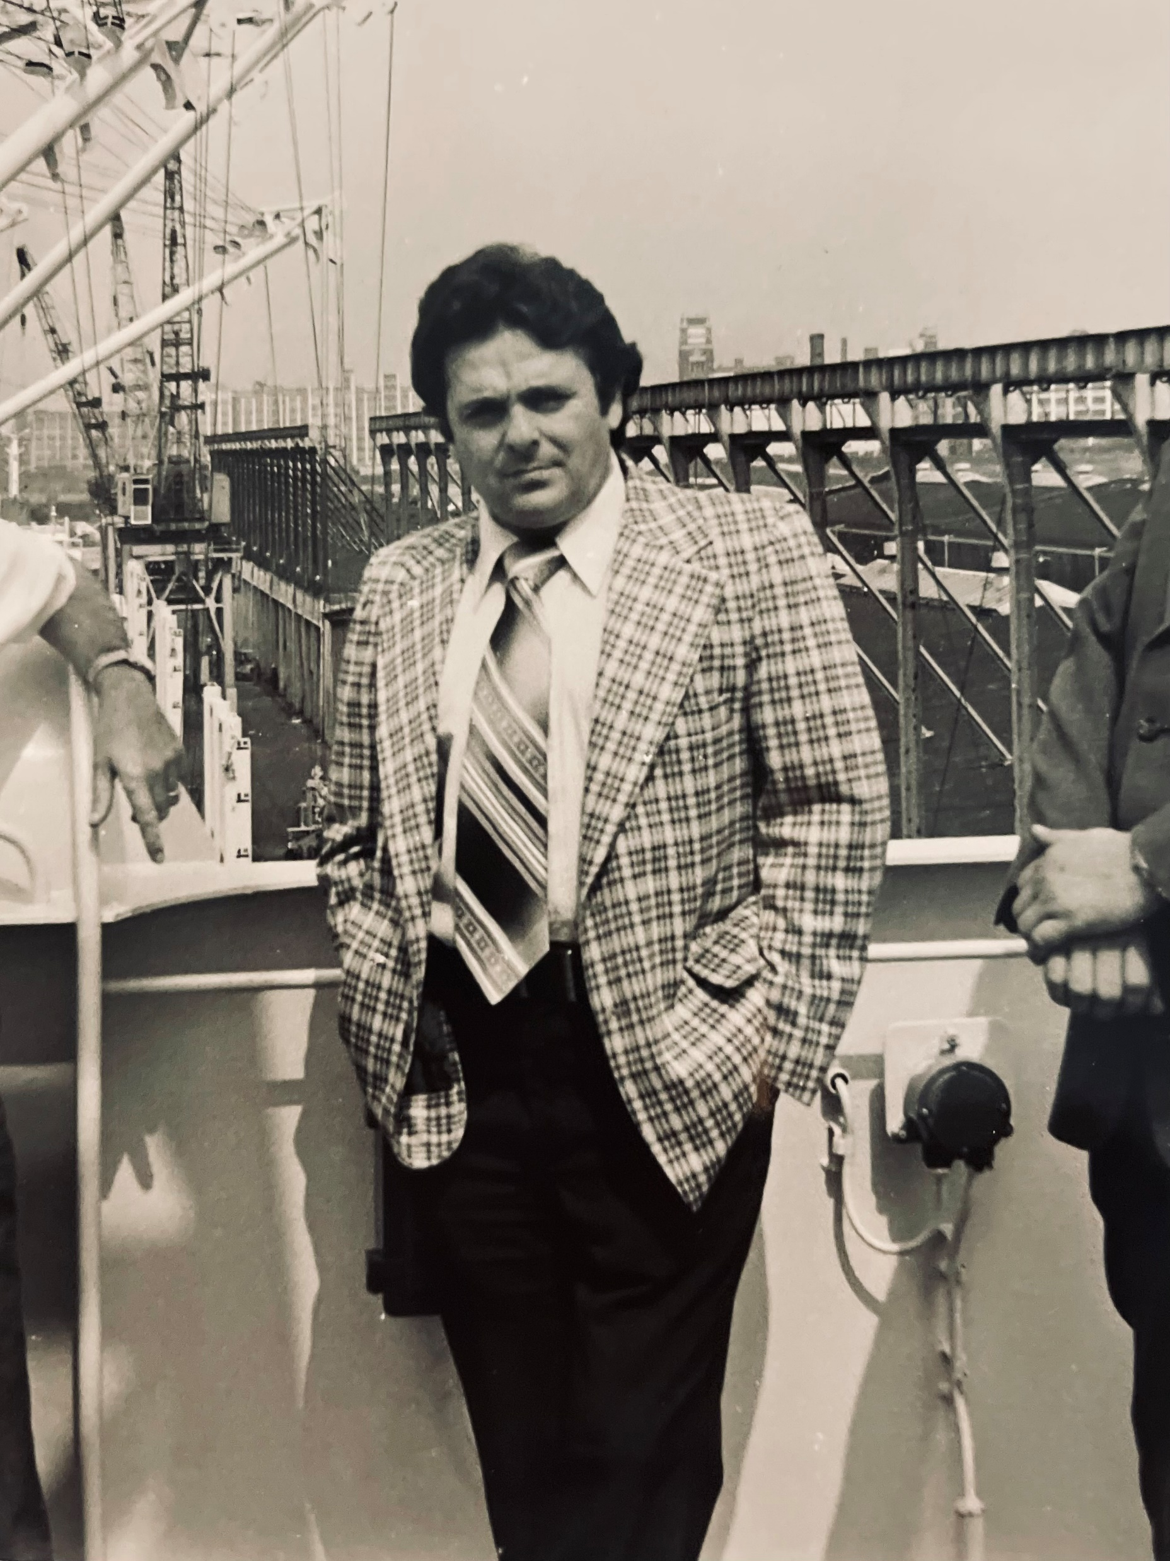
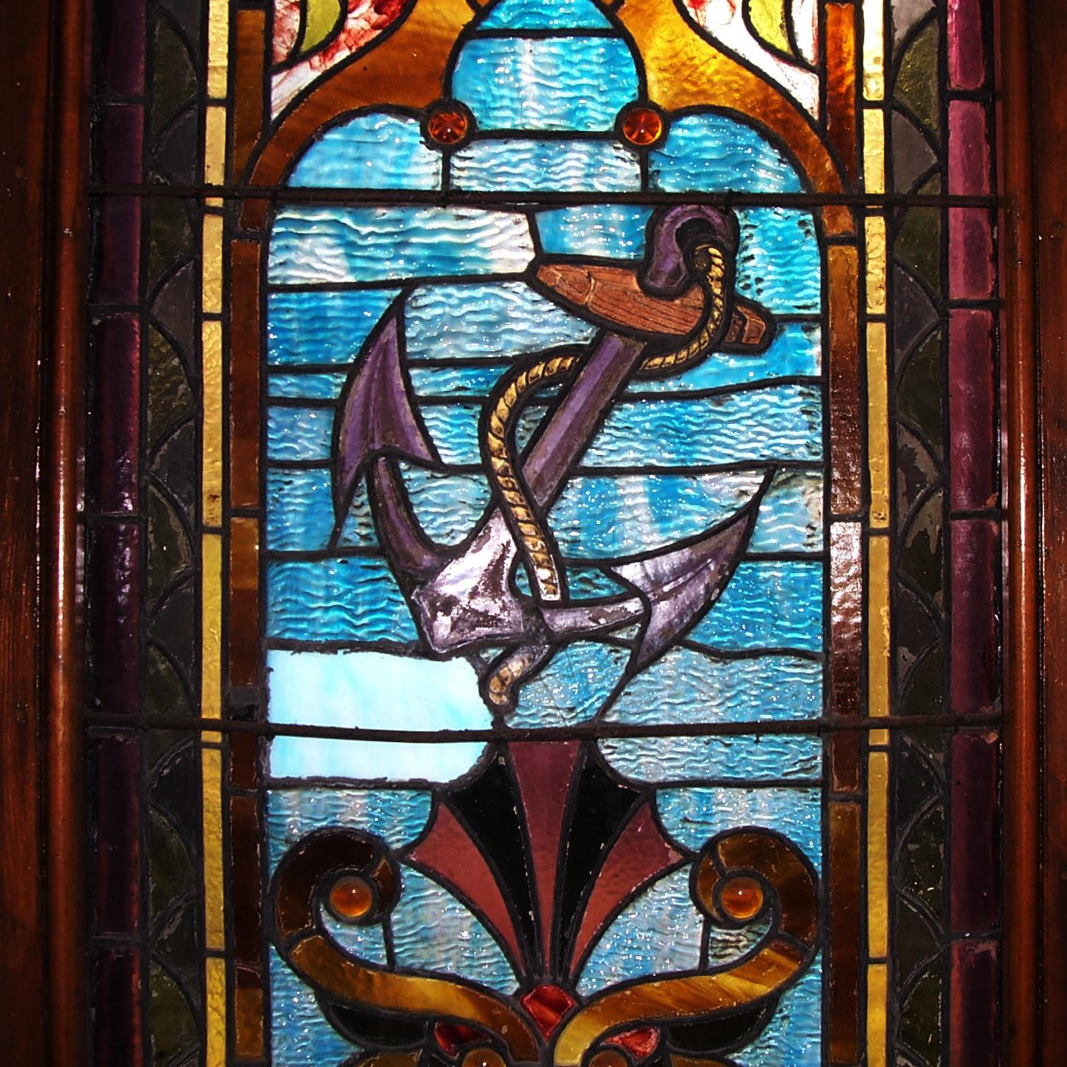
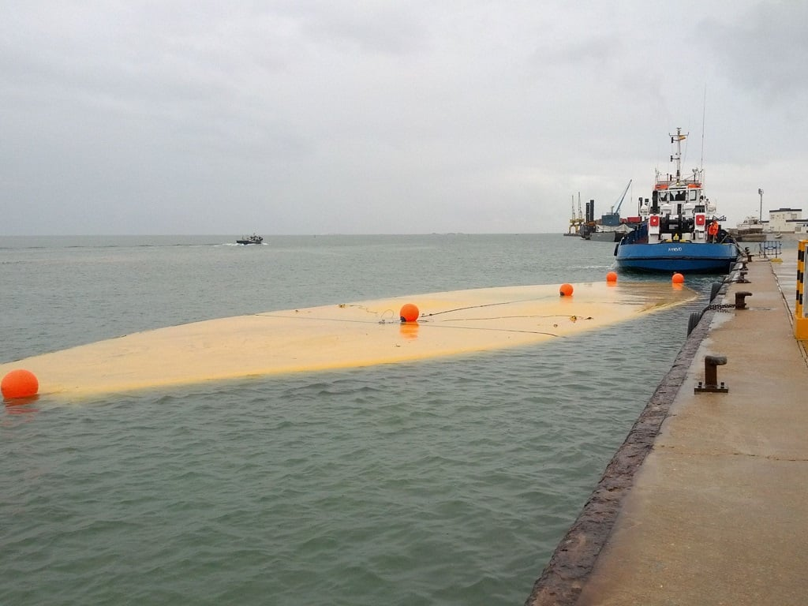

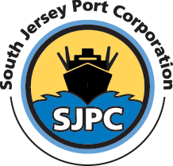
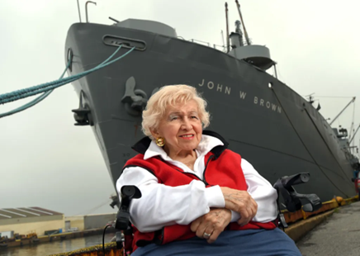

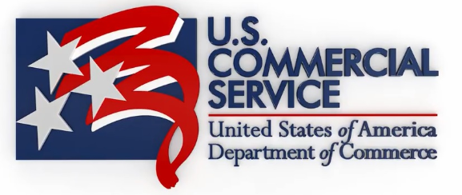
Stewardship consists of helping others do their best.
Admiral Chester Nimitz
Polar Code
Delaware River Ports
Vladivostok
Constitutional
Crisis
Henson Museum, Port of Camden
Water Vessels
Northern Sea Route
ARCTIC
SHIPPING
Joe Balzano
Courtesy South Jersey Port Corporation
Trade Link
NW Passage
Tokyo to Port of Philadelphia
9727 NM
Hon. Helen D. Bently
Port of Baltimore
First Rule: There are No Rules
Philadelphia
Maritime
Exchange
Delaware River Ports
EC USA PORTS
2026 Mariners Conference / Stewardship

Slide 6
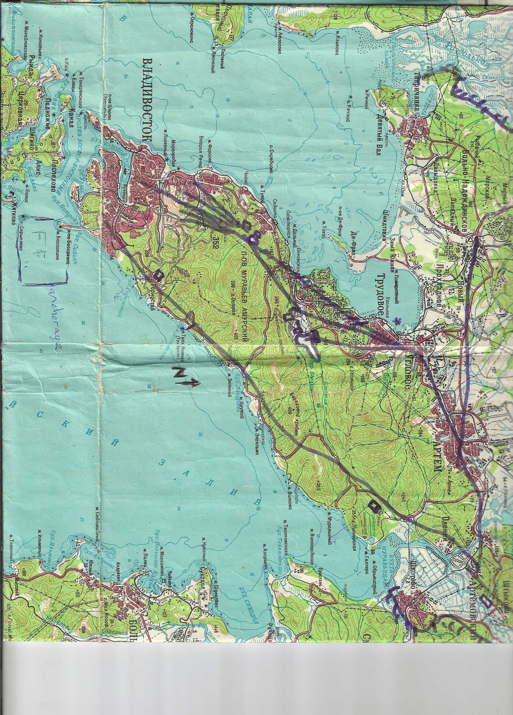
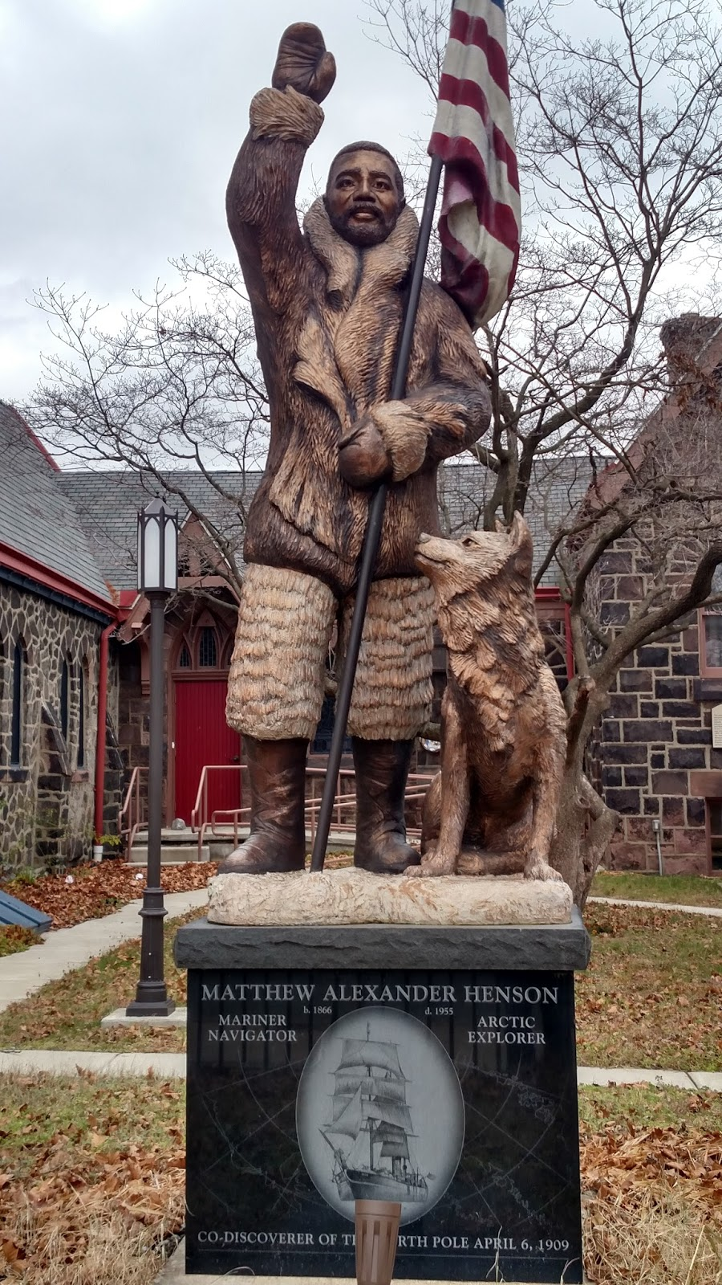
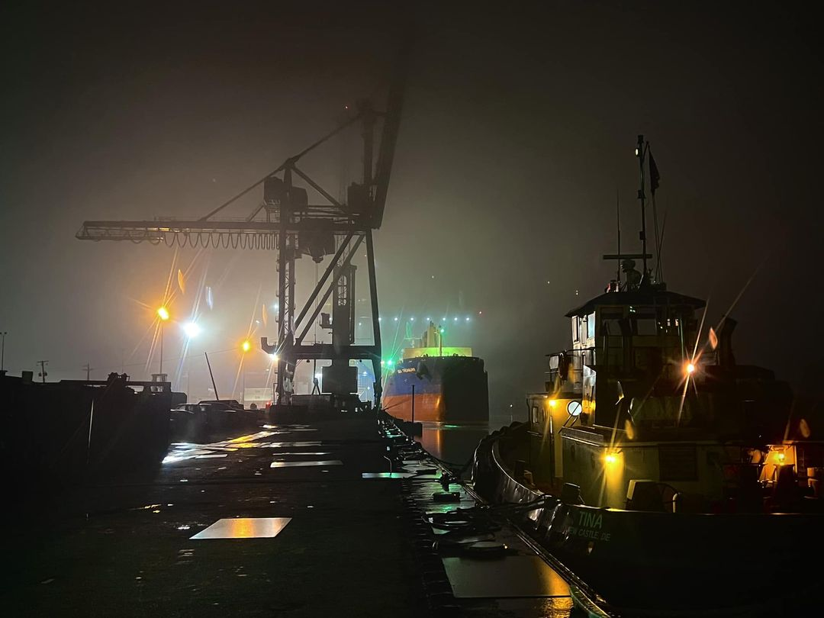
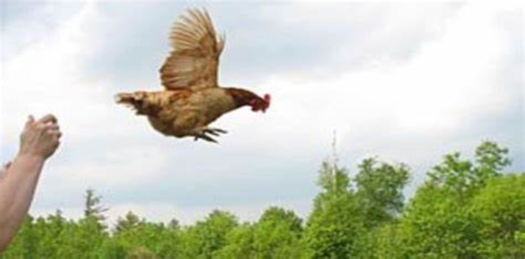
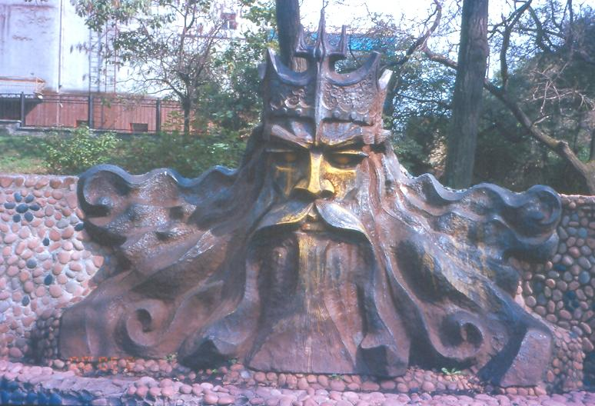
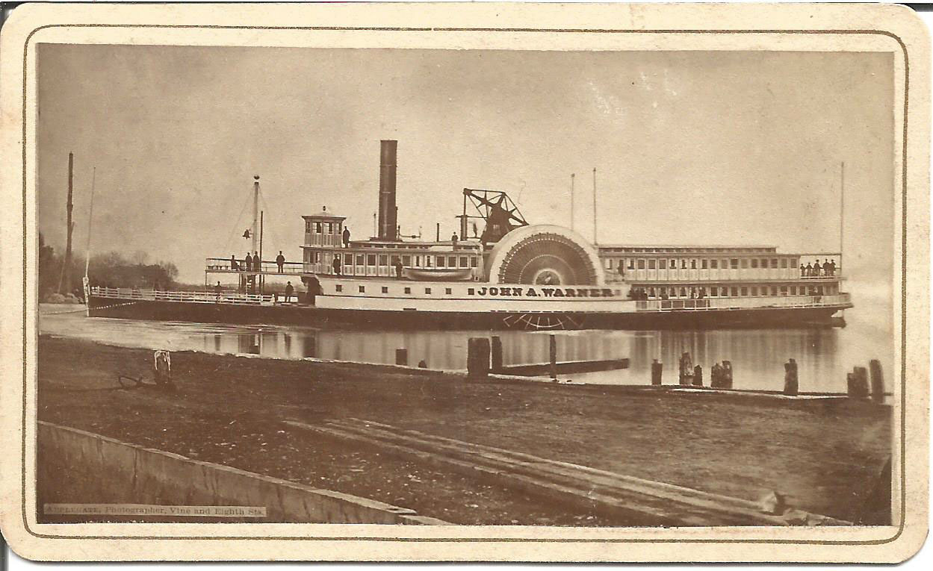
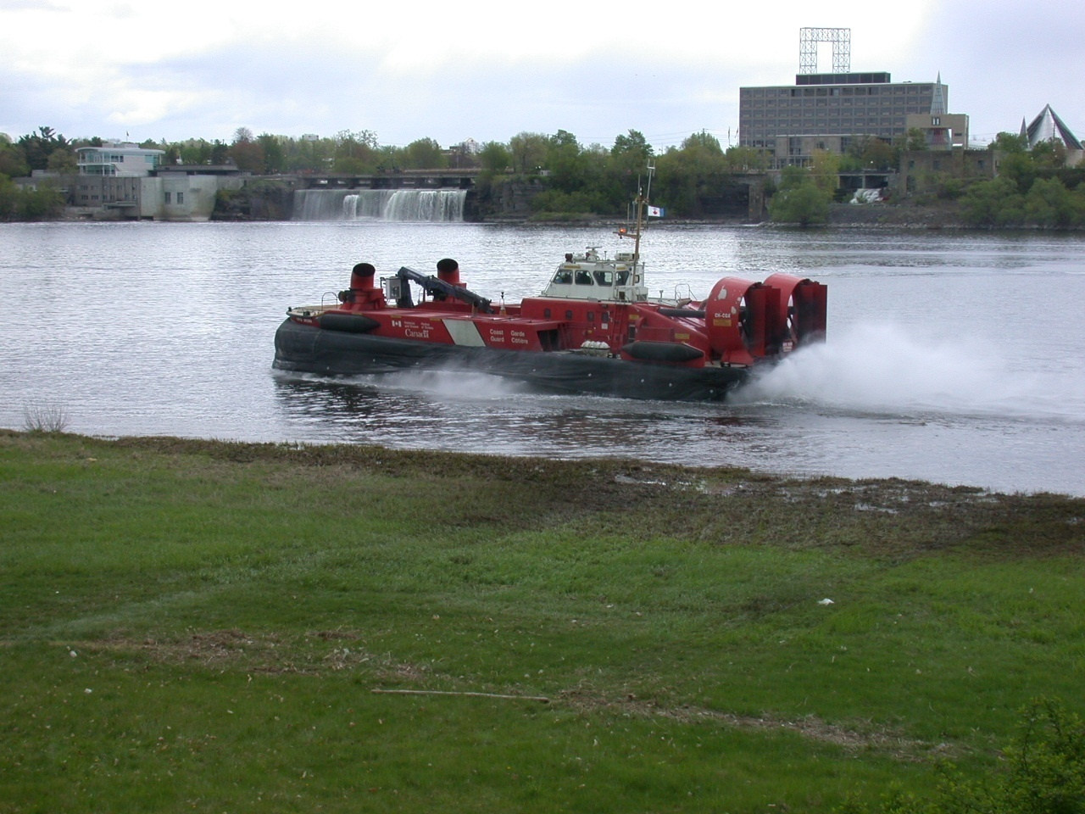
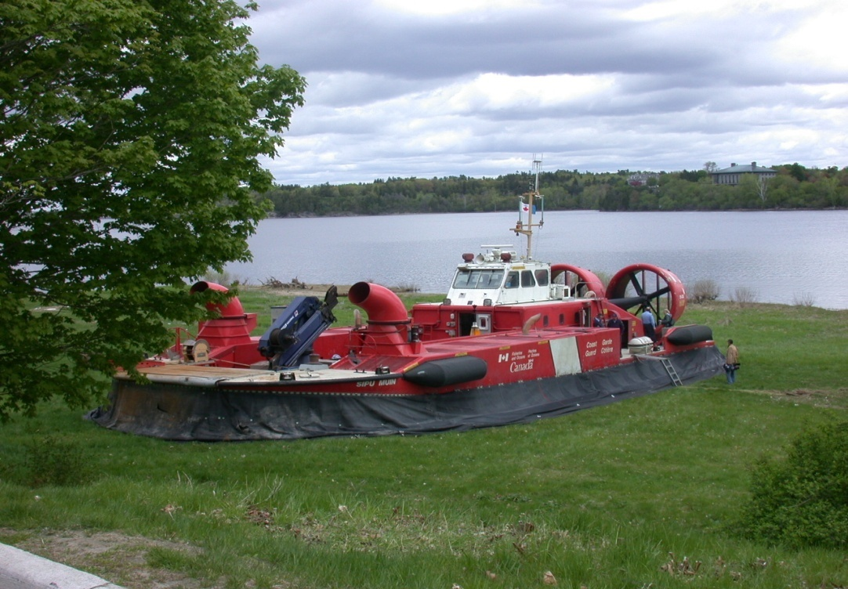
“A Garden to Grow”
James Rouse, Port of Baltimore
How Far Can You Throw a Chicken ?
Port of Camden
Matthew Henson of the Arctic (Museum)
Mid-Atlantic Ports
Delaware River
Delaware/New Jersey/Pennsylvania
Maryland’s Port of Baltimore
Port of Vladivostok
There are, however, protocols.
Port of Wilmington
Photo Credit: Del River Mariner
First Rule: There are No Rules
2026 Mariners Conference / Stewardship

Slide 7
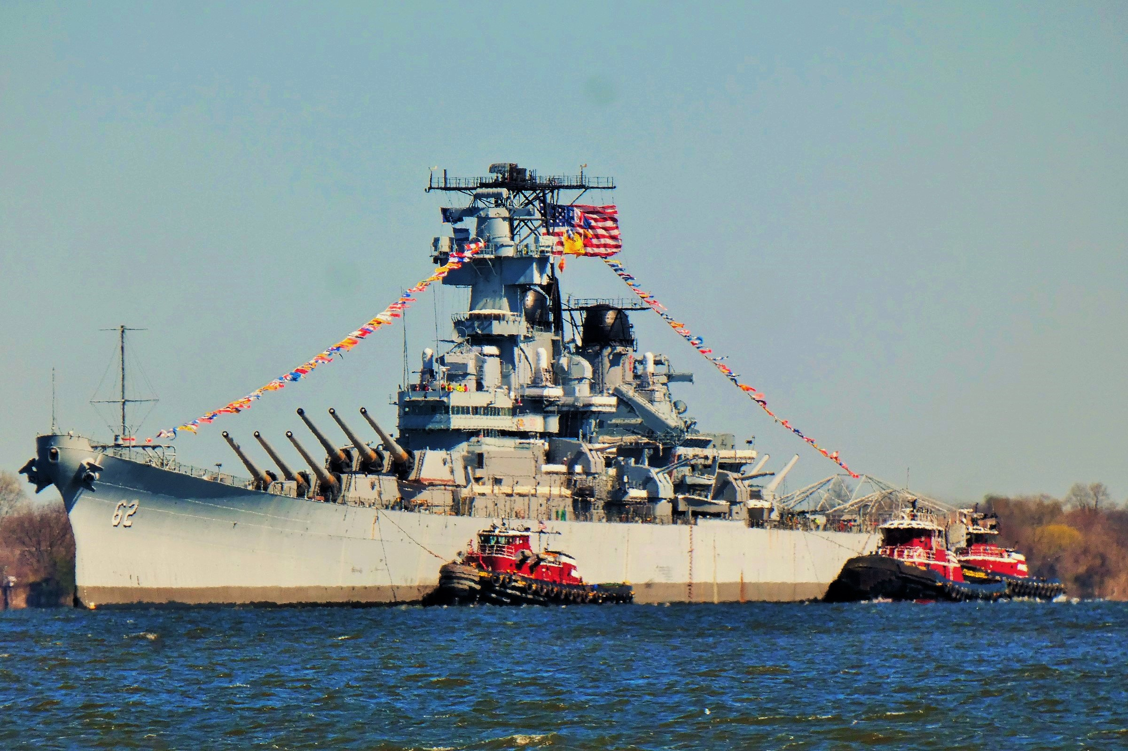
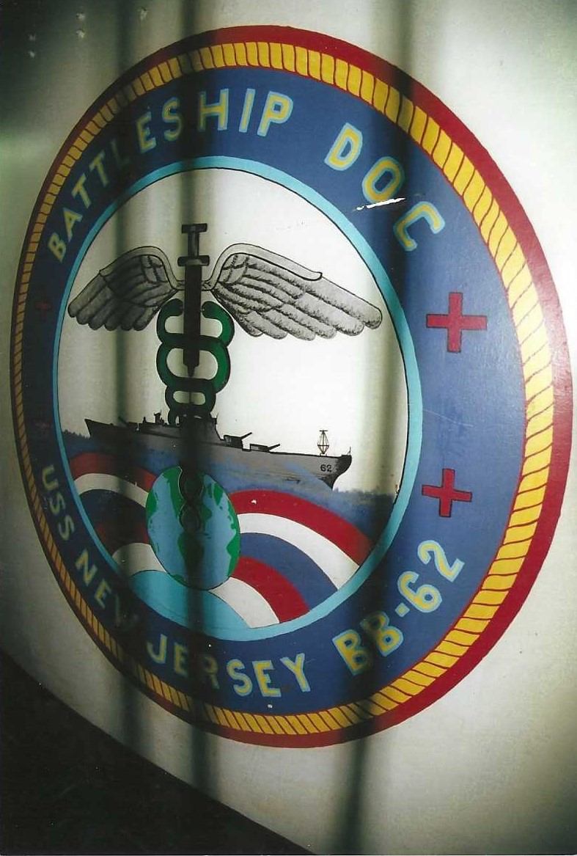
Eagle Point

Slide 8
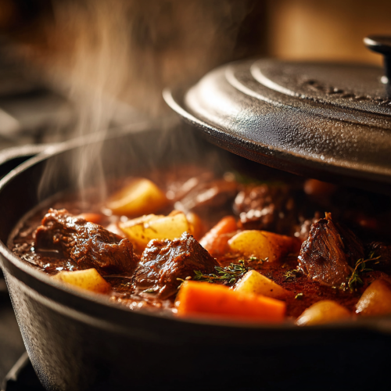
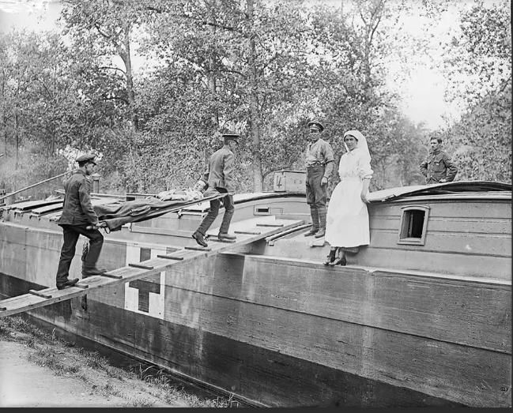
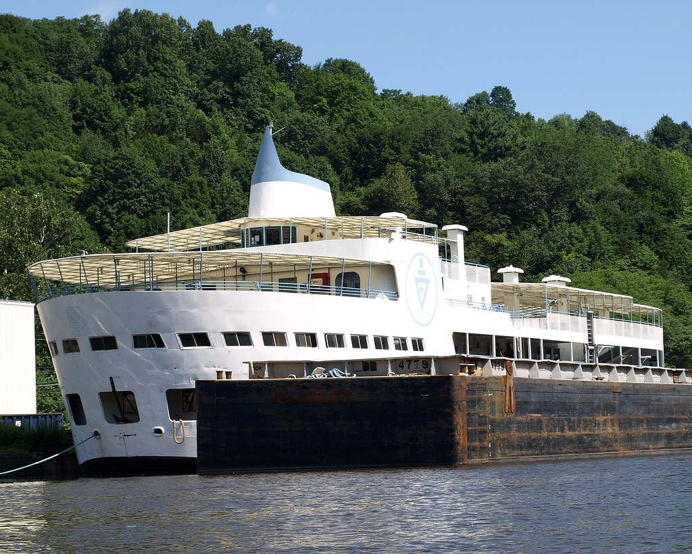
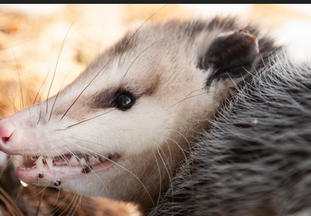
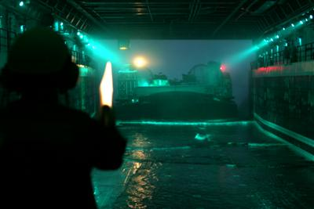

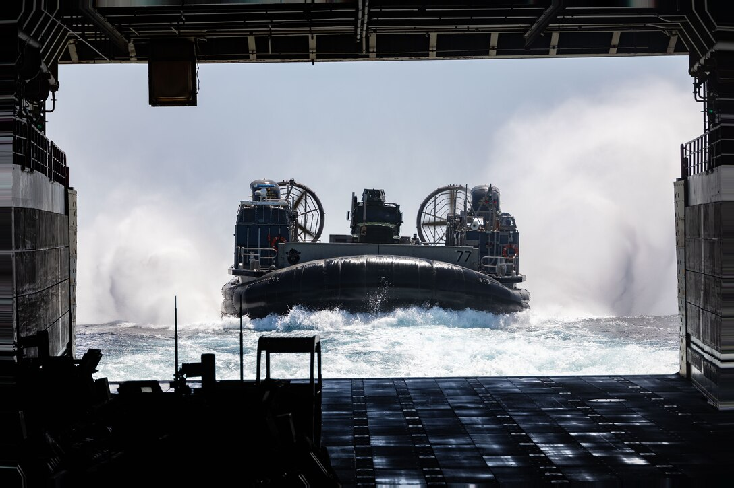
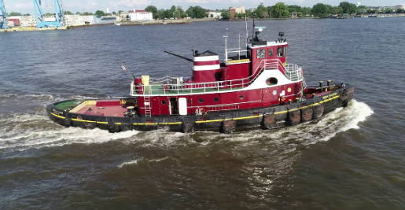
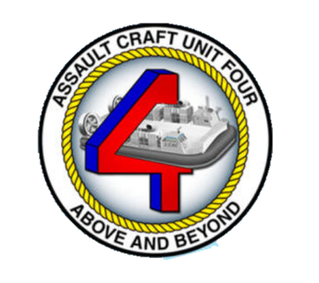
Perseverance 24/7/365
01 July 1916
NYC - The Floating Hospital 2025
Teresa
2026 Mariners Conference / Stewardship

Slide 9
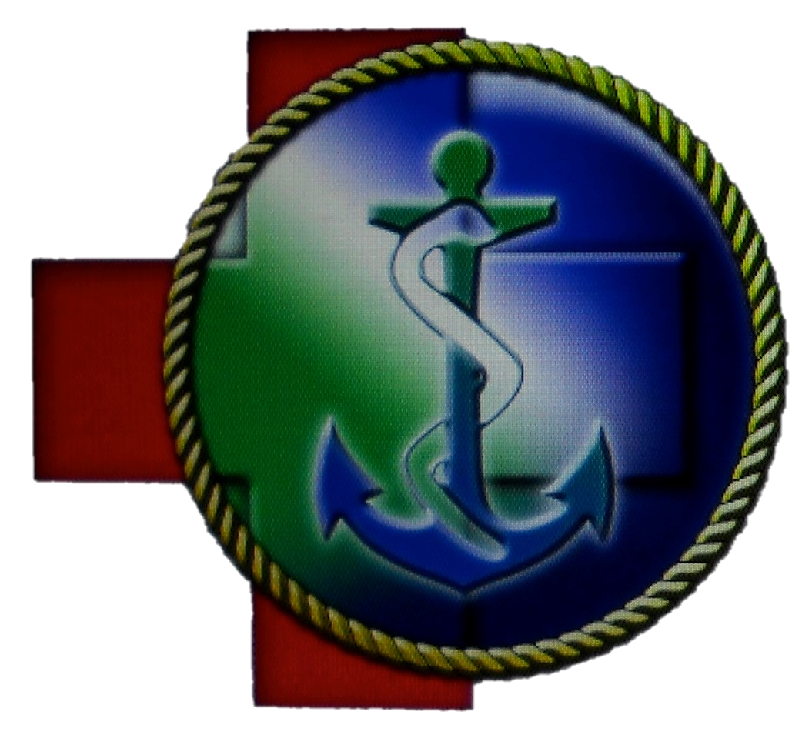
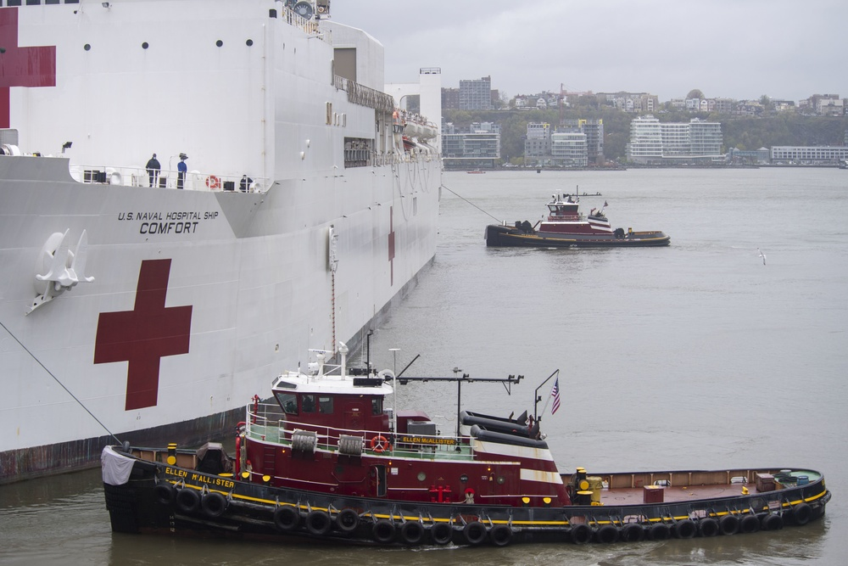
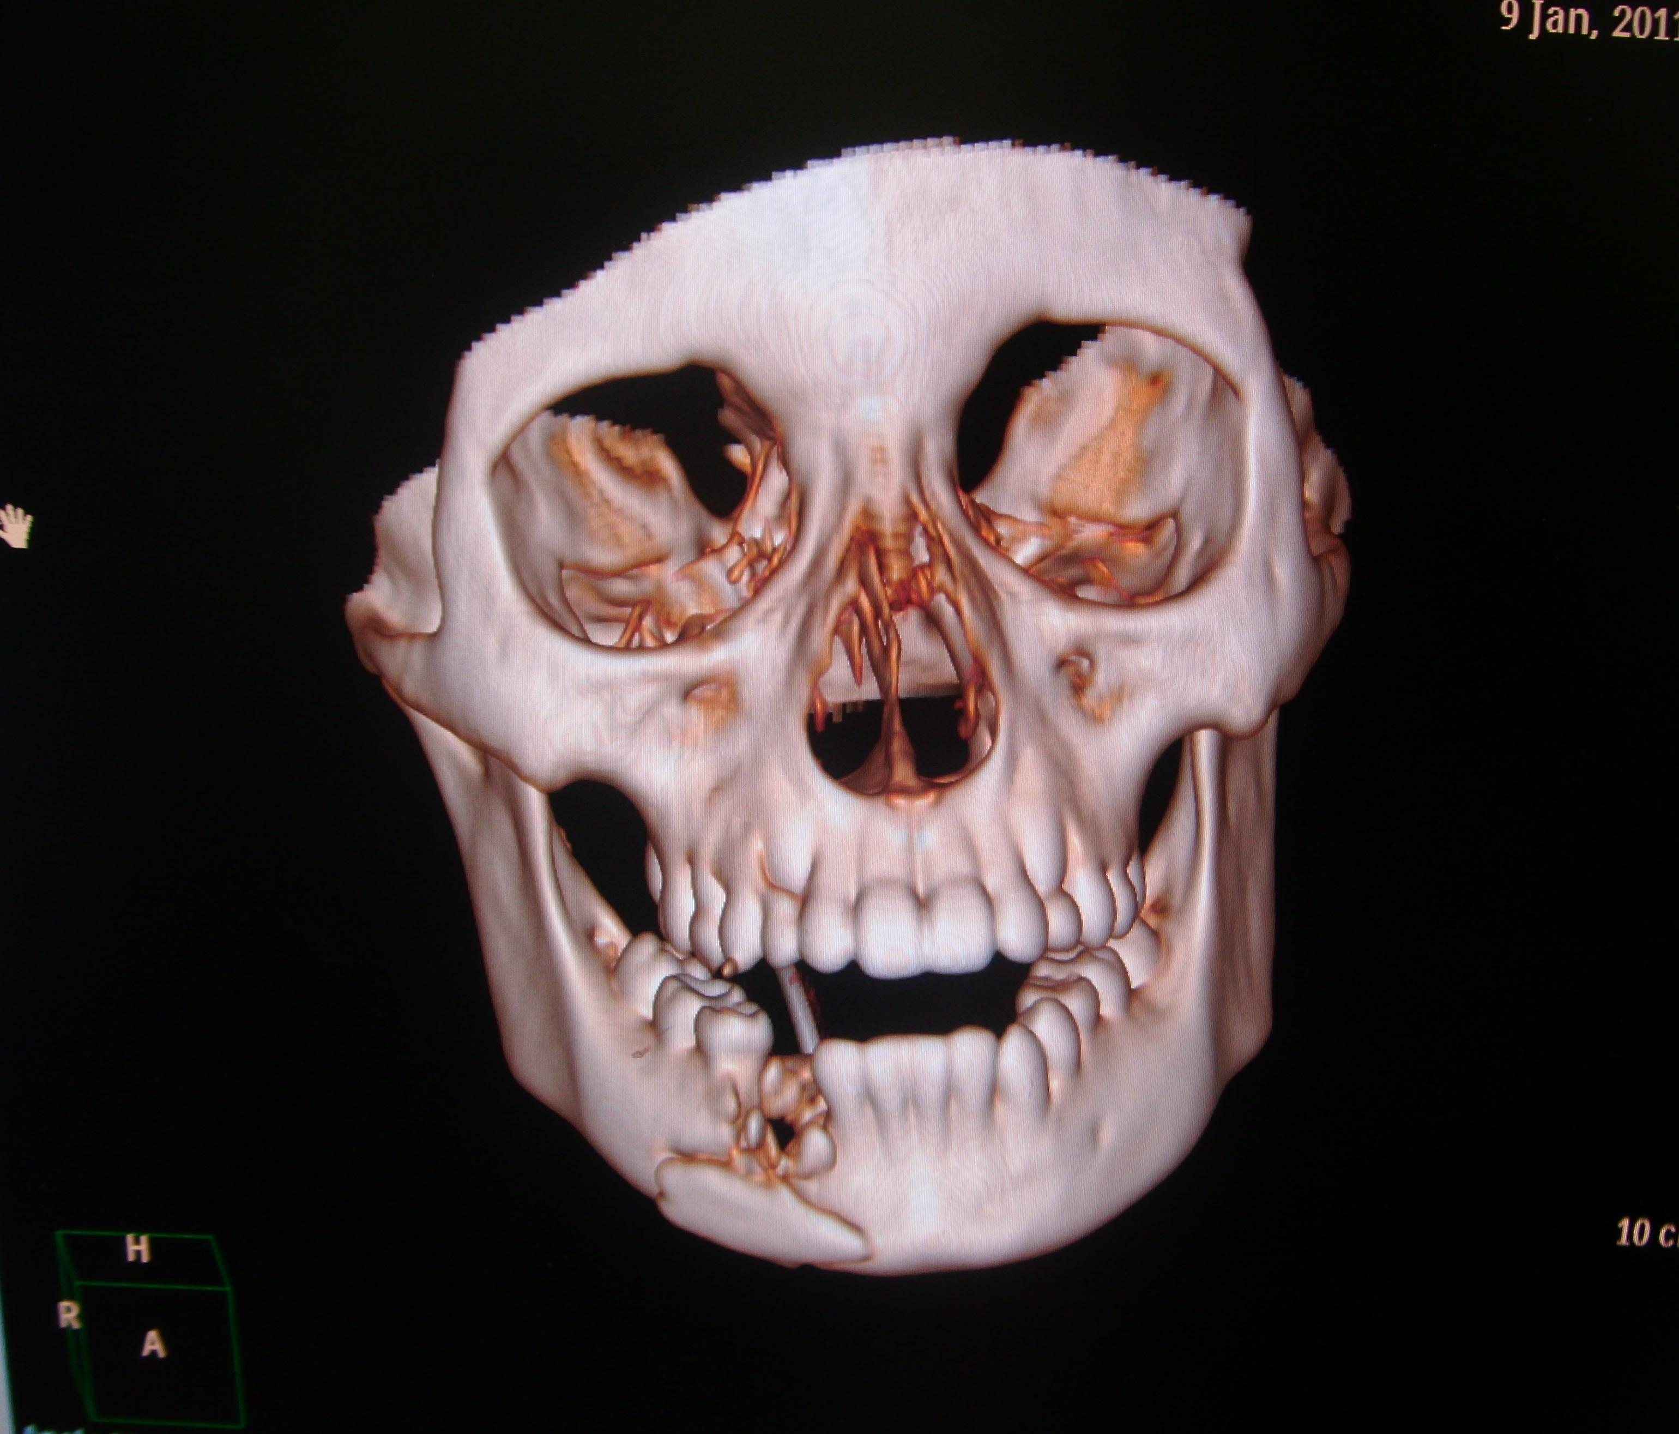
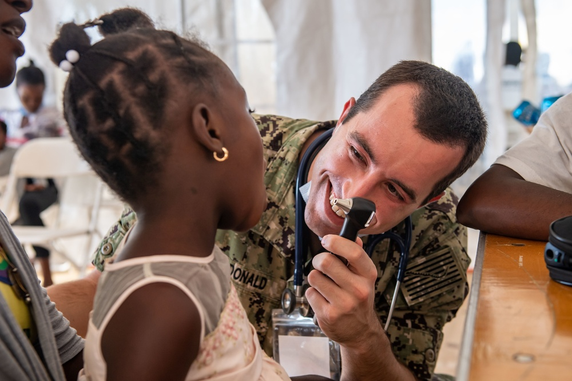
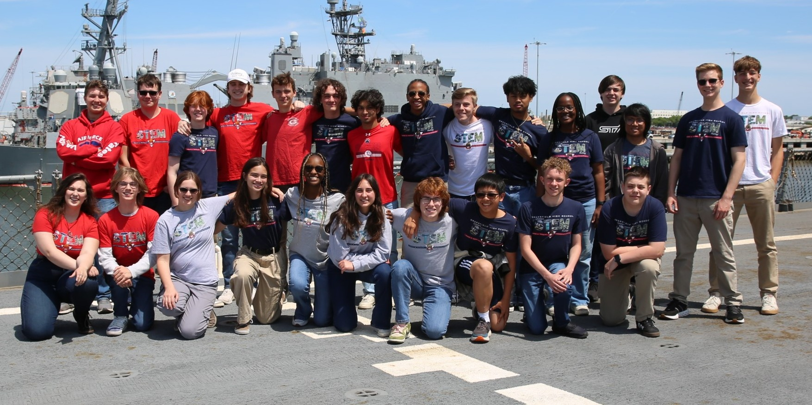
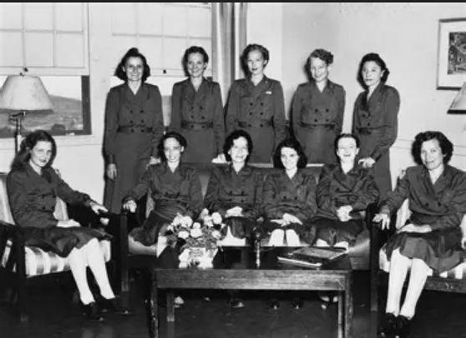
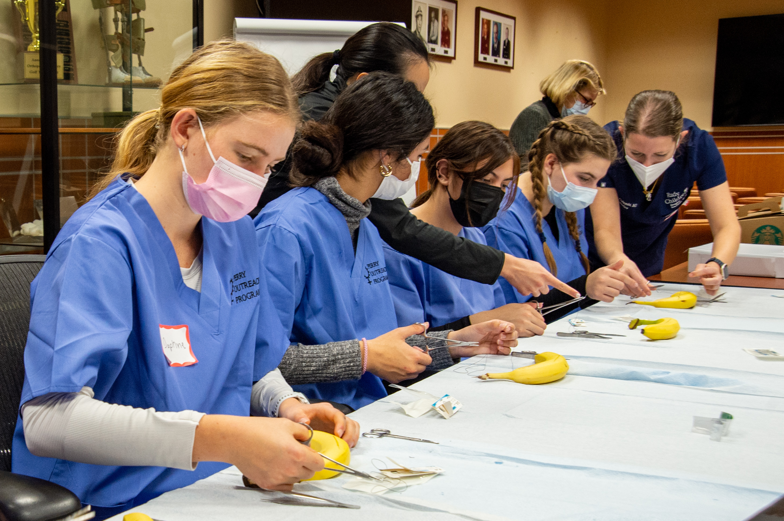
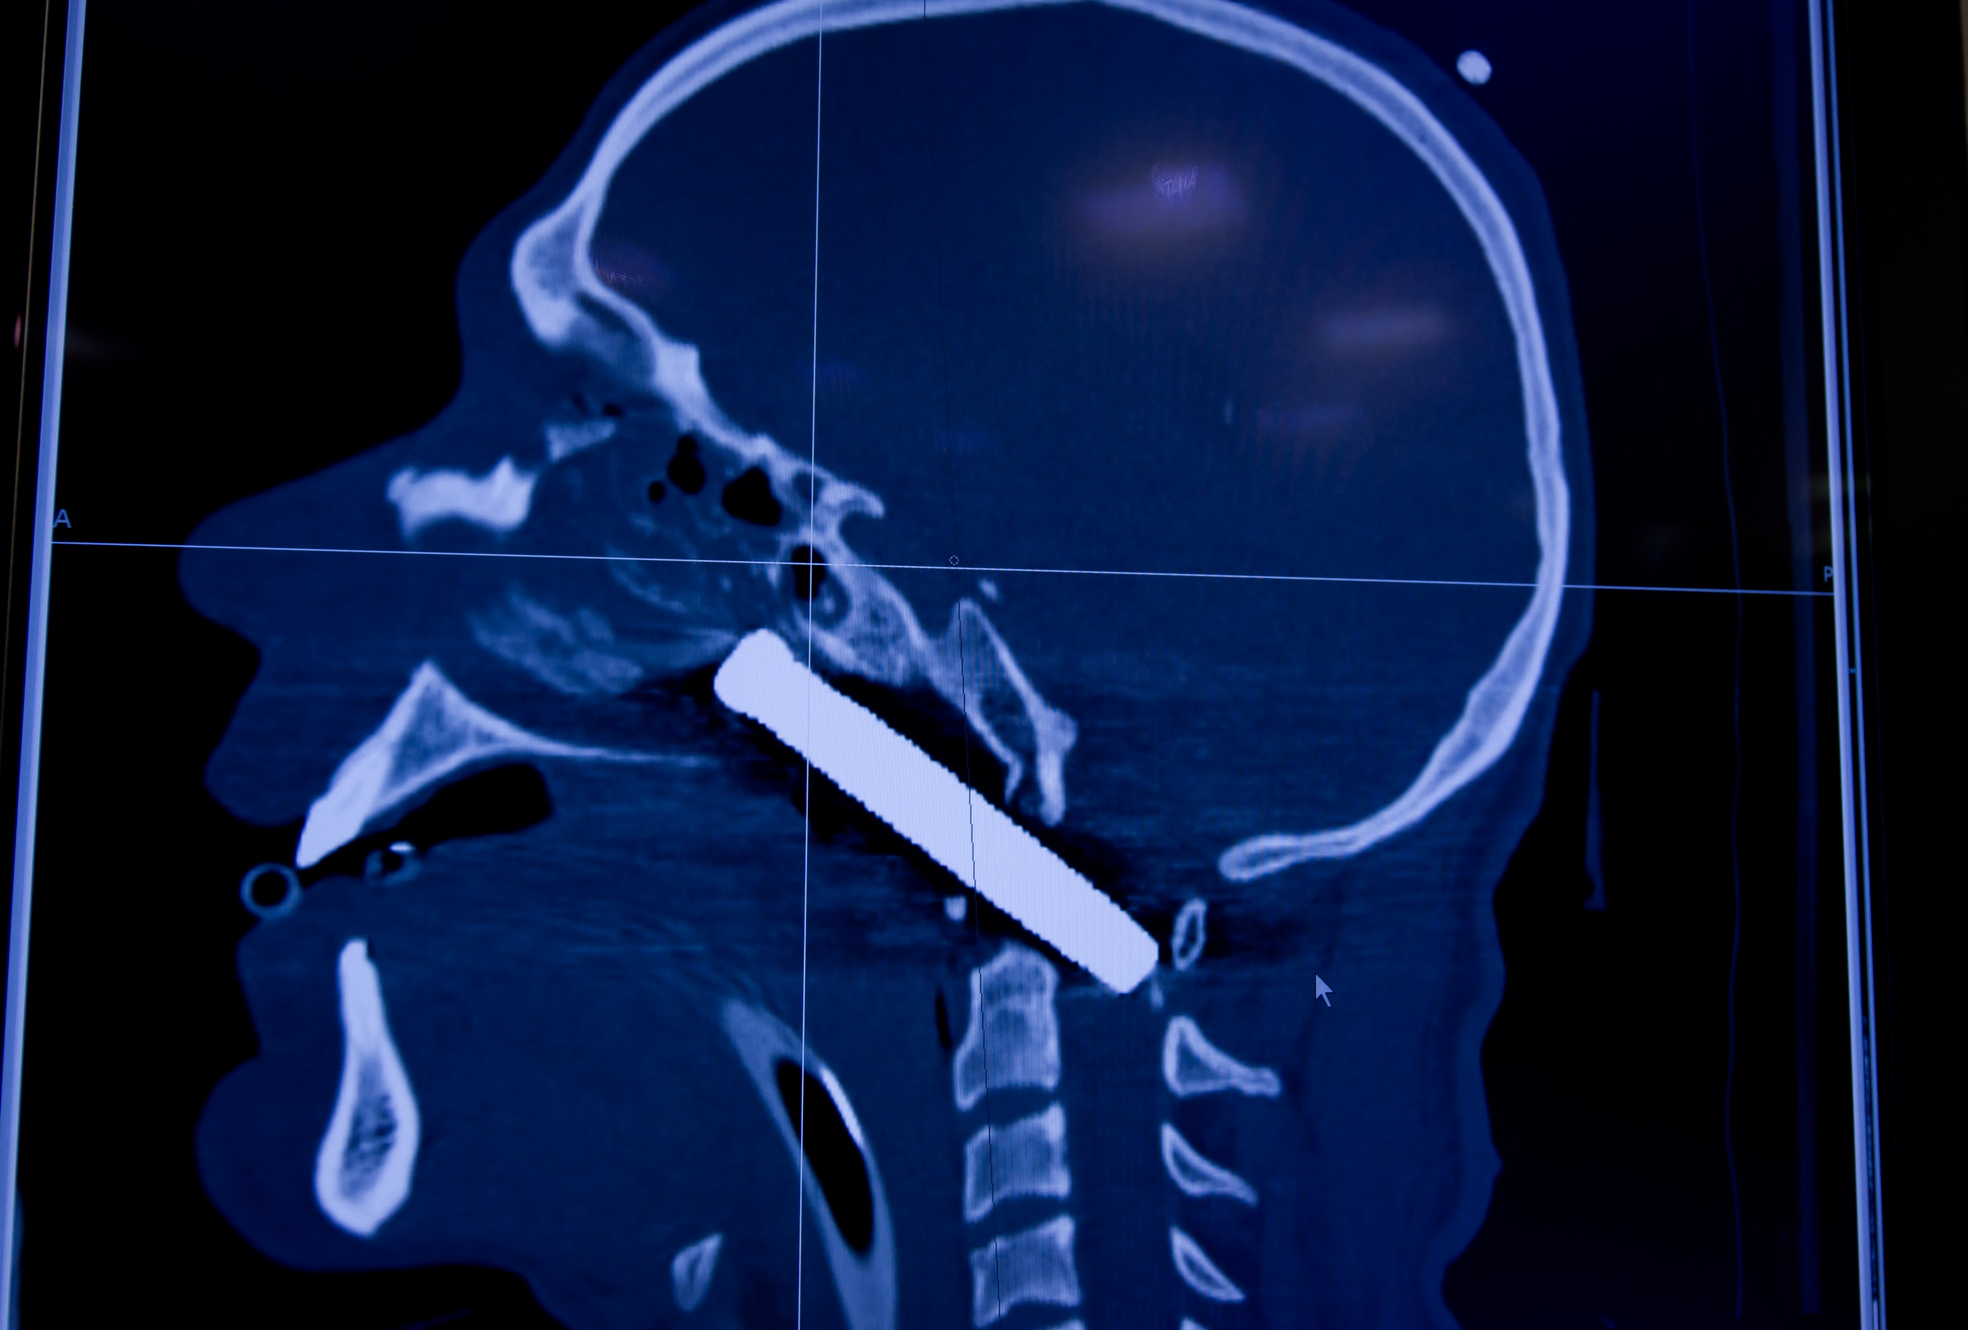
Navy Nurses - “Making a Fixture”
Bataan
Corregidor
Girard Point
2026 Mariners Conference / Stewardship

Slide 10
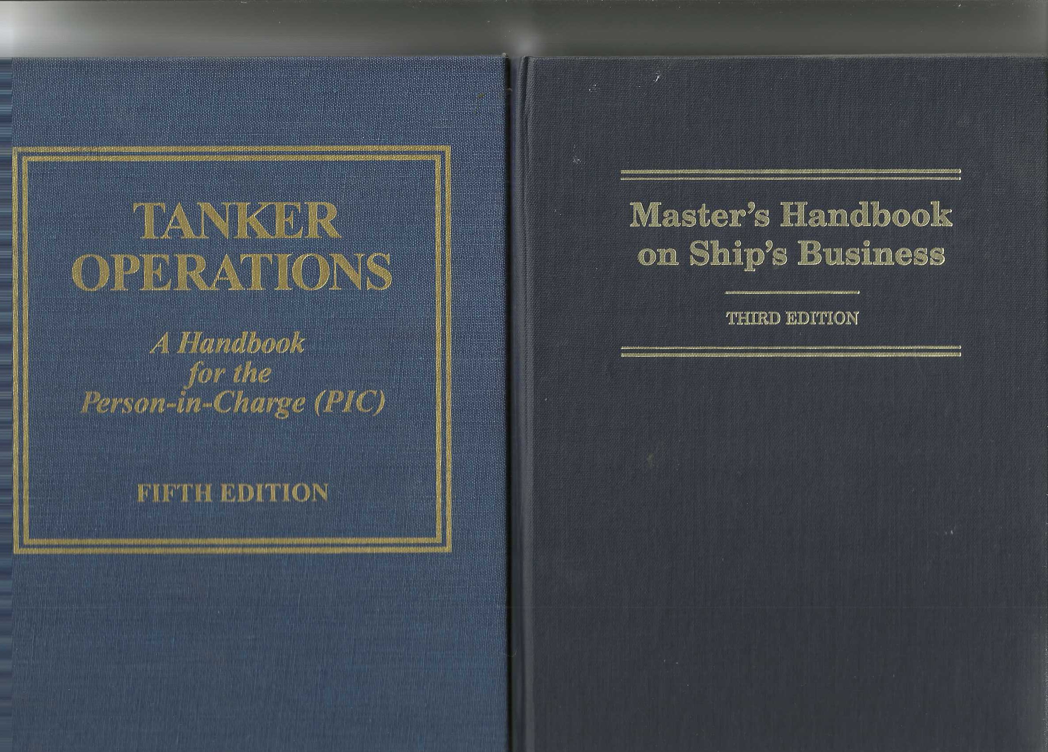
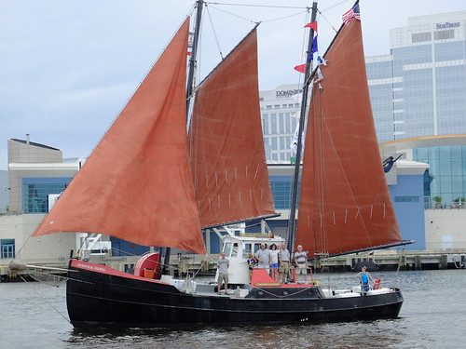
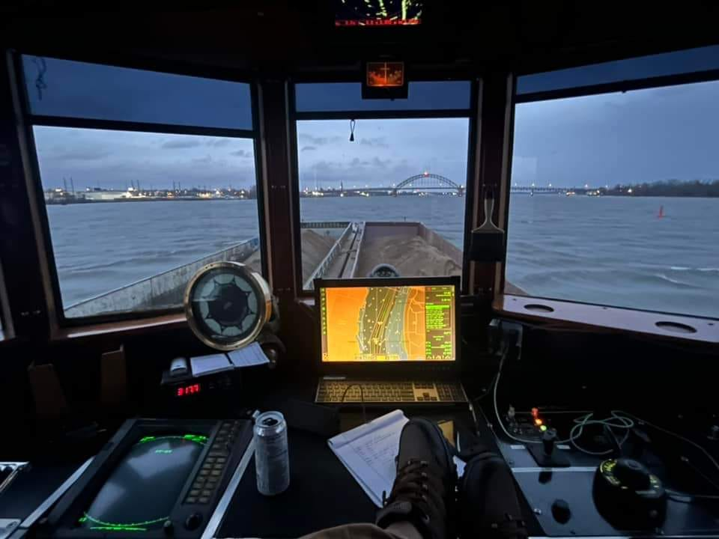








Maritime Clusters Heritage History Community
28%
Tugatine, Norfolk Rebel
Heritage New Jersey
Coastwise Trade
Compliments Capt. D. Smith
AJ Meerwald
Fusion
of
Interests
Outbound, Maurice
Compliments
Stasinos Marine
2026 Mariners Conference / Stewardship

Slide 11







Nautical Science Incubator - Technology Ohm
Risdon Tide-Water Turbine
Mt. Holly - North Branch
Head of Tide Rancocas Creek
Tidal Energy
Wind Power
Augmented
Reality Glasses
North Branch Rancocas Creek Water Trail
Mt. Holly, High Tide
152 NM above Delaware Capes
2026 Mariners Conference / Stewardship

Slide 12



Neoliner Origin - 30 October 2025
295-ft masts
32,000 sq ft
total sail.
Wind
60 to 70 %
Vsls propulsion.
Hybrid diesel electric engines.
11 knots
vs
15 knots.
Conserves fuel. Low emissions.
Wind Assisted Propulsion
Systems (WAPS)
Ref: MPA
Maryland Port Authority
Wind Propulsion Technologies
Ro-Ro Seagirt Marine Terminal 446 x 80 18”
5,300 tons cargo - 265 TEU
2026 Mariners Conference / Stewardship

Slide 13








Wind Assisted Propulsion Systems (WAPS)
Air Cushion Technology
Skills
Education
Technology
Innovation
Create infrastructure before transporting elephants
Port of Baltimore - Evolution
Tug-boat up to Wind Ship
Compliments Capt. J. Roof
Ref: Dassault Systems
Diodorus: 40 BC
2026 Mariners Conference / Stewardship
13

Slide 14


Thank-you
Dynamic for Today, Predictive for the Future
Port of Philadelphia - 1878
Source: Free Library of Philadelphia
Compliments D. Sites, Baltimore Pilot Boat
2026 Mariners Conference / Stewardship

